Slide 2
ANNUAL SAFETY BRIEF
Lab/Regulated waste Disposal
Hazardous Waste reduction
Accident Reporting
Internal/External Disaster Preparedness
Evacuation Plan
Latex Precaution
Shipping Infectious Substances
Lab Ergonomics
Formaldehyde Program
Noise Exposure
Lab General
Fire Safety
Electrical Safety
Biological Hazards
Biological Safety Cabinets
Compressed Gases
Radiation Safety
Chemical Hazards
Chemical Hygiene
HAZCOM
TB Exposure

Slide 3
Lab General
Personal Safety
Safe environment for patients as well as personnel
Report hazards and accidents to supervisors
Follow policies and procedures
Recommend improvements to provide a safer environment

Slide 4
Lab General
Personal Safety
No Smoking
Designated areas only
Eating and Drinking
Prohibited in work areas
Food and beverage not allowed in laboratory refrigerators or freezers
Application of cosmetics
Application of cosmetic/lip balm or contacts are prohibited in the work area.
Hair/beard jewelry
Hair/beards must be neat and can not come in contact with contaminated materials or equipment. Do not wear jewelry that can be caught in equipment or hang in infectious material

Slide 5
Lab General
Personal Safety
Specimens
Are potentially infectious.
Handle appropriately
Place specimens in containers that prevents leakage during collection, handling, processing, storage transport or shipping.

Slide 6
Lab General
Protective Wear
Full Face Shield
Clothing (Lab coat)
Shoes
Gloves
Respirators

Slide 7
Lab General
Frequent Hand Washing
Wash all surfaces of hands and wrists for at least 20 seconds
Rinse, blot dry w/paper towels
Turn off faucet with paper towels
NO Mouth Pipetting
Aisles and Exits
Do Not Block Aisles and Exits
Do not cover or block Fire extinguishers/alarms, safety showers/eyewash stations

Slide 8
Lab General
Standard /Universal Precautions
Memorandum IC-001, “Precaution for infection Control”
House keeping
Accidental spills clean up immediately with approved disinfectant
All Blood/Body fluid, Microbiology and tissue waste must be placed in Red Biohazard Bags

Slide 9
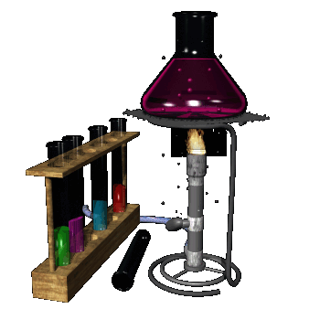
Lab General
Laboratory Equipment
Glassware
Do not use if broken or chipped
Don’t leave pipettes in bottle/flask/breaker
Hot glassware-handle with protective gloves
Handle broken glassware with mechanical devices

Slide 10
Lab General
Laboratory Equipment
Centrifuges
Never operate with cover open
Specimens must have lids
If breakage occurs-allow aerosols to settle before cleaning
Maintain rotor balance when centrifuging sample.

Slide 11
Lab General
Laboratory Equipment
Autoclaves
Do not open until temp and pressure have returned to ambient
Use insulated water repellent gloves and aprons when loading and unloading autoclave

Slide 12
Lab General
Contaminated Needle Disposal
Do not
Cut
Bend
Break
Detach from syringe or needle holders (except for blood transfer devices)
Manipulated by hand in any way
Dispose syringes/holders with needles.
Lancets and other blood letting devices are to be used once and appropriately discarded

Slide 13
Lab General
Emergency Equipment
Emergency Showers
Located in:
Histology
Microbiology
Eye Wash Stations
Located in:
Histology
Chemistry
Morgue
Microbiology
Hematology
Flush eyes for 15 minutes or longer
Eye Wash Bottles
Located in:
Central Accessioning
Blood Bank
Special Chemistry

Slide 14
Lab General
Warning Signs
Must be posted in areas of hazardous substances
Areas
Storage cabinets
Refrigerators
Shipping containers
Technical areas are considered a “Moderate Risk”
No visitors may enter the work area
Must have approval of the Chief pathologist and Clinical Lab Manager

Slide 15
FIRE SAFETY
Fire Emergency Plan
Notify everyone in immediate area by saying “CODE RED”
R.A.C.E.
Rescue
Remove those in immediate danger
Alarm
Pull the nearest fire alarm
Call 3333 give exact location of the fire
Contain
Confine by closing doors
Extinguish/Evacuate
Extinguish with fire extinguisher if possible, if not evacuate
Assist others
Do not use elevators
Call
3333

Slide 16
FIRE SAFETY
Fire Alarm
When alarm sounds
Listen for location, location will be announced as an overhead page.
Close door if fire in in the main Hospital building or the Research building
If fire is in the immediate area or if smoke is sighted. Evacuate
Evacuation routes are posted in each section/Supervisor will be responsible for assuring everyone has been evacuated
If the Fire is located in a different fire zone (East side) Be alert to the possibility that the fire may spread to our area. BE PREPARED TO EVACUATE.

Slide 17
FIRE SAFETY
Fire Drill (Quarterly/Each Shift)
When alarm sounds, Code RED is announced or condition warrants
Follow the fire drill procedures
Certain personnel will be allowed to stay (determined by supervisor)
Section supervisor or designee will assure that all personnel have evacuated

Slide 18
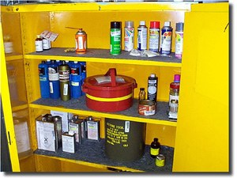
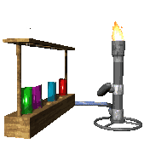
FIRE SAFETY
Fire Prevention
Flammable mixture and open flames don’t mix.
Flammables must be properly contained. No more than a gallon may be out in a section.
Use carriers when transporting.
Items must be 18” from ceiling.

Slide 19
FIRE SAFETY
Fire Prevention Training
RACE
Rescue
Alarm
Contain
Extinguish/Evacuate
PASS
Pull Pin
Aim
Squeeze
Sweep

Slide 20
ELECTRICAL SAFETY
All Electrical shocks (including small tingles) must be reported.
Power off/Unplug instrument.
Do not try to use or repair
Instruments must be repaired by qualified personnel
Building electrical will be repaired by the Engineering Department

Slide 21
ELECTRICAL SAFETY
Extension cords
Will be avoided if possible
Should be temporary, non-repetitive situations.
Should have same size wiring as the instrument/Appliance.
Should not be in the path of a walkway
Must be in good condition and have proper grounding wires.

Slide 22
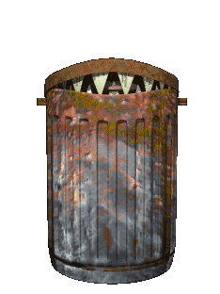
BIOLOGICAL HAZARDS
Disposal Containers
Sharps containers
Needles, scalpels or other rigid sharp items that may cause a puncture wound or cut
All sharps whether contaminated or not should be placed in Sharps container
Rigid-Sided leak proof infectious waste receptacles
Used for collection of broken glass, tubes of blood, liquid specimens and cultured media
Infectious waste bags.
Should be double bagged and used for waste with no risk of puncturing the outer layer of the bag.

Slide 23
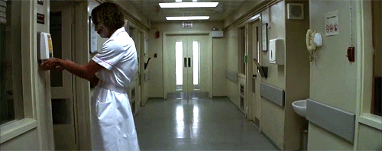
BIOLOGICAL HAZARDS
Disposal Containers
All containers for incineration are colored RED and have the Biohazard symbol on the container
Glassware
Glassware that is to be reuse, must be steam sterilized (autoclaved).
Hand washing and use of alcohol hand sanitizer should be done frequently throughout the day.

Slide 24
BIOLOGICAL HAZARDS
No open specimens in the centrifuge, must be capped to prevent aerosol droplets.
Clean work areas.
Grossly contaminated specimens will not be processed-notify delivery person, contact physician
Dispose sample cups and containers in the infectious waste containers.

Slide 25
BIOLOGICAL SAFETY CABINETS
Process any suspicious pathogenic patient specimens (Mycobacterium) in the Biological Safety Cabinet.
During the processing of TB/Fungus, allow no other person in the room – Lock the door
Disinfect work area with Tuberculocidal disinfectant
UV germicidal lights will be left on overnight after use of hood.
Centrifuge of mycobacteria, must have double containment.

Slide 26
COMPRESSED GASES
General
Cylinders must be secured in an upright position
Valve safety covers will be left on until tanks are secured and regulators attached.
Valve safety covers will be replace when regulators are remove and during transport.
Hand trucks will be used to transport cylinders.
Do not oil or grease regulators
Do not attempt to repair or force tank valves open.

Slide 27
COMPRESSED GASES
Pressure Regulator and Valves
Do not interchange valves.
Threads should be clean and tightly fitted, do not lubricate the valves.
Use proper size wrench to tighten.
Open valves slowly.
Do not force frozen valves.

Slide 28
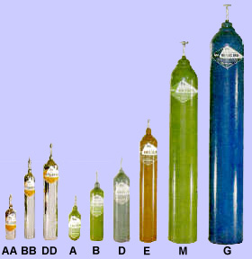
COMPRESSED GASES
Acceptance and Return of Cylinders
Cylinder lacking permanent ID will not be accepted.
New Tanks should be marked as “FULL” upon receipt
Empty tanks must be label “EMPTY”, secured upright with cap replaced.

Slide 29
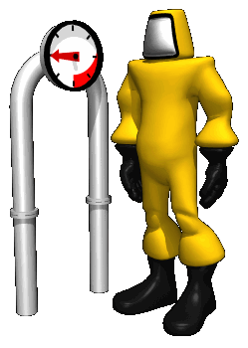
RADIATION SAFETY
Operational Checks performed by Blood Bank
Leak test every 6 months by Medical Center Radiation Safety Officer
Measurement of dose determination checked annually be BB Supervisor
Area is monitored weekly for irradiation leak with a Geiger counter by BB Personnel

Slide 30
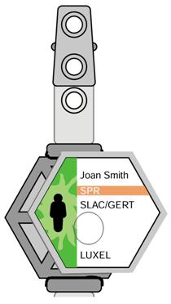
RADIATION SAFETY
Blood Irradiator
A pocket dosimeter is not required to be worn when working with the blood irradiator; however one maybe requested from the Hospital Radiation Safety Officer if an employee would like to wear one or is pregnant
Door to irradiator room must be kept locked with alarm armed 24/7
Room is under camera surveillance by VA police
When irradiator is in use the RED RADIATION light must be turned on.
Any malfunction needs to be reported to the Hospital Radiation Safety Officer Immediately (ext 3440/page 13-224)
The Wanrad-2 Gamma Radiation Alarm will sound an alarm if readings are >5mR/hr-Notify Hospital Radiation Safety Officer Immediately!

Slide 31
CHEMICAL HAZARDS
Corrosives-Acids, Anhydrides, Alkalis, Dehydrating agent, Oxidizing agents
Can damage equipment
Storage
May cause burns on skin, mouth or eyes
Store in approve containers
Store in cool dry place, well ventilated, away from direct sunlight
Segregate acids form bases
Never store above eye level
Working quantities may be stored under sinks, bulk storage in approved acid cabinets
Carriers must be use when handling bottles of acid greater then 500mls

Slide 32
CHEMICAL HAZARDS
Corrosives
Handling
Use a shield barrier or work in a sink (spill can be controlled).
Wear a protective apron, gloves and eyewear.
Do not sniff reagents.
Diluting Acid into water like you ought to!
Must use carriers for containers with more than 500ml.

Slide 33
CHEMICAL HAZARDS
Toxic Substances-Poisons, Irritants, Asphyxiates
Do not react with human tissue
They may be sensitizers that produce cytotoxic effect resulting in skin irritation or illicit an allergic reaction.
Storage
Store in cool dry place, well ventilated, away from direct sunlight and any fire hazards
Segregate toxic chemicals form acids and oxidizing agents
Containers should be sealed as tightly as possible.

Slide 34
CHEMICAL HAZARDS
Toxic Substances
Handling
Wear protective apron, glove, and eyewear
Use fume hoods
Wash glassware, work area and hands thoroughly
Exposure to the sensitizer formaldehyde is monitored as least annually by the Medical Center’s Safety Manager.

Slide 35
CHEMICAL HAZARDS
Carcinogen Substances
Chemicals capable of causing cancer. (will be discussed in later section)

Slide 36
CHEMICAL HAZARDS
Ignitable
Chemicals that can burn, combustible/flammable
Handling
Use approved metal can for volumes of 1 quart or more.
Glass containers use a protective carrier for transport.
Eliminate all sources of ignition from the flammable area.

Slide 37
CHEMICAL HAZARDS
Explosives
Reactive an unstable substances
that readily undergo violent chemical change
Cryogenics
Fluids(liquefied gases) or solids characterized by extreme low temperatures such as Dry ice
Handling
Handle in well ventilated area, can cause light headedness and extreme cases, asphyxiation.
Use insulated gloves to prevent contact burns.
Protective eyewear must be worn when breaking up chunks of solid ice or ice pellets.

Slide 38
CHEMICAL HAZARDS
Accident and spills
Eye contact
Promptly flush eyes with water for a prolonged period ( 15 minutes) and seek medical attention.
Ingestion
Follow SDS instruction on case of ingestion and seek medical attention
Skin contact
Promptly flush the affected area with water and remove any contaminated clothing. Use the safety shower when contact is extensive. Seek medical attention

Slide 39
CHEMICAL HAZARDS
Accident and spills
Clean-Up
Promptly clean up small spills using the appropriate Spill Clean-Up Kit located in:
Histology
Urinalysis
Microbiology
Hematology
Hazardous chemicals should be contained using the think CLEAN plan:
Contain
Leave
Emergency (eye wash,shower, medical)
Access the SDS
Notify a supervisor
Large spills (gallon or more), the Hospital Safety Manager must be called to clean up the spill

Slide 40
CHEMICAL HYGIENE PLAN
Your Responsibility
Planning and conducting each procedure in accordance with the chemical hygiene procedures detailed in sectional written procedures
Develop good personal chemical hygiene habits
Promptly reporting accidents and spills that result in chemical exposure to VA patients or personnel.
Chemical
Hygiene
Plan

Slide 41
CHEMICAL HYGIENE PLAN
Standard Operating Procedure
General precautions for handling all laboratory chemical should be adopted.
Minimize exposure
Assume any mixture is hazardous and toxic
Chemical
Hygiene
Plan

Slide 42
CHEMICAL HYGIENE PLAN
Chemical Inventory
Conducted bi-annually by section supervisor
Chemicals used, produced, or stored must be identified.
Defined policies and procedures for specific handling requirements.
Any chemicals classified as hazardous by Dept. of Transportation, EPA, chemicals displaying a 2 or greater in any section of the National Fire Protection Association diamond, Potential Carcinogens or reproductive toxicity
Chemical
Hygiene
Plan

Slide 43
CHEMICAL HYGIENE PLAN
Manufacturer, Importer or Distributor Labeling:
Required for all hazardous chemicals according to Hazard Communication Standards (HCS)
Use the United Nations Globally Harmonized System of Classification and Labeling of Chemicals, otherwise known as GHS.
Labels are required to have:
Product Identifier: is how the hazardous chemical is identified. This can be (but is not limited to) the chemical name, code number or batch number.
Supplier Identification: name, address and telephone number of the chemical manufacturer, importer, or other responsible party.

Slide 44
CHEMICAL HYGIENE PLAN
Manufacturer, Importer or Distributor Labeling:
Labels are required to have:
Signal Word: are used to indicate the relative level of severity of hazard and alert the reader to a potential hazard on the label. There are only two words used as signal words, “Danger” and “Warning”. “Danger“ is used for the more severe hazards, while “Warning“ is used for less severe hazards.
Hazard Statement(s): describe the nature of the hazard(s) of a chemical, including, where appropriate, the degree of hazard.
Precautionary Statement(s): describe recommended measures that should be taken to minimize or prevent adverse effects resulting from exposure to the hazardous chemical or improper storage or handling. There are four types of precautionary statements: prevention (to minimize exposure); response (in case of accidental spillage or exposure emergency response, and first-aid); storage; and disposal.

Slide 45
CHEMICAL HYGIENE PLAN
Manufacturer, Importer or Distributor Labeling:
Labels are required to have:
Pictogram(s): are graphic symbols used to communicate specific information about the hazards of a chemical. Each pictogram consists of a different symbol on a white background within a red square set on a point (ie a red diamond).
Supplementary Information: (Not required) The label producer may provide additional instructions or information that it deems helpful.
**Note: The GHS standard rating system is opposite the NFPA rating system. In GHS, lower numbers indicate more severe hazards. While in NFPA, lower numbers indicate less severe hazards.

Slide 46
CHEMICAL HYGIENE PLAN
Manufacturer, Importer or Distributor Labeling:
There are nine pictograms, but HCS requires eight of these pictograms, the exception being the environmental pictogram as environmental hazards are not within OSHA’s Jurisdiction. The hazard pictograms and their corresponding hazards are shown below.

Slide 47
CHEMICAL HYGIENE PLAN
Manufacturer, Importer or Distributor Labeling:
The hazard pictograms and their corresponding hazards are shown below.

Slide 48
CHEMICAL HYGIENE PLAN
This diagram shows which pictograms represent physical hazards, health hazards or environmental hazard.

Slide 49
CHEMICAL HYGIENE PLAN
Manufacturer, Importer or Distributor Labeling:
Sample label is shown below.

Slide 50
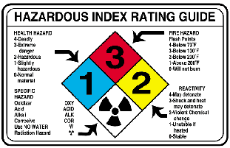
CHEMICAL HYGIENE PLAN
Secondary/Workplace Labeling
Required for all hazardous chemicals according to Hazard Communication Standard
Label using the National Fire Protection Association (NFPA) Diamond
General numbering classification
Zero (0)-Minimal
One (1)-Slightly Hazardous
Two (2)-Hazardous
Three (3)-Extreme Danger
Four (4)-Deadly
**Note: The NFPA rating system is opposite the GHS standard rating system. In GHS, lower numbers indicate more severe hazards. While in NFPA, lower numbers indicate less severe hazards.

Slide 51
CHEMICAL HYGIENE PLAN
Per the HCS, Safety Data Sheet (SDS) for hazardous chemical will provide the following information
Section 1, Identification includes product identifier; manufacturer or distributor name, address, phone number; recommended use; restrictions on use.
Section 2, Hazardous Identification includes all hazards regarding the chemical; required label elements.
Section 3, Composition/information on ingredients includes information on chemical ingredients; trade secret claims.
Section 4, First-aid measures includes important symptoms/effects, acute, delayed; required treatment.
Section 5, Fire-fighting measures lists suitable extinguishing techniques, equipment; chemical hazards from fire.

Slide 52
CHEMICAL HYGIENE PLAN
Per the HCS, Safety Data Sheet (SDS) for hazardous chemical will provide the following information
Section 6, Accidental release measures lists emergency procedures; protective equipment; proper methods of containment and cleanup.
Section 7, Handling and storage lists precautions for safe handling and storage, including incompatibilities.
Section 8, Exposure controls/personal protection lists OSHA’s Permissible Exposure Limits (PELs); Threshold Limit Values (TLVs); appropriate engineering controls; personal protective equipment (PPE).
Section 9, Physical and Chemical properties lists the chemical’s characteristics.

Slide 53
CHEMICAL HYGIENE PLAN
Per the HCS, Safety Data Sheet (SDS) for hazardous chemical will provide the following information
Section 10, Stability and reactivity lists chemical stability and possibility of hazardous reactions.
Section 11, Toxicological information includes routes of exposure; related symptoms, acute and chronic effects; numerical measures of toxicity.
Section 12, Ecological information*
Section 13, Disposal considerations*
Section 14, Transport information*
Section 15, Regulatory information*
Section 16, Other information, includes the date of preparation or last revision.
*Note: Sections 12-15 may be included in the SDS, but are not required by OSHA.

Slide 54
CHEMICAL HYGIENE PLAN
Training-What everyone should be able to do!
Locate the potentially hazardous chemicals in your workplace.
Recognize the chemical labeling and it’s meaning
Locate the SDS book in the workplace.
Locate the health hazard, physical hazard, environmental protection and special protection sections of the SDS and explain their use.

Slide 55
CHEMICAL HYGIENE PLAN
Training-What everyone should be able to do!
Identify the Laboratory Chemical Hygiene Officer by name and title.
Discuss the major components of the facilities standard labeling system.
Identify the protective clothing for the area and demonstrate its use.
Demonstrate emergency procedures in the event of a hazardous chemical spill.

Slide 56
TUBERCULOSIS EXPOSURE CONTROL PLAN
Goal is to aid in minimizing/eliminating the transmission of TB
PPD Skin test on new employees
Patient with suspected or confirmed active TB will be placed in Airborne Precautions.
Room with negative air pressure
The patient’s door must be kept closed.
You must wear fit tested particulate respirators (Training and fit testing done by Medical Center’s Safety Manager)

Slide 57
TUBERCULOSIS EXPOSURE CONTROL PLAN
Minimizing/eliminating the transmission of TB
TB Testing in microbiology will be performed in a Biosafety Class III hood.
Negative pressured room
Must wear disposable gowns and gloves while processing, handling, and evaluating potential infectious TB specimens.
You must use the aerosol-proof containers when centrifuging specimens.

Slide 58
TUBERCULOSIS EXPOSURE CONTROL PLAN
Minimizing/eliminating the transmission of TB
Pathologist/residents must handle unfixed tissues in the Biosafety Class II hood
Glove and disposable gowns are required during the processing and handling of these specimens
Everyone in morgue must wear fit tested particulate respirator masks during an autopsy of suspect patient, and clean up after.
Fit tested particulate respirator masks must be worn whenever the Stryker saw is used and for 5 air exchanges following the use (5-10minutes)

Slide 59
TUBERCULOSIS EXPOSURE CONTROL PLAN
Minimizing/eliminating the transmission of TB
Responsibility of Health Care worker
Seek medical evaluation of a PPD test conversion occurs.
If symptoms develop that may be due to TB, see medical evaluation.
You must receive appropriate evaluation
Receive therapy if required
Prevent the transmission of TB to patients and other health care workers.

Slide 60
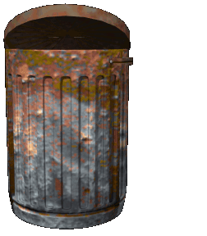
LABORATORY WASTE DISPOSAL
Lab responsibility
Identify waste and give special handling for transport or disposal.
Four broad categories of hazardous waste
Chemical
Follow guidelines in MSDS
Xylene store for recycling
Formaldehyde neutralize prior to disposal
Infectious
Cultures, blood products, contaminated waste etc.
Radioactive
Physical
Managing and disposal of discarded sharps
Drip
Pour
Flake

Slide 61
LABORATORY WASTE DISPOSAL
Regulated waste defined by Dept of Labor
Liquid or semi solid or other potentially infectious materials (OPIM)
Items contaminated with blood or OPIM (able to drip)
Items that are caked with dried blood or OPIM that may flake off
Contaminated sharps
Pathological and Microbiological wastes containing blood or OPIM
Drip
Pour
Flake

Slide 62
LABORATORY WASTE DISPOSAL
Regulated waste –Put into red bags
OSHA/City of Omaha Regulated waste is disposed as infectious waste.
All regulated waste will be placed in red disposal bags or sharps containers.
Drip
Pour
Flake

Slide 63
LABORATORY WASTE REDUCTION
The purpose of the hazardous waste program is to maintain a comprehensive control over the production, handling , transporting, storage, disposal and monitoring of all waste originating in the clinical laboratory to ensure that the health of exposed employees and the surrounding environment is properly maintain.

Slide 64
LABORATORY WASTE REDUCTION
We generate all sorts of waste and we need to be aware of how to reduce and properly dispose of the waste.

Slide 65
LABORATORY WASTE REDUCTION
Lab waste divided into these groups
Hazardous chemical waste
Infectious waste
Radioactive waste
Hazardous physical waste
Non-hazardous waste

Slide 66
LABORATORY WASTE REDUCTION
Minimization of waste hazards
Buy smaller quantities, reusable items, recycling, substitution of less hazardous materials
Waste segregation
Hazardous waste separated from non-hazardous waste
Waste handling
Handle waste with care, your safety is a prime concern.

Slide 67
Accident Reporting
Duty hours 0730-1600 notify supervisor of any occupational injury or accident.
The supervisor will notify Employee Health Secretary or Employee Health Nurse
If you need to be examined a “Report of Employee Treatment form will be initiated by supervisor
Take this form to the Admitting/ER
A CA17 form should be completed if you are restricted to “Light Duty”.

Slide 68
Accident Reporting
Non-Duty hours/weekends
You should go directly to to Admitting/ER
After being examined a “Report of Employee Treatment form will be initiated by physician/PA/Health Nurse
The form is then submitted to supervisor when employee returns to work area

Slide 69
Accident Reporting
All Accidents must be recorded in the Automated Safety Incident Surveillance Tracking System (ASISTS) in VISTA
Lab supervisor is responsible for reviewing with you the corrective action planned or taken

Slide 70
INTERNAL AND EXTERNAL DISASTER PREPAREDNESS
In the event of a disaster we need to assist members of the medical staff in carrying out their responsibilities-care and treatment of casualties

Slide 71
INTERNAL AND EXTERNAL DISASTER PREPAREDNESS
Clinical Lab Manager
Will assume responsibilities for overall coordination of laboratory activities.
Assesses staffing needs

Slide 72
INTERNAL AND EXTERNAL DISASTER PREPAREDNESS
Blood Bank Lead Tech
Notifies Red Cross of disaster and obtain current blood and blood component inventory
Assesses staffing needs

Slide 73
INTERNAL AND EXTERNAL DISASTER PREPAREDNESS
Phlebotomy Lead
Dispatches two phlebotomists to triage area
Recalls staff if necessary
Act as runners for the Blood Bank and lab specimens
Answer and route phone calls
Assign staff to Central Accessioning Area to receive specimens
Responsible for proper receipt of specimen and disposition. Communicates with triage area (Collection and Identification of patients)

Slide 74
INTERNAL AND EXTERNAL DISASTER PREPAREDNESS
Laboratory Supervisor
Recalls staff accordingly
Morgue Contract Service/Lab Personnel
Receives bodies and personal belongings
Maintain record of all deceased
Records receipt and release of bodies from morgue

Slide 75
INTERNAL AND EXTERNAL DISASTER PREPAREDNESS
Pathologists/Resident pathologist on call
Assures that adequate pathology staff is available for consultation by lab staff and Medical Center clinicians

Slide 76
INTERNAL AND EXTERNAL DISASTER PREPAREDNESS
Lab Orders
Non-computer generated requisition forms if VISTA is disabled
Patient location
Patient Identification same as the Emergency Medical Tags supplied by triage personnel

Slide 77
INTERNAL AND EXTERNAL DISASTER PREPAREDNESS
Patient specimens
Properly labeled with Emergency Medical Tag Information
Patient’s name (if available)
Initials of person who obtained the specimen.
Date and time drawn

Slide 78
INTERNAL AND EXTERNAL DISASTER PREPAREDNESS
Patient Reports
Results of all STAT request will be called to the location listed on the requisition form.

Slide 79
INTERNAL AND EXTERNAL DISASTER PREPAREDNESS
VISTA Results Entry
Volume allows and adequate information entered into VISTA (Patient Info)
Lab will order request sent on the non-computer generated requisition forms.
Results will be entered into the system as they are available.

Slide 80
EVACUATION PLAN
In an Emergency we may have to Evacuate
Each section has a fire evacuation route posted
You are responsible for knowing the alternate routes

Slide 81
EVACUATION PLAN
Simple evacuation
Remove yourself and others persons from immediate area of danger
Priorities for moving patients/staff/visitors
First-persons in imminent danger
Second-wheelchair and walking persons

Slide 82
EVACUATION PLAN
Total evacuation
Lateral or vertical movement of all patients, visitors and employees from a wing or entire facility to outside grounds.
Blankets, beds, mattresses, litters, and any other means for removing non-ambulatory patients.

Slide 83
EVACUATION PLAN
Total evacuation
All rooms, including bathrooms
Will be search upon completion of evacuation by Lab Safety Officer or designee.
Ensure all have been evacuated

Slide 84
EVACUATION PLAN
Total evacuation
Handicapped individuals (Wheelchairs, crutches, canes, etc.)
We will assist these people to the safest part of the same floor (toward an exit)
During a total evacuation the elevators may be utilized ONLY if instructed to do so by the Omaha Fire Department.
It may be necessary to carry handicapped individuals to the first floor for evacuation.

Slide 85
LATEX PRECAUTIONS PLAN Some items that contain Latex
Markers
Adhesives
Gloves
Diazosensitized photo copy paper
Electrical appliance cords
Telephone receiver headset, shoulder rest
Finger cots
Glue, envelopes, stamps, plastic
Ink, tape, erasers
Mouse pad
Plants
Rubber bands
Rubber button pads on phones, calculators
Tubing
Gowns
Butterflies
Co-flex
Latex tourniquets
Needles (rubber end)

Slide 86
LATEX PRECAUTIONS PLAN Some items that contain Latex
3M transparent tape
Ependorf combo tips
Pipette tips
Parafilm
Sed-rate tubes
Vacutainer holders
10cc, 20cc syringes
Stopper on monoject tubes
Needle banks
Beral transfer pipettes
UA cap, tubes, pipettes, V-tech Brand
Fisher brand serum filters
UA test strips
TDX sample cups

Slide 87
LATEX PRECAUTIONS PLAN
Employee identification
If you know you have a latex allergy/sensitivity you must communicate this information to your immediate supervisor
You are responsible for maintaining proper latex allergy precautions
If you suspect you have a latex allergy/sensitivity, you need to report it to your supervisor and to the Employee Health for further screening.

Slide 88
LATEX PRECAUTIONS PLAN
Employee identification
Your immediate supervisor document your latex allergy/sensitivity in your employee records.
Your department will then employ all reasonable efforts to accommodate your latex allergy/sensitivity to provide you with a latex-safe working environment
Purchase of latex-free supplies
Check equipment and replace with latex-free materials if economically feasible

Slide 89
LATEX PRECAUTIONS PLAN
In-Patient identification
All patients should be identified during their admitting screening and assessment
If patient is latex sensitive, latex sensitive cart will be assign to the patient.
You should identify the patient as being latex sensitive by the Latex Sensitive Isolation posted.
Use only the latex free items found on the cart or those provide by the lab.

Slide 90
LATEX PRECAUTIONS PLAN
Out-Patient identification
All patients should be identified by an orange tag “Latex Sensitive” attached by outpatient registration Desk Personnel
When you view the patient’s order in the computer, you should get a “Latex Allergy’ Alert
Use only latex free items on this patient.

Slide 91
LABORATORY EROGNOMICS POLICY
We need to provide a work environment that reduces or eliminates your exposure to conditions that lead to cumulative trauma disorders (CTD) and musculoskeletal disorder (MSD)
It is your responsibility to recognize the signs and symptoms associated with these ergonomics risk factors and notify your supervisor.
The NWIHCS Ergonomic Committee will do an assessment.

Slide 92
Noise Exposure
OSHA guideline
When an employee’s exposure to noise may equal or exceed 85 decibels for 8 or more hours, the employer shall develop and implement a monitoring program.
Baseline testing and monitoring will be repeated whenever a change in production, process, equipment, or controls cause an increase in noise exposures.

Slide 93
NWIHCS LAB FORMALDEHYDE PROGRAM
We need to ensure formaldehyde is handled in the safest possible manner and in compliance with all applicable codes and standards.
Limit contact
Protective clothing (lab coats)
Gloves
Eye shields/goggles if dispensing
Eyewash and safety shower near by

Slide 94
NWIHCS LAB FORMALDEHYDE PROGRAM
If you come in contact with formaldehyde
Immediately flush the exposed areas
Notify your supervisor and proceed to Employee Health
During grossing
Specimens will be handled in exhaust fume hood
Any other handling of containers with formaldehyde solutions should be handled in a well-ventilated area

Slide 95
NWIHCS LAB FORMALDEHYDE PROGRAM
Health hazards you should be aware of
Cancer
Irritation and sensitization of the skin
Affects respiratory system
Eye and throat irritation
Acute toxicity
If you experience irritation of your eyes, throat, skin due to exposure, report to Employee Health

Slide 96
Shipping Infectious Substances
Our responsibility
For the shipments
Training others on shipping procedures
Classifying, identifying
Marking, labeling
Packaging and documentation of dangerous goods
Ends when package reaches its destination safely

Slide 97
Shipping Infectious Substances
9 Classifications (We only have 2)
#6 Infectious substances
Cause serious health effects
Bacteria, virus, parasite, human samples
#9 Dry Ice

Slide 98
Shipping Infectious Substances
Packaging
Triple packaging
Primary receptacle
Secondary receptacle
Outer shipping package

Slide 99
Shipping Infectious Substances
Hazard labels
Specific hazard labels must be affixed to the outside of each package.
Biohazard Label for infectious substances
Miscellaneous for Dry Ice
Allow for pressure to be released
Write down the number of pounds used

Slide 100
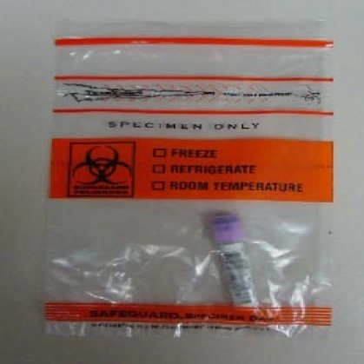
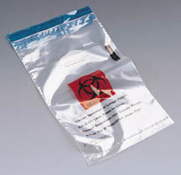
Shipping Infectious Substances
Packing
Place sample into biohazard bag with absorbent packing material

Slide 101
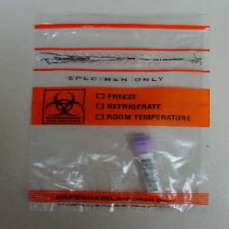
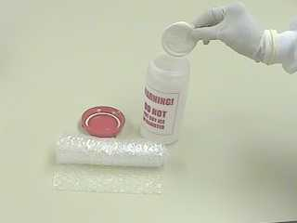
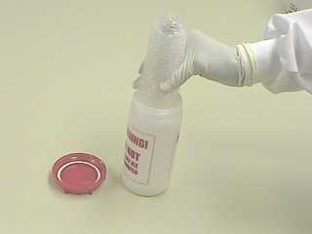
Shipping Infectious Substances
Packing
Place bag into secondary container (screw top plastic jar)

Slide 102
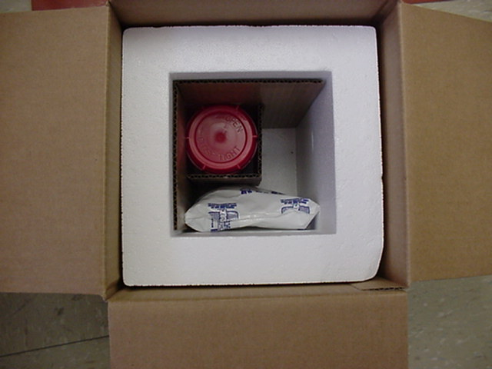
Shipping Infectious Substances
Packing
Place secondary container into Styrofoam container with corrugated cardboard box
Add Room Temp/Cold/Frozen Packs to maintain specimen temp.
Enclose an itemized list of contents between secondary packaging and the outer packaging

Slide 103
Shipping Infectious Substances
Packing
Seal box and place OSHA Biohazard Label on the outside of the package
Mail to appropriate reference lab

Slide 104
You made it through!

