Slide 1
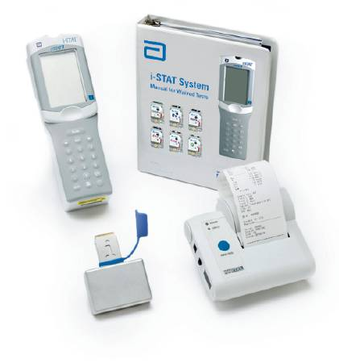
iSTAT
Arterial blood gas (ABG) testing protocol

Slide 2
Summary
Arterial Blood Gases (ABGs) consist of measured analytes (pH,PCO2 and PO2) as well as calculated analytes (BE,HCO3,TCO2 and SO2). ABG testing will be performed on an i-STAT, a hand held POCT (Point of Care Testing) device. Arterial blood will be collected by a respiratory therapist or provider bed side and given to the testing personnel for analysis. At the conclusion of testing, the patient’s ABG results will be attached to the appropriate form and forwarded to the respiratory therapist or provider for review. A final report will follow either via fax or online access.

Slide 3
Procedure
1. VISTA Personnel will bring all the equipment required to draw and run the ABG. The facility must supply the following items:
  A. physician’s order
  B. a completed Vista requisition
  C. a copy of the patient’s face sheet

Slide 4
Procedure
2. The Respiratory Therapist or Patient Provider will obtain the arterial sample using a 22gx1” needle attached to a 3ml blood gas sampler syringe coated with balanced heparin
3. Once the sample is obtained, the trained VISTA personnel will analyze the sample on the i-STAT analyzer.
4.The i-STAT generates a report that will be printed, attached to the appropriate form and given to the respiratory therapist/provider for his/her review. Both VISTA personnel and RT/Provider will sign form with attached ABG results.

Slide 5

Note
CLIA and AHCA require that the final (COPIA) ABG report be completed and forwarded to the facility to be included in the patient’s chart. The turn around time from obtaining the sample to completion in COPIA should be less than 24 hours.

Slide 6
Blood Gas Basics

Slide 7
Blood Gas Basics

Slide 8
Conditions and Causes
Metabolic acidosis pH=<7.4 HCO3 Low Kidney Failure, Shock, diabetic ketoacidosis
Metabolic alkalosis pH=>7.4 HCO3 High Chronic Vomiting, low Potassium
Respiratory acidosis pH=<7.4 pCO2 High Lung Disease, COPD
Respiratory alkalosis pH=>7.4 pCO2 Low Hyperventilation, pain,anxiety

Slide 9
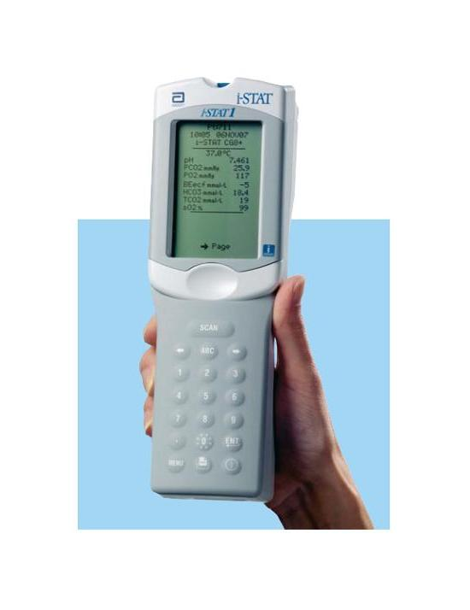
iSTAT Step by Step Guide Simulator
  Press the POWER Button
  Press the MENU button until “Analyzer Function” screen appears
  Press the #3 “Quality Test”
  Press the #4 “Simulator”
  Follow the prompts at the top of the screen
  Scan or Enter your operator ID
  Scan or Enter Simulator ID (on side of simulator box)

Slide 10
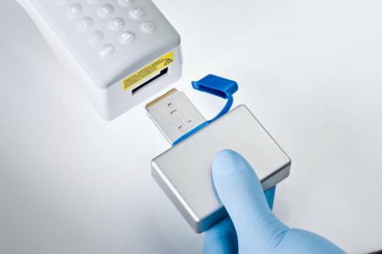
iSTAT Step by Step Guide Simulator
Insert the Simulator
  Remove the cap from the simulator
  Insert the simulator into the cartridge port
  Remove the cap from the simulator
  Insert the simulator into the cartridge port

Slide 11
iSTAT Step by Step Guide Simulator continued
  Results will appear on the screen
  If the word PASS is displayed it is okay to use the analyzer
  If the word FAIL is displayed, repeat the simulator test.
  If the simulator FAIL two times consecutive, DO NOT use the analyzer, Contact technical support.

Slide 12
Program the i-STAT
1. Press to turn on handheld.
2. Press i-STAT Cartridge.
3. Follow handheld prompts.
4. Scan the lot number on the cartridge pouch.
• Position barcode 3-9 inches from scanner
window on the handheld.
• Press and hold to activate the scanner.
• Align the red laser light so it covers entire barcode.
• The handheld will beep when it reads the
barcode successfully.

Slide 13
Apply the Sample
Replace the needle with sample application tip
Mix the sample
Remove air bubbles from syringe
Discard at least 3 drops of sample
Place sample tip into sample well
Dispense into test cartridge until the sample reaches the fill mark located on the test cartridge

Slide 14

Close the Door
Close the cover over the sample well on the test cartridge, avoiding applying direct pressure on the sample well
Inspect the test cartridge for air bubbles and adequate fill. If air bubbles or the sample fill appears inadequate, repeat sample loading with a new test cartridge.

Slide 15
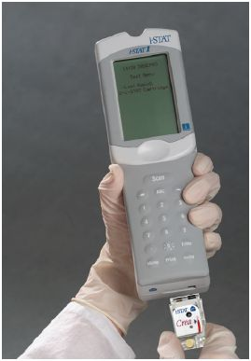
Insert the Cartridge
Insert the cartridge into the port located on the bottom of the i-STAT analyzer.
Listen for the “click” to ensure the cartridge is properly seated in the port on the analyzer.

Slide 16
Results
Results will appear on the screen.
Review the information carefully to ensure all tests were performed. No missing data for either measured or calculated results.
Align the printer with the top of the analyzer
Press the “print” button, holding the analyzer in place until printing is complete
Attach the printout from the analyzer to the necessary form and have the respiratory therapist or provider review and sign it
Make a copy of the results and forward to the laboratory

Slide 17
i-STAT Quick Notes
CARTRIDGES
  Can ONLY be touched on the sides , bottom or area to the left of the sample well
  MUST be at ROOM TEMPERATURE BEFORE use
  Dated with new 2 MONTH EXPIRATION DATE once REMOVED from the REFRIGERATOR. DO NOT RE-REFRIGERATE
  DO NOT remove the cartridge while “CARTRIDGE LOCKED” is displayed on the screen
  There is an EIGHT (8) minute window once the prompt “INSERT CARTRIDGE” is displayed. Press the SCAN KEY again if more time is needed

Slide 18
i-STAT Quick Notes
The MENU button can be used as a “HOME” key to back out of screens
The i-STAT uses two 9 volt lithium batteries or a rechargeable battery
If LESS than 10 minutes from sample draw time
  Remix the sample
  Repeat with a new cartridge
If GREATER than 10 minutes from sample draw time
  Redraw the sample
  Repeat with a new cartridge

Slide 19
Troubleshooting and Error Codes
CODE 21= Cartridge Pre-burst (caused by damage to the center of the cartridge reagent/calibrator bubbles
CODE 31= Unable to position sample (clot in sample or snap closure not sealed)
CODE 30/37= Overfill (caused by direct pressure over sample well during door close)
CODE 35/36= Under fill
FLAGS
  **** = star out caused by sensor damage
  > = above reportable range
  < = below reportable range
  < > = The result is dependent on another test that has been flagged. Any TCO2 outside of reportable range will cause this flag on the other blood results

Slide 20

Note
ALWAYS check your supplies before arrival at the facility for testing
Make it a POINT to perform your ELECTRONIC SIMULATOR every day, ensuring that it is working properly

