Slide 1
Urinary Analysis
A Brief Review

Slide 2
Sample Processing Reminders
*Mix and test samples as soon as possible. Compounds such as bilirubin and urobilinogen are unstable at room temp and in light
-If unable to test right away, refrigerate sample immediately and let return to room temp before testing
*Do not test any samples at room temp longer than 2 hours
*Only accept fresh urines in sterile non-leaking UA containers and the yellow/red marble top BD UA preservation tubes
*Label original UA container with UA Beaker Specimen label (to confirm ID) *Label the 12 mL aliquot with smaller label (patient name and MRN)
*Dip MultiStix in the aliquot and drag on vial side for the Clinitek
*Specimens 10 mL or under CANNOT be centrifuged. Perform direct microscopic exam on unspun urine and add the comment
.hhcqnsua

Slide 3
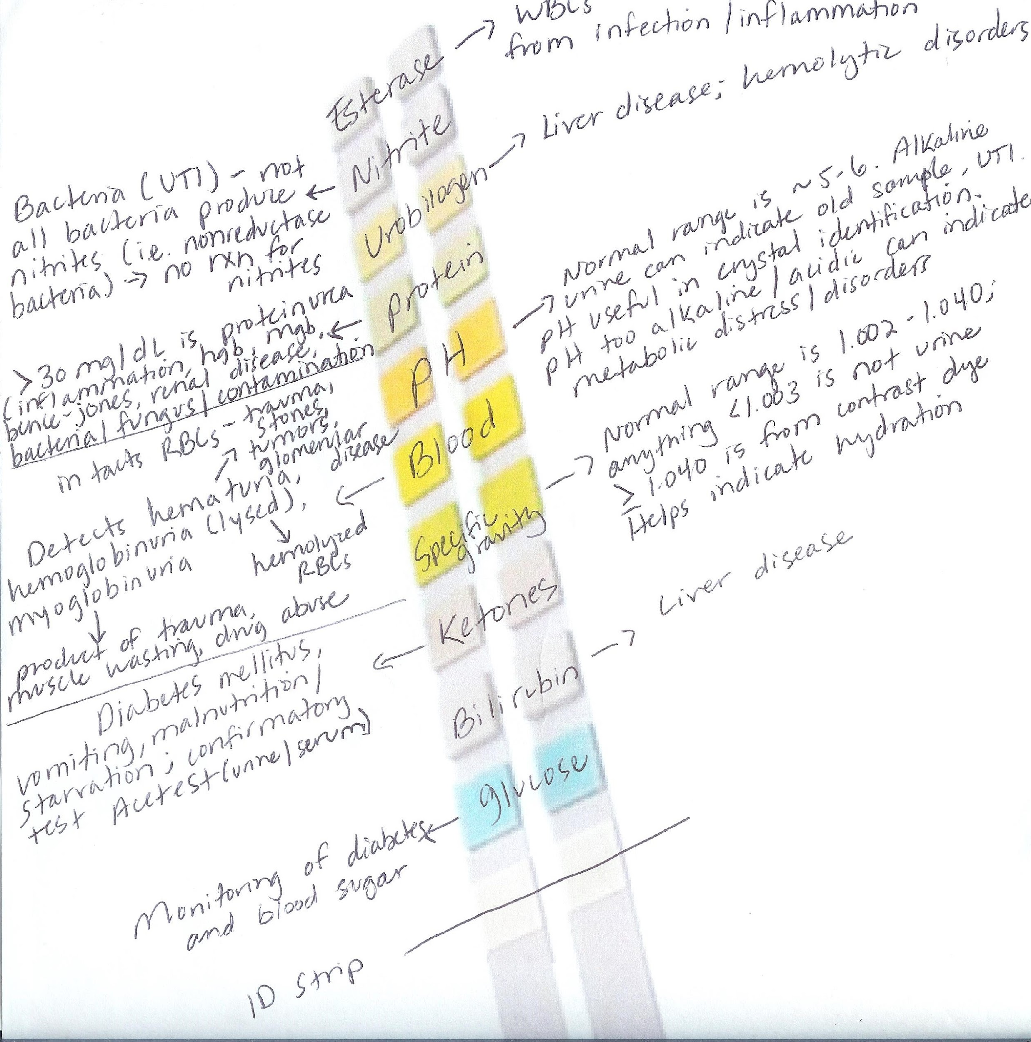
Multistix
Dipstick
Detection

Slide 4
If Sample Is Refrigerated...
*Keep in mind there are artifacts; refrigeration can increase precipitation of various amorphous and crystalline materials including:
-Calcium oxalates
-Amorphous urates (‘pink brick dust’ macroscopically)
-Amorphous phosphates
*Another reason to analyze samples ASAP; may need to recollect a refrigerated sample to determine if crystals are true to specimen

Slide 5
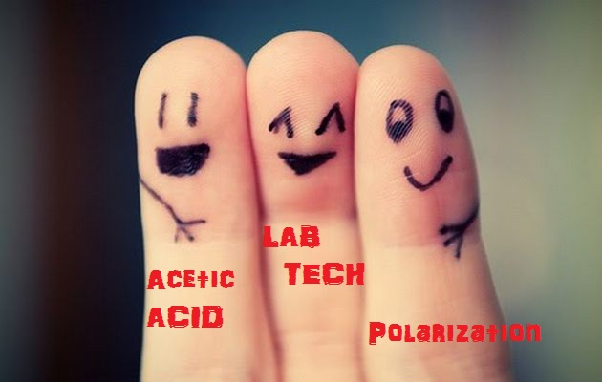
Urine Microscopic Examination
*Did you know?
-High alkaline urine with low specific gravity can lyse RBCs and cause casts to dissolve
-Acetic acid and polarization can be your friends!

Slide 6
Acetic Acid
*Located in the brown plastic bottle by the UA scope
*Take 1 drop of urine to 1 drop of acetic acid (or whatever to make a 1:2 dilution) in glass tube, mix, pipette in slide
*Lyses RBCs and can dissolve some mucous
-Clears up field for more accurate microscopic exam
-Helps quantify yeast better (since yeast and RBCs can be confused with each other)
-Can dissolve amorphous phosphates (alkaline pH)
*We are using low concentration acetic acid (vs. glacial)

Slide 7
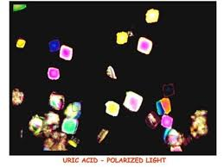
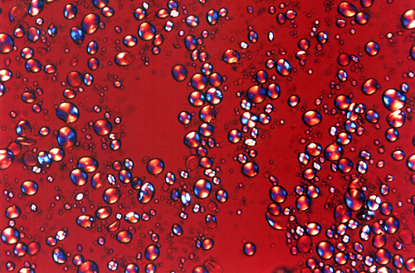
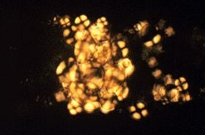
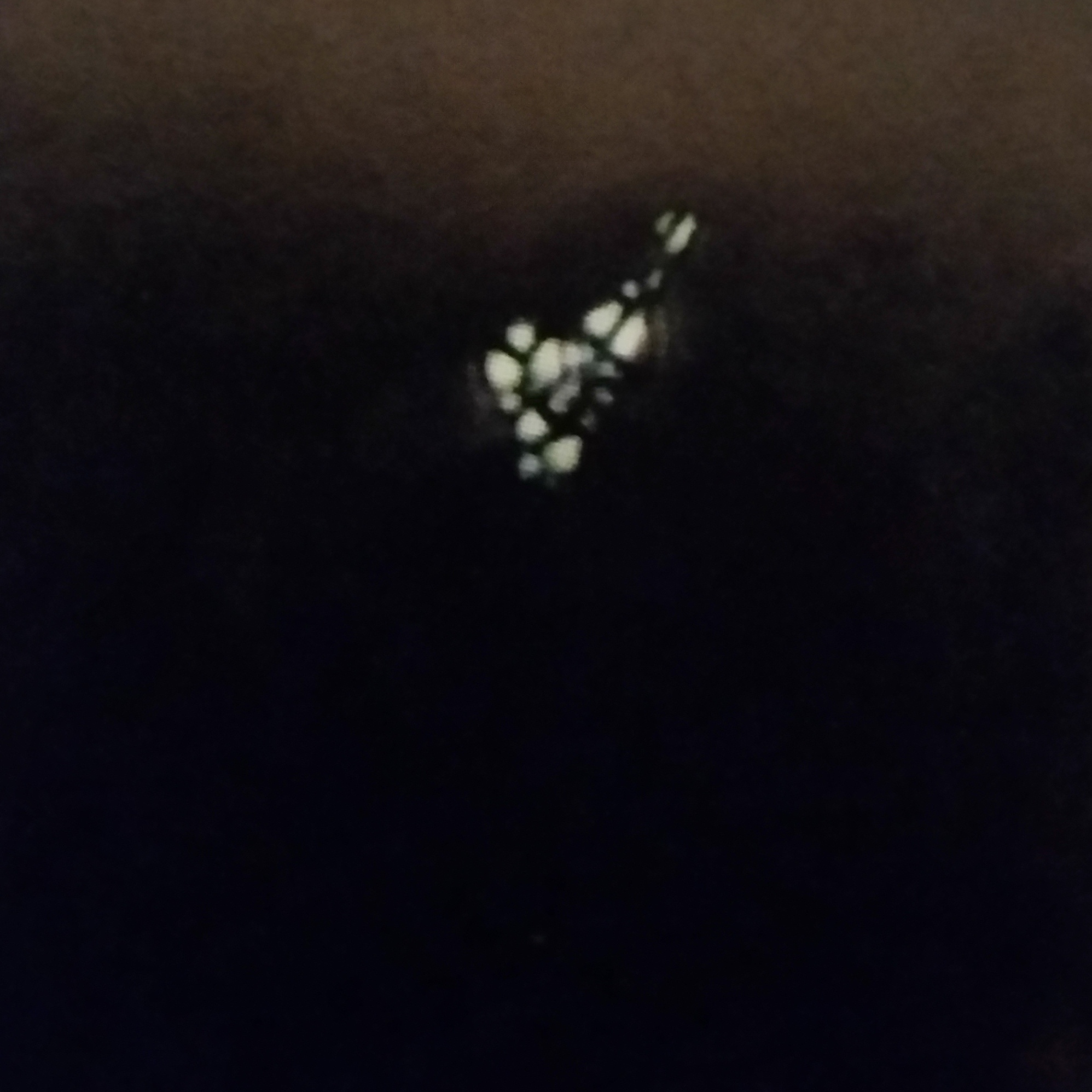
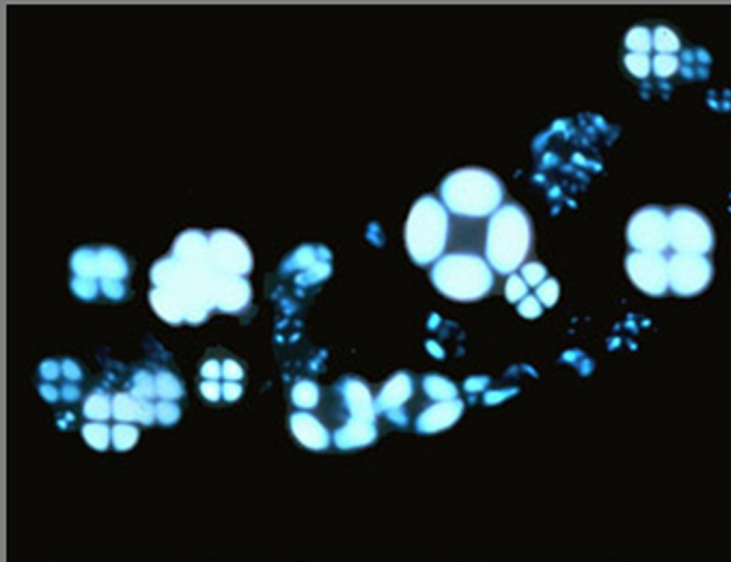
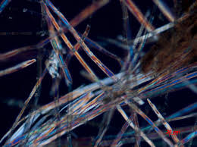
Polarization
*Can help see and differentiate crystals and fibers as well as starch granules, fat droplets, ovoid fat bodies (OFBs) and fatty casts (all produce maltese cross).

Slide 8
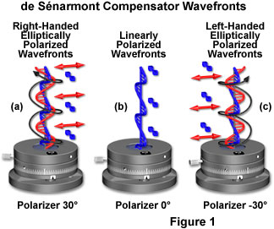
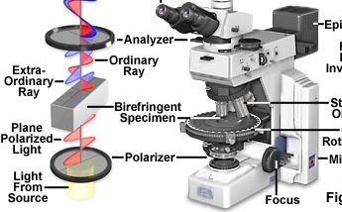
How To Polarize
*Take a drop of urine (sediment) and place on a slide with a coverslip
*Bring over to hematology microscope
*Pull out the knob, find compensator and put the dial in center position, screw on when the field is entirely BLACK. When move dial should be PINK.
*FEEL FREE TO ASK AMY TO GIVE YOU A LAB DEMONSTRATION!

Slide 9
Urine Microscopic Review
*Crystals: Acid/Alkaline/Abnormal
*Epithelial Cells
*Casts
*Other: Yeast, Bacteria, Trichomonas, Etc.
*Artifacts

Slide 10
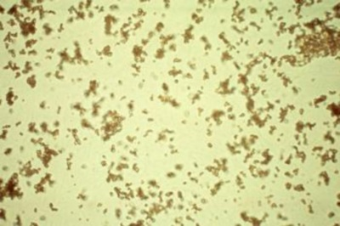
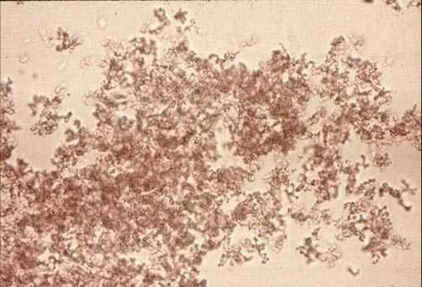
Crystals: ACID

Slide 11
Crystals: ACID
Amorphous urates (Ca+, Mg, Na+, K+)
-Small granule clusters appearing yellow-brown to pink-red
-NORMAL

Slide 12
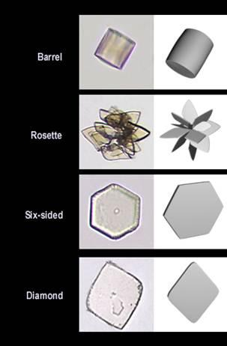
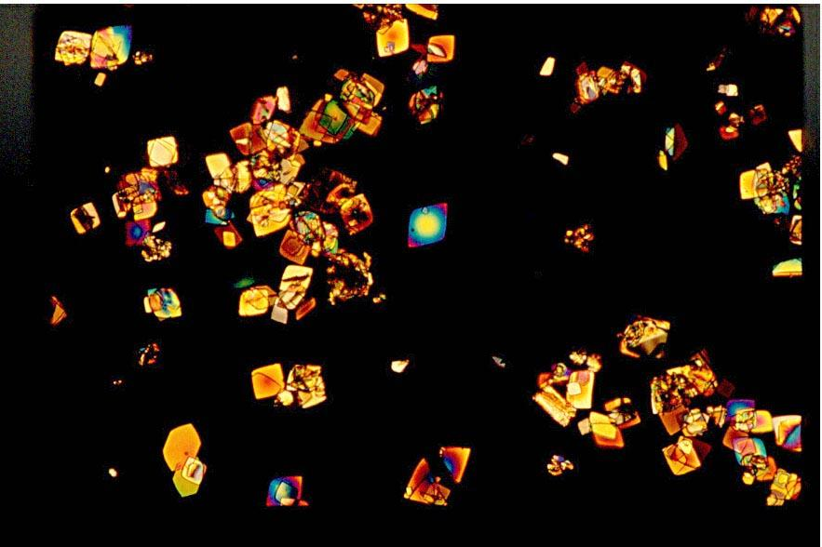
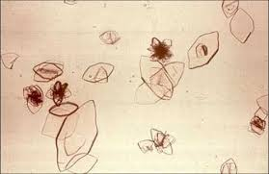
Crystals: ACID

Slide 13
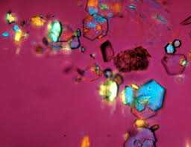
Crystals: ACID
Uric acid
-Seen in a variety of shapes: Rhombic, 4-sided flat plate, prisms, ovals with pointed ends (‘lemons’), wedges, rosettes, and irregular plates
-Usually yellow to reddish brown/brown colored, more rarely clear
-The rare 6-sided crystals that appear like clinically significant cystine crystals have birefringence under polarization (appear colorful). Cystine crystals do not
-NORMAL

Slide 14
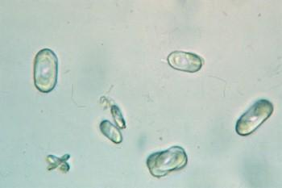
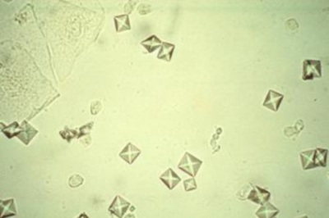
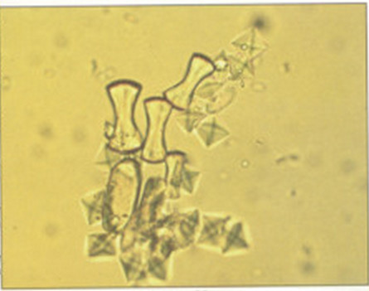
Crystals: ACID

Slide 15
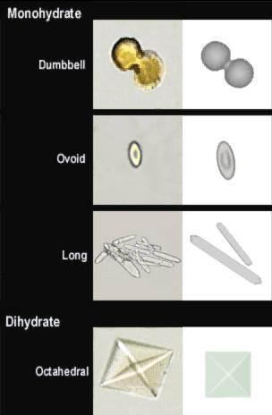
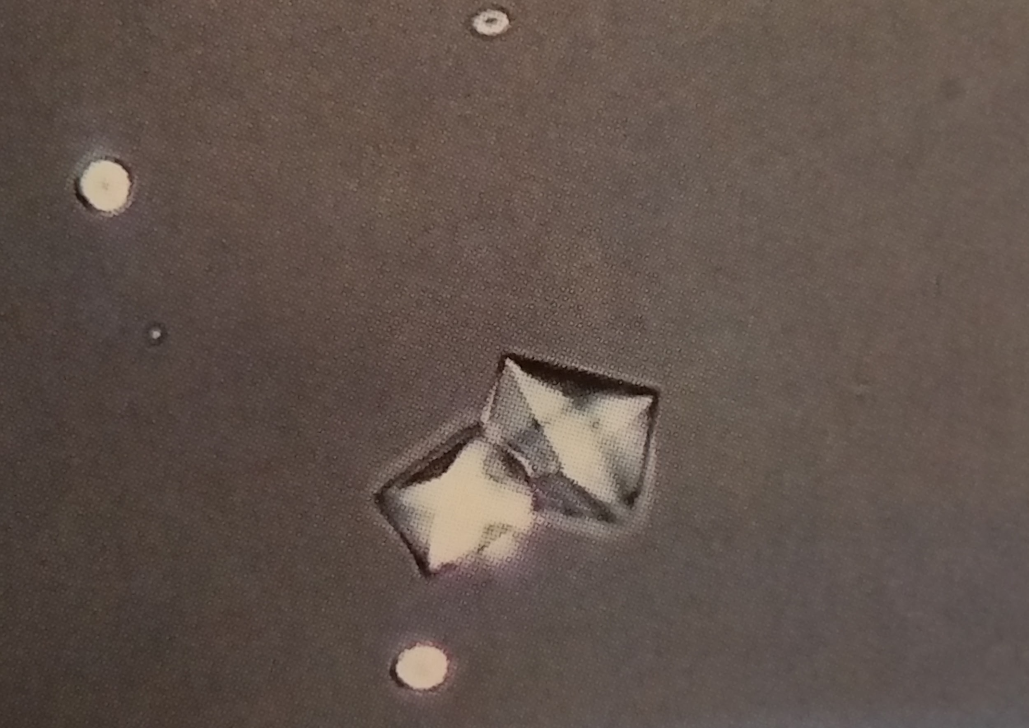
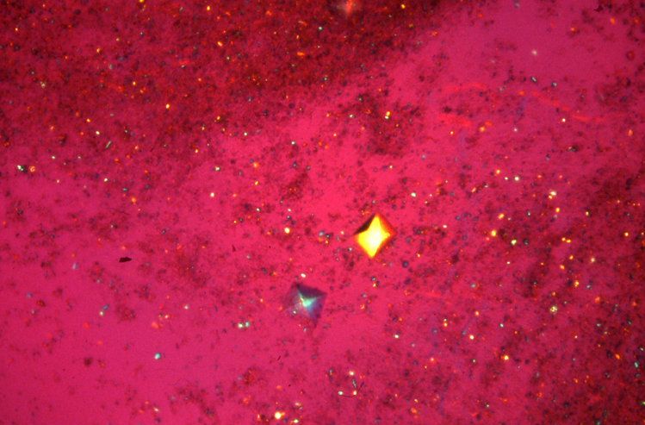
Crystals: ACID
Calcium oxalate (typically acid pH,
however can be found in alkaline pH)
-Monohydrate and dihydrate forms
-Monohydrate- commonly dumbbell
-Dihydrate- ‘letter envelopes’
-White when polarization field black,
birefringence when pink
-Usually NORMAL
UNLESS ABNORMAL
Can correlate with...
-Renal calculii (kidney stones)
-Ethylene glycol ingestion

Slide 16
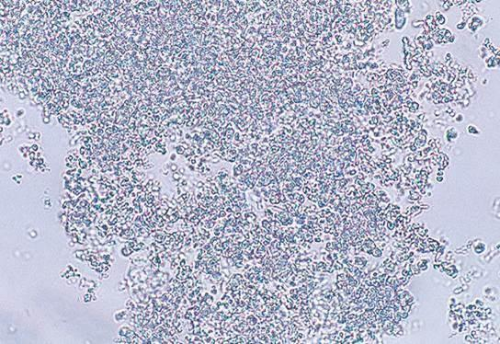
Crystals: ALKALINE

Slide 17
Crystals: ALKALINE
Amorphous phosphates (Ca+, Mg)
-Colorless, fine granular precipitates
-Dissolves with our (dilute) acetic acid
-NORMAL

Slide 18
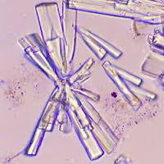
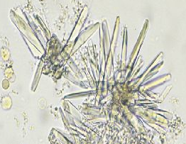
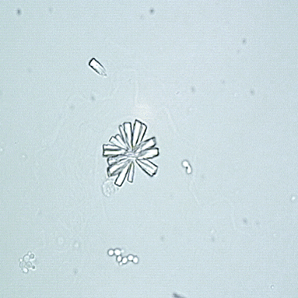
Crystals: ALKALINE

Slide 19
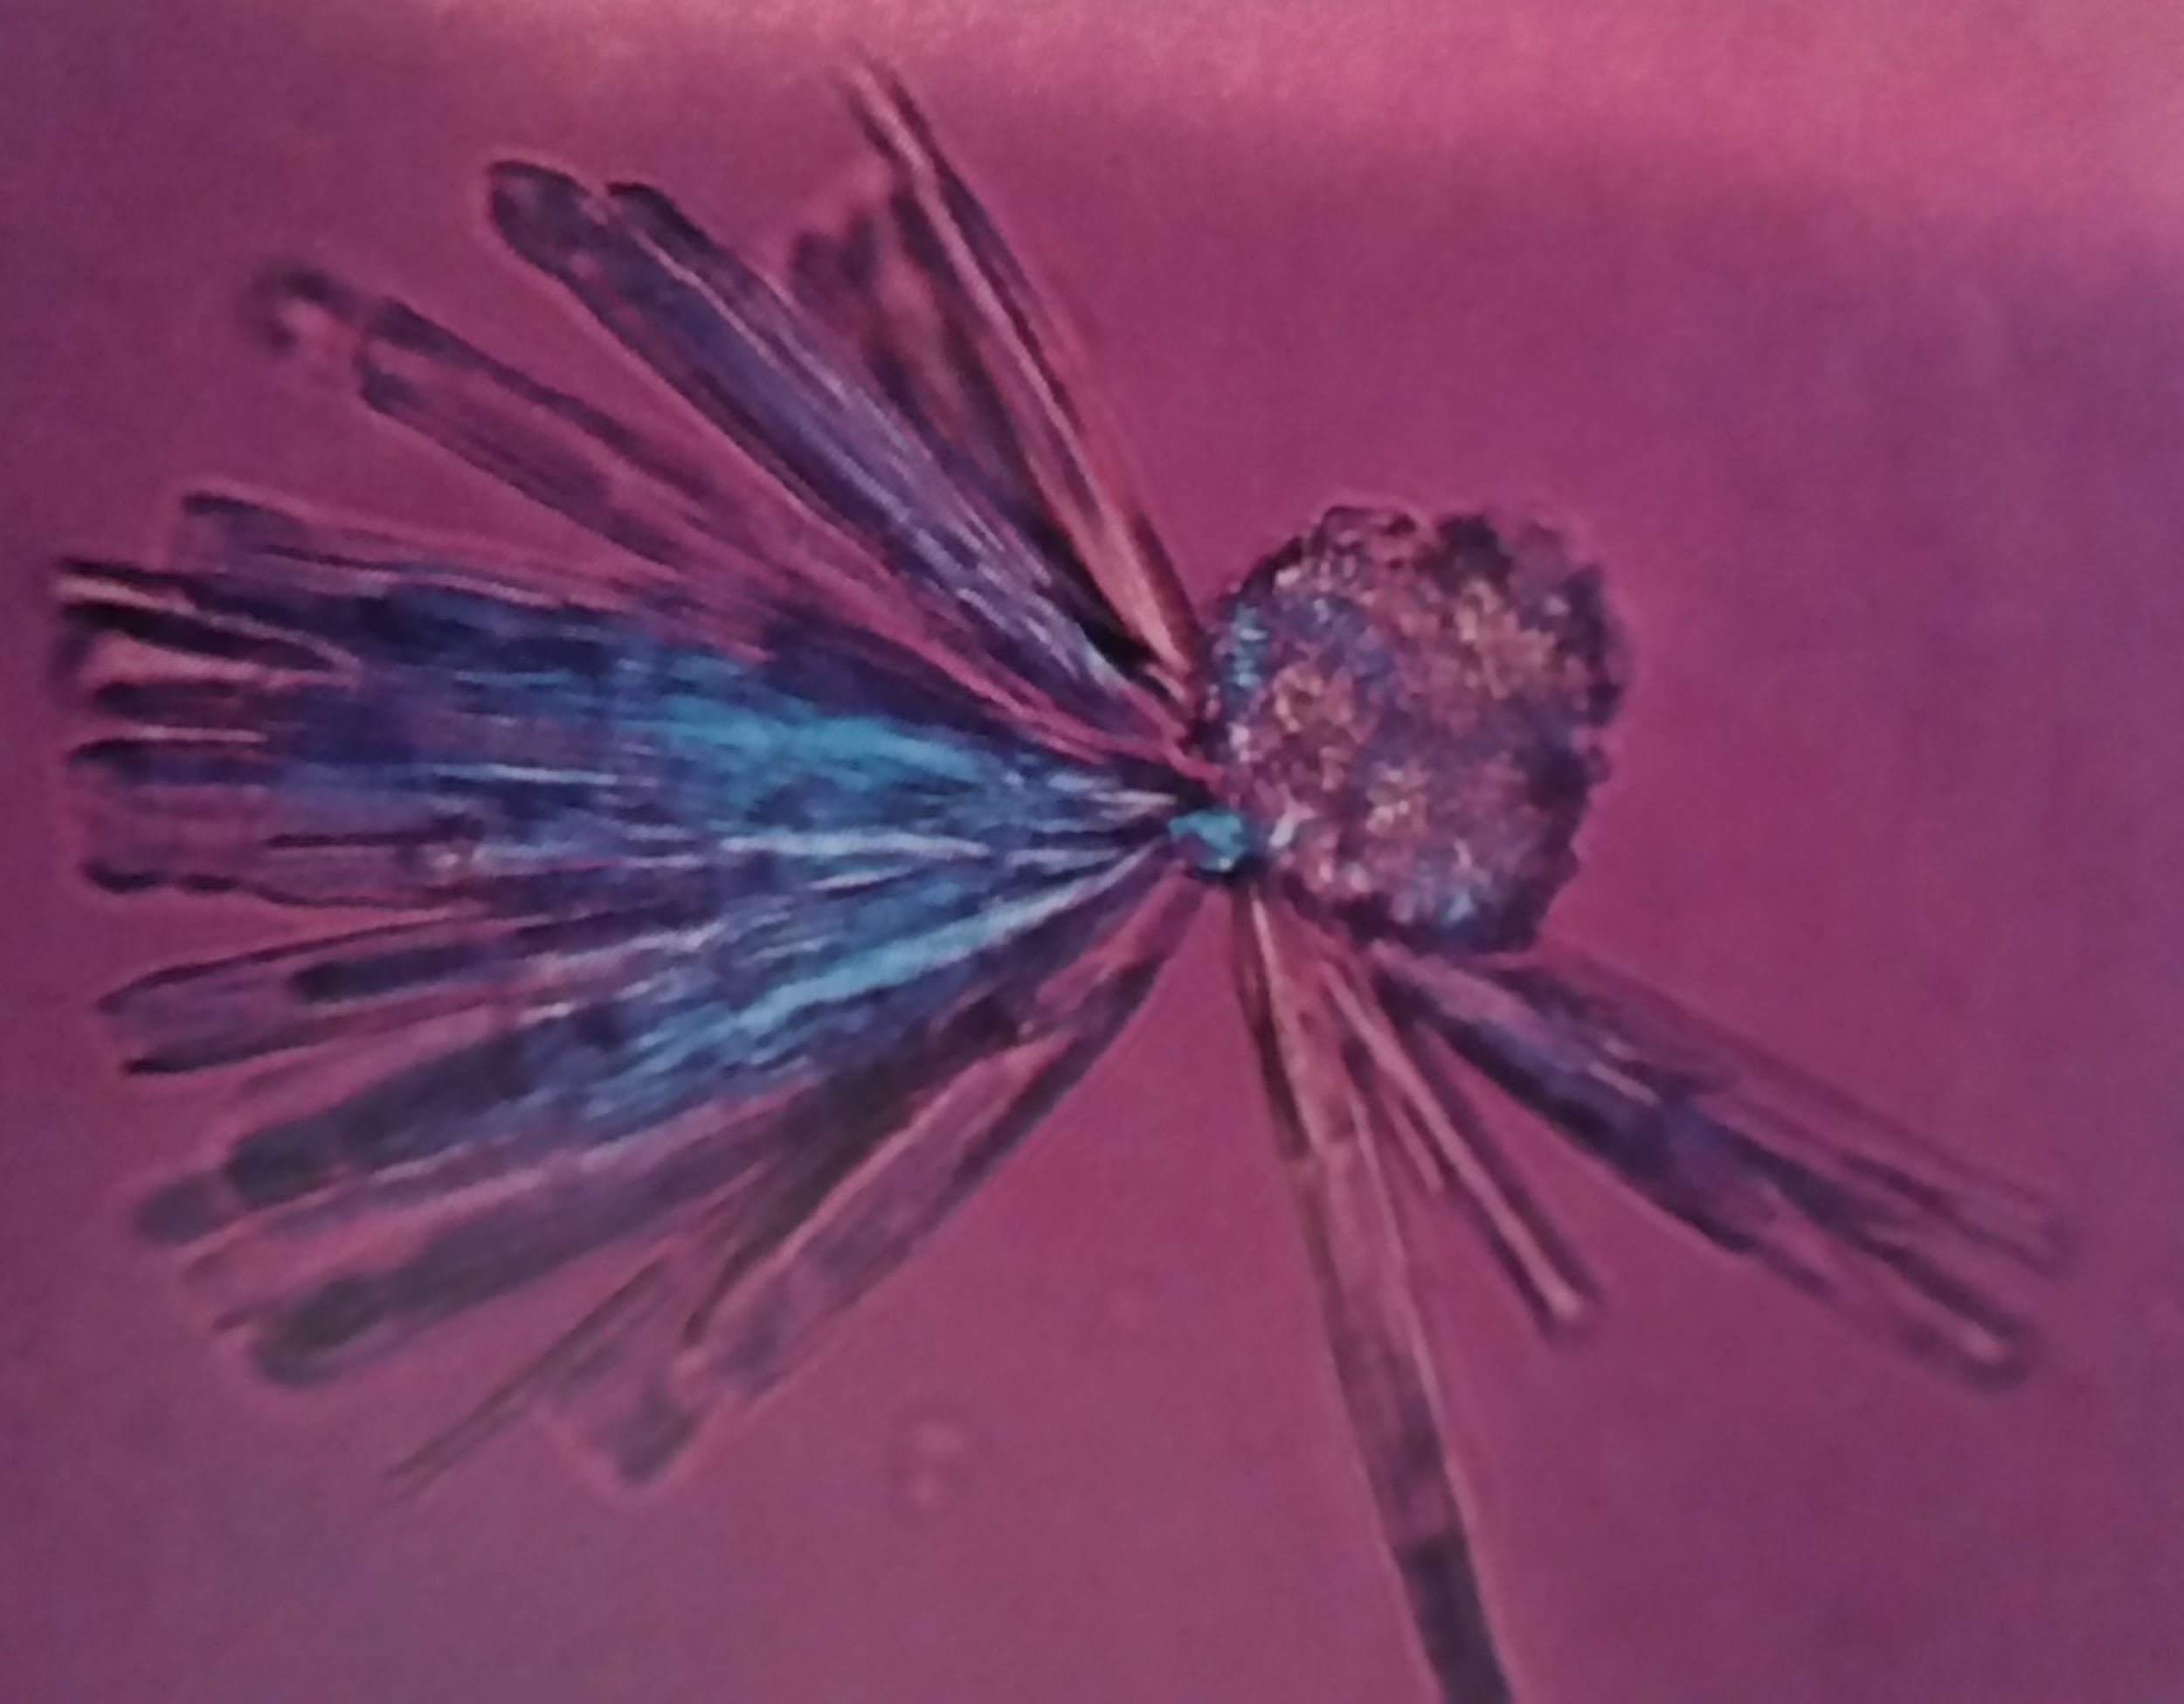
Crystals: ALKALINE
Calcium phosphate
-Colorless, star shaped or long thin prisms/needles, also rosette forms
-Dissolves in dilute acetic acid
-Birefringence w/ polarization
-NORMAL

Slide 20
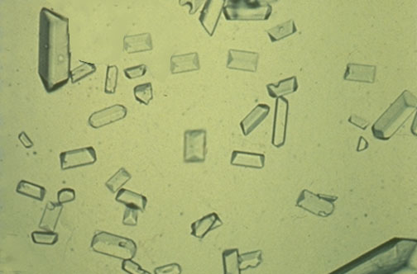
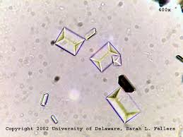
Crystals: ALKALINE

Slide 21
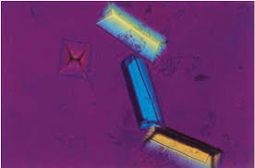
Crystals: ALKALINE
Triple phosphate
-Colorless ‘coffin lids’ or ‘gold bricks’
-Dissolves in dilute acetic acid
-Birefringence w/ polarization
-NORMAL

Slide 22
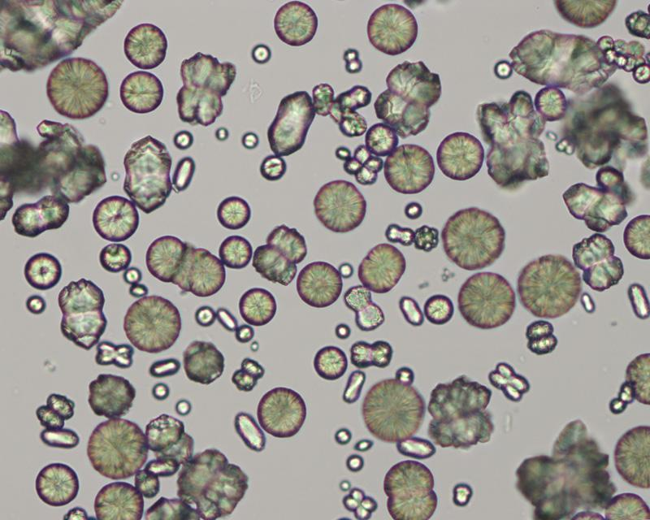
Crystals: ALKALINE

Slide 23
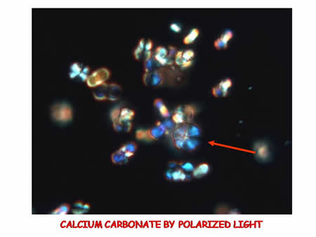
Crystals: ALKALINE
Calcium carbonate
-Uncommon, dumbbell or spherical shapes, pairs, 4s, or clumps
-NORMAL

Slide 24
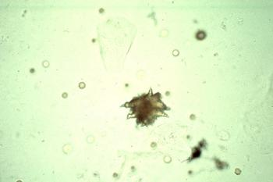
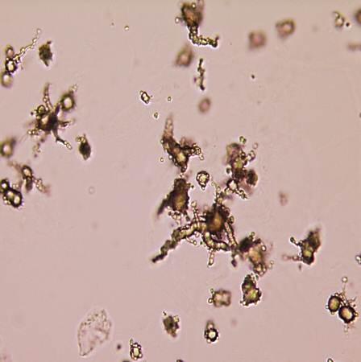
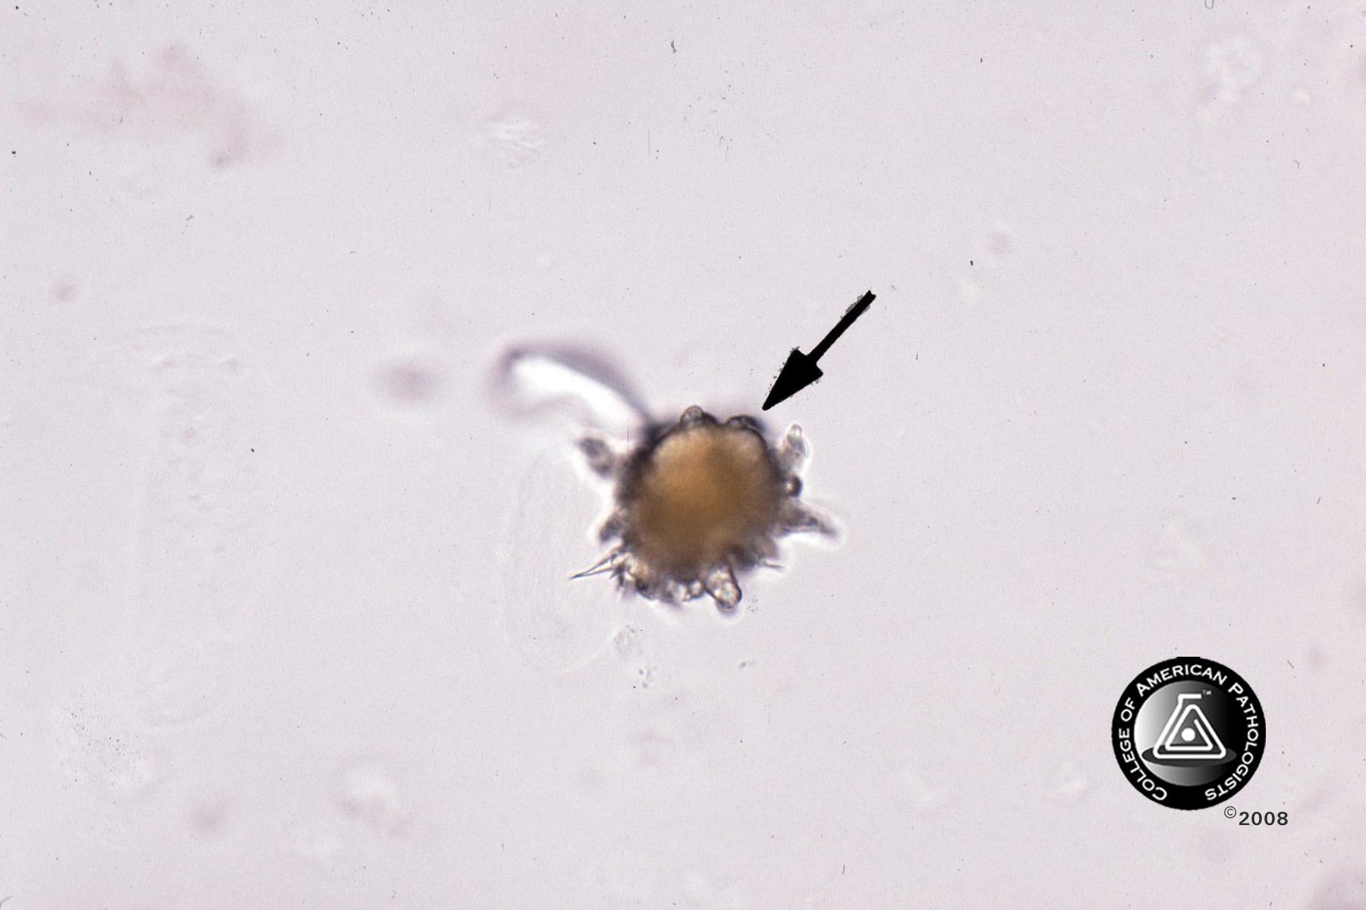
Crystals: ALKALINE

Slide 25
Crystals: ALKALINE
Ammonium biurate
-Dark yellow/brown ‘thorny apples’
-NORMAL

Slide 26
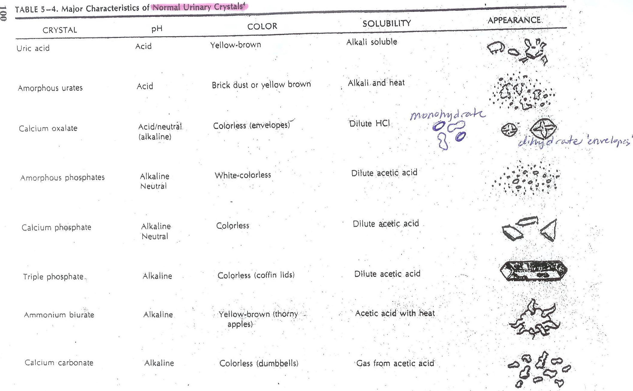
REVIEW: Normal Crystals

Slide 27
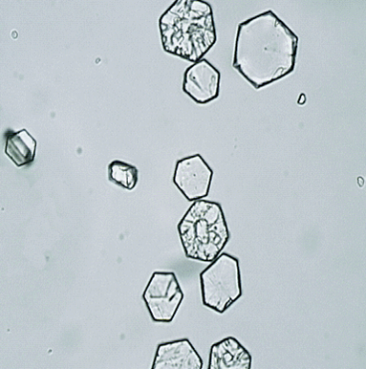
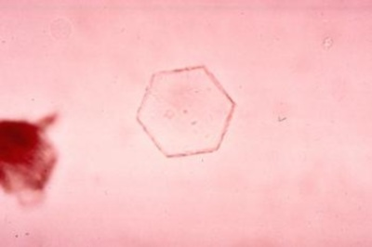
Crystals: ABNORMAL

Slide 28
Crystals: ABNORMAL
Cystine
-Crystals produced as a result of a genetic defect in cystine (the amino acid) transport
-Colorless hexagonal plates
-NO birefringence with polarization (unlike uric acid hexagons)

Slide 29
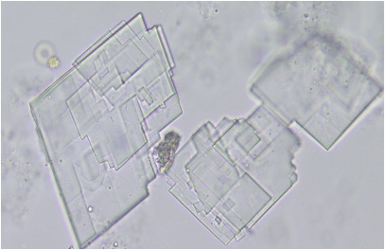
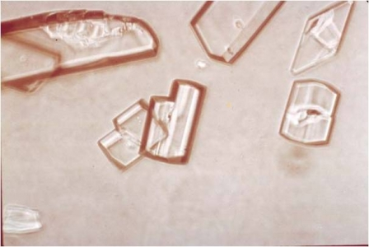
Crystals: ABNORMAL

Slide 30
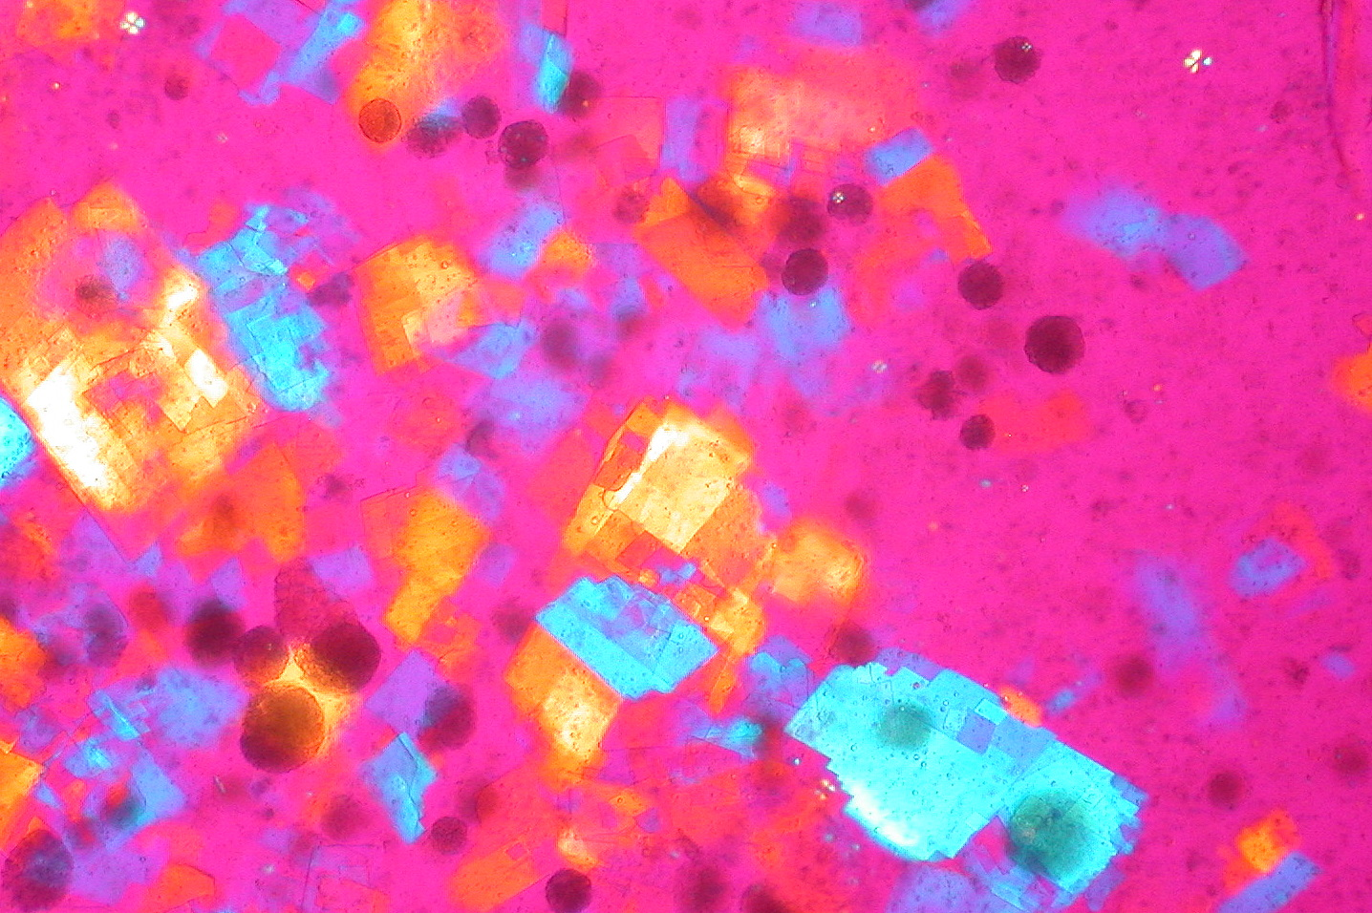
Crystals: ABNORMAL
Cholesterol
-Rare, colorless crystals, generally appear as ‘flat plates with notched corners’
-Typically accompanies fatty casts and OFBs in nephrotic syndrome

Slide 31
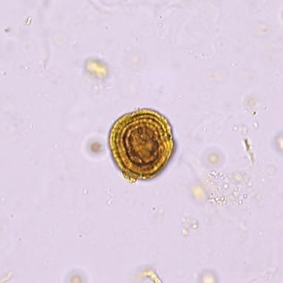
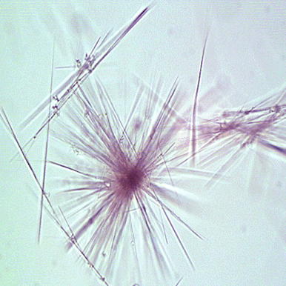
Crystals: ABNORMAL
Can you identify these two crystal types almost always found together in urine of patients with severe liver disease?

Slide 32
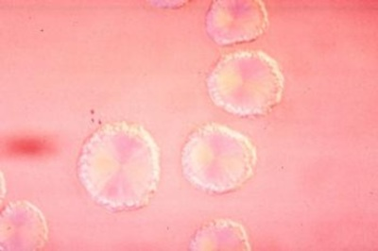
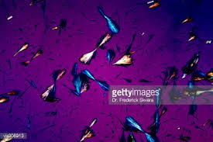
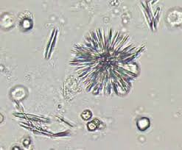
Crystals: ABNORMAL
Left: Leucine
-Yellow, oily appearing spheres with radial striations (‘wagon wheels’)
Right: Tyrosine
-Colorless or yellow fine,
silky needles in sheaves or rosettes
-Can also be yellow-brown spheres

Slide 33
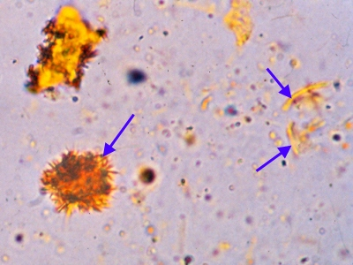
Crystals: ABNORMAL
What other crystal, not yet mentioned, can be associated with liver problems?

Slide 34
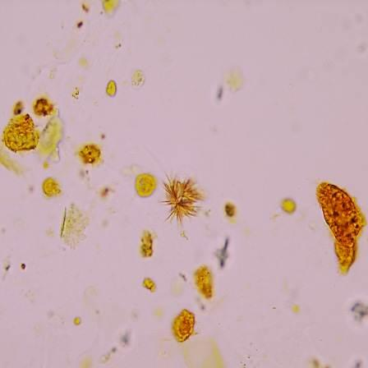
Crystals: ABNORMAL
Bilirubin
-Yellow to reddish/brown in color
-Shapes: Amorphous needles, rhombic plates, or cubes
-Should correlate with positive bilirubin dipstick

Slide 35
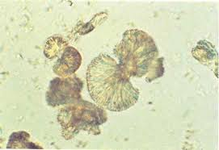
Crystals: ABNORMAL
‘Textbook’
form...

Slide 36
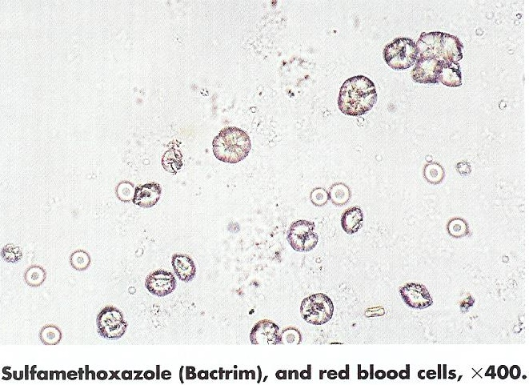



Crystals: ABNORMAL
Sulfa crystals--Various forms based on compound
Sulfamethoxazole
-Most common urine sulfa crystal from high doses of Bactrim
and Septra
-Seen as an irregular divided sphere or dense brown sphere
Acetylsulfadiazine
-Rarely used yet dangerous (‘yellow/brown sheaves of wheat’)
Sulfadiazine
-Rarely used yet dangerous (brown dense globules, below)

Slide 37

Crystals: ABNORMAL

Slide 38
Crystals: ABNORMAL
Radiographic media (radio dye)
-Should corollate with specific gravity >1.040
-Flat, colorless, thin rhombic plates (may be notched) or long, slender rectangles ‘broken glass’
-Most noteable because may be mistaken for cholesterol
-Can indicate renal blockage in dehydrated elderly patients receiving dye for imaging

Slide 39

Crystals: ABNORMAL

Slide 40
Crystals: ABNORMAL
Ampicillin
-Long fine colorless structures (left); refrigeration creates ‘bundle’ forms (right)
-Noticed in urine of patients on very high doses (i.e. bacterial meningitis)

Slide 41

REVIEW: Abnormal Crystals

Slide 42

Epithelial Cells
Squamous epithelial cell
Skin contaminant

Slide 43

Epithelial Cells

Slide 44
Epithelial Cells
Clue cell
-Squamous epithelial cell covered with bacteria (bacterial vaginosis)

Slide 45

Epithelial Cells

Slide 46
Epithelial Cells
Transitional epithelial cell
-Not of clinical significance unless in large clumps/sheets
-Can be increased in catheterization
-1:3 nucleus to cell ratio

Slide 47

Epithelial Cells

Slide 48


Epithelial Cells
Renal tubular epithelial cell
-Tubular damage/necrosis if
increased (>2 per hpf)

Slide 49

Epithelial Cells

Slide 50
Epithelial Cells
Ovoid fat body (OFB)
-Renal epithelial cells with fat droplets (lipids) inside
-Often seen with fatty casts & fat drops
-Very serious, usually indicative of nephrotic syndrome but also diabetic nephropathy or lupus nephritis

Slide 51

Casts

Slide 52

Casts
Hyaline cast
-No clinical significance; colorless, transparent with low refractivity (hard to see), and rounded ends
-Cylindroids are a
type of hyaline cast

Slide 53

Casts

Slide 54


Casts
Waxy cast
-Indicates renal failure (renal failure cast)
-Sharp refractile outline; matrix clear; irregular ‘broken off’ ends

Slide 55

Casts

Slide 56

Casts
RBC cast
-Red cells in a hyaline matrix
-Infection, inflammation, and strenuous exercise
-RBCs may degenerate and appear as a reddish-brown granular cast (this is a hemoglobin cast)

Slide 57


Casts

Slide 58
Casts
WBC cast
-WBCs in a hyaline matrix; should see multilobed nuclei
-Found with infection and inflammation

Slide 59

Casts
Stained
to help
visualize

Slide 60
Casts
Renal epithelial cast
-May be hard to differentiate from WBC cast
-Kidney tubular damage from inflammation/necrosis
-Often observed with RBC and WBC casts

Slide 61


Casts

Slide 62
Casts
Mixed cell cast
-A mix of different cell types in a cast
-I.e. eukocyte/renal, erythrocyte/leukocyte, etc.
-If cells too degraded to distinguish it is then referred to as a cellular cast

Slide 63

Casts

Slide 64

Casts
Granular cast
-A degenerated cellular cast; can be clinically significant
-Opaque granules filling a matrix with rounded ends (compared to a granular hyaline cast [below] which does not have many granules)

Slide 65


Casts

Slide 66
Casts
Fatty cast
-Fatty material incorporated into cast matrix from lipid filled renal epithelial cells
-Very refractive, yellow to brown in color
-With polarization produces maltese crosses within the cast
-Indicative of nephrotic syndrome; usually found with OFBs and fat droplets

Slide 67

Casts

Slide 68

Casts
Crystal cast
-Can see any crystal in a cast matrix
-Strong polarization
(Bilirubin cast)

Slide 69


Casts

Slide 70
Casts
Broad cast
-Diameter 2-6x the size of a regular cast
-Indicates chronic renal failure
-Poor prognosis (end stage renal disease)

Slide 71

REVIEW:
Casts

Slide 72






Other: Yeast, Bacteria, Trichomonas, Etc.

Slide 73
Other: Yeast, Bacteria, Trichomonas, Etc.
Bacteria Yeast (not lysed with acetic acid) Trichomonas
Unlike RBCs which are lysed

Slide 74



Other: Yeast, Bacteria, Trichomonas, Etc.
A B C

Slide 75
Other: Yeast, Bacteria, Trichomonas, Etc.
Mucous--Can falsely increase protein
Sperm--Can falsely increase protein
Pinworm Ova--Common 1st world parasite

Slide 76






Artifacts
Last game: Can you identify the artifacts?

Slide 77
Artifacts
Last game: Can you identify the artifacts?
Starch granules Fibers Air bubbles Pollen granules
ALL CAN BE MISTAKEN FOR OTHER MICROSCOPIC FINDINGS

Slide 78
Thank you for your attention and participation!!!
Questions? Comments?
Remember: UA book in drawer is a great resource when in question!

