Slide 1
Cells in CSF
A variety of cell types may be identified microscopically in CSF.
Red blood cells (RBC, erythrocytes) are readily identified by their pink color, small size and absent nucleus.
The white blood cells consist of cells having segmented nuclei (poly) or nonsegmented (mono) nuclei. The cells with segmented nuclei may have granules in their cytoplasm which are fine and pale pink (neutrophils), coarse and red (eosinophils), or coarse and purple (basophils).
The cells with nonsegmented nuclei consist of lymphocytes and monocytes/macrophages. The lymphocytes have scant, pale blue cytoplasm and a round nucleus. Macrophages have larger folded nuclei and abundant pale blue cytoplasm that often contains vacuoles
Other cells or variations of the above can be observed in CSF and may be more difficult to identify. The following slides are provided to assist in the recognition of some of these cells.

Slide 2
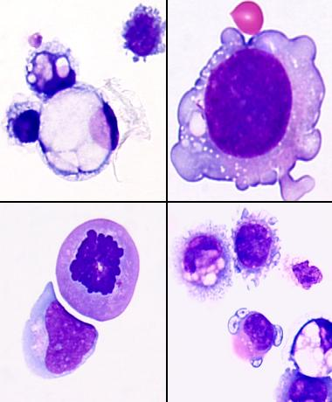
Malignant Cells
Malignant cells are difficult to specifically identify unless the primary tumor is known. If the primary tumor is known, the specific identity of the malignant cells can often be inferred. If unusual cells are observed, the slide should be referred to a pathologist for final reporting.

Slide 3
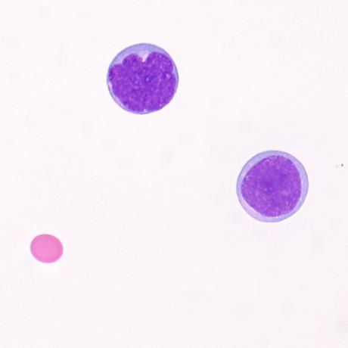
Malignant Cells-Blast
Lymphoid appearing cells having mildly increased size, fine uniform chromatin, and scant pale cytoplasm without identifiable nucleoli are present, consistent with lymphoid blasts.

Slide 4
Malignant Cells-Blast
A single intermediate to large cell having fine chromatin, a distinct nucleolus and a moderate amount of blue cytoplasm with a suggestion of fine pink granules is seen

Slide 5
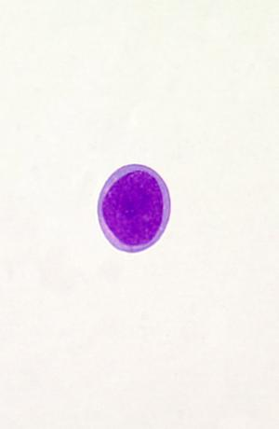
Malignant Cells-Blast
The pictured cell has fine, uniform chromatin and scant pale blue cytoplasm, most consistent with a blast.
A reactive lymphocyte would typically have more abundant pale to blue cytoplasm and more coarse, heterogeneous chromatin.

Slide 6
Malignant Cell
Morphologic features of malignant cells include: Increased N/C ratio, irregular nuclear borders, large nucleoli, vacuoles overlying the nucleus, sharply defined cytoplasmic borders, increased mitosis, and 3-dimensional aggregates.

Slide 7
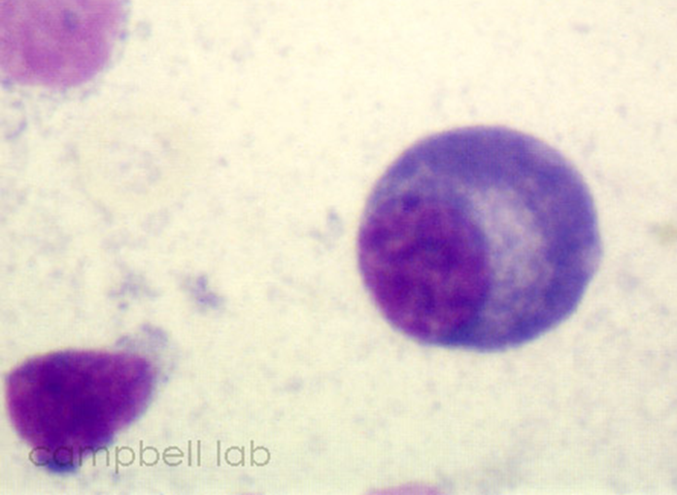
Plasma Cells
Plasma cells have an eccentrically located nucleus with prominent chromatin clumping. The cytoplasm is basophilic, and a perinuclear zone (hof) is present.

Slide 8
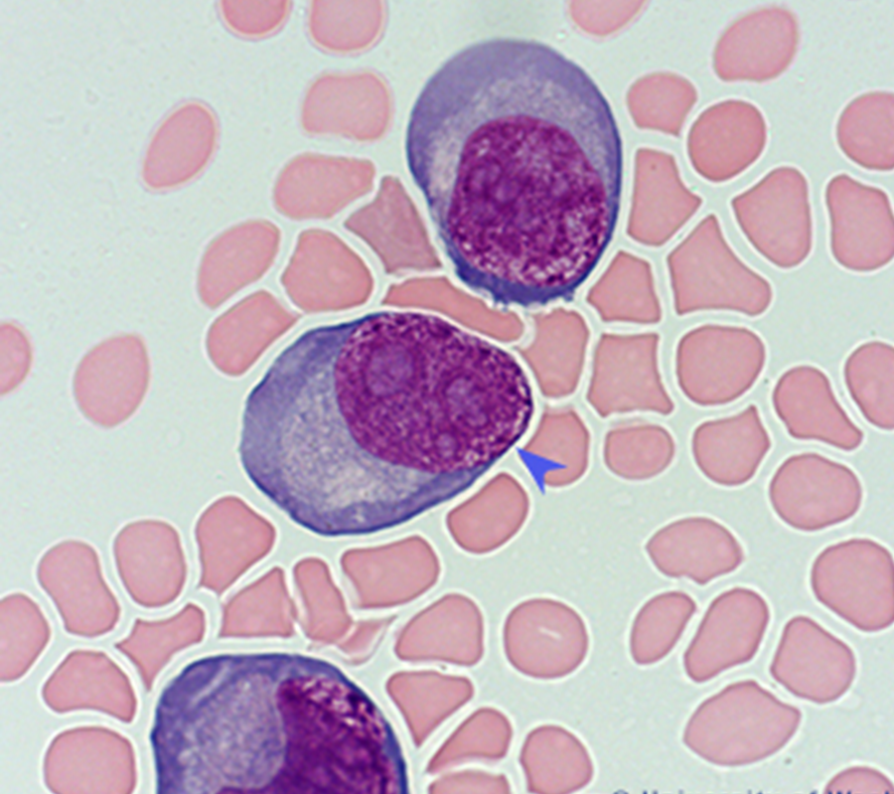
Malignant Cell versus Plasma Cell
Malignant cells
Plasma cell

Slide 9
Monocyte/Macrophage Vs Neutrophil
Monocyte nuclei may be round, kidney shaped or horseshoe shaped, with fine raked chromatin and dirty gray cytoplasm. They often contain fine azurophilic granules and numerous cytoplasmic vacuoles.

Slide 10
Monocyte/Macrophage Vs Neutrophil
Macrophages are commonly present in CSF and have large folded nuclei with mature-appearing chromatin and relatively abundant pale blue-gray cytoplasm. Often the cytoplasmic border is frayed or irregular and occasional clear vacuoles may be seen in the cytoplasm.
Neutrophils
Macrophages

Slide 11
Monocyte/Macrophage Vs Neutrophil
Neutrophils are easily identifiable in body fluids, as they appear quite similar to those found in peripheral blood.

Slide 12
Monocyte/Macrophage Vs Neutrophil
Neutrophil
Monocyte/Macrophage

Slide 13
CSF Crystals
Hematin crystals are a byproduct of hemoglobin breakdown. They are generally yellow-orange in color and indicate a prior hemorrhage

Slide 14
CSF Crystals
Hemosiderin is seen as dark blue-black granules and is the residual byproduct of hemoglobin breakdown from phagocytized RBCs.
It is important to be able to distinguish hemosiderin from intracellular bacteria.

Slide 15
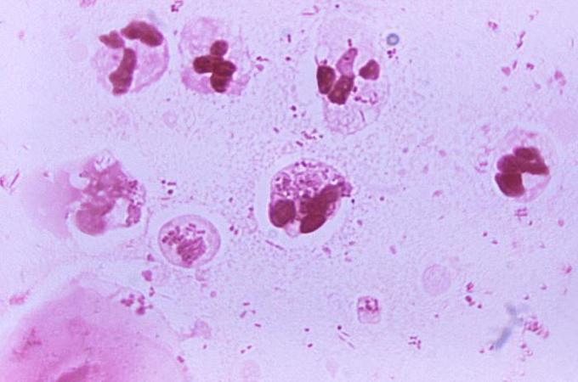
bacteria
hemosiderin
bacteria

Slide 16
Hutchinson Health Lab CSF Manual Differential
Per the procedure LAB HH HEM CEREBRAL SPINAL FLUID EXAMINATION PROCEDURE, when performing a CSF manual differential, the cells are differentiated into two categories Polynuclear and Mononuclear.
Polynuclear includes neutrophils, basophils and eosinophils.
Mononuclear includes monocytes, macrophages and lymphocytes.
It is still important to recognize cells other than those listed above such as immature (blasts)/malignant cells or variations of the above such as plasma cells. Identification or suspicion of these cell types would require sending the smear to be reviewed by pathology.
The presence of crystals should also be noted.

