Slide 1
Injury & Illness Prevention Program
(IIPP)

Slide 2

Injury and
Illness

Slide 3




Not allowed in the lab
Injury and Illness
DRINKING
Eating
Applying
Makeup
Inserting Contacts

Slide 4



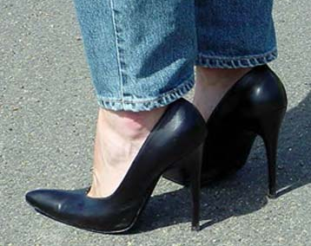
Lab Footwear
While working in the lab, only closed-toed, flat shoes must be worn at all times (i.e. no high-heeled shoes or sandals)

Slide 5
TRASH CANS
Injury and Illness
Red
  Biohazard Waste (SHARPS)
Regular
  All others
Blue
  Recycle

Slide 6
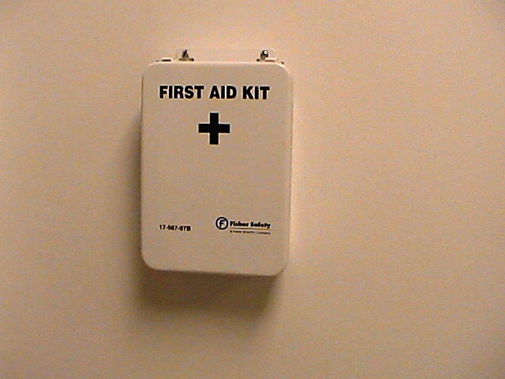
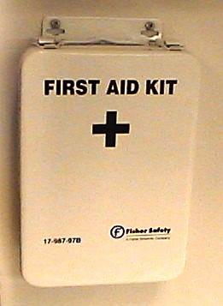
First Aid Kits
First aid kits are located throughout the building for all employees to use. All first aid kits are checked and restocked on a monthly basis.
Injury and Illness

Slide 7

Red Biohazard Waste Containers
Injury and Illness
Located throughout the lab.
Keep covered except when in use.
TCI will dispose of this waste, once a week.
Do not put sharps in these bags.

Slide 8
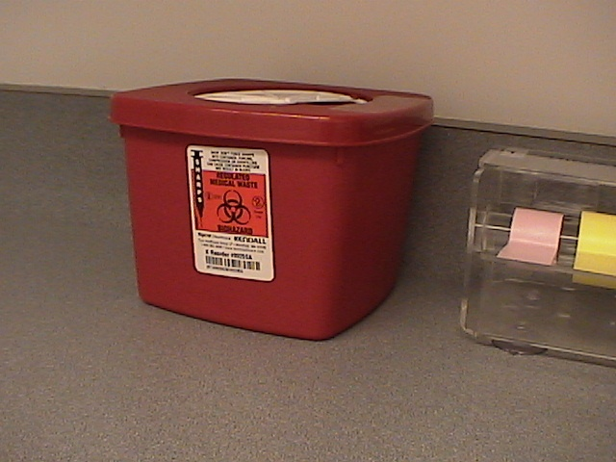
SHARPS Containers
Injury and Illness
These RED containers are located throughout the lab.
Fill only ¾ full
Tape Shut & Date
TCI will pick up
Never re-enter once the container is sealed.

Slide 9

Hazard Communication

Slide 10




Internal Disaster
Hazard Communication
Fire
Computer failure
Medical emergency
Power failure
Phone failure

Slide 11




External Disaster
Hazard Communication
Civil disturbance
Earthquake
Flood
Hurricane

Slide 12
Equipment Monitoring
Hazard Communication
Employees must do their part in notifying Facilities or Safety about real or potential problems.
Each Department is responsible for the maintenance of their own equipment.

Slide 13

Equipment Monitoring
Look/Listen for…………
Hazard Communication
Tingling
Buzzing
Faulty
Wires

Slide 14
Tagging/repairing broken Laboratory equipment
Hazard Communication
Records will be kept on broken and/or damaged equipment, by the individual departments to be shown upon demand to employees, supervisors, safety team or inspectors.

Slide 15
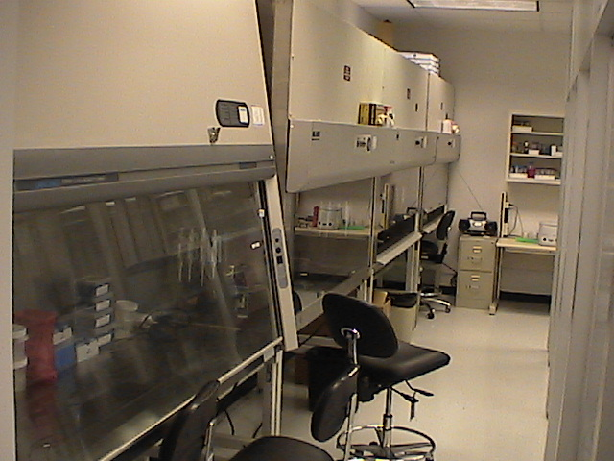
Safety Hoods
Hazard Communication
Checked once per year by a licensed company.
To ensure air flow and draw are performing up to standards
The hoods will have stickers attached with inspection due dates.

Slide 16
CombiMatrix Safety Committee
The Safety Committee will meet monthly.
Random accidents will be reviewed with supervisor and victim.
All accidents will
be discussed and
reviewed
by the Safety
Committee.
Safety Committee:
Justin – Safety Officer
Lori
Bruce
Aria
Gerald
Trends will be reviewed, identified and corrected by the Safety Committee.

Slide 17
Safety Inspections
Safety checks will be performed monthly and reviewed by the Quality Management team.
Signed copies of the checks and audits will be kept on file for review.
Safety audits will be performed quarterly and reviewed by the Quality Management team.

Slide 18
Where to go for additional help
Web sites:
    http://www.msdsonline.com
    http://www.cdc.gov/niosh
    http://www.fireextinguisher.com
    http://www.practicingsafescience.org/
Safety Manager: Justin Johnson
Phone: 949.255-1579 internal ext. 452
Email: jjohnson@combimatrix.com

Slide 19

You have successfully completed
“Combimatrix IIPP Training”!

