Slide 1
Injury & Illness
Prevention Program
(IIPP)

Slide 2
Injury and Illness

Slide 3
Not allowed in the lab
Injury and Illness
DRINKING
Eating
Applying
Makeup
Inserting Contacts

Slide 4
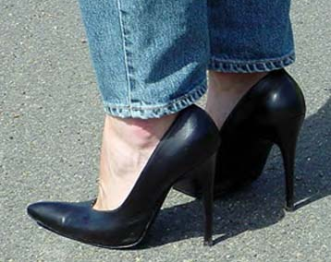
Lab Footwear
Injury and Illness
While working in the lab, only closed-toed, flat shoes must be worn at all times (i.e. no high-heeled shoes or sandals)

Slide 5
TRASH CANS
Injury and Illness
Red
Biohazard Waste (SHARPS)
Regular
All others
Blue
Recycle
Grey
Hazardous Waste (Chemical)

Slide 6
First Aid Kits
First aid kits are located throughout the building for all employees to use. All first aid kits are checked and restocked on a regular basis.
Injury and Illness

Slide 7
Red Biohazard Waste Containers
Injury and Illness
Located throughout the lab.
Keep covered except when in use.
TCI will dispose of this waste, once a week.
Do not put sharps in these bags.

Slide 8
SHARPS Containers
Injury and Illness
These RED containers are located throughout the lab.
Fill only ¾ full
Tape Shut & Date
TCI will pick up
Never re-enter once the container is sealed.

Slide 9
Hazard Communication

Slide 10
Internal Disaster
Hazard Communication
Examples of internal disasters include:
Fire
Computer failure
Medical emergency
Power failure
Phone failure

Slide 11
External Disaster
Hazard Communication
Examples include:
Civil disturbance
Earthquake
Flood
Hurricane
Fires

Slide 12
Equipment Hazards
Hazard Communication
Employees must do their part in notifying Facilities or Safety about real or potential problems with any equipment.

Slide 13
Equipment Monitoring
Look/Listen for…………
Hazard Communication
Tingling
Buzzing
Faulty
Wires

Slide 14
Tagging/repairing broken Laboratory equipment
Hazard Communication
Records will be kept on broken and/or damaged equipment, by the Facility Team.
The Facility Team will also work with the vendor to repair equipment.

Slide 15
Safety Hoods
Hazard Communication
Checked at least once per year by a licensed company.
The hoods will have stickers attached with inspection due dates.

Slide 16
Irvine Invitae Safety
Monthly Safety Meeting with all lab staff
Safety Officer will perform monthly safety audit for each department
Any incidents or accidents will
be discussed and
reviewed at the monthly safety meeting
Safety Team Resources:
Frances – Safety Officer
Lori
Bruce
Aria
Gerald

Slide 17
Safety Inspections
Safety checks will be performed monthly and reviewed by the Quality Management team.
Signed copies of the checks and audits will be kept on file for review.

Slide 18
Where to go for additional help
Web sites:
http://www.msdsonline.com
http://www.cdc.gov/niosh
http://www.fireextinguisher.com
http://www.practicingsafescience.org/
Safety Officer: Frances McKelvey
Phone: 760-696-2705
Email: frances.mckelvey@invitae.com

Slide 19
You have successfully completed Irvine Invitae IIPP Refresher Training

