Slide 1
LABORATORY SAFETY
Northside Hospital-Forsyth
Mandatory Orientation/Annual Update
Revised: 3/2017

Slide 2
Laboratory Safety Officer-LSO
Sonya Penny is the laboratory’s Safety Officer. The acting safety officer when is not not on site will be the assigned “Charge” person for the laboratory. The LSO coordinates activities regarding Safety Management.
Other Responsibilities
Section/Shift Supervisors or lead techs are responsible for monitoring staff on a daily basis for safe work practices as outlined in Laboratory Safety Manual and for initial and follow-up training.
Laboratory Employees are responsible for completing mandatory safety CBLs, quizzes as assigned, and annual safety education.

Slide 3
Location of Safety Related Manuals for Laboratory
OSHA Standards (Federal Register) Online at http://www.osha.gov
Laboratory Safety Manual In Lucidoc on Intranet. Hard copy in book shelves back of
chemistry.
Environment of Care In Lucidoc EOC Manual-System Wide. Hard copy in book shelves back of chemistry.
Emergency Preparedness Manual(EPM) In Lucidoc Manual-System Wide. Hard copy in bookcase
in back of chemistry.
(contains All Hazards Ops Plan & Emergency Operations Plan)
SDS Information (formerly MSDS) NSH Intranet, Information/Resources/MSDS Sheets MSDSonline, 1(888)362-7416
Hospital & Laboratory In Lucidoc on Intranet. System-wide Manuals. Hard copy
Administration Manuals in book case at the back of chemistry.
Safe Medical Devices Act (SMDA) In Lucidoc. EOC Manual-System Wide.
Hazardous Materials & Waste Mgmt. In Lucidoc. EOC Manual-System Wide.

Slide 4
Laboratory Safety Manual
General Safety Policies
Biological Safety
Chemical Safety
Lab Emergency Plan of Action
Mechanical Safety
Waste Disposal
Bioterrorism Readiness
TB Exposure Control Plan

Slide 5
Emergency Conditions & Codes
Code Orange: Bomb Threat
Code Brown: Evacuation / Relocation
Code Green: Mass Casualty Event
Code Red: Fire, smoke, burning smell
Code Pink/Amber: Missing Infant / Child
Code Purple: Missing/Wandering Patient
Code Yellow: HazMat Decontamination
Code Grey: Tornado
Code Dry: Water System Failure
Code White: Snow/Ice
Code Silver: Active Shooter
Code One Immediate Security required
Code Blue: Medical Emergency
Code Yellow

Slide 6
Emergency Phone Numbers
NHF Security: Ext. 43444
NHF Emergency (for codes): Ext. 54321

Slide 7
Fire Safety & Code RED
There are to be no open flames (candles) in the Laboratory due to solvents & flammable chemicals.
The Laboratory is required to evacuate (fire drill) once/year.
  A RED HAND, RED/ORANGE FLASHING LIGHT, or RED
  TOWEL will indicate that there is a drill underway
  When RED HAND, RED/ORANGE FLASHING LIGHT, or
  RED TOWEL is found, implement R.A.C.E.

Slide 8
R.A.C.E.
Rescue those in immediate danger, if safe to do so.
Activate the alarm, dial emergency # & pull manual alarm. Dial 54321 and notify operator of Code RED location. If the alarm is part of a Fire Drill, ask the person conducting the drill if they want the alarm pulled. Know locations of manual alarms. If two employees are available, one may activate alarm while the 2nd person makes the call.
Contain the fire (close doors). Automatic doors will shut, but if not, close them and be sure all fire doors are closed. C is also Clear the hallways.
Extinguish if safe. Get the fire extinguisher. Know the locations of extinguishers in the Laboratory.

Slide 9
P.A.S.S.
Using Fire Extinguisher
Pull the extinguisher pin
Aim the nozzle of the extinguisher
Squeeze the extinguisher handle/trigger
Sweep the extinguisher flow from side to side at the base of the fire

Slide 10
P.A.S.S.
Using Fire Extinguisher
Stand approximately 6 feet from the fire to extinguish it.
The fire extinguishers in the laboratory will typically extinguish a fire the size of a tall trash can. If the fire is larger than that, do not attempt to extinguish.

Slide 11
Location of FIRE Safety Equipment/Devices
ALARMS/FIRE PULLS
  Take time to locate all alarms in the vicinity of the Lab
  The NHF Lab has two fire alarms/pulls located within the Lab; one by the exit door and one at the exit to outside.
FIRE BLANKET
  At NHF Lab, a fire blanket is not required because there are no open flames in the Lab.
Elevators
  Do not use an elevator during an actual fire or fire drill
EXTINGUISHERS
  ABC extinguishers: We have extinguishers located throughout the lab. Take time to locate all extinguishers in Laboratory!
POOLING AREAS for LAB
  During an evacuation from the Lab, exit via the back exit near Chemistry. Pool in the surgery parking lot. The secondary exit is through the Outpatient surgery entrance at the rear of the hospital and the pooling area will, also, be the surgery parking lot.
  FIRE DOORS
  Fire doors are designed to resist/deter flames & have 3 levels of ratings. The laboratory is a fire compartment (Smoke Compartment 7, see next page) and all doors in and out of the lab are fire doors. The door between the storeroom and the lab is also a fire door. None of these doors are to be propped open.

Slide 12
Laboratory

Slide 13
Northside Smoking Policy
Smoking is prohibited inside all Northside Hospital buildings and the entire campus.

Slide 14
Northside Smoking Policy
Employee infractions of this policy shall follow the progressive disciplinary process.
Visitors who do not abide by the policy shall politely and appropriately be asked to conform to the hospital policy.
Employees, volunteers, and medical staff who feel their right to a smoke free environment is compromised should take concerns to the security department.

Slide 15
CODE ORANGE-
BOMB THREAT
Checklist copy will be located in the Lab’s Emergency Box. for use at phones in department & helps to prompt staff member. A copy can also be found in Lab’s Lucidoc Safety Manual at Bomb Threat Checklist-
  To listen to caller w/o interruption at first
  Notify supervisor & security immediately after receiving call
  NEVER use a cell phone or walkie-talkie when under a Code Orange
  Note date/time of call and document who received the call
  Write down exactly what caller says if possible
  Record if caller is male or female and estimate age of caller
  Try to ascertain origin of call (check caller ID on phone if available on display), voice characteristics, speech, language, accent, manner of caller-calm/angry/rational and background sounds that are heard
  Ask questions if possible such as, When is bomb going to explode? What kind of bomb? Where is it located? Where are you calling from? What is your name? What does it look like? etc..
  Staff does not evacuate Laboratory unless in immediate danger & should assist in looking for any suspicious packages or boxes.

Slide 16
CODE PINK/AMBER-INFANT/CHILD ABDUCTION
Code PINK/AMBER is announced over PA system
Laboratory is responsible for manning the outside area of the back Laboratory door. The areas of responsibilities are:
  West Surgical Stairway located at the rear door of Lab
  Hallways in front of the Lab and Pharmacy
Approach anyone exiting that is carrying anything that could conceal an infant or small child & politely explain that there is a possible infant abduction & hospital staff need to search their bags/purses, etc…
Check people both leaving & entering areas of responsibility.
If a person refuses to cooperate, do not attempt to detain them; notify security. Follow only if safe to do so.
There are periodic Code PINK drills conducted.
If Code PINK is announced simultaneously with another Code (other than SILVER), Code PINK takes precedent.
Remain in the area of responsibility until Code Pink “All Clear” is called.

Slide 17
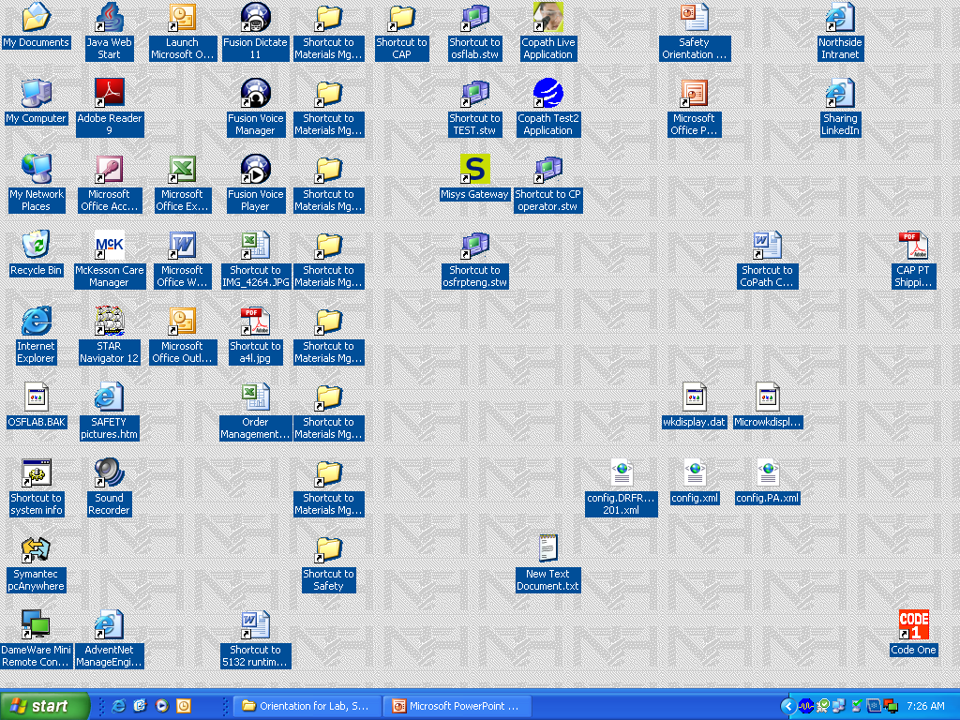
CODE ONE-
Immediate Security Assistance Required
This icon appears on computer terminals throughout the hospital. It is a silent alarm that security responds to.
Only click it if there is a need for IMMEDIATE security assistance.

Slide 18
CODE GREEN-
Mass Casualty Event
Refers to a multiple casualty event off-site that will cause an influx of patients (victims) and visitors
Respond according to Department Response Plan. [In the Lab, at least 1 LTA (2 LTAs if more than two are present) will be sent to the ER to stand-by for collections; other Lab staff will proceed as usual adjusting as needed to workload]
Transfusion Services will do an inventory of available blood product and alert Management & Pathologists. An inventory of the morgue should be done and alert Management & Pathologists of space available.
NHF participates in a metro-wide drills that tests response system

Slide 19
Code Brown
Evacuation
Laboratory has 3 levels of evacuation:
Level 1: Partial lab evacuation on campus
Level 2: Full lab evacuation on campus
Level 3: Full lab evacuation off campus

Slide 20
Code GREY: Tornado
TORNADO WATCH:
  Laboratory staff DO NOT have to evacuate.
  TORNADO WARNING:
  Laboratory staff MUST evacuate. Lab staff are to shelter in the hospital hallway away from windows and doors to the outside. Talking & noise should be kept to a minimum so not to cause disruption or confusion.

Slide 21
Disaster Plan
To obtain supplies, equipment, etc. during a disaster, refer to the Laboratory’s Emergency Plan: Fire & Codes located in Lucidoc/ Laboratory System-wide/Safety-Laboratory Incident Command Center:
  Primary---ED Conference Room 43520
  Secondary ---Administration Conference Room
  43401

Slide 22
Lab Bioterrorism Plan
Bioterrorism is defined as “the intentional use of microorganisms or toxins derived from living organisms to produce death or disease in humans, animals, or plants.”
The Laboratory Bioterrorism Readiness Plan is in compliance with the hospital wide Biological Response Plan.
This plan is found in Lucidoc--Laboratory Safety Manual and details the lab’s role in the event of a bioterroristic act.

Slide 23
Additional CODE Points
Code BLUE: Does not apply only to cardiac incident; also applies to any medical emergency
Code WHITE: When Winter weather advisories are issued, staff may need to be picked up if appropriate to staff departments and the staff may need to be prepared to stay over at the hospital to help w/ staffing needs
Code Silver: Active Shooter. Our primary response is to “shelter in place.” Barricade if appropriate & stay low to ground if possible. Do not use a phone to notify Security if shooter is possibly within ear-shot & can over hear you; wait for them to leave the area before calling Security w/ last known location.
No other codes will be activated during Code Silver.
Wait for “All Clear” to be announced.

Slide 24
Additional CODE Points
Code DRY: When the regular water system is no longer available, patient needs are assessed and drinking water is obtained for both patients and departments. Long term needs are determined & addressed. If the main line or any source line that serves the hospital is cut, the hospital can lose H2O. During Code Dry, do not use plumbed eye wash stations. Engineering & Security are to be notified of suspected Code Dry immediately & will make the determination to implement.
Code YELLOW: Patient goes through a decontamination process and the Laboratory should not receive radiation exposed blood samples.
Code Purple: Activated when there is high suspicion that a patient is missing that has been deemed dangerous to self/others or who has been assessed as risk for wandering from the clinical setting

Slide 25
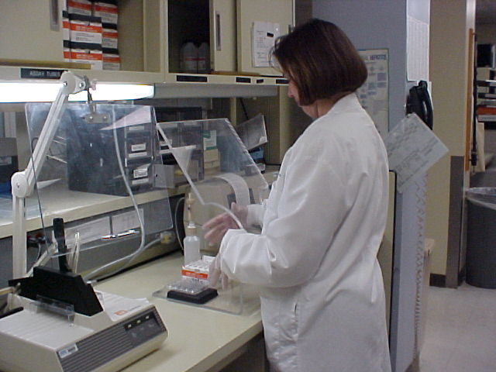
Personal Protective Equipment P.P.E.’s
Gloves
  Powder-free latex or latex-free gloves, Synthetic & Nitrile are available
  Change gloves in front of patients
  Only lotions approved for use w/ gloves are the ones provided by the hospital
  Available in Lab & on LTA trays
  Cut-resistant gloves are available in Pathology & Cryostat location
  Cold resistant gloves are available
  Eye Protection
  Goggles, safety glasses
  Safety Shields
Lab Coat
  Lab supplied lab coat is for use within the lab & stored in storeroom.
  Protection from biohazardous material
  Must be fluid resistant
Safety Needles & Devices
  Used to assist in preventing needle sticks
  Located with LTA supplies
Masks
  N-95 mask are CDC approved mask used by staff for patients w/ suspected TB & should be located on isolation cart when required.

Slide 26
Where Can I Wear My Lab Coat?
To be worn only in the Laboratory*(see next slide) & must be buttoned.
If you have worn a lab coat in the laboratory, it is considered contaminated. Please, take it off when leaving the laboratory.
Do NOT wear your lab coat:
  Walking to the parking deck
  To the cafeteria/gift shop
  To the any area designated as “Clean Room”
  To the restroom
  Into the break room
  Anywhere outside the Laboratory

Slide 27
Where Can I Wear My Lab Coat?
  *LTA staff may wear a lab coat up to the floor to collect blood and lab coat should be buttoned.*
  *Bone marrow collectors need to don a clean coat before leaving the lab and lab coat should be buttoned.*
  *Histology may wear lab coats when picking up specimens & lab coat should be buttoned.*

Slide 28
Gloves & Latex Allergy
Northside Hospital is primarily latex free.
Latex allergy is a reaction to certain protein in latex rubber. These proteins can attach to powder used in some gloves. Protein/powder particles can become airborne and be inhaled.
Symptoms of latex allergy: skin rash; hives; flushing; itching; nasal, eye, or sinus symptoms; asthma; and rarely shock.
Contact Employee Health if you suspect you have a latex sensitivity/allergy.
During patient contact, use hypoallergenic gloves when indicated by patient or health care provider history.

Slide 29
Hand Washing & Glove Removal
Wet hands
Apply soap (hospital approved antimicrobial soap)
Apply friction for 15 seconds
Rinse hands
Dry hands
Turn off faucet with paper towel

Slide 30
Glove Use & Care
Glove fit and size: Use the properly fitting gloves that gives you the needed dexterity.
Your hands should be clean before using gloves.
Replace gloves immediately if they have cuts, tears, holes, defects or become contaminated.

Slide 31
Glove Use & Care
Do not wash or disinfect gloves for reuse.
Remove gloves by turning one glove inside out as you remove it, placing it in remaining gloved hand & then peeling 2nd glove off inside out over the first removed glove.
Decontaminate hands after glove removal using an effective antimicrobial method.

Slide 33
Biological Exposure Plan
Located in the Laboratory System-wide Safety Manual in Lucidoc
Tasks Exposure Plan determines what type of PPE’s and precautions are to be in place based on what task is being performed (i.e. phlebotomy, specimen processing, tissue cutting, etc.)
Standard Precautions are to be used for every patient

Slide 34
Biological Exposure Plan
STANDARD PRECAUTIONS: An approach to Infection Prevention in which all human blood and certain human body fluids are treated as if known to be infectious for HIV, HBV, and other Blood Borne pathogens.
ISOLATION: If a patient is on isolation or requires special precautions, approved signage will be placed on the patient’s room door

Slide 35
Additional Biological Safety Issues for the Laboratory
OSHA requires that the hospital & the Lab post “Right to Know” posters in appropriate locations. The NHF lab poster is on the safety board.
NO EATING or DRINKING in the LAB except in designated areas (break room)!!!
Food & drink removed from the cafeteria must be covered.
DO NOT PUT MAKE-UP on in the LAB!!!
There are designated hand washing sinks & non-hand washing sinks.

Slide 36
Additional Biological Safety Issues for the Laboratory
The HEPATITIS VACCINE is available to all hospital employees at no charge through Employee Health Office
N95 is the TB exposure control mask
RED BAGS are to be used for contaminated (biological) waste needs.
Sharp Containers should never be more than 3/4 full

Slide 37
What do I do when I have an EXPOSURE to blood or other body fluid?
At Northside Hospital-Forsyth,all employee exposures are reported to the House Coordinator & your supervisor.
The House Coordinator will initiate management of the exposure & determine if employee needs to go to Emergency Department.
Employees will be evaluated to type & extent of exposure and if the source patient is known, source patient will be evaluated for any applicable testing that may be needed. Rapid HIV testing is available in NSH Lab.
If employee needs testing, EHO will perform.
All staff MUST complete an INCIDENT report whenever there is an exposure, fall or job related injury.

Slide 38
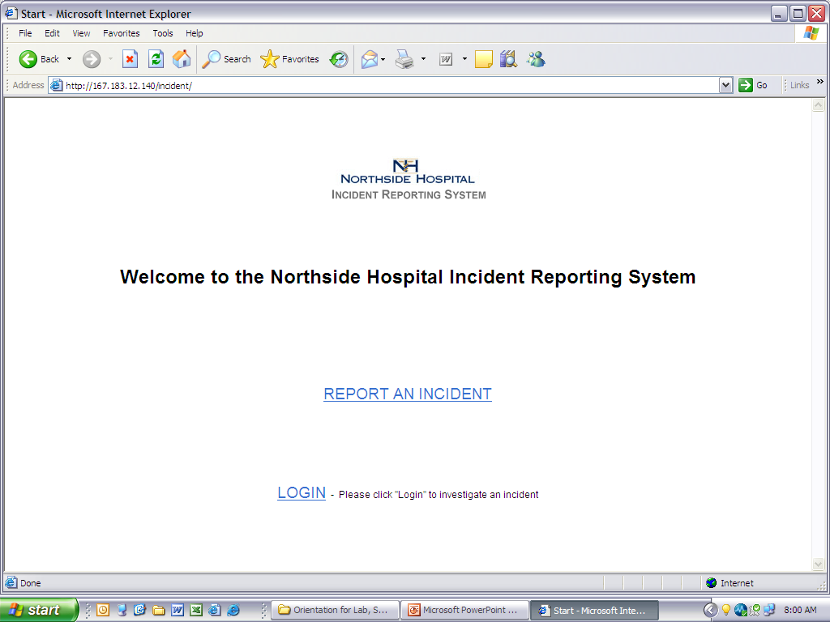
INCIDENT REPORTING SYSTEM
All incidents are reported via the Online Incident Reporting system on the Northside Intranet found under “Applications” tab. Use this application to report all Patient, Employee, Visitor and SMDA related incidents.

Slide 39
Safe Medical Device Act-SMDA
In compliance with the Safe Medical Devices Act of 1990, it is the policy of Northside Hospital to report all deaths, serious illnesses, or injury to the Food and Drug Administration (FDA) and/or the manufacturer that are sustained by a patient at Northside Hospital and were or may have been caused or contributed to by a medical device. Any equipment involved in an incident resulting in possible harm/injury to a patient should be removed from service immediately & not used again until cleared by Biomedical Engineering. Any SMDA incident requires completion of an incident report.

Slide 40
Chemical Hygiene Plan-
Important Points
Safety Data Sheets-SDS (Previously known as Material Safety Data Sheets)-
  SDS contain product names, product #, manufacturer information, safety information related to health, flammability, reactivity or special warnings. Exposure warnings and treatment instructions are also found in MSDS.
  SDS contain information how to store, handle, transport and hazards associated with a chemical.
  There is a chemical inventory list and a carcinogen/mutagen/ teratogen/reproductive effects list. These lists are kept either within the NSH SDS online application or in a separate chemical inventory binder.
  SDS are available 24 hours a day, 7 days a week by calling MSDSonline. Staff may also call 888-362-7416 for emergency contact or routine questions.
  Also available on the NSA Intranet under Information Resources /Safety Data Sheets.
  Annually all employees should document that they’ve been made aware of the list of chemicals w/in the Laboratory that are designated as having carcinogen/mutagen/teratogen/reproductive effects.

Slide 41
CHEMICAL LABELING-
NFPA HAZARD CODES
RED warning refers to FLAMMABILITY
YELLOW warning refers to REACTIVITY / INSTABILITY of reagent/chemical
BLUE warning refers to HEALTH risk associated w/ chemical
WHITE warning refers to SPECIAL WARNINGS and will be specified in white area of the label such as oxidizing, radioactive, moisture/water hazard
Red, Yellow and Blue warnings are rated from 0-4 with 0 being no risks to 4 being associated with high risk.

Slide 42
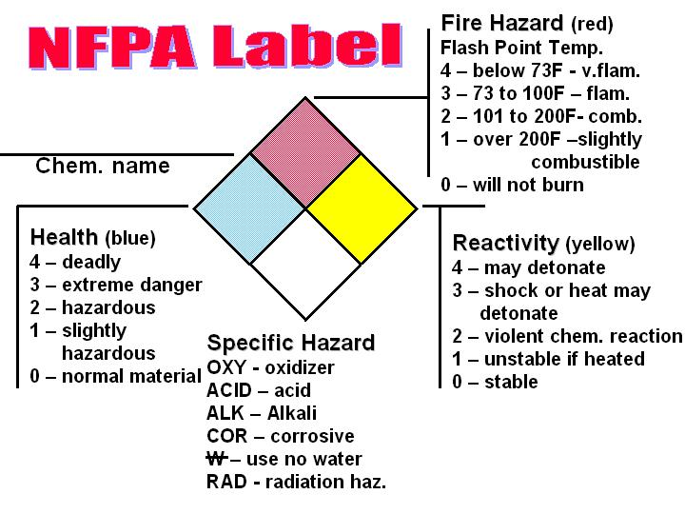

Slide 43
Hazard Communication Standard Pictogram
OSHA Requirements as of 6/1/2015
Effective 6/1/2015 OSHA required that the Hazard Communication Standard (HCS) use pictograms on labels to alert users of the chemical hazards associated with chemicals that they may be exposed to. Each pictogram consists of a symbol on a white background framed within a red border and represents a distinct hazard(s). The chemical hazard classification determines which pictogram(s) are used.
The next slide shows all of the Pictograms that are required as of 6/1/2015. Only the “Environment” pictogram is non-mandatory.
For more information contact OSHA at:
  www.osha.gov or
  Call 800-321-OSHA (6742)

Slide 45
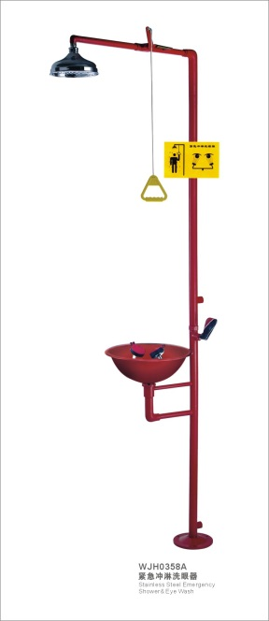
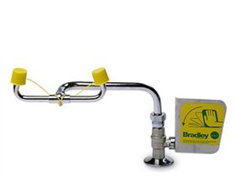
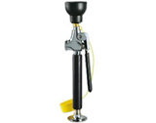
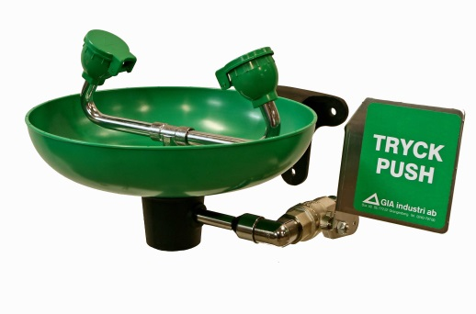
Eye Wash/Safety Shower:
In NHF Laboratory a safety shower and eyewash is located in the front of laboratory near the front door. Another safety eyewash is located in the rear of the lab between Histology and Chemistry.

Slide 46
SPILL RESPONSE
There are two major types of spills that are found in hospitals:
  Chemical: Determine if chemical spill is acid, caustic, flammable, formaldehyde (formalin) or mercury and use appropriate spill kit
  Biological: If the spill is blood, urine or other body fluid it may cleaned up w/ diluted bleach or if large use “Universal Absorbent” (kitty litter) to dam up the spill and call Environmental Services
  Northside Hospital-Forsyth Spill Responsibilities:
    Formalin Spills: All Formalin spills are the responsibility of Laboratory staff
    Biological Spills: Are the responsibility of the department they occur in
    Chemo Spills: Are the responsibility of Pharmacy
    Radioactive Spills: Are the responsibility of Radiology
    Gas Issues: Responsibility of Engineering & Respiratory Therapy

Slide 47
Additional Chemical Issues
There are very few bases in the Lab but if present, they are stored separately in the corrosives cabinet.
Oxidizers, if present, must also be stored away from other chemicals.
In the Histology Lab at NSH, formalin is neutralized prior to being discarded.
Formalin and Xylene exposure are monitored on Histology/Cytology staff by use of “Exposure Tags”
Formalin Spill kits are stored in those areas where formalin is used such as Histology area, Histology Storage area and Histology waste solution room on the loading dock. NOTE: 10% formalin will not solidify when using “kitty litter” on it due to the H20 content.
Staff working with Pathology specimens are required to complete annual formaldehyde exposure questionnaire & safety training.

Slide 48
Additional Chemical/Safety Issues
In NHF Laboratory the Biological Safety Cabinet/Hood is located in Microbiology section of the Laboratory.
Flammable Storage Cabinets are located in the Histology and the Hematology departments.
Safety Bulbs for pipetting are available in technical areas.
Acid Cabinet is located in the cabinet under the front drop off counter.
Safety Step Stool is available in the Laboratory & should be used when access to upper cabinets, etc. is needed.
If an employee has a chemical exposure, they should seek treatment if indicated and complete and incident report.
Employees should be familiar with approved disinfectants & how to properly use them to decontaminate work areas or equipment as well as how to prepare them if applicable.

Slide 49
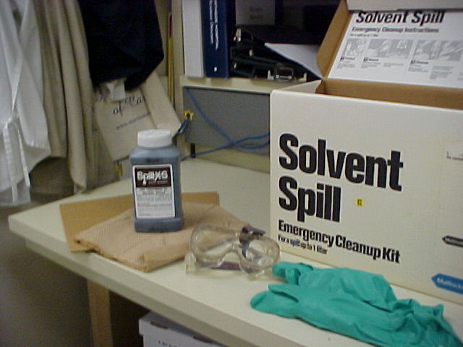
SPILL KITS & CLEAN-UP
Spill kits are located near the back emergency exit behind the Chemistry section. Formalin kits are located in histology & in the areas where formalin is used.
Sections may have their own “Spill Kit” so that kit is located at point of use
Determine if spill is CHEMICAL or BIOLOGICAL
If chemical, determine correct SPILL KIT to use and if spill is too large, call 54321 for emergency response.
If biological, determine if spill is small, large and/or requires Environmental Services to respond or if “kitty litter” needs to be used.

Slide 50
CHEMICAL SPILL CLEAN UP PROCEDURE
For small spills choose correct kit, dam the material, scoop the muddy residue, dispose in red bag
Use Aldex Spray to help disperse formalin vapors/smell if applicable to formalin spill
For LARGE spills, activate SPILL TEAM & remember to
  Contain the spill; dam material if needed
  Leave the area
  Emergency treatment (eye wash, shower, etc.)
  Access the SDS
  Notify the supervisor
  Fill out an incident report.

Slide 51
ELECTRICAL SAFETY ISSUES
RED plugs indicate emergency power.
Tan plugs are not on emergency power.
The Electrical panel for the Lab are located in Histology across from the Flammable cabinet. It requires Engineering assistance if there is an electrical issue in the Laboratory.
When working on any printers or equipment, always turn off the power and never use metal tools with the power still on .
If you experience an electrical shock, seek treatment if required in EHO or Emergency Department. Complete incident report and remove equipment from service until checked out by BME.

Slide 52
LIQUID NITROGEN SAFETY PRECAUTIONS
Note: NHF Laboratory Does Not Use LN₂
Liquid Nitrogen is in use in both the Hematopoietic Stem Cell Lab (BMT Lab-NHA) and in the Histology/Cytology Lab sections.
LN₂ is colorless & odorless w/ extremely wide temperature range. At room temperature & pressure it is a non-flammable gas. At temperatures below -195.8°C, nitrogen is in a liquid state which can be used as a cryogenic liquid for freezing & storing certain tissues & cells.
Inexperienced staff need to be supervised while using LN_{2.} Training of staff & precautions must be documented
LN₂ can cause frostbite to the skin and face. Face shield or goggles and cryogloves should be worn when using LN₂ . Do not wear open-toed shoes or sandals around LN₂ or in the Lab at all as a safety precaution.
Never have LN₂ in a closed system where it may vaporize quickly at room temperature and can cause explosive rupture
Only use solid, non-conducting material such as wood or plastic when measuring storage chamber.
Do not bang on valve to open or close by hitting a stuck valve. Call for someone stronger or contact provider.
Refer to procedure for spill response and exposure precautions & treatment.

Slide 53
DRY ICE SAFETY PRECAUTIONS
Always wear protective gloves when handling dry ice.
Gaseous CO₂ vapors can cause suffocation
Never dump dry ice down any plumbed area such as a sink or toilet. Dry ice should not be disposed of in septic tanks or sewers. Instead, allow the ice to sublimate in a well-ventilated area.
When sealing up a shipping container with dry ice, do not completely seal the entire perimeter of the lid with tape; secure the lid with a vertical strip on 4 sides. The dry ice vapors need to “breathe” and escape the box otherwise a risk for the box to explode from the vapors exists.

Slide 54
Medical Gas Zone Valve
There is no Medical Gas Zone Valve in the NHF Laboratory .
Those authorized to turn it off are:
  F: Fire Marshall
  R: Respiratory Therapy
  E: Engineering
  S: Safety Officer for the Hospital
  H: House Coordinator

Slide 55
TRANSPORT OF SPECIMENS
All blood specimens and nurse collect specimens should be transported to the Lab in “zip-lock type bag” whenever possible even if sent via the “Pneumatic Tube System”
All surgical and cytology samples need to be sent in appropriate containers and transport media
All specimens should be sent to the Lab with patient’s name, MRN, account # (Histology), date/time of collection, tech code/initials/name of person collecting and the collection site if tissue or culture on the container w/ correct orders
DO NOT SEND SAMPLES THRU THE TUBE SYSTEM IF THEY CANNOT BE READILY RECOLLECTED IF LOST!!!
Do not send any tissue, cytology, CSF, joint fluids, amniotic fluids, body fluids, etc. via the pneumatic tube system.
Blood and urine may be sent via the tube system.
Do not overfill the pneumatic tube or place more than 2 blood culture bottles in a tube at a time. Latches must be secured.

Slide 56
Shipping Infectious/Biological Specimens
All staff who are responsible for shipping/ mailing specimens must have training a minimum of once every 3 years & training must be documented in employee file.
There are USDOT, ICAO & USPS regulations that regulate the shipping of infectious & biological agents/specimens.
Shipper’s are responsible for all aspects of specimen packaging including correct container & proper labeling, documentation including that all spelling is correct & employee training.
The UN has designated 9 classes of hazardous materials & Lab related falls under class 6.2 & 9.
Most of the items that NHF Lab would ship fall into Category B-Infectious Substances (Biologicals) that would not cause permanent disability or be considered life-threatening.

Slide 57
Equipment & Instrument
Inspections & Service
All equipment & instrumentation must be checked prior to being placed into active use by Biomedical Engineering (BME).
BME can service certain equipment & instrumentation but some testing instrumentation such as a Chemistry or Hematology analyzer may have a service contract with the manufacturer & service engineers from the company will service the analyzer.
BME is required to inspect all equipment & analyzers periodically and a BME sticker must be placed indicating the frequency of the inspection and the date of the last inspection. Examples: A “6” on the sticker indicates inspections required every 6 months; a “12” indicated annual inspection; an “X” indicates no inspection required.

Slide 58
ERGONOMIC PROGRAM
Ergonomics refers to the identification of physical work activities or conditions of the job commonly associated with work related musculoskeletal disorders (MSD) & recommendations to eliminate these hazards.
Ergonomics addresses the proper way to sit or stand at a workstation, repetitive motions. & the need to periodically stand & stretch.
Management & employees need to be actively involved in the ergonomic process.
Employees are required to complete the Body Mechanics CBL annually & should be familiar with the Laboratory’s Ergonomic policy.
Laboratory activities, workplace & equipment (chairs, workstations, computer keyboards & displays) should be designed to reduce the risks of ergonomic distress disorders & accidents.

Slide 59
Additional Safety Issues
If a visitor falls on hospital grounds, offer assistance, offer ED visit, but if person refuses try to have a 2nd witness to the refusal. Never offer any statement to the person as to responsibility or payment. Notify supervisor or management. Complete an incident report. If the person is unconscious, get immediate emergency assistance.
Always keep work area clean & clutter free. Keep aisles & corridors free of clutter and do not block exit routes or doors.
Always keep Protected Health Information (PHI) secure and out of view of visitors & patients. Follow all HIPAA guidelines in protecting patient information. Log out of computer programs when not in use and turn computer monitors away from public view.
Access to all hospital systems is password protected.
C-doc bins are used to dispose of all PHI.

Slide 60

SAFETY IS IMPORTANT
Safety is everyone’s responsibility
Complete annual requirements for safety
Stay familiar with procedures
Ask questions if needed
STAY SAFE

Slide 61
WALK THROUGH TOUR of LABORATORY

