Slide 1
POC Fecal Occult Blood Testing Using the Hemoccult SENSA®

Slide 2
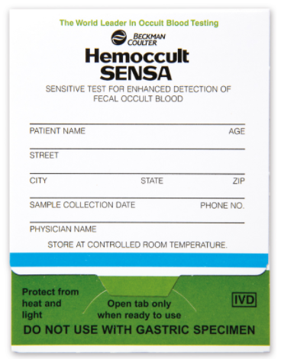
Rationale
The intended use of the Hemoccult SENSA test is a rapid, qualitative method to detect fecal occult blood which may be indicative of gastrointestinal disease.
Note: It is not a test for colorectal cancer or any other specific diseases.
Results cannot be considered conclusive evidence of the presence or absence of gastrointestinal bleeding or pathology.
This test is intended for preliminary screening as an aid to diagnosis and not intended to replace other diagnostic procedures.
This test is defined as waived under CLIA regulations.

Slide 3
Test Principle
The Hemoccult SENSA test is based on the oxidation of guaiac by hydrogen peroxide to a blue-colored compound.
If present in the fecal specimen, the heme portion of hemoglobin has peroxidase activity that catalyzes the oxidation of alpha guiaconic acid (the active component of the guaiac paper) by hydrogen peroxide (an active component of the developer) for form a highly conjugated blue quinone compound.

Slide 4
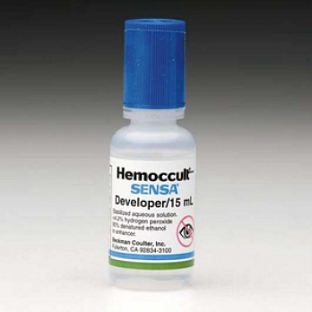
Reagents & Supplies
Hemoccult SENSA® Test Cards and Developer
Store test cards and developer at room temperature
Do not freeze or refrigerate.
Protect from heat and light.
Do not store with volatile chemicals.
Test cards and developer are stable until the manufacturer’s printed expiration date.
Notes:
Hemoccult SENSA developer is an irritant and flammable.
Avoid contact with skin and eyes.
Use Hemoccult SENSA developer only with Hemoccult SENSA test cards.
Do not interchange with other Hemoccult test reagents or components from any other manufacturer.
Test Card
Developer Bottle

Slide 5
Reagents & Supplies Continued
Applicator Sticks
Gloves
Test Card
Developer Bottle

Slide 6
Safety and Verifying Patient ID
All patient specimens should be considered potentially infectious. Wear personal protective equipment (PPE), such as gloves, fluid resistant lab coats, etc. during patient testing.
Prior to obtaining samples for point of care testing, the patient should be appropriately identified using the patient’s wristband or registration label.
Use 2 identifiers to verify patient ID, such as name, medical record number (MRN) or date of birth.

Slide 7
Patient Preparation
Patients should follow the Patient Instructions at least 7 days prior to and continuing through the test period.
Patients should be carefully instructed to not ingest foods and vitamins which can cause false-positive or false-negative test results for at least 72 hours before and through the test period.
Note: Do not collect specimens during or until 3 days after menstrual period or while having bleeding hemorrhoids or blood in urine.
Eat a well balanced diet, with the following exceptions:
Avoid:
7 days prior and during testing:
No more than one adult aspirin (325 mg) a day
No other non-steroidal anti-inflammatory drugs such as ibuprofen (Motrin, Advil).
3 days prior and during testing:
No red meat (beef, lamb or liver)
No more than 250 mg vitamin C from supplements, and citrus fruits and juices.

Slide 8
Procedure
Specimen Type, Collection & Handling Criteria
Specimen Type
Stool
Specimen Collection
The Hemoccult SENSA test requires only a small amount of fecal specimen.
If the specimen is to leave the patient’s immediate area, the specimen must be labeled with the patient’s name, MRN and the date & time of collection.
Do not collect a sample if blood is visible in the stool or urine (e.g. menstruation, active hemorrhoids, urinary tract infection).
Specimen Processing
The specimen is applied to the guaiac paper of the Hemoccult SENSA test card as a thin smear using an applicator stick.
2 different sections of fecal specimen should be used during testing.
Specimen Rejection Criteria
Any specimen not properly labeled with 2 patient identifiers.
Any stool specimen contaminated with toilet water.
Stool smeared slides greater than 14 days following sample application.
Any specimen other than stool (e.g. gastric specimen).

Slide 9
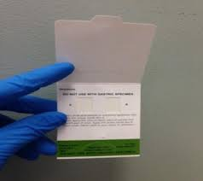
Patient Testing
Label the Hemoccult SENSA test card with the patient’s name, medical record number and/or date of birth and sample collection date & time.
Open the Hemoccult SENSA test card flap so both specimen windows are visible.

Slide 10
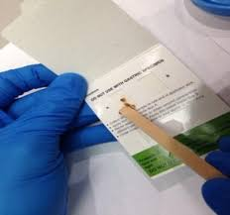
Patient Testing
Apply the specimen to the test windows:
Using an applicator stick, apply a very thin smear of stool covering Box A.
Reuse the applicator to obtain a second sample from a different part of the stool sample.
Apply a very thing smear of stool covering Box B.
Close the cover of the test card.

Slide 11
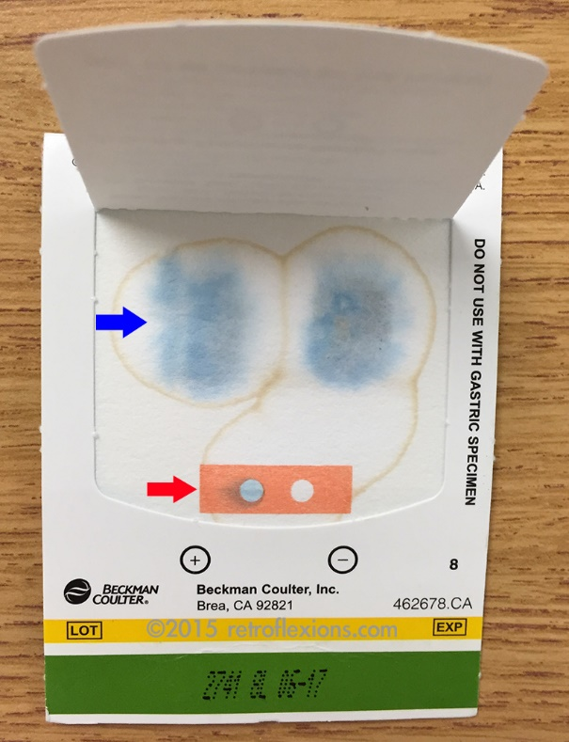
Patient Testing
Wait 3 to 5 minutes before developing.
Flip the test card over and open the back flap.
Apply 2 drops of Hemoccult SENSA developer to the guaiac paper directly over each smear.
Read and interpret the patient test results within 60 seconds.
Apply 1 drop of Hemoccult SENSA developer to the performance monitor area (internal controls).
Verify the internal controls performed as expected.
Dispose of all testing materials into an appropriate biohazard container.

Slide 12
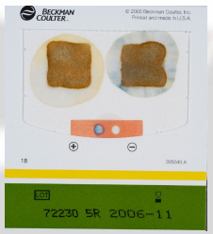
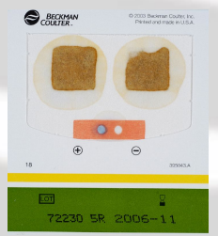
Results
Interpretation
Positive
Any shade of blue color in either of the patient test areas. Any trace of blue on or at the edge of the smear is considered positive for occult blood.
Negative
No detectable blue color in either of the patient test areas.
Note: Some specimens have a high bile content, which can cause feces to appear green. A distinct green color (no blue) appearing on or at the edge of the smear within 60 seconds after adding Hemoccult SENSA developer should be interpreted as negative for occult blood.

Slide 13
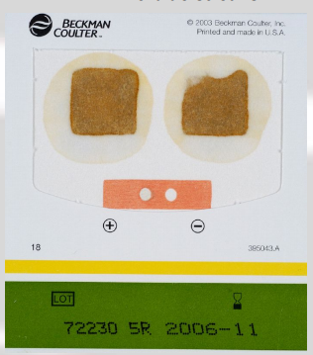
Results
Interpretation
Invalid
If the performance monitor area results (internal controls) are unacceptable, the patient test result is considered invalid.

Slide 14
Recording & Reporting Results
Per federal regulatory requirements, providers and clinic staff are required to order and enter results in Epic for non-interfaced point of care testing that is performed.
A POCT guaiac fecal occult blood test order should be placed in Epic.
The result should then be entered into the patient’s electronic medical record through Enter/Edit.
Refer to the Epic@UNC Training Tip Sheet for instructions on how to document the result.
Test Name | Epic Code
POC Guaiac Fecal Occult Blood Test (FOBT) x1 | POC13

Slide 15
Limitations
Bowel lesions, including some polyps and colorectal cancers, may not bleed at all or may bleed intermittently. Blood, if present, may not be distributed uniformly in the fecal specimen. Therefore, a test result may be negative even when disease is present.
A test result may be positive on specimens from healthy patients. This may be due to interfering substances in the diet or to medications. It may also be due to low but detectable levels of blood loss, common to both health adults and patients with gastrointestinal disease.
Results cannot be considered conclusive evidence of the present or absence of gastrointestinal bleeding or pathology. The Hemoccult SENSA test is designed for preliminary screening as an aid to diagnosis. It is not intended to replace other diagnostic procedures, such as sigmoidoscopy, colonoscopy, barium enema, or other x-ray studies.

Slide 16
Limitations
The Hemoccult SENSA test should not be used to test gastric specimens. Interfering factors, such as low pH, high drug concentrations, metal ions or plant peroxidase in food, may affect the function of guaiac-based occult blood tests.
Addition of a drop of water (rehydration) to the guaiac test card prior to the addition of the developer increases the number of false-positive test results. Rehydration is not a recommended procedure for the Hemoccult SENSA test.
Refer to the policy or manufacturer’s package insert for a full list of interfering substances (i.e. false positive and false negative test results.

Slide 17
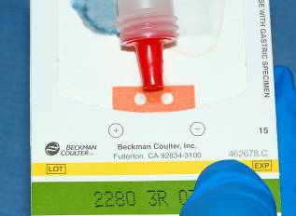
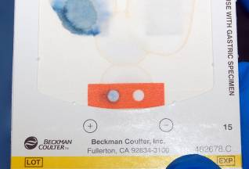
Quality Control
Internal performance monitor checks (internal positive and negative controls) must be performed with each Hemoccult SENSA test card to ensure the quality of patient test results.
Note: Do not apply developer to the performance monitor area before interpreting the patient test area.
Locate the performance monitor area on the Hemoccult SENSA test card, below the sample windows on the developing side of the card.
Apply one drop of the Hemoccult SENSA developer between the positive and negative performance monitor area.
Read the results within 10 seconds of applying the developer.

Slide 18
Quality Control
Acceptable
The positive control in the performance monitor area should be blue in color.
The negative control in the performance monitor area should have no blue color.
Unacceptable
If the performance monitor area (internal controls) results are unacceptable, the patient results are invalid and should not be reported.
Check the expiration dates of all reagents and repeat the test with a new card and developer bottle.
Note: Neither the intensity nor the shade of blue in the performance monitor area should be used as a reference for the appearance of positive patient test results.

Slide 19
Color Perception Assessment
Interpretation of Hemoccult® SENSA test results may be affected by poor color vision.
Up to 10% males and 0.4% females may be color deficient to some degree.
If you have not done so already, have your color vision checked if you perform point of care tests or other tasks that require color discrimination.
There is a color perception assessment available on LMS.
Search the Learning Activities for the following code:
UNCHPOCCLR

Slide 20
Training & Competency Requirements
Prior to performing patient testing, providers and clinic staff are required to complete this module to satisfy federal requirements for initial training.
Those who perform waived testing must be trained for each test that they are authorized to perform. The training for each waived test is documented.
Competency for waived testing is assessed annually using the following methods per person:
Monitoring of each user’s quality control performance
Captured via reporting of the internal performance monitors on patient test results
Use of a written test specific to the test assessed
Assignment of an online module
Note: Performance of a test on a blind specimen OR periodic observation of routine work by the supervisor or qualified designee can also be used in place of the above methods, if needed.

