Slide 1
POC Fecal Occult Blood Testing Using the HemaPrompt FG

Slide 2
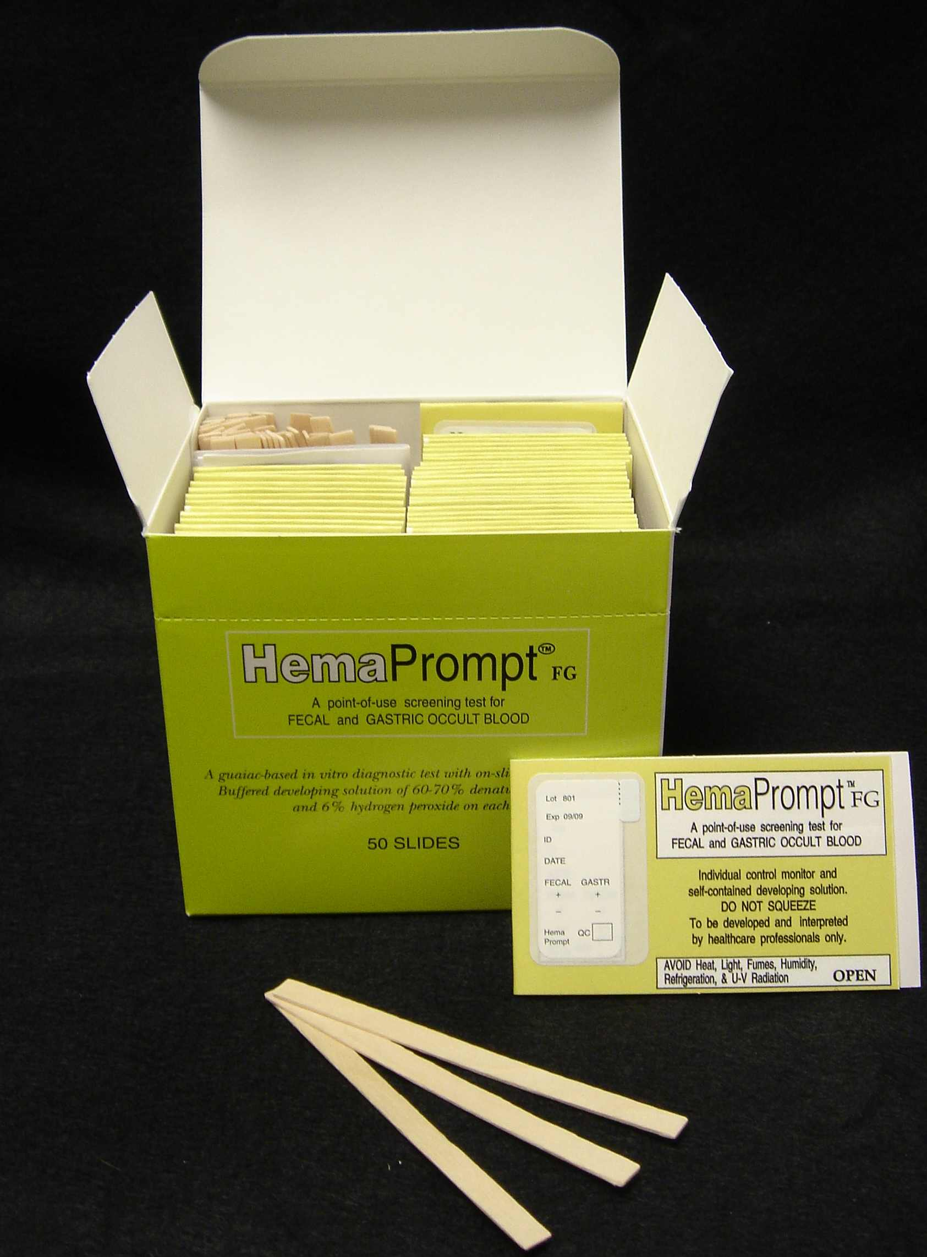
Rationale
The intended use of the HemaPrompt FG test is for the qualitative detection of occult blood in feces.
Note: The test is intended to be used as a preliminary indicator and not as a replacement for other diagnostic procedures.
This test is defined as waived under CLIA regulations.

Slide 3
Test Principle
The HemaPrompt FG test is based on the oxidation of phenolic compounds present in guaiac to quinones, resulting in the production of a blue color.
If blood is present in the fecal sample, the heme portion of the hemoglobin molecule can function in a pseudoenzymatic manner, catalyzing the release of oxygen from the hydrogen peroxide, which in turn causes the oxidation of guaiac.

Slide 4
Test Principle continued
HemaPrompt FG is composed of guaiac-impregnated paper mounted on a cardboard frame that permits sample applications to one side with development and interpretation from the reverse side.
The stool specimen containing occult blood contacts the guaiac-impregnated paper and a pseudo-peroxidase reaction occurs when developing solution is brought in contact with the guaiac paper, by pulling the tab.
Monitors on the guaiac side indicate if the chemicals are functioning properly.

Slide 5
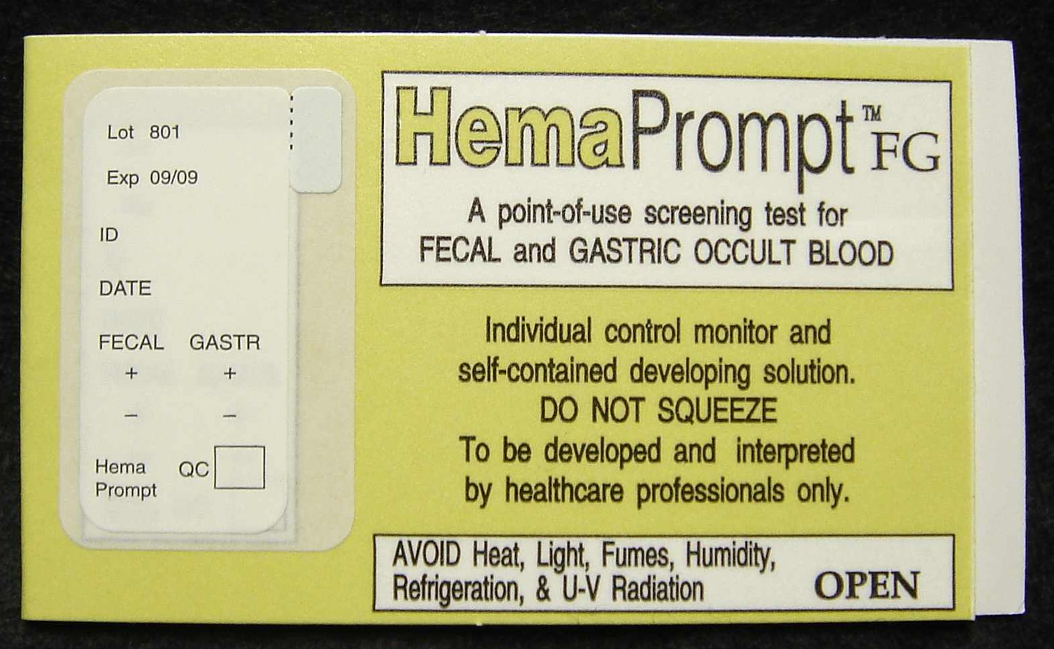
Reagents & Supplies
HemaPrompt FG Test Cards
Store test cards at room temperature.
Do not freeze or refrigerate.
Protect from heat, sunlight, fluorescent light, UV radiation, humidity, volatile chemicals and gases.
Test cards are stable until the manufacturer’s printed expiration date.
Discard test cards that exceed expiry.
Test Card
Developer Bottle

Slide 6
Reagents & Supplies continued
Each HemaPrompt FG test kit includes 50 test cards & applicator sticks per box.
Gloves
Test Card
Developer Bottle

Slide 7
Safety and Verifying Patient ID
All patient specimens should be considered potentially infectious. Wear personal protective equipment (PPE), such as gloves, fluid resistant lab coats, etc. during patient testing.
Prior to obtaining samples for point of care testing, the patient should be appropriately identified using the patient’s wristband or registration label.
Use 2 identifiers to verify patient ID, such as name, medical record number (MRN) or date of birth.

Slide 8
Patient Preparation
In the acute setting, no particular patient preparation will be possible.
For screening purposes, a special diet is recommended 2 days prior to and during the 3-day test period.
Exclude: red and rare meats, horseradish, raw fruits and vegetables (e.g. broccoli, cauliflower, red radish, cantaloupe, parsnips & turnips, or other high peroxidase containing vegetables)
An acceptable diet could include: cooked fruit and vegetables (e.g. spinach, corn, lettuce, prunes, grapes, apples), cereal, well-cooked fish and fowl
At the discretion of the physician, certain medications might be temporarily discontinued for 7 days prior to and during the test period.
Aspirin, indomethacin, phenylbutazone, reserpine, corticosteroids and nonsteroidal anti-inflammatory drugs
Dosages of greater than 250mg of vitamin C per day
Iron containing compounds

Slide 9
Procedure
Specimen Type, Collection & Handling Criteria
Specimen Type
Stool
Specimen Collection
In the acute setting, the specimen can be obtained by direct rectal exam.
It is recommended that smears be collected from 2 different area of each stool from 3 consecutive bowel movements as closely spaced in time as possible or by the physician following a rectal exam.
Using toilet paper, specimen can be taken from stool smeared on the bowl and above the toilet water level, from the toilet paper used following defecation, or from a specimen caught in a clean cup.
For screening purposes, samples should not be collected if the patient is experiencing menstrual bleeding, constipation bleeding, bleeding hemorrhoids, when rectal suppositories or medication is being used or if there are cuts on the hand.
If the specimen is to leave the patient’s immediate area, the specimen must be labeled with the patient’s name, MRN and the date & time of collection.

Slide 10
Procedure continued
Specimen Type, Collection & Handling Criteria
Specimen Processing
Application to the slide may be performed from the gloved finger (after rectal exam), applicator, or by use of toilet paper.
No more than 5 days should elapse between specimen application and testing.
Rehydration is neither necessary nor recommended for this time interval.
Specimen Rejection Criteria
Any specimen not properly labeled with 2 patient identifiers.
Any stool specimen contaminated with toilet water.
Stool smeared slides greater than 5 days following sample application.
Any specimen other than stool (e.g. gastric).

Slide 11
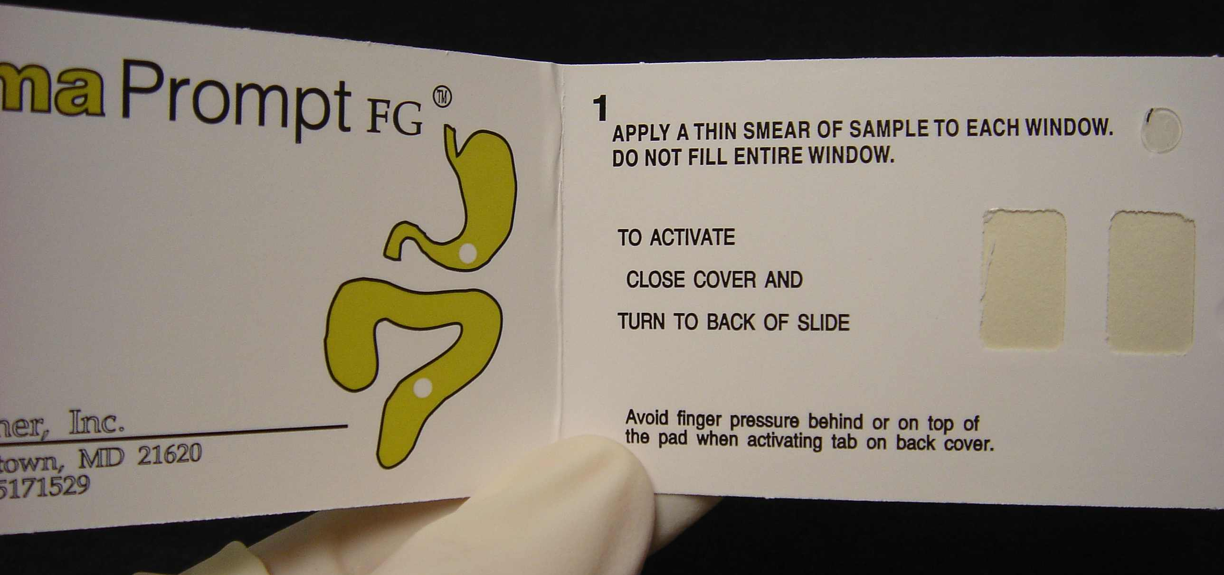
Patient Testing
Label the HemaPrompt FG test card with the patient’s name, medical record number and/or date of birth and sample collection date & time.
Open the HemaPrompt FG test card flap so both specimen windows are visible.

Slide 12
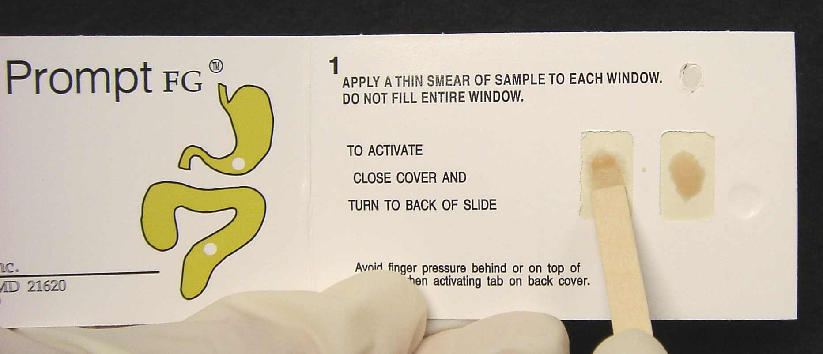
Patient Testing continued
Apply specimen to the test card windows:
Using an applicator stick provided in the HemaPrompt FG kit, apply a very thin smear of stool to the first window of the test card. Note: Do not completely cover the window. Leave an outer periphery of white for contrasting background color.
Repeat the process, applying a thin smear of stool to the second window of the test card in the same manner.
Close the cover of the test card. Note: Avoid applying finger pressure to the card.

Slide 13
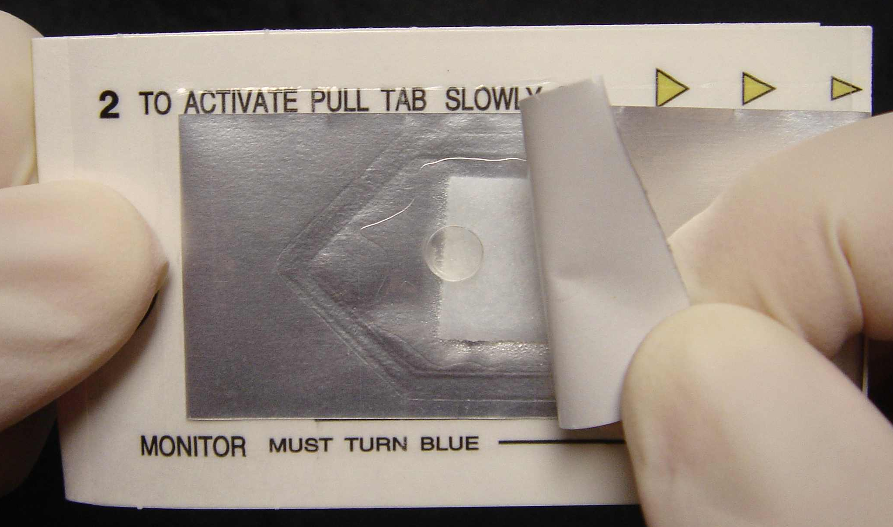
Patient Testing continued
Turn the card over to the back.
Hold the card with thumb & forefinger at “grip” indicator.
Using other hand, lift the silver tab up so the reagent pad is visible.
Grip here
Lift here

Slide 14
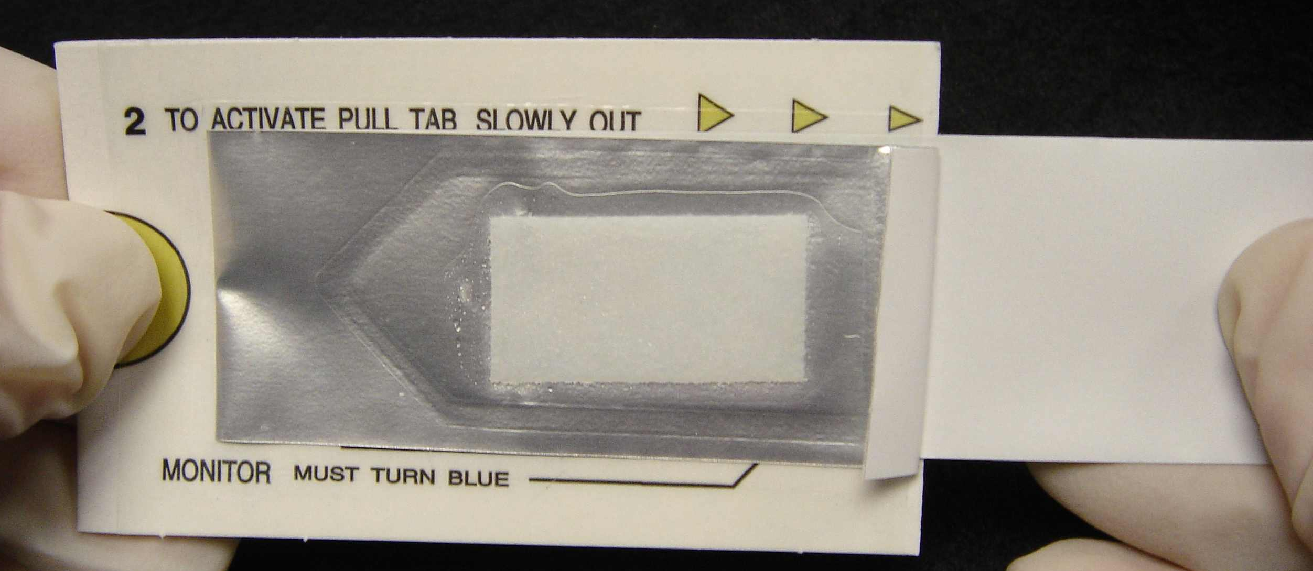
Patient Testing continued
Slowly & steadily pull the long silver tab all the way to the right and completely remove it from the test card. Note: The white reagent pad will flip over as the tab is pulled, covering the specimen with the developer solution.
Wait 1 minute after pulling the tab before interpreting the test result. Note: Interpret the result before 3 minutes.

Slide 15
Patient Testing continued
Verify that the internal procedural controls performed as expected.
Dispose of all testing materials in the appropriate biohazard container.

Slide 16
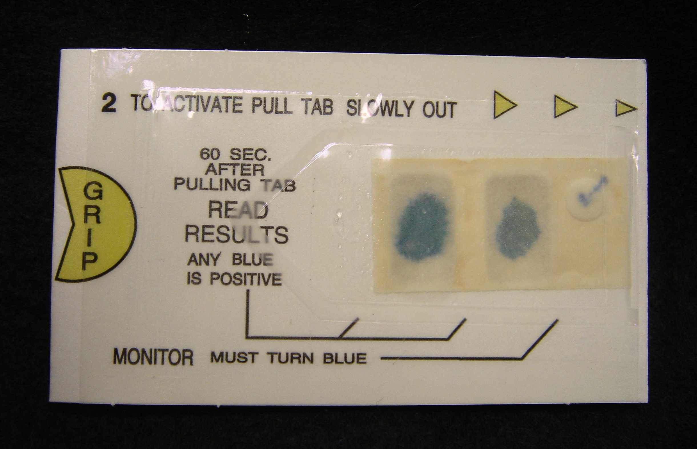
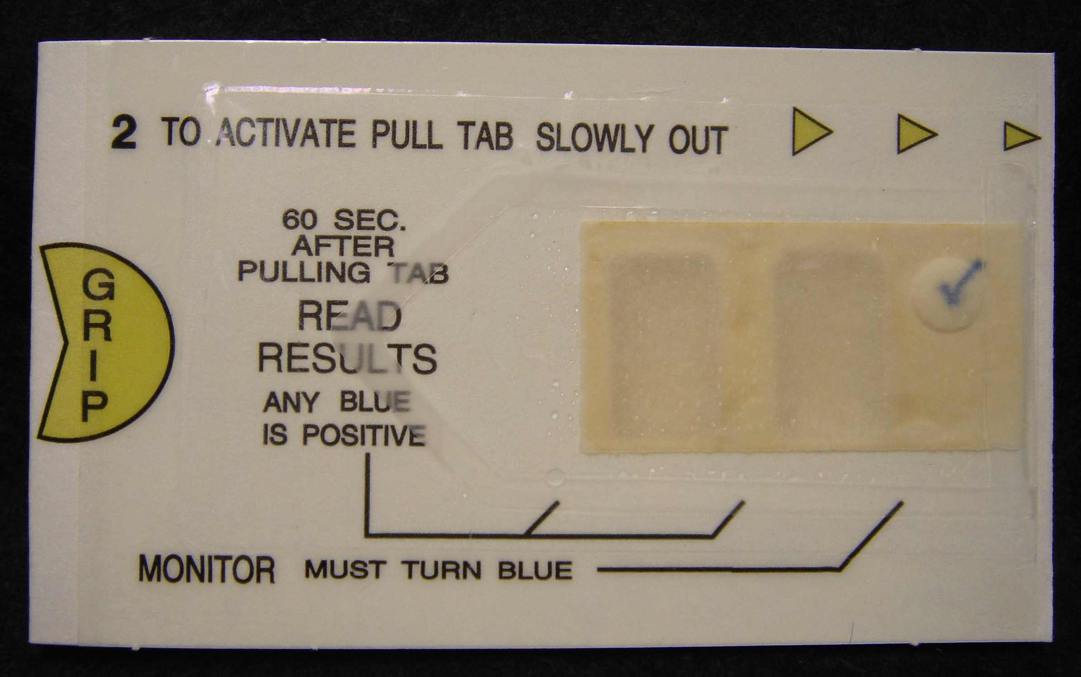
Results
Interpretation
Positive
Any shade of blue color in either or both specimen windows.
Negative
No detectable blue color in either window.

Slide 17
Results
Interpretation
Invalid
The positive and negative control monitors must give the acceptable results in order for patient results to be valid.
Do not report out patient results if controls do not function correctly.

Slide 18
Recording & Reporting Results
Per federal regulatory requirements, providers are required to order and enter results in Epic for non-interfaced point of care testing that is performed.
A POCT guaiac fecal occult blood test order should be placed in Epic.
The result should then be entered into the patient’s electronic medical record through Enter/Edit.
Refer to the Epic@UNC Training Tip Sheet for instructions on how to document the result.
Test Name | Epic Code
POC Guaiac Fecal Occult Blood Test (FOBT) x1 | POC13

Slide 19
Limitations
Gastro-intestinal cancers, adenomas and ulcerations do not always bleed.
Results cannot be considered conclusive evidence of the presence or absence of GI bleeding or pathology
False positive or negative reactions are known to occur under certain circumstances such as a person's diet or medication (see Patient Preparation).
Hydrating stool by adding distilled water may produce false positive results and is not recommended.
Stool samples should not be collected if the patient is experiencing menstrual bleeding, constipation bleeding, bleeding hemorrhoids or when rectal suppositories or medication is being used.
Blood if present, may not be distributed uniformly in the fecal specimen. Consequently, a test result may be negative even when disease is present.

Slide 20
Limitations
HemaPrompt FG test cards are designed for preliminary screening as an aid to diagnosis. They are not intended as a replacement for other diagnostic procedures. Further testing and examination by the physician need to be performed to determine the exact cause and source of the occult blood in the stool specimen.
HemaPrompt FG test results are to be read 1 minute after pulling the silver tab, but before 3 minutes. After 3 minutes, intensity of the blue color may decrease or fade, and possibly appear negative.
Refer to the policy or manufacturer’s package insert for a full list of interfering substances (i.e. false positive and false negative test results.

Slide 21
Quality Control
Internal procedural controls are built into each test card. These controls indicate that the test card is working properly after the developer has been added.
The controls must give acceptable results for patient test results to be considered valid.
Positive Control
The positive control appears as a blue checkmark on the far right side of the card after the developer has been added.
Negative Control
The negative control is the white background behind the blue checkmark. The background color should remain unchanged after the developer is added.

Slide 22
Color Perception Assessment
Interpretation of HemaPrompt FG test results may be affected by poor color vision.
Up to 10% males and 0.4% females may be color deficient to some degree.
If you have not done so already, have your color vision checked if you perform point of care tests or other tasks that require color discrimination.
There is a color perception assessment available on LMS.
Search the Learning Activities for the following code:
UNCHPOCCLR

Slide 23
Training & Competency Requirements
Prior to performing patient testing, providers are required to complete this module to satisfy federal requirements for initial training.
Those who perform waived testing must be trained for each test that they are authorized to perform. The training for each waived test is documented.
Competency for waived testing is assessed annually using the following methods per person:
Monitoring of each user’s quality control performance
Captured via reporting of the internal performance monitors on patient test results
Use of a written test specific to the test assessed
Assignment of an online module
Note: Performance of a test on a blind specimen OR periodic observation of routine work by the supervisor or qualified designee can also be used in place of the above methods, if needed.

