Slide 1
POC Nitrazine Test

Slide 2
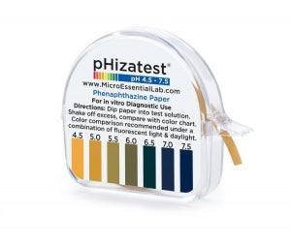
Rationale
Nitrazine (phenaphthazine) paper is used to measure the vaginal pH of expectant mothers.
Premature rupture of the membrane can result in small volumes of amniotic fluid leaking into the upper vagina.
Amniotic fluid has a neutral pH whereas the upper vagina pH is normally acidic.
Leakage of amniotic fluid into the upper vagina may elevate the pH and detection of this elevated pH using the nitrazine paper may assist in determining the presence or absence of amniotic fluid.

Slide 3
Test Principle
Nitrazine paper is impregnated with an indicator dye phenapthazine. The dye develops color (yellow, orange, green or blue) upon exposure to a fluid specimen, which correlates with the pH of the specimen.
This test is defined as waived under CLIA regulations.

Slide 4
Reagents & Supplies
Micro Essential Laboratory pHizatest Phenaphthazine paper
Should be stored at room temperature.
Keep out of direct light.
Stable until the manufacturer’s expiration date.
Discard expired paper.
Test Card
Developer Bottle

Slide 5
Reagents & Supplies Continued
Sterile swabs
Gloves
Test Card
Developer Bottle

Slide 6
Safety and Verifying Patient ID
All patient specimens should be considered potentially infectious. Wear personal protective equipment (PPE), such as gloves, fluid resistant lab coats, etc. during patient testing.
Prior to obtaining samples for point of care testing, the patient should be appropriately identified using the patient’s wristband or registration label.
Use 2 identifiers to verify patient ID, such as name, medical record number (MRN) or date of birth.

Slide 7
Procedure
Specimen Type, Collection & Handling Criteria
Specimen Type
Vaginal secretion
Specimen Collection
Remove a sterile swab from its protective sleeve.
Collect vaginal secretion with a sterile cotton swab from the upper vaginal tissue.
Specimen Rejection Criteria
Do not refrigerate the specimen.
Do not touch the tip of the swab or allow it to come in contact with any liquid or other substance which might affect pH.

Slide 8
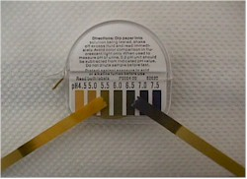
Patient Testing
Remove a piece of nitrazine paper about 3 inches long from the protective container.
Collect the patient sample.
Immediately after collection, bring the strip of nitrazine paper into contact with the specimen by touching the paper to the swab.
Immediately match the color change of the nitrazine paper to the closest color on the color chart supplied within the pH paper dispenser.
Dispose of all biohazardous testing materials in the appropriate biohazard bag.

Slide 9
Results
Interpretation
Color | Approximate pH Value | Indication Consistent With
Yellow-orange | 4.5 | Intact amniotic membrane
Yellow-orange | 5.0 | Intact amniotic membrane
Yellow-orange | 5.5 | Intact amniotic membrane
Yellow-olive | 6.0 | Intact amniotic membrane
Olive-green | 6.5 | Intact amniotic membrane
Blue-green | 7.0 | Ruptured amniotic membrane
Blue-black | 7.5 | Ruptured amniotic membrane

Slide 10
Recording & Reporting Results
Per federal regulatory requirements, providers are required to order and enter results in Epic for non-interfaced point of care testing that is performed.
A POCT nitrazine paper test order should be placed in Epic.
The result should then be entered into the patient’s electronic medical record through Enter/Edit.
Refer to the Epic@UNC Training Tip Sheet for instructions on how to document the result.
Test Name | Epic Code
POCT Nitrazine pH | POC119

Slide 11
Limitations
Interferences
False Positive
Abnormal vaginal flora such as bacterial vaginosis or trichomoniasis infection which can increase vaginal pH
False Negative
Insufficient sample

Slide 12
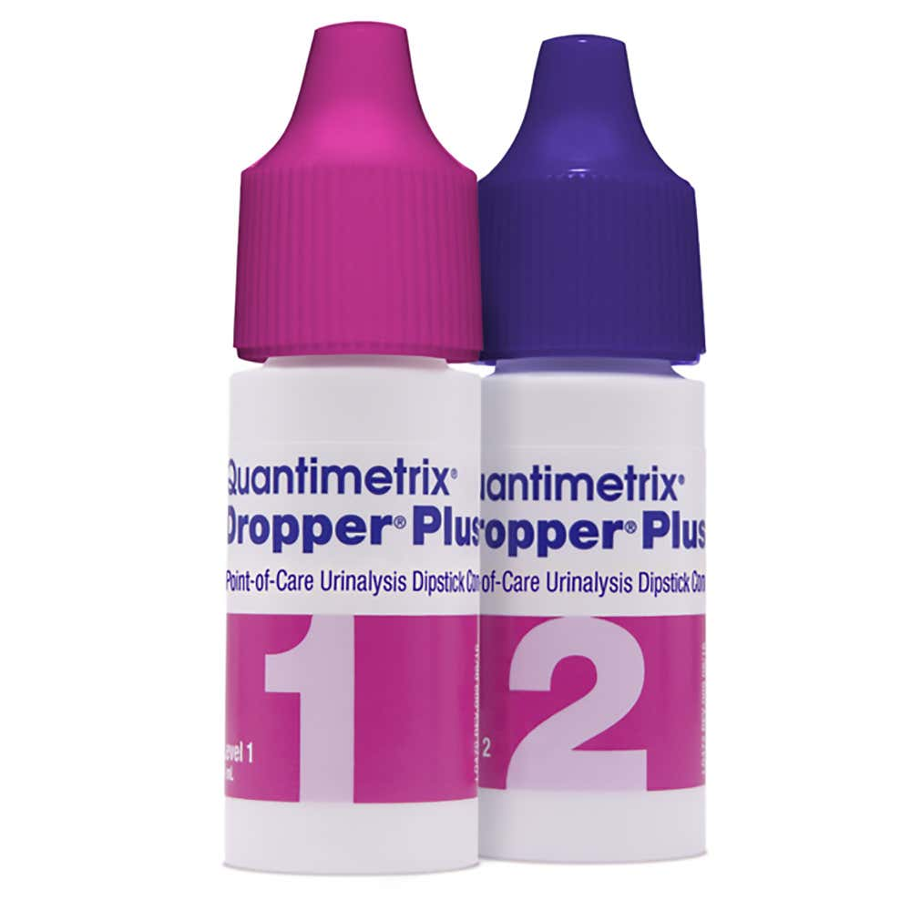
Quality Control
Quality control testing for the nitrazine paper should be performed upon receipt of each new shipment and/or lot number.
Both levels 1 & 2 of the Quantimetrix® Dropper® Plus Point-of-Care Urinalysis Dipstick control solutions must be analyzed.
Remove a piece of nitrazine paper about 3 inches long from the protective container.
Place 2 drops of the Level 1 quality control solution on the paper.
Immediately match the color change of the nitrazine paper to the closest color on the color chart supplied within the pH paper dispenser.
Record the pH result, test date and the lot numbers of the nitrazine pH paper and quality control solution on the log sheet.
Repeat the above procedure using the Level 2 quality control solution.
Dispose of all biohazardous testing materials in the appropriate biohazard bag.

Slide 13
Color Perception Assessment
Interpretation of nitrazine pH paper test results may be affected by poor color vision.
Up to 10% males and 0.4% females may be color deficient to some degree.
If you have not done so already, have your color vision checked if you perform point of care tests or other tasks that require color discrimination.
There is a color perception assessment available on LMS.
Search the Learning Activities for the following code:
UNCHPOCCLR

Slide 14
Training & Competency Requirements
Prior to performing patient testing, providers are required to complete this module to satisfy federal requirements for initial training.
Those who perform waived testing must be trained for each test that they are authorized to perform. The training for each waived test is documented.
Competency for waived testing is assessed annually using the following methods per person:
Monitoring of each user’s quality control performance
Captured via reporting of QC acceptability on patient test results
Use of a written test specific to the test assessed
Assignment of an online module
Note: Performance of a test on a blind specimen OR periodic observation of routine work by the supervisor or qualified designee can also be used in place of the above methods, if needed.

