Slide 1


Massive Transfusion Protocol Revision and updates
Sara Lesnicki BS, RN, TNS, CEN

Slide 2
MTP activations
2016 N= 6
2017 N= 16

Slide 3
The ED Care Team
THAT IS YOU!!! And it includes the nurse, secretaries, ED Techs and the physicians.
You have the ability to impact that patient. Critically think about the processes that are affecting the patient. C-ABC’s
IS hypotension present? How much fluid has the patient received. Sometime you are the only one that knows that. Don’t assume that the doctor knows because chances are is that they do not.
Suggest therapies-- Has your patient received a blood gas/heart panel? If not why? How can we see if our resuscitation status is appropriate? Look at lactate and base excess for resuscitation status. Trend those values.
Metabolic acidosis resulting from acute trauma is a consequence of inadequate tissue perfusion which leads to lactic acid production. Get an ABG early on! Lactate levels and base excess levels are prognostic values used to help optimize your resuscitation. In the MTP they will be drawn every hour.
  Increasing levels of lactate and base excess = POOR outcome
  Trend your gases and intervene early!

Slide 4
Bleeding Types
There are 2 types of bleeding
Mechanical
Coagulopathic
Coagulopathic bleeding is much harder to control.

Slide 5
What is shock and why is it important?
Why is it important
In its early stages, shock is subtle and the body is able to compensate by activating its compensatory mechanisms such as HR Resp Rate. If not identified and corrected, the body switches from aerobic to anaerobic metabolism which leads to acidosis and ultimately death.
Hypovolemic/hemorrhagic Shock- The most common type of shock seen in trauma patients is due to loss of circulating volume, initially producing hypovolemic or hemorrhagic shock
Get an ABG early on! Monitor your base excess levels because are prognostic values used to help optimize your resuscitation. In the MTP ABG’s will be drawn every hour.
  Increasing levels of lactate and base excess = POOR outcome
  Trend your gases and intervene early!

Slide 6
Stages of Shock
There are 3 stages of shock.
Remember shock is a dynamic state- meaning patients can fluctuate in between different stages.
Compensated
Stage I
Decompensated
Stage II
Irreversible
Stage III

Slide 7
Normal saline …. Is it Normal?
NO! There is nothing normal about normal saline
PH of saline is 5.
It is essentially IV ACID further worsening your patients acidosis. That is why we want to limit the initial resuscitation with saline to 2 L and then move on to blood
Saline is good for vomiting and diarrhea and fluid losses
It is only the initial treatment for blood loss until blood/blood products become available.

Slide 8
Fluid resuscitation
Current therapies recommend 1-2L of crystalloid of WARMED fluid.
That includes the fluid from prehospital providers
If you patients blood pressure continues to rely on fluid boluses, move on to blood
Trauma-induced coagulopathy (TIC) is a common problem caused by dilution and consumption of clotting factors, hypothermia and acidosis. Evidence suggests it can be decreased by early delivery of blood products.
Crystalloids ARE NOT and SHOULD NOT be the mainstay of trauma resuscitation!!

Slide 9
Triad of death
Acidosis
Hypothermia
Trauma
Triad
Of
Death
Coagulopathy
Early Recognition and treatment is Essential!!

Slide 10

Goals of Resuscitation
Early recognition of the shock state
Oxygenate and ventilate
Restore organ perfusion
Restore homeostasis / repay “oxygen debt”
Stop the bleeding- Surgeon’s job
(Damage Control Surgery)
Treat coagulopathy (PREVENTION FIRST)
Restore the circulating volume (minimize saline)
Continuous monitoring of the response– Trend your gases/ lactate and base deficit
Metabolic acidosis resulting from acute trauma is a consequence of inadequate tissue perfusion which leads to lactic acid production

Slide 11
Why 1:1:1
Restores the circulating volume
Best substitution for fresh whole blood
Data from the PROPPR trial revealed that mortality at 3 hours after injury due to exsanguination was lower in patients resuscitated with a 1:1:1 ratio compared to 1:1:2.
Once major bleeding has been controlled, and the rate of transfusion has slowed, it is appropriate to switch to a POCT based transfusion. (TEG)

Slide 12
Fibrinogen is the fundamental building block of clot formation;
Fibrinogen is actually rapidly consumed by the body in trauma
Cryoprecipitate, is a less purified source of fibrinogen. It has been shown to be an essential component of MT protocols for mitigating the dilutional coagulopathy caused by red cell additive solution and anticoagulant.

Slide 13
Lets Talk about products
RBC’s | PLATELETS | PLASMA | CRYO
The only oxygen carrying blood component | Apheresis (pooled) from a single donor | 55-65% of blood volume | Obtained from plasma cooled until the desired blood components precipitate out
Hemocrit 55-70% | 5 day shelf life | 200-250ml per unit | Prepared on demand- not stored
Banked RBC’s have a shelf life of 42 days |  | Contain: Albumin, fibrinogen, globulins. Clotting factors but no cells | Takes one hour to prepare
 |  | Up to 7 years when frozen | Concentrated amounts of factors VII, XII, Von Willeband, fibronectin and Fibrinogen
 |  | 5 day shelf life when thawed

Slide 14
Massive transfusion
Massive Transfusion is defined as the urgent need for, and rapid transfusion of massive amounts of blood products in order to attempt volume resuscitation or salvage of a coagulopathic, exsanguinating patient.
The goal is early identification of a patient who has an actual and/or anticipated need for more than four units of Packed Red Blood Cells (PRBC) in less than four hours, who is hemodynamically unstable, or with suspected ongoing bleeding
Give what is being sent up. Do not customize it early on your patient needs ALL of the factors.

Slide 15
When to Activate Massive transfusion
Substantial acute or imminent acute blood loss
Severe on-going blood loss secondary to trauma, operative circumstances, predisposing medical conditions.
The DCR clinical guidelines for resuscitation of combat wounded in hemorrhagic shock requiring a massive transfusion recommend:
  The infusion of fresh frozen plasma (FFP): packed red blood cells (PRBCs: platelets in a 1:1:1 ration and the minimization of crystalloids and/or synthetic colloids). (Blackbourne) (region IX guidelines)

Slide 16
Newly added Activation Triggers
Indicators to activate MTP may be based on the following criteria:
*When 3 of 4 Triggers are present consider ACTIVATION OF MTP*
TRIGGERS | PATIENT POPULATION
HR GREATER THAN 120 BPM | TRAUMA, OB, MED-SURG
SBP LESS THAN 90 MM/HG | TRAUMA, OB, MED-SURG
QUANTIFIED AND OR ESTIMATED BLOOD LOSS GREATER THAN 1500ML | OB
BASE DEFICIT LESS THAN -6 | TRAUMA, OB, MED-SURG
+ FAST EXAM | TRAUMA, OB, MED-SURG

Slide 17
Monitoring
Monitor for Hypocalcemia – This can happen due the citrate binding of ionized calcium. This can lead to a clinically significant fall in the plasma free calcium concentration
The hallmark of acute hypocalcemia is tetany, which is characterized by neuromuscular irritability. The symptoms of tetany may be mild such as perioral numbness, paresthesias of the hands and feet, muscle cramps) or severe (carpopedal spasm, laryngospasm, and focal or generalized seizures,

Slide 18
TEG
Stands for Thromoboelastography
Tests the efficacy of blood coagulation
Tests the strength and stability of the clot
Tests the effect of platelet, coagulation factor and cellular interactions
Risk of hemorrhage and thrombosis and identification of Fibrinolysis
Provides a visual representation of the patients hemostasis
Giving unnecessary plasma and platelets should be discouraged in order to reduce the risk of transfusion-related acute lung injury. Point of care coagulation tests may aid decision-making and reduce unnecessary transfusions.

Slide 19
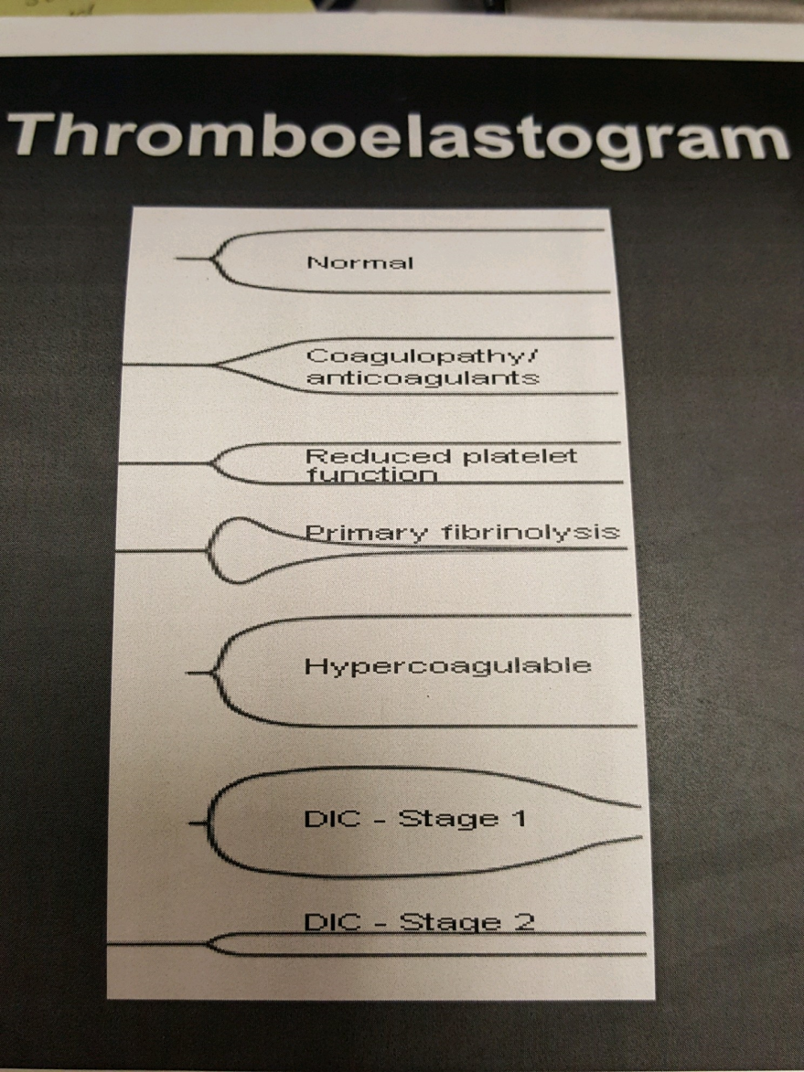

Slide 20
Massive Transfusion
 | Shipment | RBC | FFP | Platelets | Cryo
Trauma A | Activation | 2 O-Neg | - | - | -
 | Consider TXA for patients ≥ 16 y/o and injury ≤ 3 hours
Initial | At Start Time | 5 (3 if given 2 O-Neg) | 5 | 1 (4-5 pooled units) | 0
Tier 2 | 30 minutes | 5 | 5 | 1 | 10
Tier 3 | 1 hour | 5 | 5 | 1 | 0
Tier 4 | 1.5 hours | 5 | 5 | 1 | 10
Tier 5 | 2 hours | 5 | 5 | 1 | 0
Tier 6 | 2.5 hours | 5 | 5 | 1 | 10
Tier 7 | 3 hours | 5 | 5 | 1 | 0
Tier 8 | 3.5 hours | 5 | 5 | 1 | 10
Tier 9 | 4 hours | 5 | 5 | 1 | 0
Tier 10 | 4.5 hours | 5 | 5 | 1 | 10
***Consider drawing TEG after initial resuscitation is complete****

Slide 21
Considerations
Monitor serum calcium levels (watch for hypocalcemia)
Do not overload with saline
Prevent and treat hypothermia
Blood warmers and rapid infusers should be utilized (with the exception of platelets)
Prevent and treat acidosis
    “REPLACEMENT WITH PRBC’S AND SALINE WITHOUT TRANSFUSING PLATELETS AND PLASMA FUTHER DILUTES THE PATIENTS ABILITY TO CLOT” (TNCC 7th ed.)
The decision to activate a massive transfusion protocol (MTP) should be communicated to the Blood Bank immediately by the Charge Nurse

Slide 22

MTP at RCMC
There are multiple tiers embedded in the MTP.
DO NOT FLOOD YOUR PATIENT WITH SALINE (PH OF 0.9 is 5)!!!
The blood products are on a timed schedule
1:1:1 ratio
Initial transfusion (Tier 1)includes RBC’s and FFP for non-type specific
If type specific is available then it includes RBC’s, FFP, and platelets
Utilize the downtime procedure on these patients **NO SCANNING OF PRODUCTS**
Platelets and Cryoprecipitate never get transfused through the rapid infuser
If we start the MTP in the ED and the patient goes to another unit NOTIFY Blood bank they will continue the shipments to that specific area.
Once activated the blood bank will continue with shipments until they are notified to stop
If your patient is going to the OR or ICU make sure this is part of hand-off. Charge RN’s please communicate to the other charge RN that this specific patient is on the MTP.
This is an “all hands on deck patient”

Slide 23
Our MTP policy
The activation of MTP automatically serves as an approval for Blood Bank to release uncrossmatched blood and compatible non-type specific blood products, when applicable.
Upon activation of the MTP, Blood Bank will prepare to dispense the initial transfusions.
Intravenous access should include two large bore, 16-gauge or 18-gauge, intravenous lines. A central line placement by physician should be considered.
STAT baseline labs should be drawn which include: CBC, PT/PTT, CMP, fibrinogen, D-Dimer, ABG and Type and Screen
The Level 1 Rapid Transfuser and Fluid Warmer should be utilized for PRBCs and Plasma. Platelets and Cryoprecipitate should be administered at room temperature.
Tranexamic Acid (TXA) should be considered and administered at the discretion of the physician. Order for TXA should include:
  TXA 1000 mg intravenously single dose STAT over 10 minutes; if older than 16 years, and injury is less than three hours. Earlier administration has shown to be most beneficial.
  Followed by TXA 1000 mg intravenously single dose to be infused over 8 hours.
  For Obstetric patients refer to policy: “Guidelines for use of Tranexamic Acid IV (TXA) in the Family Birth Center”
Continuous assessment, control of ongoing blood loss, and control of further hemorrhage should be performed by the physician and/or physician designee by applying direct pressure, applying tourniquet three inches above the injury, using hare traction device, or applying pelvic binder where applicable.
Laboratory studies should be monitored with every tier paying careful attention to calcium levels.
Blood products in subsequent tiers will automatically be delivered to the center secretary until the Blood Bank is notified by the unit charge nurse that the MTP is no longer necessary.
Consider drawing a thromboelastogram (TEG) in the OR or ICU at the discretion of the physician
All unused blood products need to be returned to Blood Bank immediately.
Each unit specific contact will notify blood bank when the patients transfers to another unit or the massive transfusion is ceased.

Slide 24
TXA Refresher
“Results from a recent randomized, placebo-controlled trial suggest that the early treatment of trauma patients with tranexamic acid may result in a significant reduction of trauma-associated mortality” (Schochl et. al 2012)
MUST BE GIVEN AGES 16 yrs OLD or GREATER AND WITHIN THE FIRST 3 HOURS OF INJURY.
EARLIER THE BETTER!
Early treatment and administration IDEALLY within the first hour
Early treatment (≤ 1 hour from injury) significantly reduced the risk of death due to bleeding 198 out of 3747 patients (Crash-2 Trial)
TREATMENT | DOSE
LOADING | 1 gm / 10 min (BOLUS)
Maintenance | 1gm / 8 hours (IV infusion)

Slide 25
Tranexamic Acid (TXA).. Refresher
What is it and Why
Hemorrhage is the leading cause of survivable death in trauma patients.
We NOW KNOW that impaired coagulation occurs in nearly all patients immediately after a severe injury.
Severe shock and major tissue trauma are two main causes of hyperfibrinolysis
Postinjury hyperfibrinolysis is documented in some studies to have an associated mortality rate at 70% to 100% (Napolitani et. al 2013)
TXA is a medication that is an antifibrinolytic which prevents clot breakdown and allows good clots to remain working on reducing bleeding
Crash 2 MATTERs results showed a reduced mortality by 6.5% with TXA .

Slide 26

Remember New Changes coming…
MINIMIZE THE AMOUNT OF SALINE WE INFUSE******
New Activation Triggers are incorporated
All TRAUMA A patients will receive an initial Heart Panel
Trauma flowsheet will include a new page (#4) with the activation triggers and the MTP product delivery schedule
Center Secretaries will be calling Pharmacy with the Cat A patients name once registered
Pharmacy will be calling the charge nurse 20 mins after patient arrival to verify if patient is a TXA candidate.
The charge nurse is the point person for blood bank.
No scanning of the blood products during MTP. The secretary or nurse will need to make copies of downtime forms and send copies to Blood Bank and originals stay with chart.

Slide 27
Case Study – EMS report
50 year old M s/p unwitnessed fall from 30-35 ft from a scissor machine. Patient reports pain to left arm, difficulty breathing. Patient appears amnestic to the event
Vitals prehosp 52/33 HR 73
100/p
GCS 15

Slide 28
Arrival to ED
  Patient had deterioration in mental status. Decision made to intubate the patient and then upgraded to Trauma category A.
  Upon arrival B/P 65/42 HR 65
  CXR completed prior to CT IVF given for hypotension with slight improvement.

Slide 29
Continued
Upon arrival to ED pt moaning GCS 9
Vitals upon arrival 65/42 HR 65
4 mins after arrival 0.9NS wide open started
8 mins after arrival 77/48 HR 102
18 mins after arrival 111/68 HR 102 (pt intubated and upgraded to Trauma A)
23 mins after arrival 108/60 HR 71
25 mins after arrival 96/57 HR 71 (to CT at this time)
50 mins after arrival 137/90 HR 71
57 mins after arrival 90/74 HR 75
Still Wide open fluids
63 mins 57/31 HR 86 blood started (1 hour after arrival) 3000 total 0.9 NS infused at this point
Patient had persistent hypotension,
Chest tube placed 800cc of blood B/P 60/25
TS and CV surgeon took pt to OR. 4000 cc IVF given O-neg x1 started prior to OR

Slide 30
Continued
  Trauma w/u: Large L sided hemo/pneumo, pneumomediastinum, pulmonary hemorrhage L post 4th-12th rib fx in 2 or more places, Fx of L T 12 process, R 12th rib fx, Shattered spleen, large L kidney laceration, complex fx of L 1 and left transverse process fx’s of L 3 L4 and L5.
  Multiple pelvic fx with disruption of pubic symphysis. Pelvic binder placed. Chest tube placed 800cc of blood. Pt remained hypotensive

Slide 31
What are the identified areas of improvement in this scenario
EARLIER transfusion of Blood (1st unit of blood was started an hour after arrival) Pt was hypotensive pre-hospital
Earlier Activation (met criteria due to hypotension)
Would that have increased our level of suspicion?
Not sure but that would have brought the Trauma Surgeon to the bedside sooner
Fast Exam?
Was the patient stable enough to go to CT?
What is the definition of stable?
Minimize the IVF ← Start blood and blood products
Activate the MTP

Slide 32
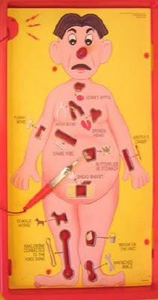
Patient follow up
1. Exploratory laparotomy with a splenectomy and control bleeding from a liver laceration
2. Subxiphoid pericardial window
3. Exploratory left thoracotomy.
4. Left lower lobectomy
5. Temporary pacemaker placement.
6. Intraoperative cardiac massage.
7. Placement of pericardial patch to reconstruct the pericardium
Found a traumatic rupture of the pericardium that extended from the diaphragm along the phrenic nerve up to the apex of the chest. Total blood products..
15 RBC’s 6 U FFP 4 U Platelets
Albumin 3000cc and 5500 cc of crystalloid.
Pt expired at in the OR

Slide 33
Massive Transfusion
 | Shipment | RBC | FFP | Platelets | Cryo
Trauma A | Activation | 2 O-Neg | - | - | -
 | Consider TXA for patients ≥ 16 y/o and injury ≤ 3 hours
Initial | At Start Time | 5 (3 if given 2 O-Neg) | 5 | 1 (4-5 pooled units) | 0
Tier 2 | 30 minutes | 5 | 5 | 1 | 10
Tier 3 | 1 hour | 5 | 5 | 1 | 0
Tier 4 | 1.5 hours | 5 | 5 | 1 | 10
Tier 5 | 2 hours | 5 | 5 | 1 | 0
Tier 6 | 2.5 hours | 5 | 5 | 1 | 10
Tier 7 | 3 hours | 5 | 5 | 1 | 0
Tier 8 | 3.5 hours | 5 | 5 | 1 | 10
Tier 9 | 4 hours | 5 | 5 | 1 | 0
Tier 10 | 4.5 hours | 5 | 5 | 1 | 10
***Consider drawing TEG after initial resuscitation is complete****

Slide 34
New Changes coming…
MINIMIZE THE SALINE*** There is nothing normal about normal saline!!
New Activation Triggers are incorporated
All TRAUMA A patients will receive an initial Heart Panel
Trauma flowsheet will include a new page (#4) with the activation triggers and the MTP product delivery schedule
Center Secretaries will be calling Pharmacy with the Cat A patients name once registered
Pharmacy will be calling the charge nurse 20 mins after patient arrival to verify if patient is a TXA candidate.
The charge nurse is the point person for blood bank. Any movement of the patient (i.e transfer to OR or elsewhere needs to be communicated immediately)
No scanning of the blood products during MTP. The secretary or nurse will need to make copies of downtime forms and send copies to Blood Bank and originals stay with chart.

Slide 35

What you do, and do not do, does make a difference in the outcomes of the patients that we treat!!
Be the leader in times of darkness!

Slide 36



Slide 37
References
Binz, S., McCollester, J., Thomas, S., Miller, J., Pohlman, T., Waxman, D., ... Tracy, R. (2015, September 7). CRASH-2 Study of Tranexamic Acid to Treat Bleeding in Trauma Patients: A Controversy Fueled by Science and Social Media. Journal of Blood Transfusion. http://dx.doi.org/10.1155/2015/874920
Cheatham, M. L., Block, E. F., Smith, H. G., & Promes, J. T. (2014). Shock: An Overview. Retrieved from http://surgicalcriticalcare.net/Lectures/shock_overview.pdf
Greenfield, B. S. (May 4th 2016). TXA-The Great Debate [Lecture notes]. Retrieved from www.alanticare.org/symposium/presentation/Greenfield-TXA.pdf
Napolitan, L. M., Cohen, M. J., Cotton, B. A., Schreiber, M. A., & Moore, E. E. (2013). Tranexamic acid in trauma: How should we use it? Acute Care Surgery, 74. http://dx.doi.org/10.1097/TA.0b013e1829cc54
Roberts, L., Shakur, H., Coats, T., Hunt, B., Balogun, E., Barnetson, L., ... Kawahara, T. (2013). The CRASH-2 Trial: a randomised controlled trial and economic evaluation of the effects of tranexamic acid on death, vascular occlusive events and transfusion requirements in bleeding trauma patients. Retrieved from http://www.ncbi.nlm.nih.gov/pubmed/?term=Roberts%20I%5BAuthor%5D&cauthor=true&cauthor_uid=23477634
TCAR Educational Programs
TNCC 7th Ed
TNS 2014 Core Curriculum
U.S. ARMY INSTITUTE OF SURGICAL RESEARCH JTS Clinical Practice Guidelines
Wells, J. C., & Stevermer, J. J. (2013, May). Trauma Care-don’t delay with TXA. Journal of Family Practice, 62, E4-E6. Retrieved from http://www.mdedge.com/jfponline/article/65139/trauma-care-dont-delay-txa

