Slide 1
Soft ID training
TC52

Slide 2
What is SoftID?
SoftID is the software that supports two functions:
  Positive patient identification.
  Bedside specimen collection with label printing in real-time at the bedside.

Slide 3
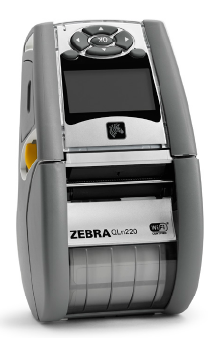
Key Points
All orders are entered and cancelled in Epic. Epic will send orders to Soft.
Equipment Needed – TC52 hand held device with SoftID installed and a label printer. The hand held and the printer are paired; labels will only print to their assigned printer.

Slide 4



Hand held TC52 Touch Screen
Power the device on by pressing and holding down the top button.
Scan by pressing either of the 2 side buttons.
The device will go to sleep after 5 minutes of inactivity. Press the left scan button to wake it up.
Back Button- Displays the previous screen. Closes the on-screen keyboard, if open.
Opens a menu with items that allow switching between SoftUpdate and desktop.
Displays recently viewed apps and webpages.

Slide 5
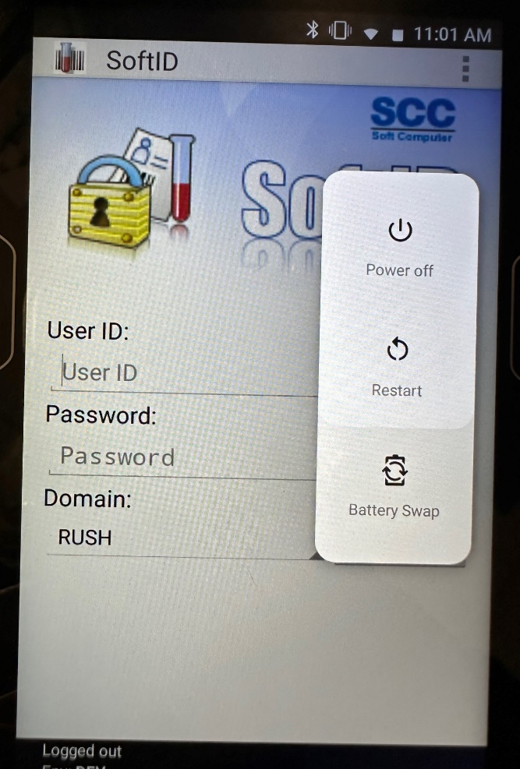
TC52 Touch Screen Maintenance
Devices should be Restarted daily.
Holding down the Power button on the top of the device will display the power options.
Select Restart.

Slide 6
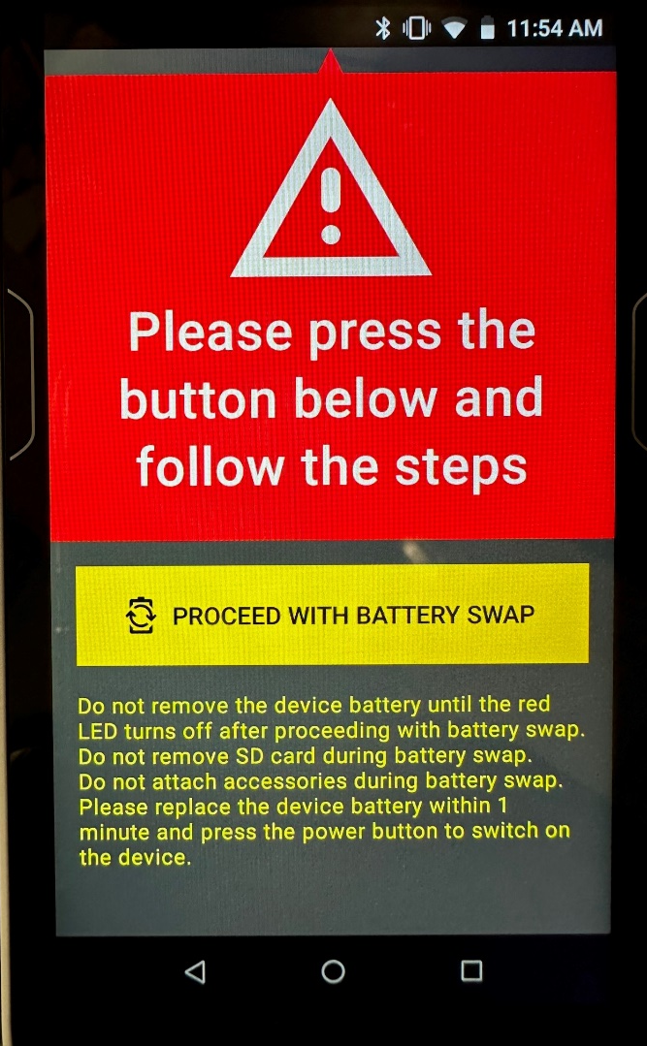
TC52 Touch Screen Maintenance
To change the Battery:
Hold down the Power button on the top of the device to display the power options.
Select Battery Swap.
Follow the on-screen instructions, paying specific attention to the red LED light that will turn on.
DO NOT Remove the battery until the red LED light turns off.
Replace the battery by squeezing the two blue side buttons from the back of the device.

Slide 7
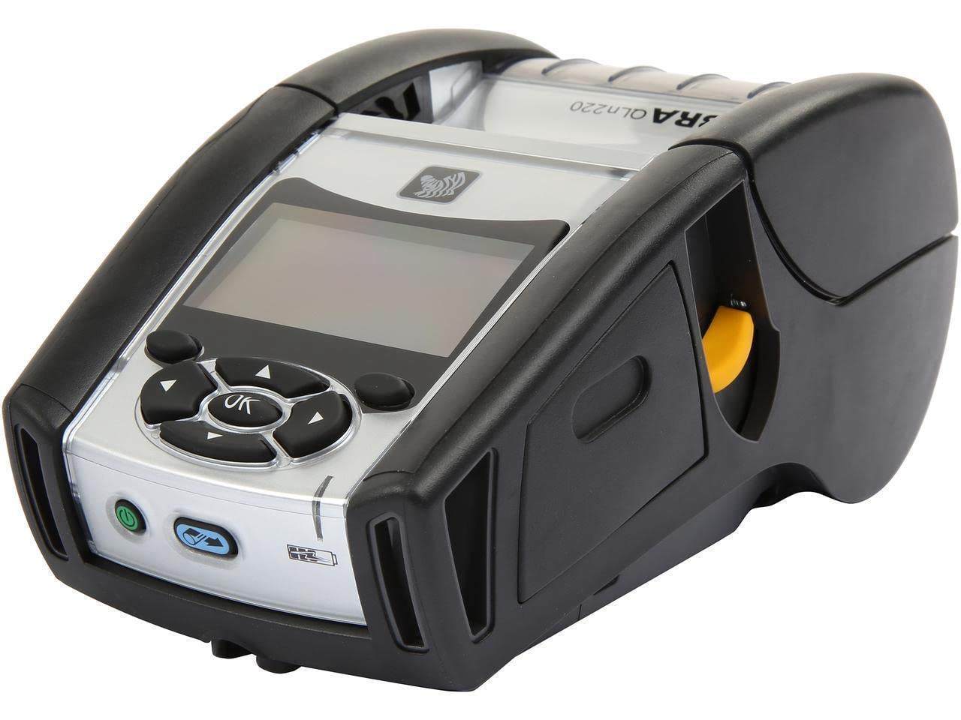
Printer
Power the printer on by hitting the green button.
Advance the labels once, by pressing the blue button.
Label stock is the responsibility of each department. Follow your department’s procedure for ordering label supplies.

Slide 8
SoftID Workflow - Overview
Bring the hand held, label printer, and collection tubes/supplies or specimen container to the patient room.
Turn on printer & advance labels (press blue button).
Log into SoftID.
Choose a role, select OK.
A list of all patients needing specimens collected will display.
Scan the patient ID band.
Using 2 identifiers, Verify the patient and click verify.
Draw blood or collect specimen.
Select Print.
Unselect the labels for the tests that were not collected.
Select Print Labels.
Label tubes/container (label must match tube color).
Scan each tube/container.
Scan patient ID band to submit, log out.

Slide 9
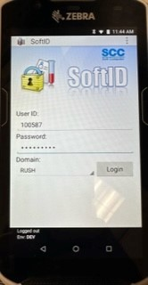
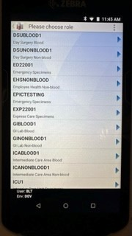
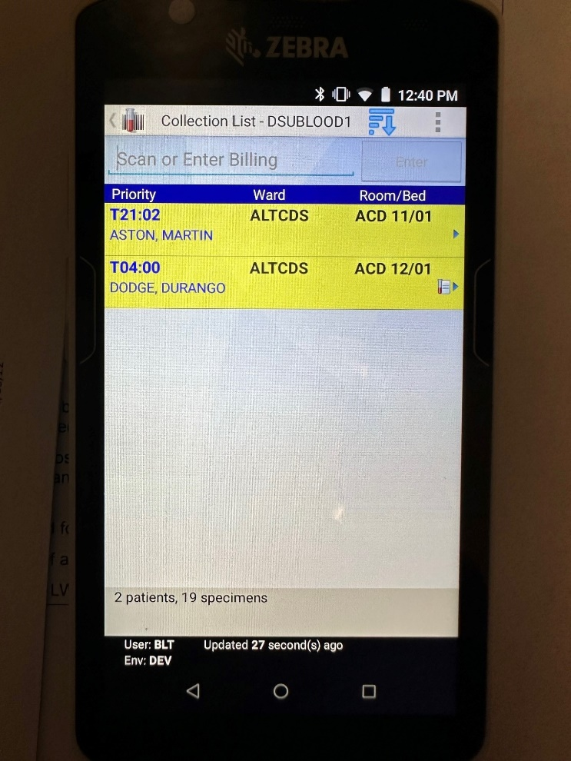
Log In
Log in to SoftID:
  Scan your badge or enter your user name, then enter your password and click Login.
Choose a Role:
  Roles are based on:
    Department (location of the patient)
    Blood vs. Non-blood collections (except ICU and NICU)
To Change your Role:
  Click the test tube at the top left of the screen, next to “Collection List”. The list of roles will reappear.

Slide 10
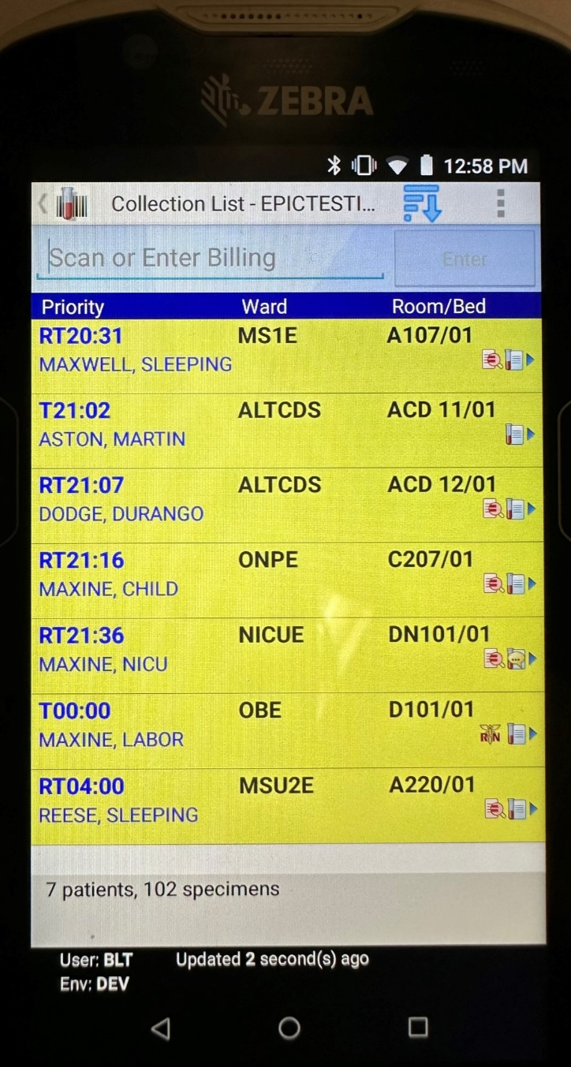
Patient List Details
Once logged in, the Patient List will display. Take note of any icons that appear.
  Indicates the collection is to be performed by a Nurse.
  Indicates the presence of Label Text, instructions specific to the ordered test.
  Indicates Draw Instructions.
  Indicates a Comment.
  Indicates Draw instructions with comments.
  Displays Information.
  It is the responsibility of the Phlebotomist to READ ALL DRAW INSTRUCTIONS AND COMMENTS.

Slide 11
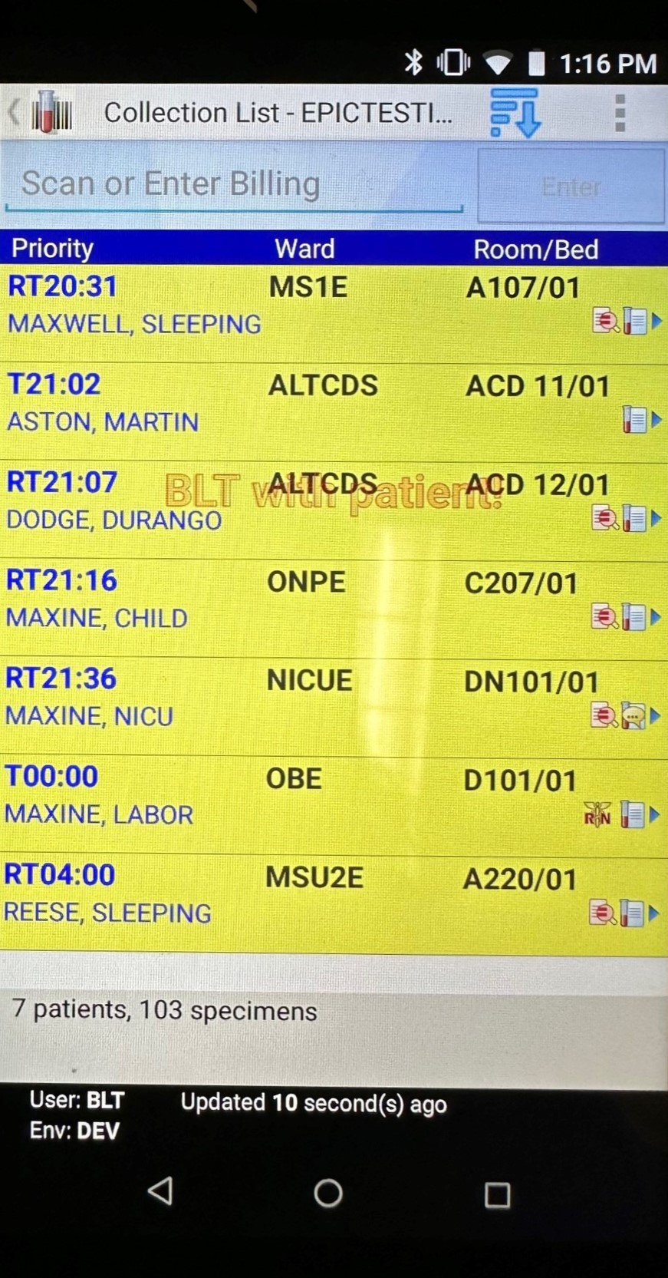
Patient List Details continued
Priority – STAT orders display in Red, Timed orders display in Blue, Routine orders display in Black, all followed by the time displayed in HH:MM format.
Orders may have multiple priorities and will display as such. Example: RT20:31 (Routine and Timed).
Patients that are currently being collected will display a watermark of the collector’s initials.
-D is displayed after the time, if the order was placed over twenty four hours earlier than the current time.
Orders highlighted in Yellow indicate Timed Specimens that are overdue.

Slide 12
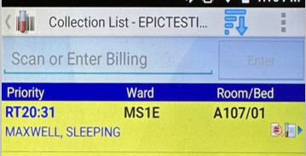
Patient List Details continued
The patient list can be sorted by clicking the blue Sorting Order icon.
The list of sorting options will display.
Each option can be sorted in ascending or descending order by clicking the up or down arrows.
Click OK when finished.

Slide 13
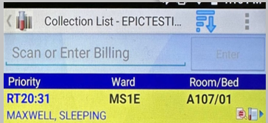
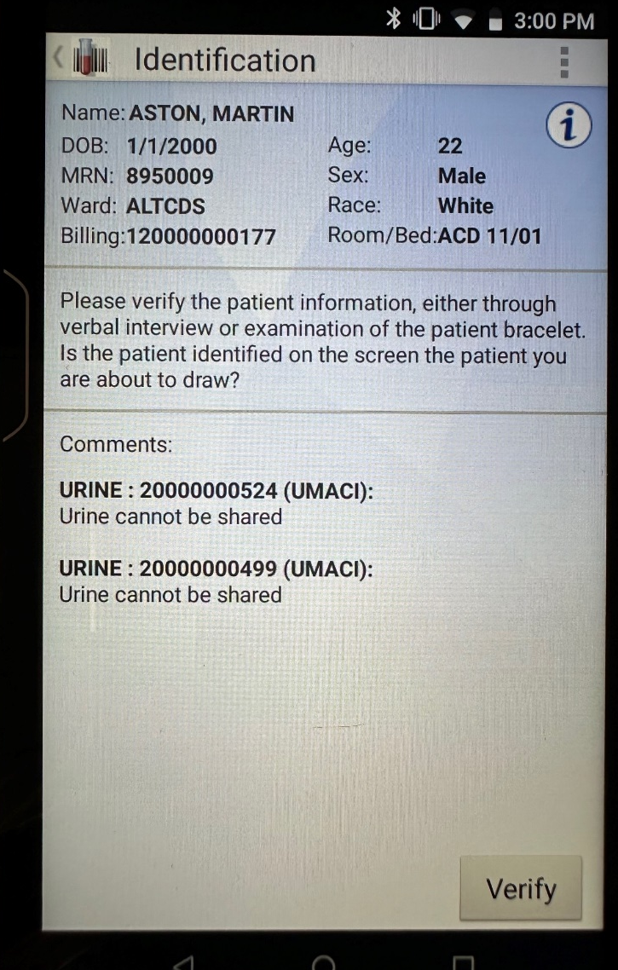
Scan the Patient
Scan the patient ID band, assuring the cursor is in the scan field before scanning.
The Patient identification window will appear, including any collection instructions or comments. Read the Comments and Instructions.
Verify the patient information using 2 patient identifiers, then click Verify.
  If the patient displayed is not your patient, Stop the process and go back! Verify your patient is banded correctly, the band is not damaged or wrinkled, and restart the process.

Slide 14
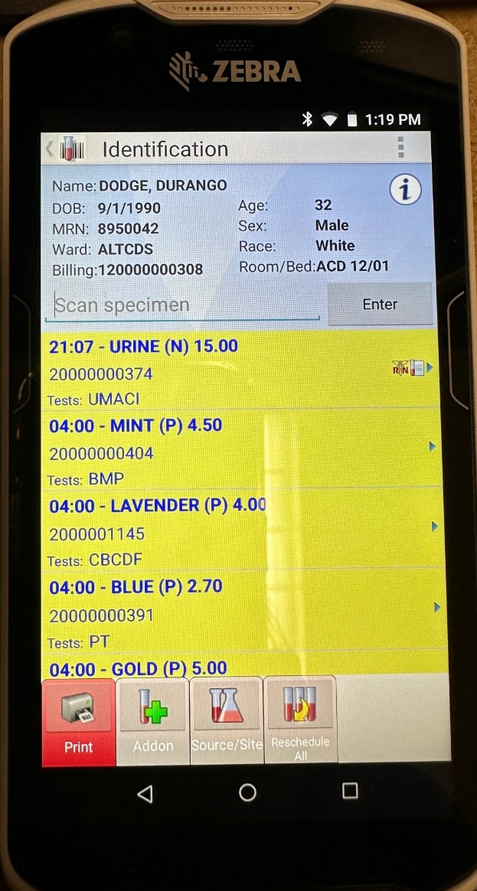
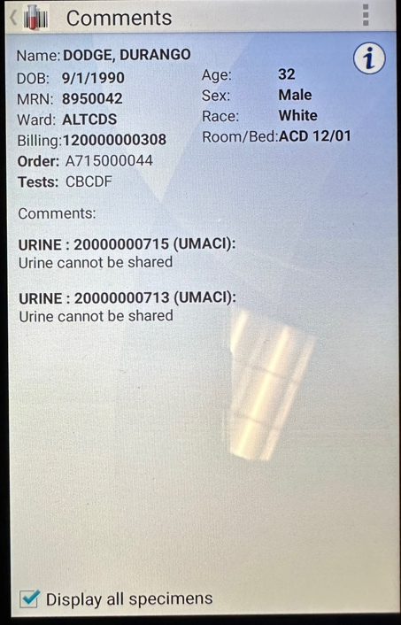
Patient Orders
The list of tubes and corresponding tests will display.
Click on the Label Text, Comment, or Draw Instruction icons.
The Comments window will display. To see ALL comments for all tests, check Display all specimens.
Read all Instructions and Comments.
Draw history can be seen by pressing the Information Icon.

Slide 15
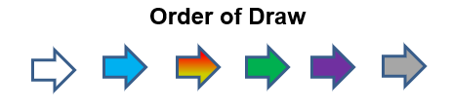
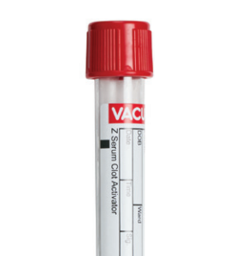
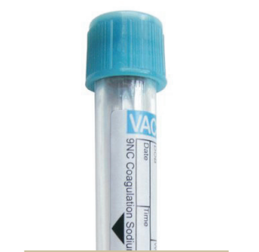
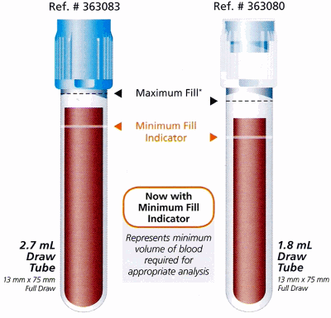

Draw/Collect Specimen
  Follow the Order of the Draw
  Fill each tube to the corresponding fill line indicated on the tube.

Slide 16

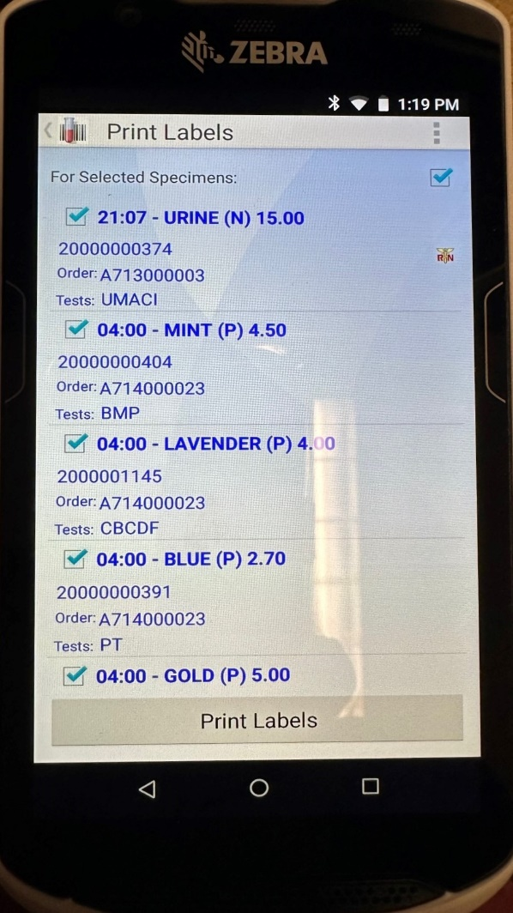
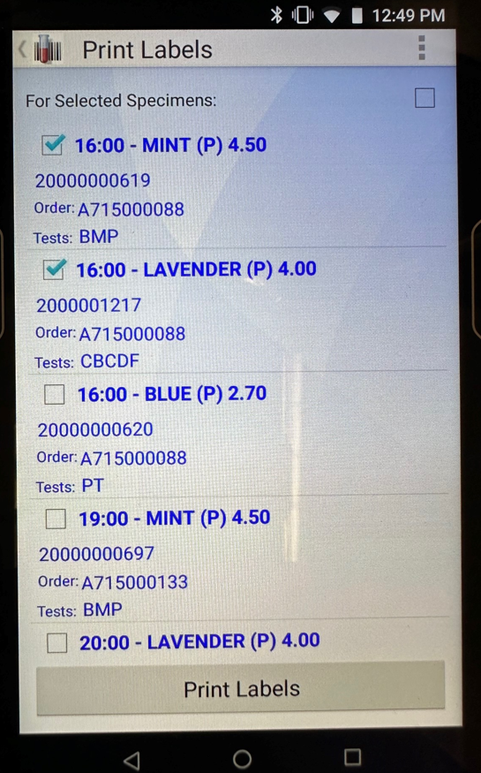
Print the Labels
Click Print. All labels will be selected by default. To print specific labels, uncheck the box in the right hand corner, then check the individual boxes for the labels that will be printed.
Click Print Labels.

Slide 17
Label the Specimens
Place labels on the long axis of the tube directly on top of the vendor labels.
Hold the cap of the tube in your left hand and attach the label on the tube lengthwise approximately ¼ inch from the top of the vacutainer stopper with the name facing you.
Do not cover any hand written identification that might be on this label.
Labels must be flat on the tubes with no wrinkles or folds; they may not extend below the bottom of the tubes or up onto the caps.
Do not place labels onto the stoppers of the vacutainer tubes as the laboratory instruments will not be able to read the bar codes.

Slide 18
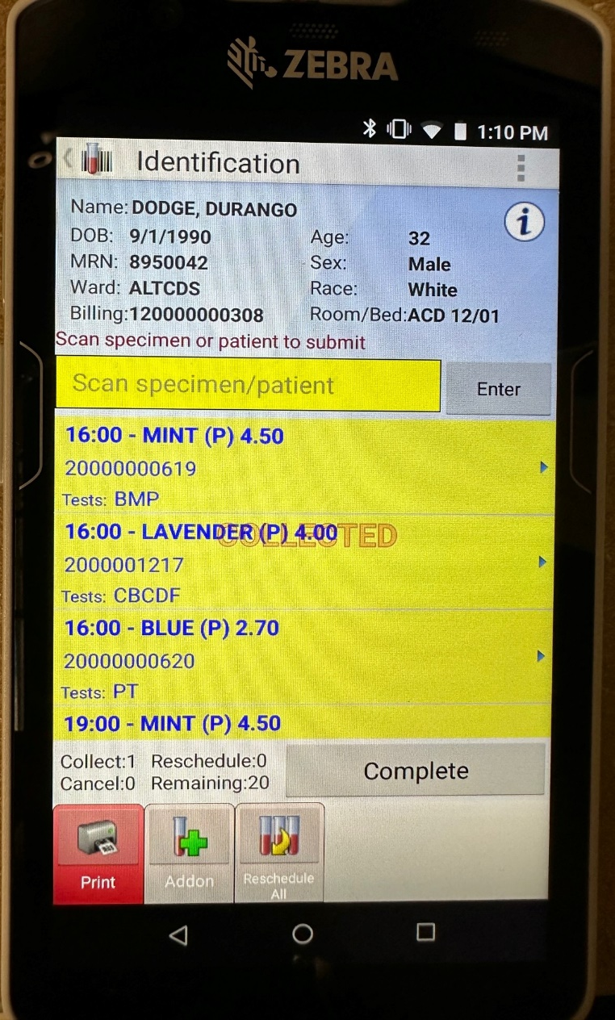
Scan the Labels
Scan each of the labeled specimen(s) barcodes that were collected.
  As they are scanned, a “Collected” watermark will appear.
  The screen will also display the number of specimens collected.
Scan the patient’s armband to complete the process.
Samples received in the Lab that have not had the process completed, will be rejected and a redraw will be required.

Slide 19
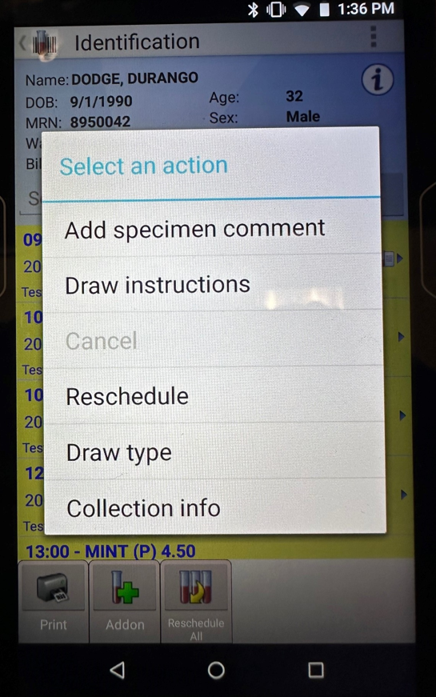
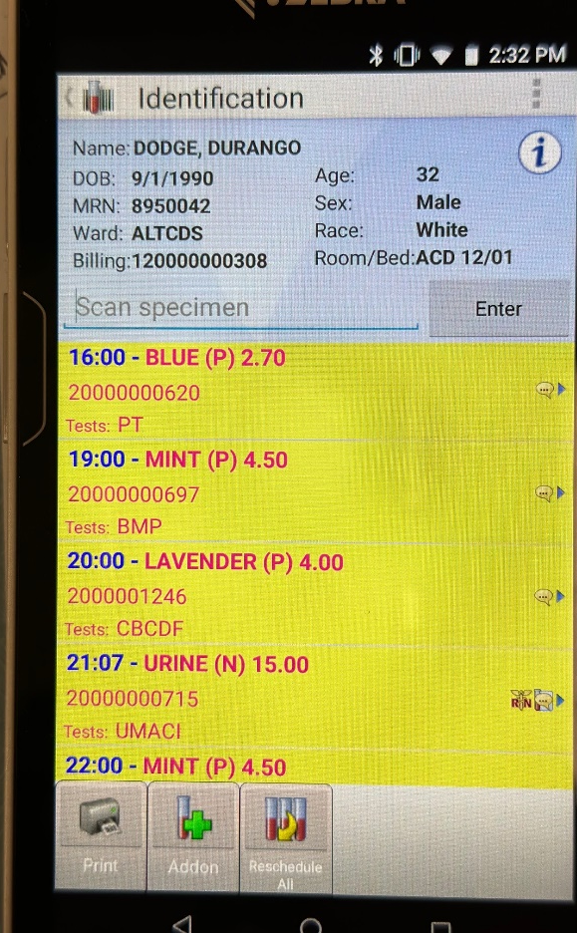
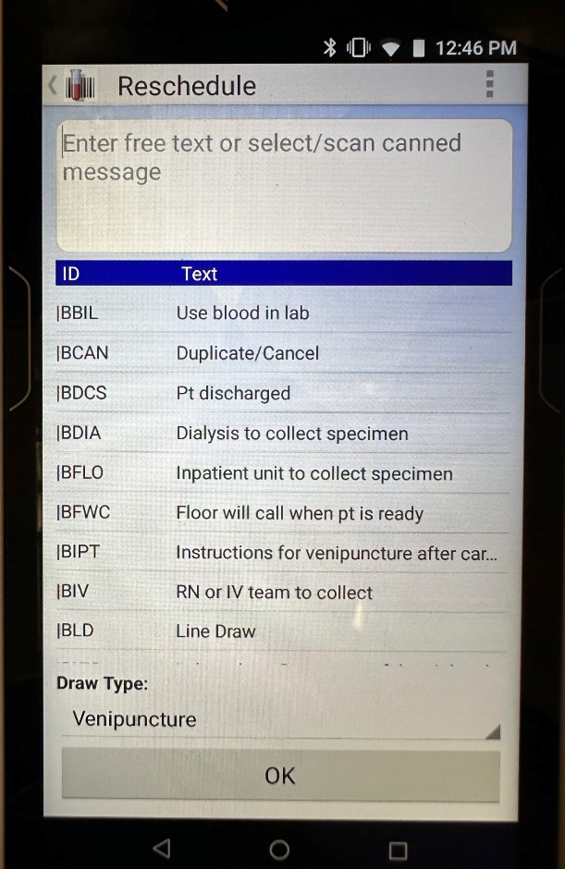
Rescheduling 1 Test
To Reschedule a single test/tube, press and hold the specimen line item.
The Action Window will appear, select Reschedule.
Select a canned message or enter free text to indicate the reschedule reason.
Click OK when finished.
Scan the patient to complete the Reschedule.

Slide 20
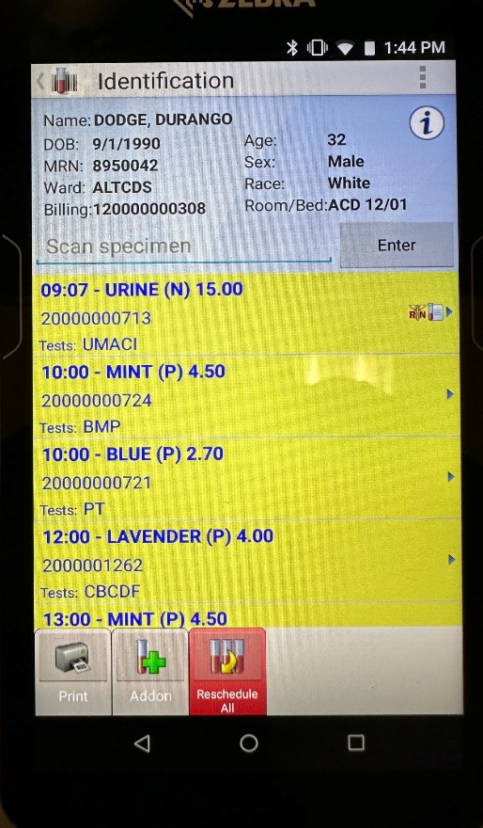
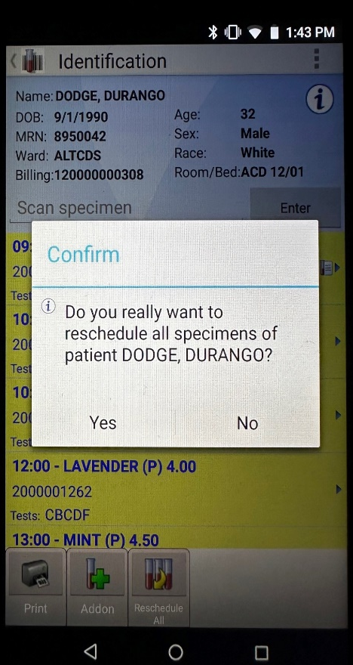

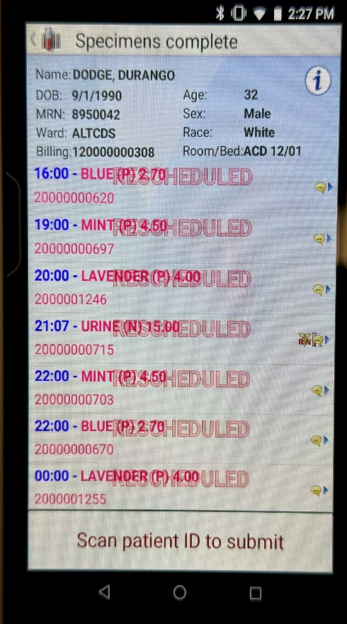
Rescheduling All Tests
To Reschedule all specimens, click the Reschedule All button.
Click Yes to confirm you want to reschedule all specimens.
Select a canned message or enter free text to indicate the reschedule reason then click OK.
Scan the patient to complete the Reschedule.

Slide 21
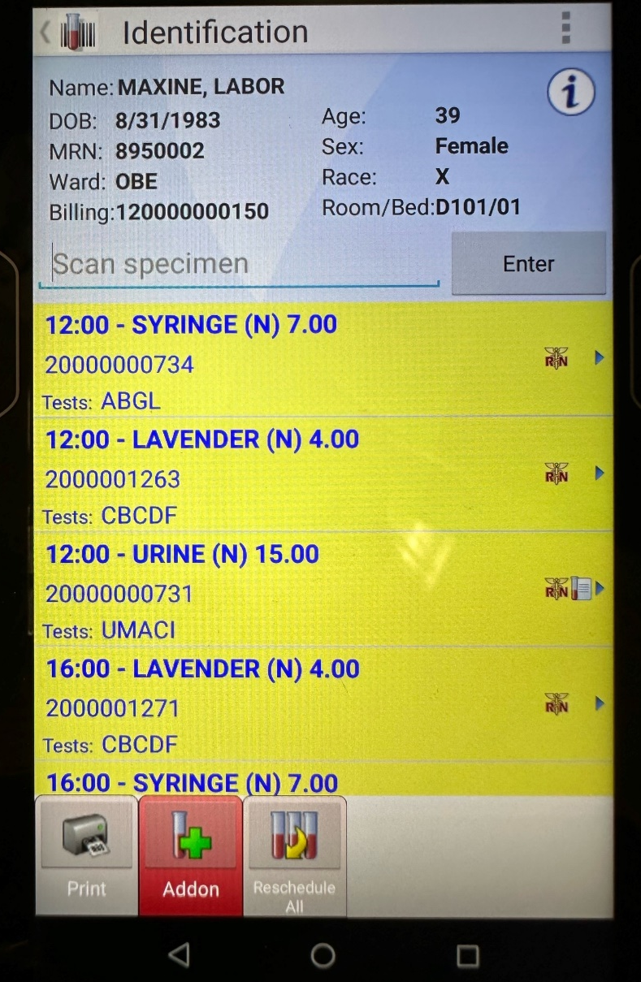
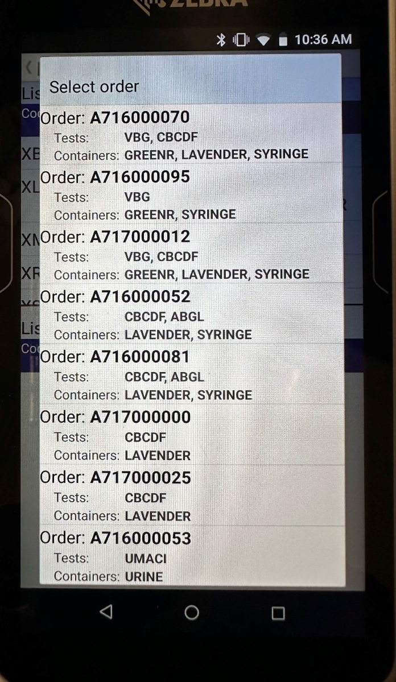
Add On Tests/Extra Tubes
To Add on specimens, click the Addon button.
Select the order from the list to add the specimen.

Slide 22
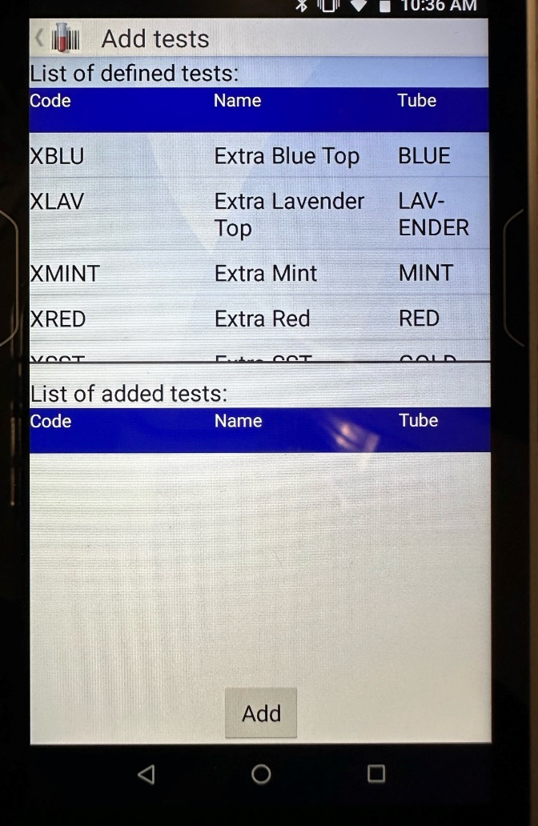
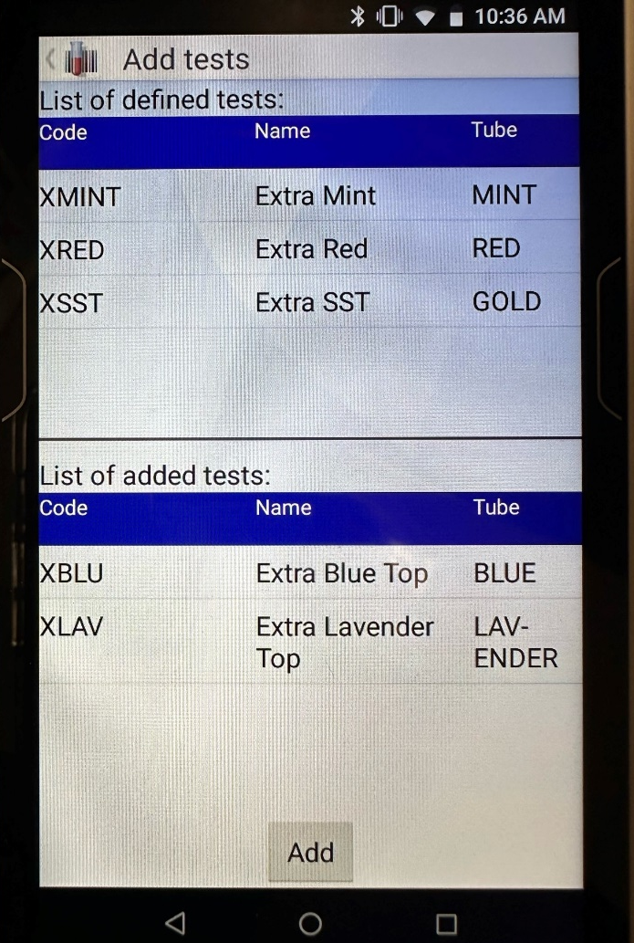
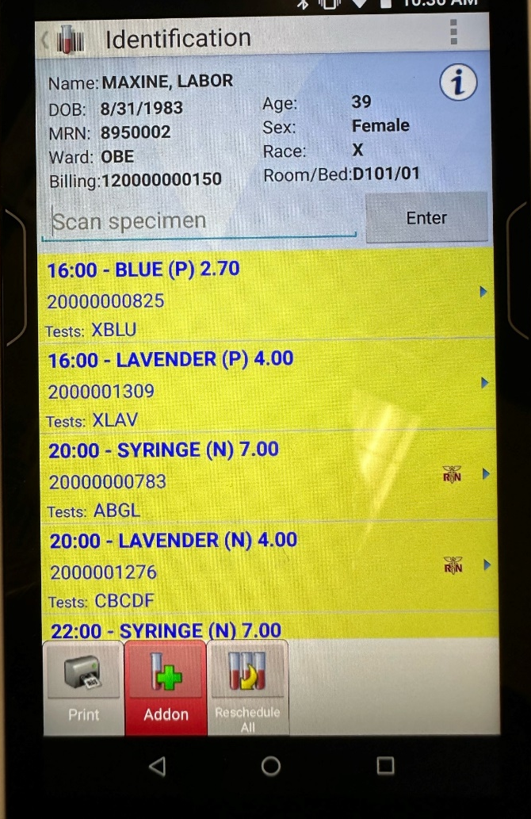
Add On Tests/Extra Tubes
Choose the tube from the top list of defined tests.
The tube will move to the bottom list of added tests.
Click Add.

Slide 23
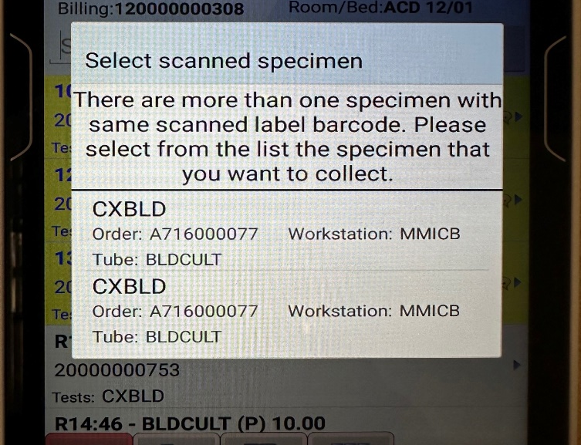
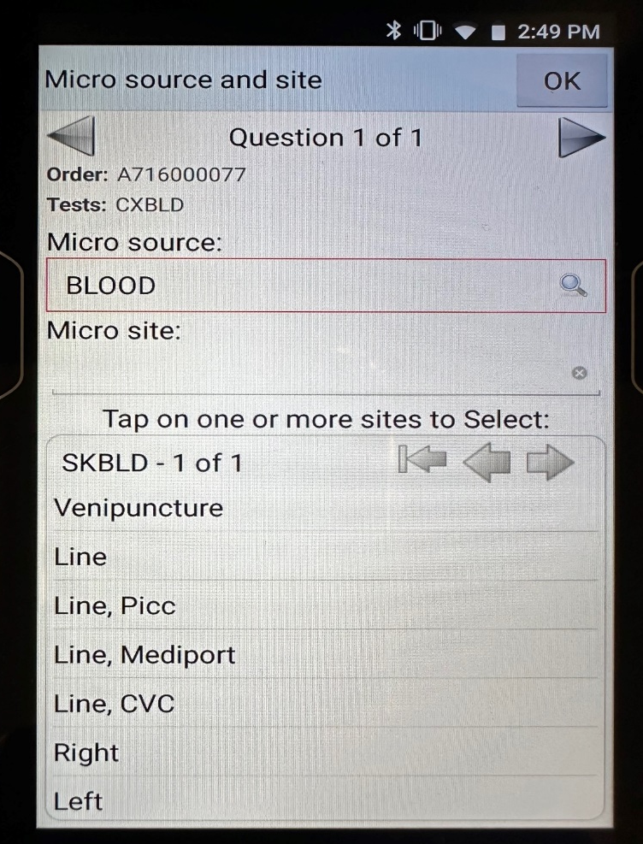
Micro Tests –Source and Site
When scanning the labels of Blood cultures (2 specimens), the system will prompt the user to select which specimen they are collecting.
Highlight the first specimen, the system will then prompt the user to add the Source and Site.
The source of specific tests, such as Blood cultures, will default. Otherwise, click the magnifying glass to search for the corresponding source.
To select the site of the collection, tap the corresponding site from the displayed list.
If an error is made when selecting the site, click the “x” to remove the erroneous entry.
Click OK when finished, or hit the right arrow to advance to the next question..

Slide 24
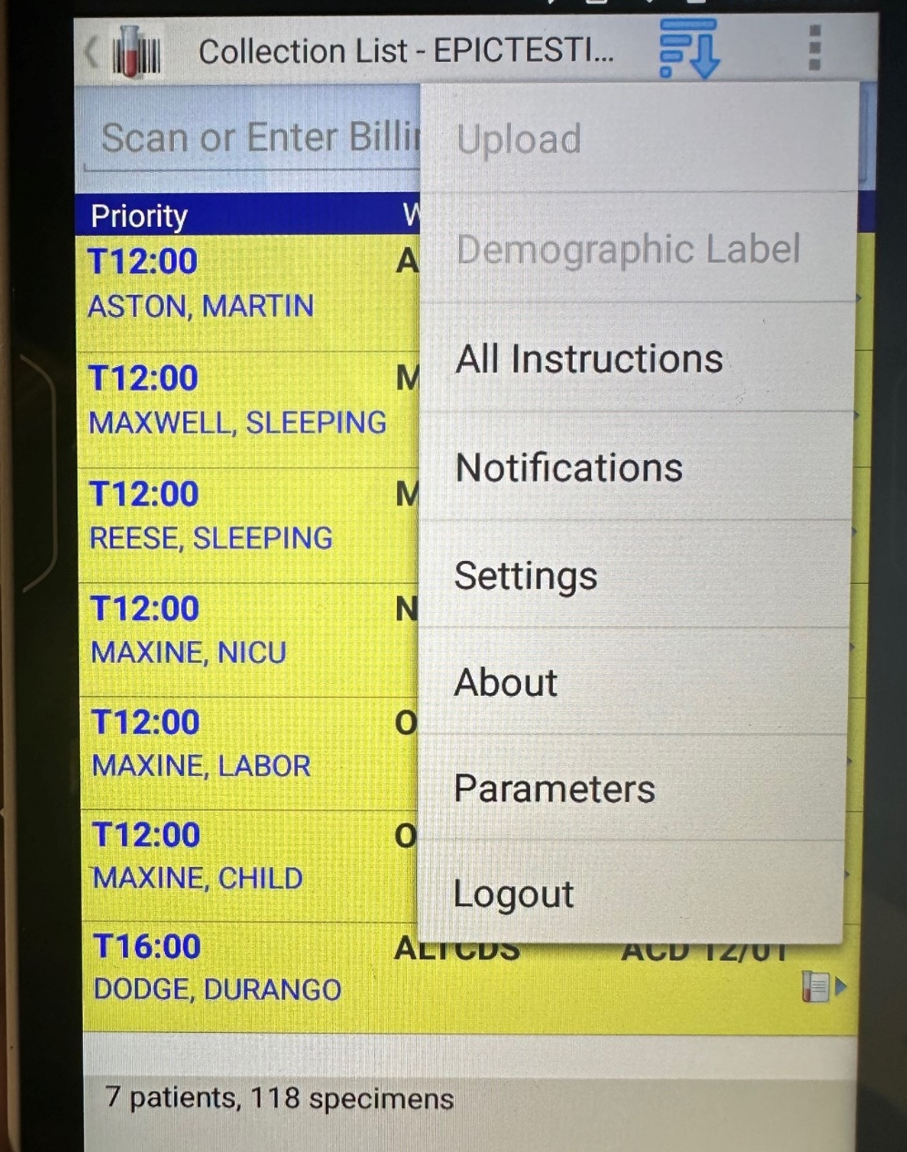
Log out
To log out, click the Menu (3 dots in the right hand corner)
Select Logout.

Slide 25
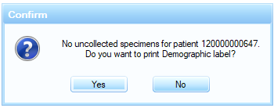
Demographic Label
During urgent situations (code stroke, etc.), there maybe times when orders have not populated SoftID, but the patient needs to be drawn. Here, a demographic label can be printed.
After scanning the patient’s armband, the system will indicate there are no uncollected specimens and will prompt the user to print a demographic label.
Click Yes.
Verify the patient information when prompted, then click Verify.

Slide 26
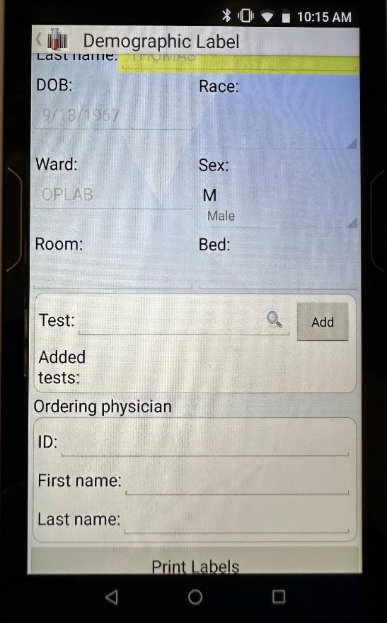
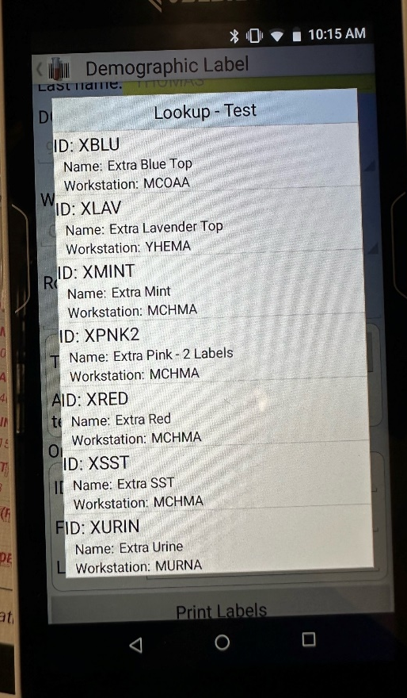
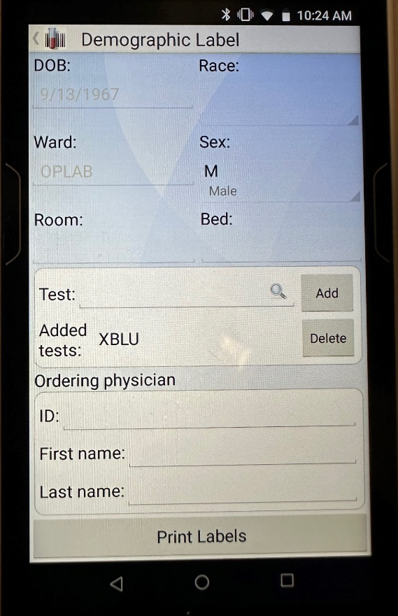
Demographic Label
The Demographic Label box will appear. In the Test field, click the magnifying glass to select the tube to be drawn.
If more than one tube is needed, select from the list again. Repeat as necessary. If a tube is added in error, to remove it click the Delete button next to the tube.
When finished adding the tubes, click Print Labels

Slide 27
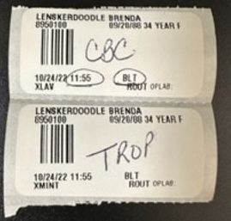
Demographic Label
The demographic label will print for each added test/tube.
The collector’s initials and the time of the collection will print on the label.
Write the test to be performed on the label.
The demographic label can be used in place of a chart label, saving the end user from having to manually indicate the time of collection and their initials.

Slide 28
Tips to Remember
Only print the labels for the specimens that have been obtained.
Whoever draws the specimen is the one printing the label (You Draw, You Print)
If blood needed exceeds the volume of the tube, two labels will print – draw two tubes of that color
Put the correct label on the correct specimen tube (colors must match) – Look at the Label!
Do Not scan the specimen label until the blood is drawn and the label is on the tube/specimen.
If you printed a label for an uncollected specimen, reschedule the draw and shred the label.

Slide 29
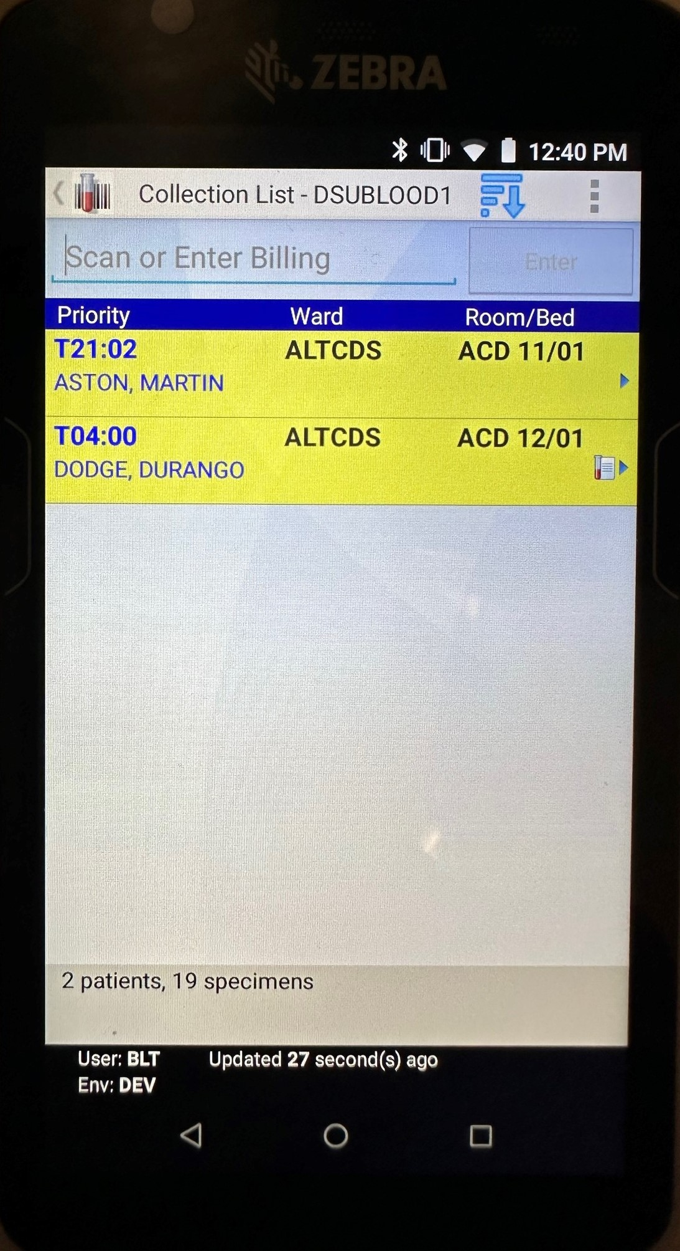
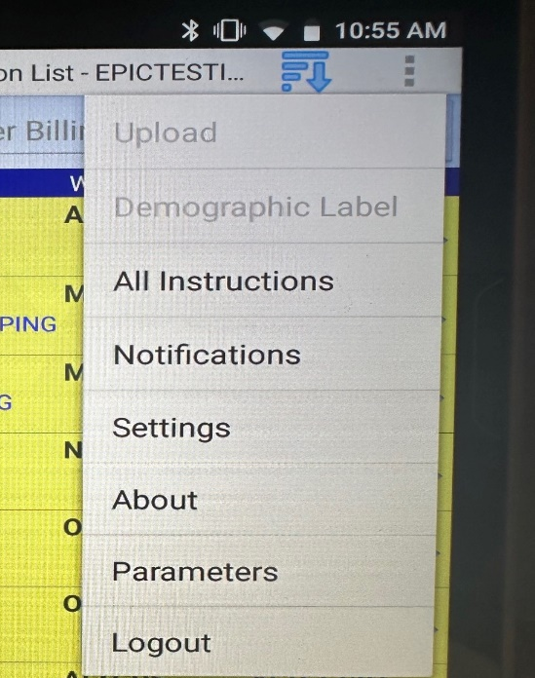
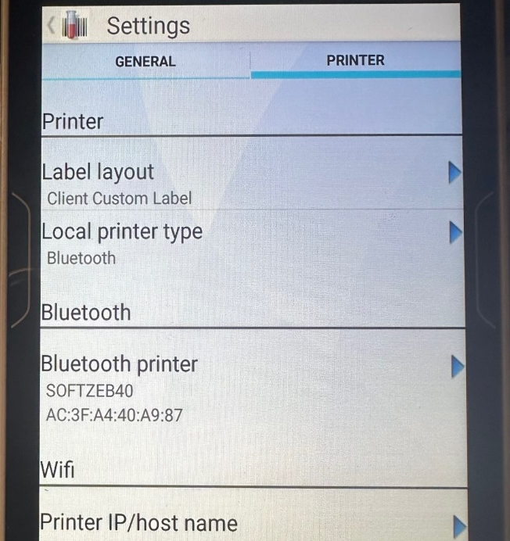
Pairing the Hand held and Printer
If the hand held and printer become unpaired:
From the Collection list, select menu (three dot menu).
Tap Settings.
Tap or slide to the Printer tab and tap the Bluetooth printer under Bluetooth.

Slide 30
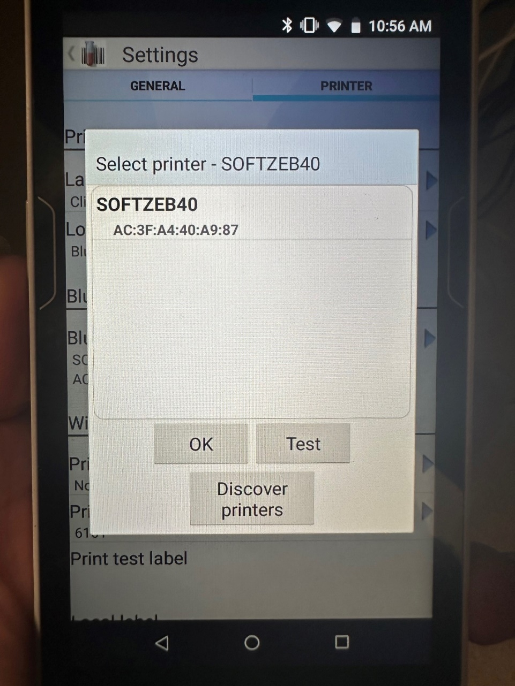
Pairing the Hand held and Printer continued:
Tap Discover printers if your printer is not listed in the Select printer field.
Select your printer and press Test. Make sure the test label prints to the expected printer.
Select OK.
Select Back to exit.

