Slide 1
ABL 90 FLEX PLUS by Radiometer
POC Blood Gas Analyzer Operation & Maintenance 2023
Laura Sandor MT(ASCP)

Slide 2
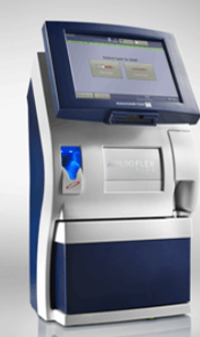
ABL 90 FLEX PLUS
The ABL 90FLEX PLUS blood gas analyzer is designed for POC testing
Results available in as little as 35 seconds on up to 17 parameters: blood gas, electrolytes, metabolites and oximetry
Areas of use include Yorkville FEC
Test panels can be designed for areas of use to best serve the patient’s treatment & outcome
**tBili only available for neonatal specimens

Slide 3
Blood gases: pH, pCO₂, PO₂ Oximetry: tHb, sO₂, FO2Hb, FCOHb, FHHb, FMetHb, FHbF Electrolytes: Sodium (Na+), Potassium (K+), Chloride (Cl-), ionized Calcium (Ca²⁺) Not done in Yorkville Metabolites: Glucose, Lactate, tBilirubin (tBili-neonates only) Not done in Yorkville
Up to 17 critical parameters in 65 µl of blood!

Slide 4
ABL 90 FLEX PLUS: Front View Features
APRIL 2023

Slide 5
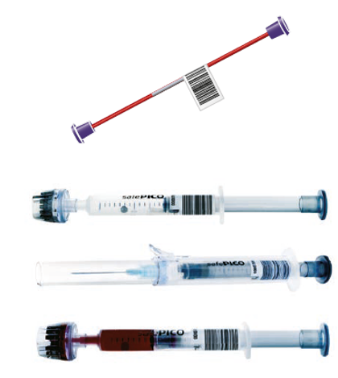
Sample Types
Choose either Syringe or Capillary
Arterial, Venous, Mixed Venous and Capillary blood may be processed
Heparin is the only anticoagulant recommended by Radiometer
Dry electrolyte-balanced heparin is preferred
Do not use EDTA as an anti-coagulant as it will cause incorrect pH, pCO², Na⁺, K⁺ & Ca²⁺ results

Slide 6
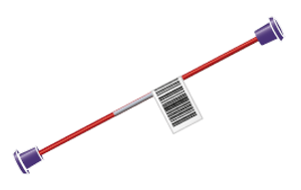
Sample Storage Conditions
All samples should be processed as quickly as possible after collection!
NEVER place syringe or capillary samples on ice-keep at room temperature!
Syringe samples must be analyzed within 30 minutes of collection
Samples with high pO₂ values should be analyzed within 5 minutes after they are collected
Capillary samples must be analyzed within10 minutes of collection

Slide 7
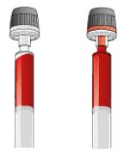
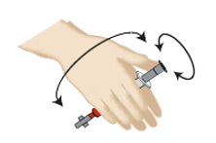
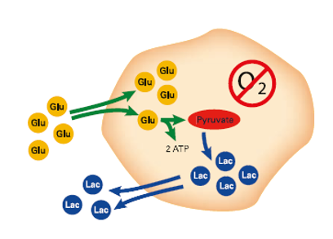
Sample Integrity
Inspect and Expel
Mix! Mix! Mix!
Analyze Promptly!
Visually check sample for appearances of air bubbles
Expel any bubbles from sample prior to analysis
A homogenous sample is critical to proper analysis
Mixing reduces sedimentation
Mix the sample by rolling between the palms or rotating the sample in a figure 8 configuration.
Expel the 1st two drops to ensure sample homogenization.
When using safePICO syringe, use mixer on analyzer.
The sample will continue to metabolize so it is critical to analyze the sample within the listed time restraints.
The following analytes are affected by delayed analysis: pO2 , pCO2 , pH , Ca2+ , Glu , Lac

Slide 8
Consumables
Solution Pack
Contains pouches with QC and calibration material, rinse solution, a gas mixture and closed containers to hold liquid and clot waste
Store at Room Temperature (18ºC-30ºC)
Solution packs are good for up to 30 days once placed on the instrument
A Solution pack can be reinstalled on another instrument if done prior to the scheduled replacement date and there are activities remaining for the pack
APRIL 2023

Slide 9
Consumables
Sensor Cassettes
Contains sensors for the tests (except for the oximetry and bilirubin tests)
Store refrigerated 2-8ºC
Sensor cassettes are good for up to 30 days once placed on the instrument
A Sensor Cassette can be reinstalled on another instrument if done prior to the scheduled replacement date, the transfer is completed within 2 hours from removal from the original unit and there are activities remaining for the pack
After a sensor cassette replacement, a calibration is performed with every measurement for the first four hours
APRIL 2023

Slide 10
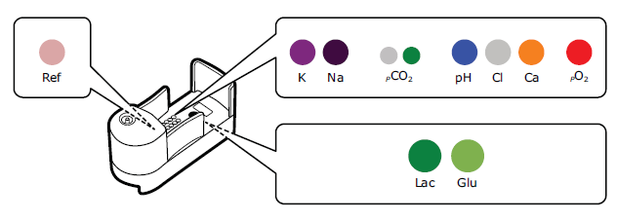
Consumables: Sensor cassette cont’
The sensors are located on sensor boards in the Sensor Cassette
4 different measuring principles are employed
Potentiometry: measures pH, pCO₂, K⁺, Na⁺, iCa²⁺ & Cl⁻
Amperometry: Glu and Lac
Optical pO₂: pO₂
Spectrophotometry: tHb, sO₂, FO₂Hb, FCOHb, FHHb, FMetHb, FHbF & tBili
APRIL 2023

Slide 11
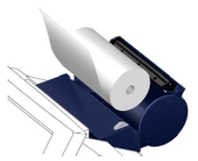
Consumables
Inlet Gasket Holder
Holds the Inlet Gasket where you place your sampling device for sample aspiration
Changed during scheduled service but may need to be changed off-schedule
Thermal Printer Paper
Unwinds from underneath, paper needs to extend out of printer before closing chamber
Instrument does NOT inform operator when paper roll needs to be replaced!
Keep unused rolls of paper in dark, away from heat
APRIL 2023

Slide 12
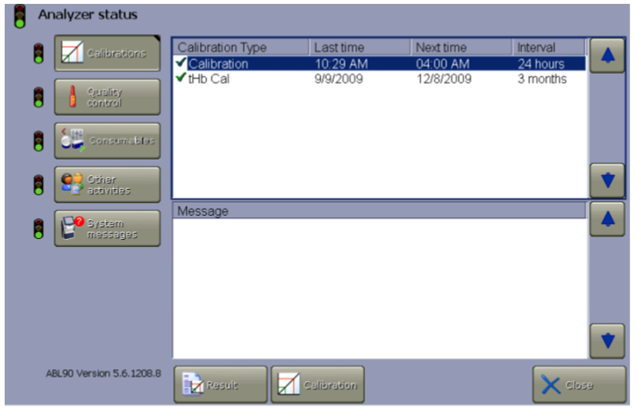
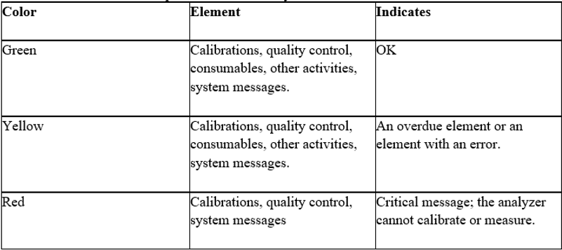
Analyzer Status
The analyzer functions on the traffic light system of GREEN, YELLOW & RED
The Analyzer status icon is found on the main screen at the top of the banner
Press the button to access detailed status information
Verify all errors are corrected prior to sample processing

Slide 13
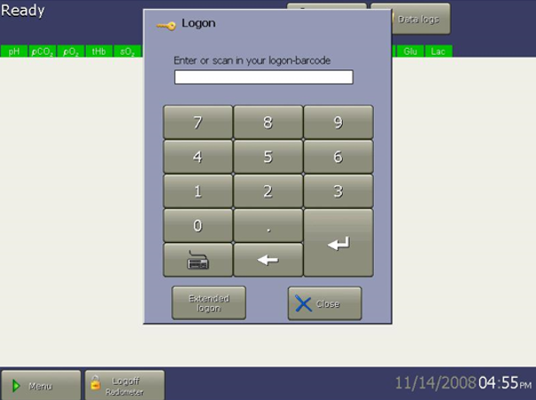
Instrument Access
Scan your badge or enter your logon using the keypad
APRIL 2023

Slide 14
Quality control
3 levels of Internal Quality Control (QC) are contained in the Solution Pack
One level of QC is processed every 8 hours
The traffic light for each parameter must be green in order to produce a result for that parameter
Resolve any QC issue prior to processing patient samples

Slide 15
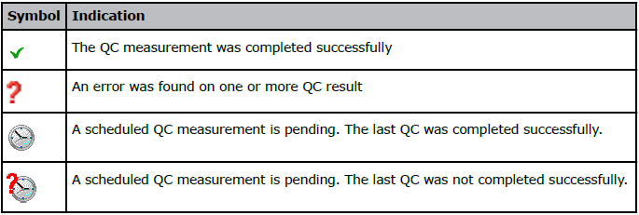
Quality Control Measurement Status
Tap MENU→ ANALYZER STATUS
Tap the QUALITY CONTROL button
APRIL 2023

Slide 16
Sample Processing General
The analyzer screen must show READY in upper left-hand corner
All analytes must be Green, indicating no errors are present for sample analysis
Make sure that the Inlet probe does not touch the plunger or fiber disk of the syringe as this could lead to incorrect sample aspiration
To avoid bending the Inlet probe, hold the sampling device still during sampling.
If the Inlet probe gets bent, do NOT use the analyzer, the probe must be replaced.
Once the Inlet is opened, there is a short time to complete the actions necessary for sampling
Delay in removing the sampling device when prompted can cause the sample to be aborted.

Slide 17
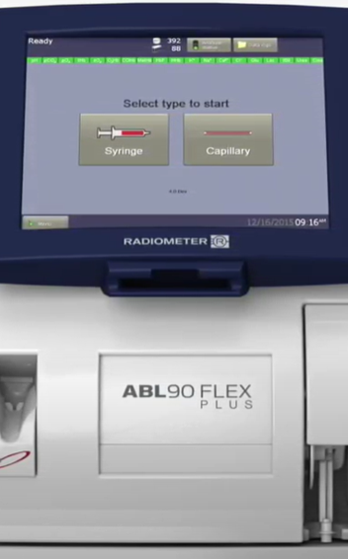
Sample Processing
Verify
Verify that READY appears in the upper left-hand corner
Verify
Verify that all Parameters are GREEN and the Analyzer Status is GREEN
Scan
Scan employee badge (or enter badge number) to access the instrument
Select
Select either the SYRINGE or CAPILLARY icon to initiate the processing sequence
Select
Select the correct Sample Mode/Panel for the sample type selected

Slide 18
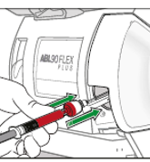
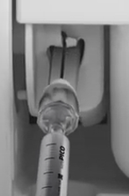
Sample Processing Syringe
Syringe samples
The Analyzer opens the Inlet after Syringe is selected
Select the measurement/panel required for the sample
Follow the directions on the screen
If the sample is collected in a safePICO with a safeTIPCAP cap, do not remove the cap prior to analysis
Holding the syringe by the barrel, place & hold the tip of the syringe in the center of the Inlet gasket
Push the syringe into the analyzer as far as it will go and hold it in position as instructed
Remove the syringe when directed, the analyzer will close the Inlet.
Scan the patient barcode into the system

Slide 19
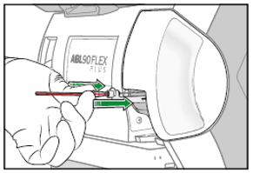
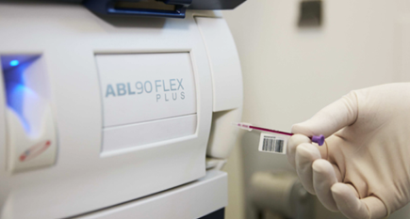
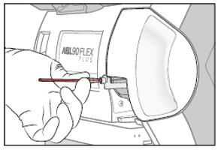
Sample Processing Capillary
Capillary samples (not typically done in Yorkville)
Remove the capillary end caps and attach the Clot Catcher to one end
The Analyzer opens the Inlet after Capillary is selected
Select the measurement mode/panel required for the sample
Follow the directions on the screen
Holding the capillary by the Clot Catcher, place & hold the tip of the Clot Catcher in the center of the Inlet gasket
Push the capillary into the analyzer as far as it will go and hold it in position as instructed
Remove the capillary when directed, the analyzer will close the Inlet.
Scan the patient barcode into the system

Slide 20
Measurement Process
Patient, Quality Control and Calibration samples are all processed similarly
The sample is drawn into the Sensor measurement chamber and Oximetry measurement chamber
Liquid sensors control the measurement process and can detect inhomogeneity and air bubbles in the sample
If a measurement is aborted, a message is attached to the result if problems are detected or the sample volume is too low.
A rinse of solution and air/gas occurs after each sample
A status calibration is done for all parameters after each sample
APRIL 2023

Slide 21
Sample Result
Sample results are generated in approximately 35 seconds
Verify the patient results match the patient conditions
Verify all parameters have generated a result
Results with a ? indicate that an error has occurred
Accept or reject the results using the icon at the bottom of the results screen
Results that have been accepted will automatically be sent to the patient’s chart
Print results using the Print icon
APRIL 2023

Slide 22
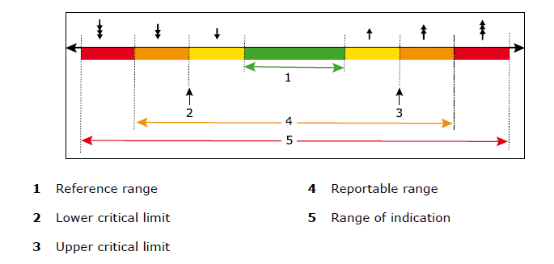
Sample Results
Measurement results are marked by symbols to show where they fall in relation to reference ranges, critical limits and reportable ranges. The diagram illustrates these relationships.
No values are issued for any analyte marked with the 3 arrows (up or down) as the range of indication is the instrument range not the reportable range

Slide 23
Troubleshooting
Troubleshooting a recommended action
Troubleshooting quality control errors
Troubleshooting quality control messages
Follow the instructions on the screen for resolution
Select the QC measurement marked by symbol
Tap the RESULT button
Tap the MESSAGES button
Select the message
Tap the TROUBLESHOOT button
Follow the instructions on the screen for resolution
Select the QC MESSAGE
Tap the TROUBLESHOOT button
Follow the instructions on the screen for resolution

Slide 24
Troubleshooting
Troubleshooting calibrations
Troubleshooting calibration messages
Troubleshooting consumables or system messages
Select the calibration measurement marked by a symbol
Tap the RESULT button
Tap the MESSAGES button
Select the message
Tap the TROUBLESHOOT button
Follow the instructions on the screen for resolution
Select the CALIBRATION MESSAGE
Tap the TROUBLESHOOT button
Follow the instructions on the screen for resolution
Select the message on the screen
Tap the TROUBLESHOOT button
Follow the instructions on the screen for resolution

Slide 25
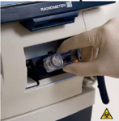
Maintenance: Video aids on board for performing each function
Solution Pack
Sensor Cassette
Inlet Gasket Module & Holder
Printer Paper
Stable for up to 30 days on analyzer
Follow directions provided by the on- board video
Stable for up to 30 days on analyzer
Follow directions provided by the on- board video
Change as needed, analyzer does not notify operator.
Cover must “click” into place after replacement
Replaced by service or as needed
Follow directions provided by the on- board video

Slide 26
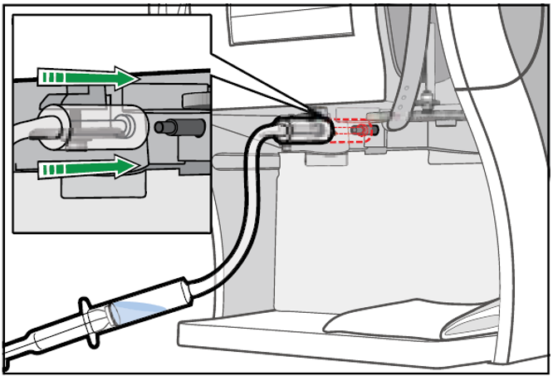
Maintenance: Flushing/Cleaning as needed
Fluid Transport System
Flushing of the Fluid Transport System is indicated when a clot may be present, follow the on-board video
Inlet Gasket
Clean to verify correct sample aspiration, use lint-free cloth & water
Touch Screen
Use tap water & lint-free cloth to clean, 70% alcohol to disinfect
Analyzer exterior
Cleaning wet wipes have not been validated, use soapy water & lint-free cloth
APRIL 2023

Slide 27
Limitations of Use
tBili results are only valid on neonatal samples-do not expose to artificial light or sunlight! (Not done in Yorkville)
All consumables are to be treated as biohazardous waste
Heparin is the only anticoagulant acceptable for use
Homogeneity and time restrictions are critical for sample integrity
If the Inlet Probe is bent, it must be changed before the instrument may be used for sample analysis
Use a Clot Catcher when analyzing a capillary sample (Capillary not done in Yorkville)
The color of the battery symbol changes from green to red when the power falls below 14%. The analyzer shuts down when less than 11%

Slide 28
Limitations of Use cont’
Hemolysis may cause K⁺ , Na⁺ , Ca²⁺ and cannot be determined visually in whole blood.
It may take up to 4 hours for a new sensor cassette to condition after installation
A calibration is performed with every sample for the first 4 hours. It does a calibration with every sample.

Slide 29
You have completed the ABL Blood Gas module. You may review the material contained in this CBL before proceeding to the test questions.

