Slide 1
LABORATORY TDG
Safe Transportation of Clinical Specimens

Slide 2
HOW DO I FIT IN?
Everyone who handles laboratory clinical specimens, including the person who loads or unloads, is responsible for making sure the goods are transported safely to the referral laboratory.
Each individual involved should;
  Understand the hazards of class 6 dangerous goods
  Recognize the hazards shown by labels and placards.
  Be able to demonstrate training on class 6 dangerous goods.
  Handle the clinical specimens carefully to prevent spills and leaks.
  Take appropriate action in case of a spill or leak.
It is each employer’s responsibility to provide specific details about the dangerous of Class 6 dangerous goods to their employees are expected to handle, ship or transport.

Slide 3
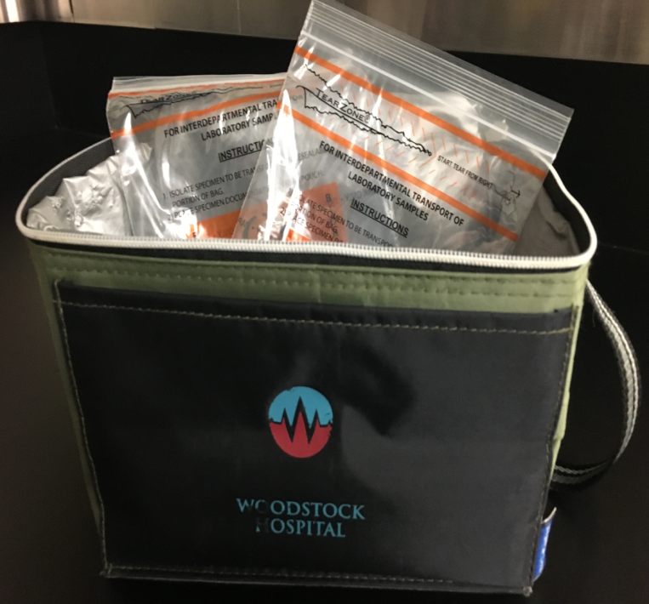
Shipper
The person who prepares the shipment:
Finds out the classification
Packages the goods securely
Completes a shipping document.
Labels and marks the packages
Provides placards if necessary.

Slide 4
Driver
Before accepting a shipment, the driver:
  All documentation is complete.
  Ensures that the labels and markings used on containers match the information on the shipping documents.
  Drivers must not accept shipments until the document, labels and markings are complete and correct. They must not accept containers that could leak or are in poor condition.
The driver also:
  Attaches placards, if required
  Makes sure the dangerous good are loaded and secured properly
  Carries the document with the goods

Slide 5
Receiver
The person who unloads the shipment is a handler of dangerous goods and has the general responsibilities listed earlier under, How Do I Fit In?

Slide 6
CLASS 6 – TOXIC / INFECTIOUS SUBSTANCES
Class 6 products or substances harm people by poisoning or infecting them. Infectious substances are divided into two categories; A (the most hazardous) and B (less hazardous).

Slide 7


Category A
Infectious substances in Category A are known or suspected to cause disease.
The label and placard show a “biomedical” symbol, and the label has specific emergency instructions.
There are two shipping names for Category A:
Infectious substances, affecting humans – UN 2814
Infectious substances, affecting animals – UN 2900

Slide 8

Category B
There is only one shipping name for Category B.
  Biological substance, Category B
  Small containers must display UN number 3373 in a diamond
  For more information about Class 6.2, contact Health Canada’s Office of Laboratory Security, Biosafety Division, at 613-957-1779.

Slide 9
Please complete the accompanying quiz

