Slide 1
Proficiency Testing
What is Proficiency Testing (PT)?
Why do we do PT?
What happens if a PT challenge is missed?
What else do we investigate through PT?
What are the causes of missed PT challenges?
Who should I ask if I have questions about PT?

Slide 2
Proficiency Testing
What is Proficiency Testing (PT)?

Slide 3
What is Proficiency Testing?
Proficiency Testing (PT) is a program in which multiple samples are periodically sent to members of a group of laboratories for analysis and/or identification, in which each laboratory’s results are compared with those of other laboratories in the group and/or with an assigned value, and reported to the participating laboratory and others.

Slide 4
What is Proficiency Testing?
PT allows the laboratory’s results to be compared to its peers, reference standards, and/or reference laboratories.
PT serves as an external validation of the quality of a laboratory's results.

Slide 5
What is Proficiency Testing?
College of American Pathologists (CAP) PT is used for most tests at SHSL
When CAP PT is not available, other commercial PT providers are used, such as DEQAS or RCPA
When there is no commercially available PT, laboratories are required to complete an Alternate Assessment. There are a number of ways to complete Alternate Assessment. Often at SHSL, we utilize blind testing

Slide 6
What is Proficiency Testing?
CAP/DEQAS/RCPA sends specimens for testing to the participating laboratories
The laboratories analyze the specimens, and submit the results to CAP/DEQAS/RCPA
Results are evaluated using comparable peer groups, or a reference method
Results over time are evaluated and monitored by the laboratory, CAP, and CMS.

Slide 7
Proficiency Testing
Why do we do Proficiency Testing?

Slide 8
Why Do We Do Proficiency Testing?
To meets regulatory and accreditation requirements
Regulatory Requirements: Centers for Medicare & Medicaid Services (CMS) is a US federal agency. CMS regulates all medical laboratory testing performed on humans in the U.S. through the Clinical Laboratory Improvement Amendments (CLIA)
Accreditation: The CAP inspects and accredits medical laboratories under the deemed authority of CMS

Slide 9
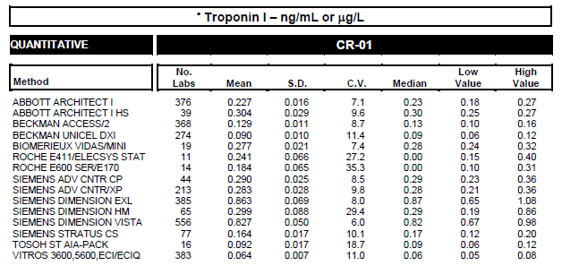
Why Do We Do Proficiency Testing?
Allows comparison of performance and results among different testing sites

Slide 10
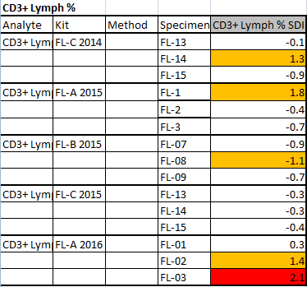
Why Do We Do Proficiency Testing?
Provides early warning for systematic problems associated with imprecision, systematic error, and human error

Slide 11
Why Do We Do Proficiency Testing?
Provides objective evidence of testing quality

Slide 12
Why Do We Do Proficiency Testing?
Indicates areas that may need improvement
Identifies training needs

Slide 13
Why Do We Do Proficiency Testing?

Slide 14
Proficiency Testing
What happens if a PT challenge is missed?

Slide 15
What happens if a PT challenge is missed?

Slide 16
What happens if a PT challenge is missed?

Slide 17
What happens if a PT challenge is missed?
Regulated Analytes: Regulated analytes are tests and/or subspecialties for which PT through a CMS approved program is required by CLIA regulations. CAP reports results to CMS, and CMS monitors the laboratory’s results. Examples of regulated analytes include Sodium, Chloride, and Potassium. PT for regulated analytes must occur three times per year, with five challenges (specimens) each.
Non-Regulated Analytes: PT or Alternative Assessment is required for all non-regulated analytes twice per year. CAP does not report results to CMS, however, CAP Accreditation Program monitors the laboratory’s results for CAP PT.

Slide 18
What happens if a PT challenge is missed?
Regulated Analytes:
Unsatisfactory PT Performance is failure to attain a satisfactory score (80% for most) for 1 testing event
Unsuccessful PT Participation is failure to attain a satisfactory score for 2/2 of 2/3 testing events
Repeat Unsuccessful PT Performance is unsatisfactory PT performance in 3/3 or 3/4 testing events. Also, 2/3 testing events occurring two times for the same analyte
Non-Regulated Analytes:
Similar missed PT escalation with a few differences. See CAP reference for details

Slide 19
What happens if a PT challenge is missed?
Regulated Analytes
Missed PT Escalation | Description | Actions
Unsatisfactory PT Performance | Failure to attain a satisfactory score for 1 testing event | *Investigation and Corrective Action required *Lab is mailed a PT Compliance Notice (PTCN) *PTCN response not required to be mailed to CAP, unless it was a failure to participate
Unsuccessful PT Performance | Failure to attain a satisfactory score for 2/2 or 2/3 testing events | *Investigation and Corrective Action required *Lab is mailed a PT Compliance Notice (PTCN) *PTCN response is required to be mailed to CAP *CAP will review and will alert the laboratory they are in danger of receiving a cease testing
Repeat Unsuccessful | Failure to attain a satisfactory score for 3/3 or 3/4 testing events, or 2 occurrences of 2/3 testing events for the same analyte | *The laboratory will be required to cease testing for the analyte/subspecialty for 6 month *Laboratory Director must acknowledge cease testing form *Submission of evidence of ceased testing, Investigation report (root cause analysis), corrective action plan, patient impact analysis, and retraining documentation

Slide 20
Proficiency Testing
What are the causes of missed PT challenges?

Slide 21
What are the causes of missed PT challenges?

Slide 22
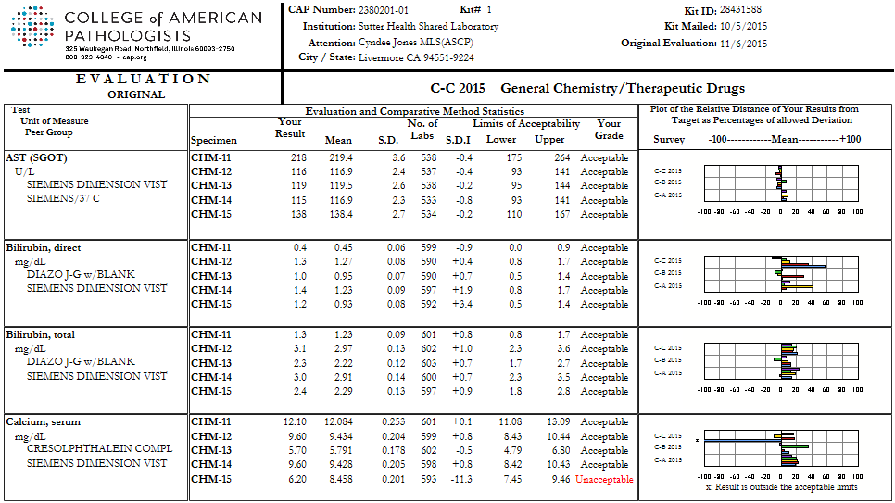
What are the causes of missed PT challenges?
What causes of PT misses do we see here at Shared Lab?

Slide 23
What are the causes of missed PT challenges?
Clerical
Incorrectly transcribed results
Missed Test Orders
Tests ordered, but testing not done
Incorrect Test Codes for Assigned Survey
Incorrect method codes

Slide 24
What are the causes of missed PT challenges?
Procedural
PT specimens cannot be repeated, unless that is the procedure you would use for patient testing
PT samples must be integrated within the routine laboratory workload. For example, if we batch testing, PT samples must be incorporated in batches.
PT samples must not be referred to another laboratory. This includes PT result interpretations.

Slide 25
CAP Checklist Item
COM.01600 PT Integration Routine Workload Phase II
The laboratory integrates all proficiency testing samples within the routine laboratory
workload, and those samples are analyzed by personnel who routinely test patient/client
samples, using the same primary method systems as for patient/client/donor samples.
NOTE: Duplicate analysis of any proficiency sample is acceptable only if patient/client specimens
are routinely analyzed in the same manner. With respect to morphologic examinations
(identification of cell types and microorganisms; review of electrophoretic patterns, etc.), group
review and consensus identifications are permitted only for unknown samples that would
ordinarily be reviewed by more than one person in an actual patient sample.
If the laboratory uses multiple methods for an analyte, proficiency samples should be analyzed
by the primary method. The educational purposes of proficiency testing are best served by
a rotation that allows all testing personnel to be involved in the proficiency testing program.
Proficiency testing records must be retained and can be an important part of the competency
and continuing education documentation in the personnel files of the individuals. When
external proficiency testing materials are not available, the semiannual alternative performance
assessment process should also be integrated within the routine workload, if practical.
Evidence of Compliance:
✓ Written policy describing proper handling of PT specimens AND
✓ Instrument printout and/or work records AND
✓ Completed attestation pages from submitted PT result forms

Slide 26
Proficiency Testing
What else do we investigate through PT?

Slide 27
What Else Do We Investigate Through PT?

Slide 28
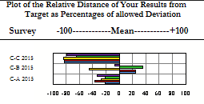
What Else Do We Investigate Through PT?
The QA department investigates PT result trends over time
One common area of investigation occurs when PT results are all acceptable, but indicate that there could be an assay bias for an analyte, with respect to other laboratories using the same method

Slide 29
Proficiency Testing
Who should I ask if I have questions about PT?

Slide 30
Resources
Proficiency Testing Policy, Proficiency Testing Procedure, and Proficiency Testing Workflow are located in Lab QMS under Quality Assurance
Technical Directors, Technical Managers, Technical Supervisors, and Leads are available for questions about Proficiency Testing
QA Manager and QA Specialists are available for questions about Proficiency Testing

Slide 31
Resources
Escalation Process for PT Failures of CLIA Regulated Analytes/Subspecialties/Specialties:
http://www.cap.org/apps/docs/laboratory_accreditation/build/pt-tip-sheet.pdf
Troubleshooting Guide for Proficiency Testing Data:
http://www.cap.org/apps/docs/proficiency_testing/troubleshooting_guide_for_pt_data.pdf
CLIA :
https://www.cms.gov/Regulations-and-Guidance/Legislation/CLIA/index.html
CLIA Brochure #8 - Proficiency Testing:
https://www.cms.gov/Regulations-and-Guidance/Legislation/CLIA/Downloads/CLIAbrochure8.pdf

