Slide 1
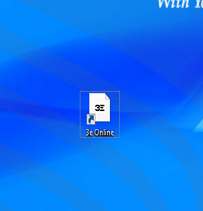
3eOnline.com
Objective:
Navigate and understand Website Tools
Obtain SDS
Print Labels

Slide 3
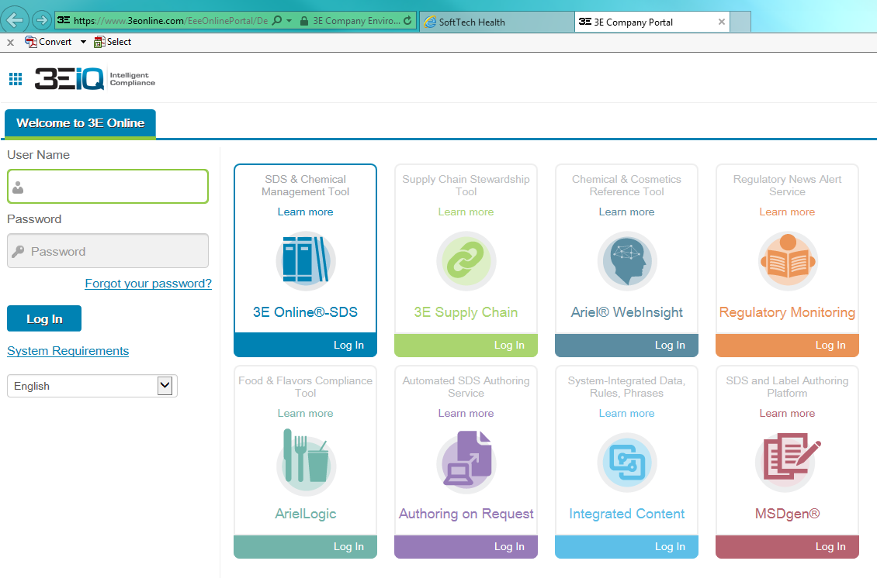
SHSL

Slide 4
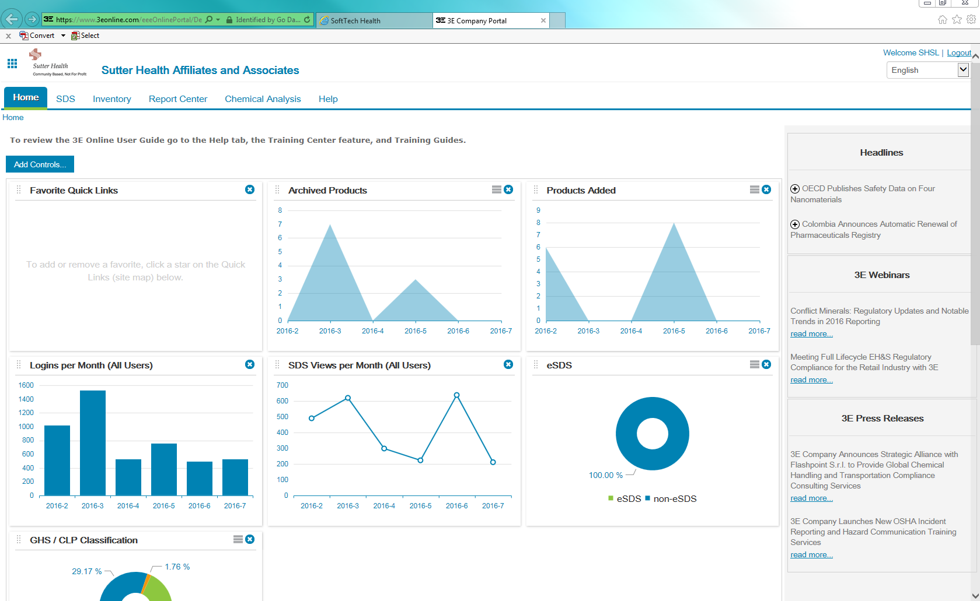
Click on Inventory tab on top and select “Search Inventory”

Slide 5
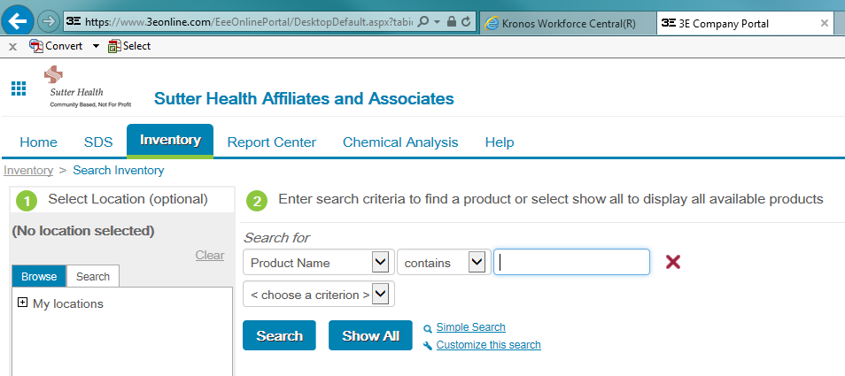
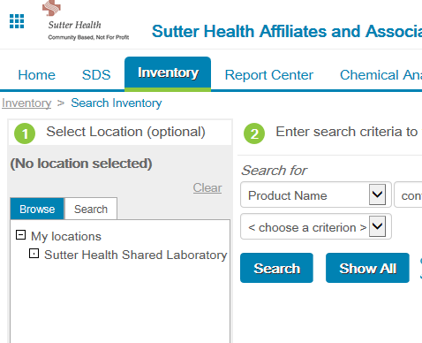
Click on “+” sign and click on “Sutter Health Shared Laboratory to make sure you are searching within the Shared Laboratory.

Slide 6
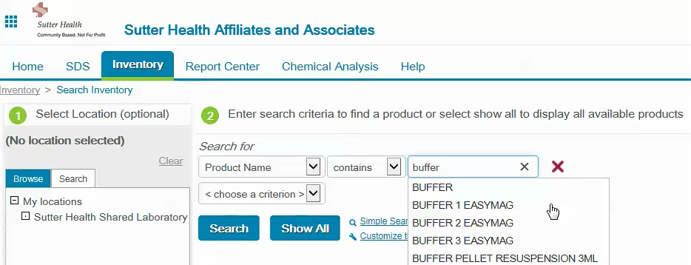
Enter words that will help search for the chemical. For example, enter “buffer” then click “Search”

Slide 7
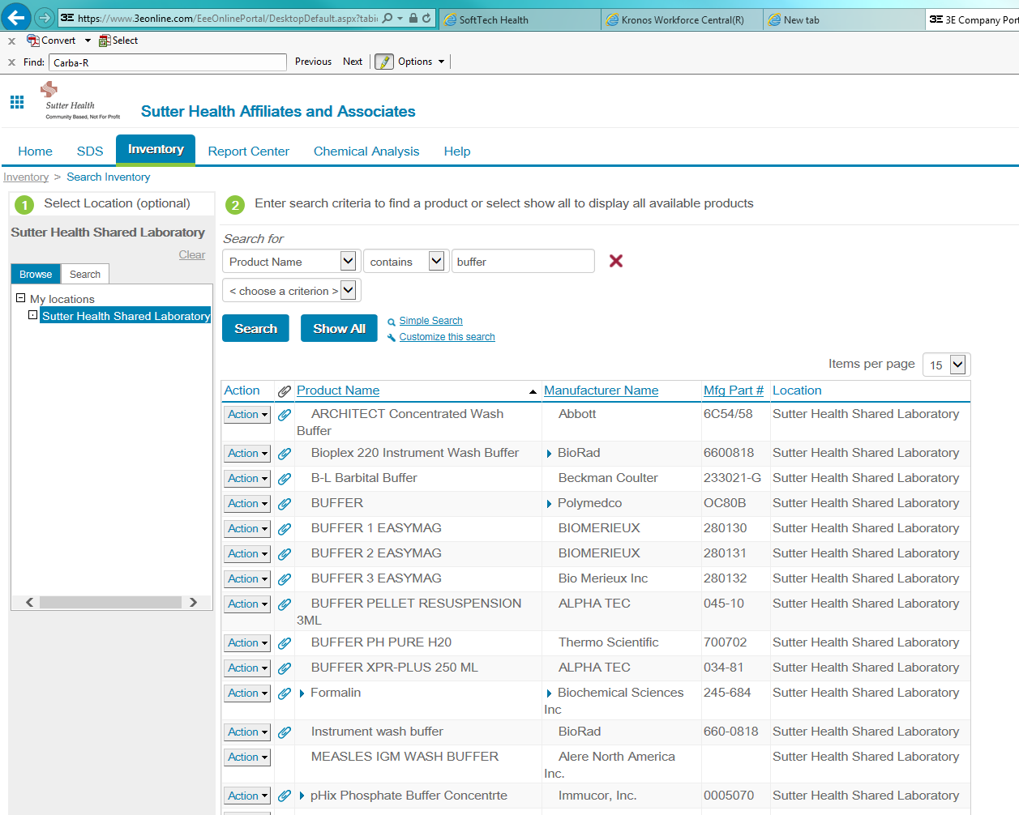
Search Results within Shared Lab

Slide 8
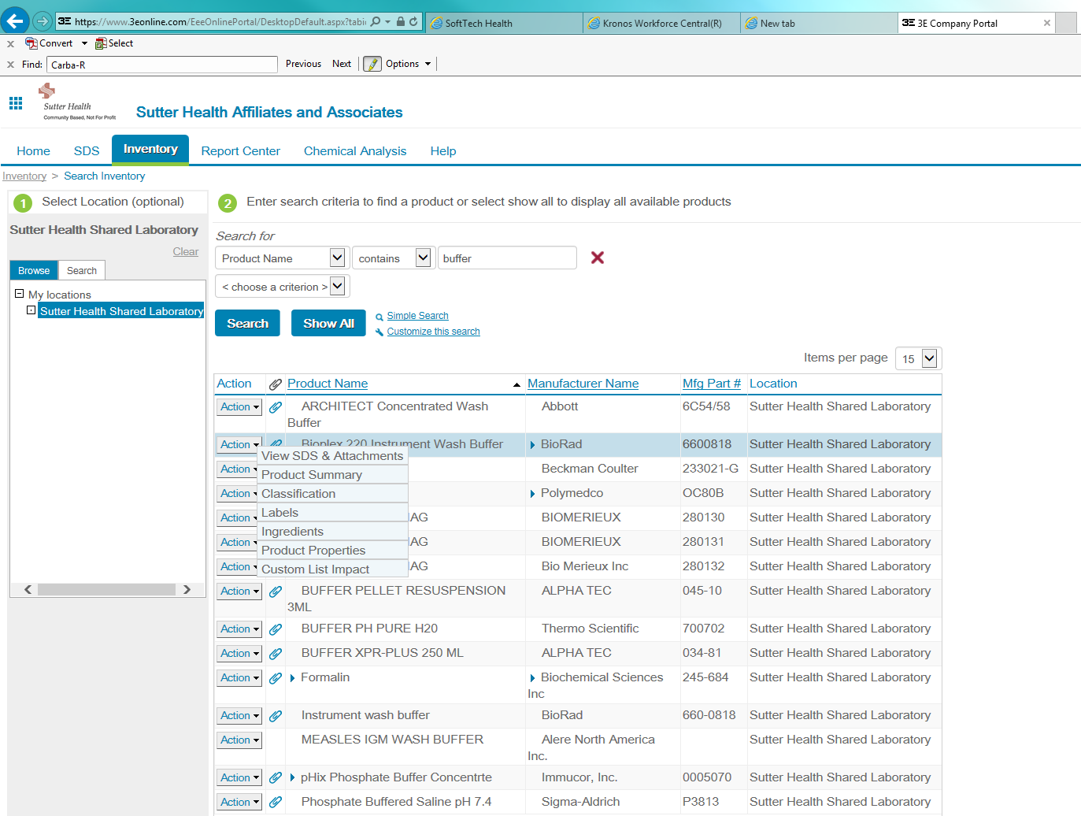
Click on next to “Action” to see choices of actions
Select “View SDS & Attachment to see SDS
Select “Labels” to print chemical label for secondary container

Slide 9
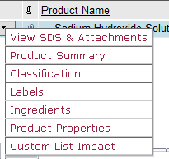
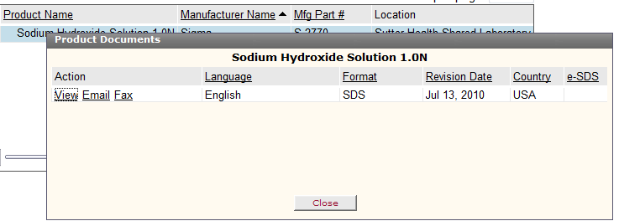
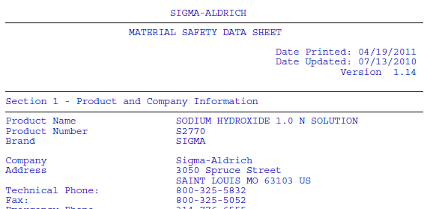
View SDS & Attachments
Action Pop-Up
Note: Manufacturer SDS formats will be different

Slide 10
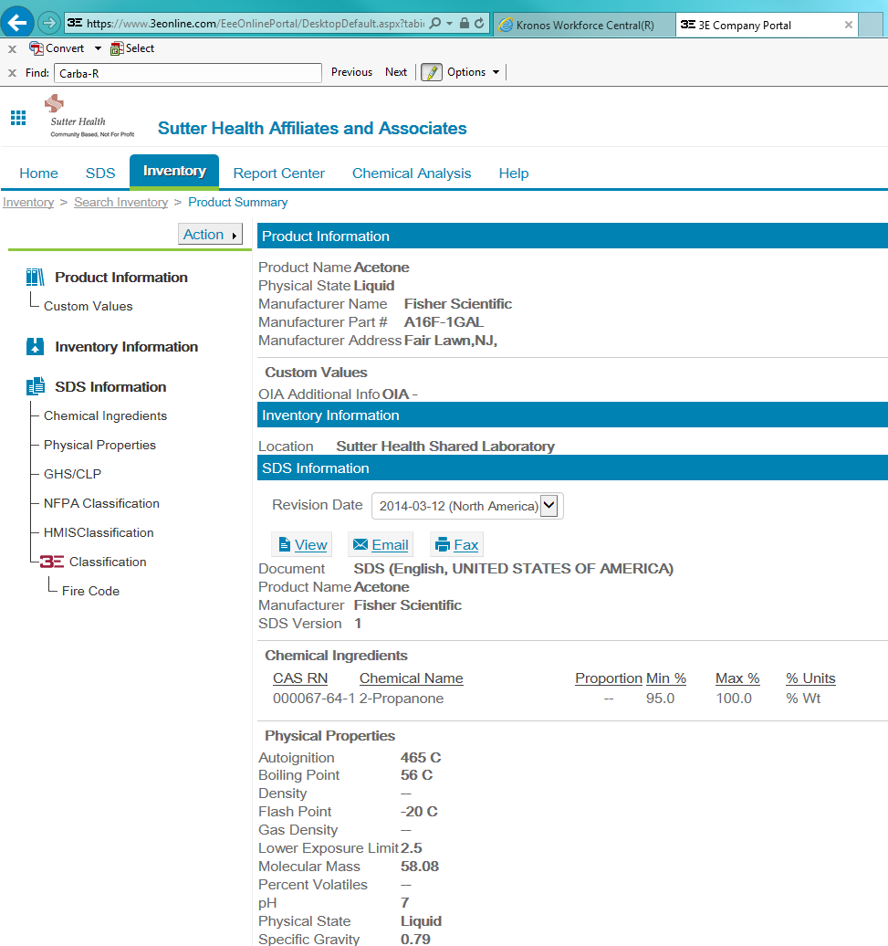
Product Summary

Slide 11
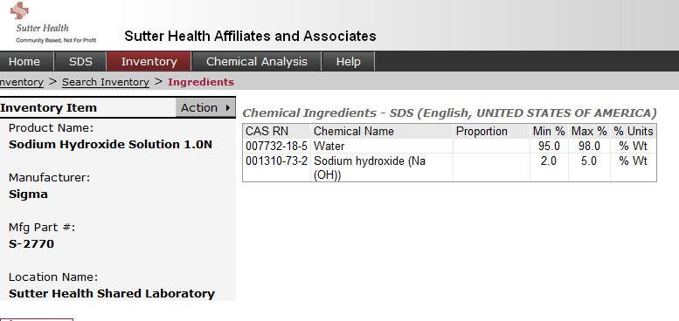
Inventory
Action Pop-Up
Defined Chemical components with quantity

Slide 12
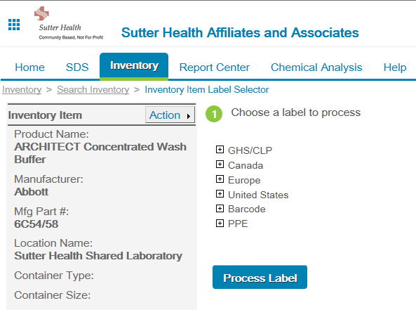
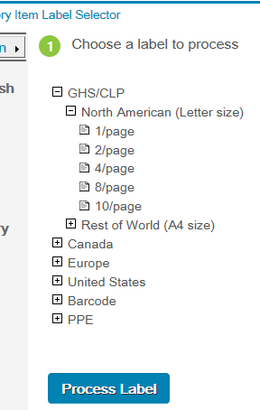
Inventory
Labels
OSHA now uses GHS labeling system
Click on “+” sign to open up options

Slide 13
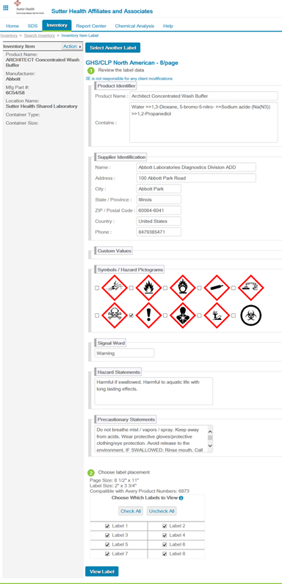
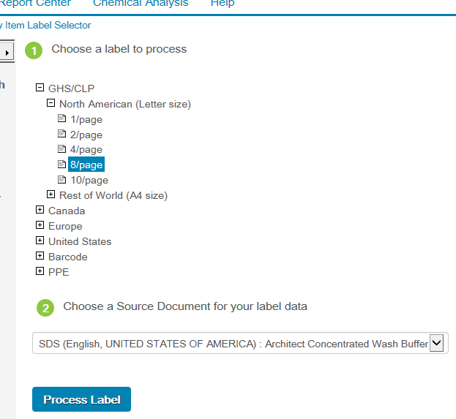
Labels
Select size of labels-the more the labels on a page, the smaller the size of each label
Information on label
Click on “Process Label
Click on “View Label”

Slide 14
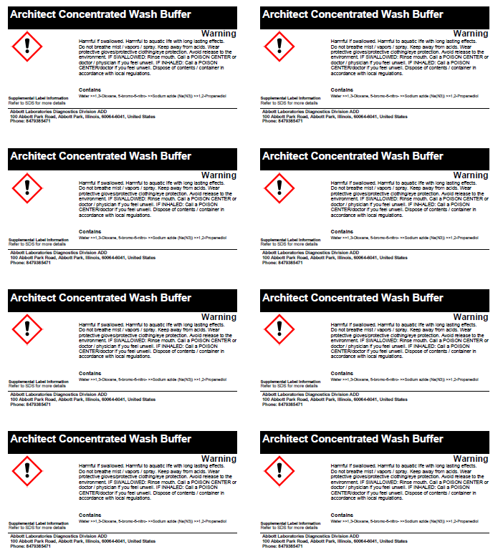
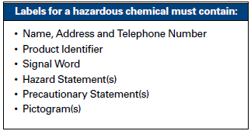
Labels
Print them on labels or regular paper

Slide 15
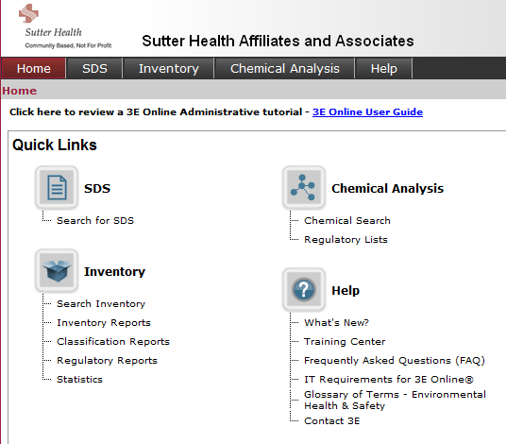
Chemical Analysis

Slide 16
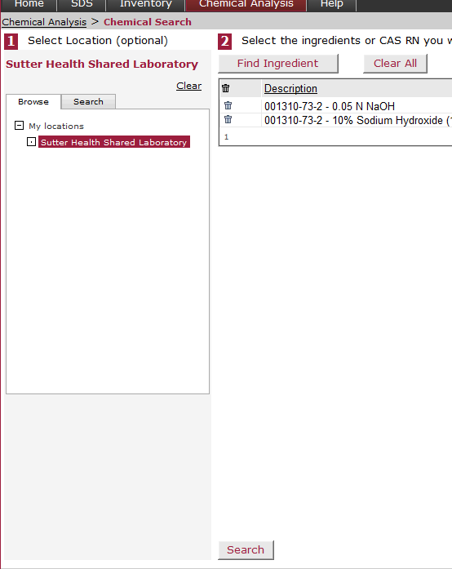
Chemical Analysis
1. Click Search
2. CLICK: OK
!DO NOT DELETE!
3. Click Search

Slide 17
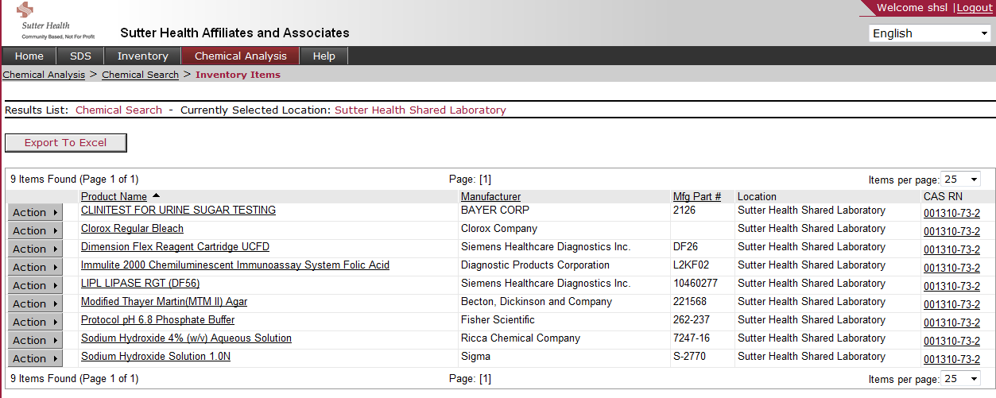
Chemical Analysis
List of all chemicals which contain
Sodium Hydroxide CASRN 001310-73-2

Slide 18
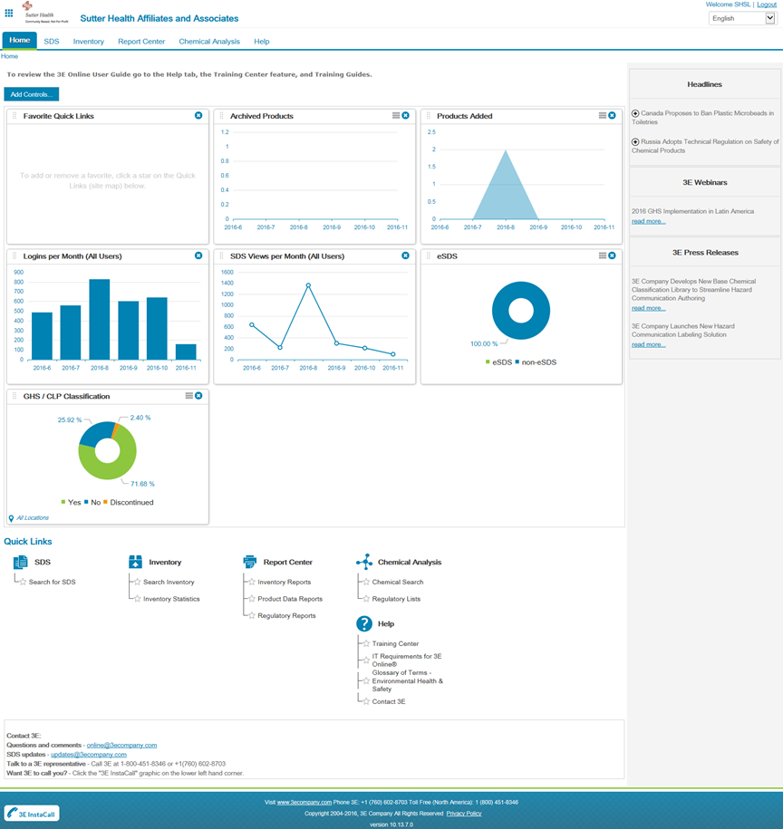
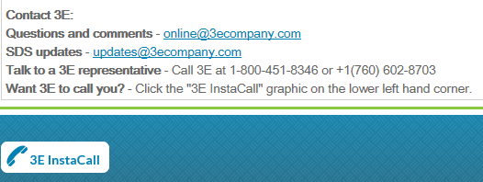
HELP

Slide 19
3eOnline.com
Questions??

