Slide 1
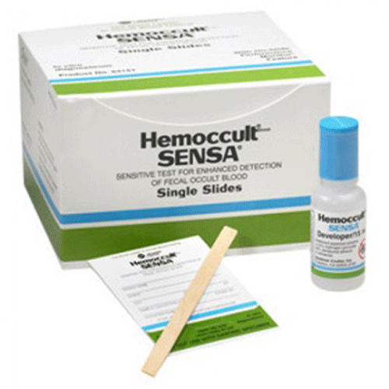
Welcome to the Learning Module: BSHR Point of Care Testing
Hemoccult Sensa Fecal Occult Blood Testing
Course Description
This course presents information about specimen collection and testing for fecal occult blood using the Hemoccult Sensa specimen collection card.
Course Objectives
At the completion of this course, the participant will:
recognize the correct method for applying a specimen to the hemoccult card.
know the proper method for performing the quality control.
understand how to interpret test results.
know how to document test results.
know how to document quality control.

Slide 2
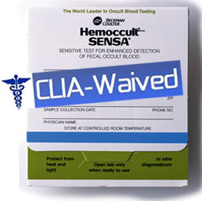
BSHR Point of Care Testing
Hemoccult Sensa Fecal Occult Blood Testing
Intended Use
The hemoccult test is a rapid, convenient and qualitative method for detecting fecal occult blood, which can be indicative of gastrointestinal disease.
It is not a test for colorectal cancer or any other specific disease.
The test is a CLIA (Clinical Laboratory Improvement Amendments of 1988) waived screening test.

Slide 3
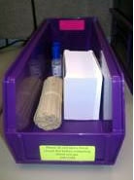
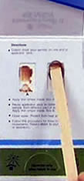
BSHR Point of Care Testing
Hemoccult Sensa Fecal Occult Blood Testing
Collecting the Specimen
 | Step 1 |  | Step 2
 | Retrieve the hemoccult test card and applicator stick from the Hemoccult Kit on your unit. Place a patient barcoded label on the hemoccult card after properly identifying your patient against their armband. |  | Open the front flap of the card and apply a small amount of specimen taken from two different areas of the specimen. Wait 3-5 minute

Slide 4

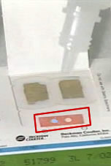
BSHR Point of Care Testing
Hemoccult Sensa Fecal Occult Blood Testing
Developing the Specimen
1. Open the back flap of the card and apply 2 drops of developer to test windows. 2. Interpret patient test results. 3. Apply 1 drop of developer to the performance monitor area. 4. Interpret performance monitor.
 | Step 1 | Step 2

Slide 5
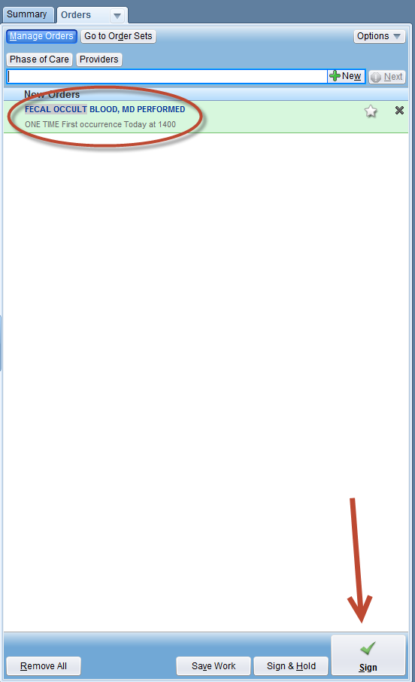
BSHR Point of Care Testing
Hemoccult Sensa Fecal Occult Blood Testing
Documenting Results
ALL patient test results must be recorded with each card tested.
Patients are not charged for the test until results are documented properly.
While in the patient’s chart, order “Fecal Occult Blood, MD Performed.”
Sign the Order.

Slide 6
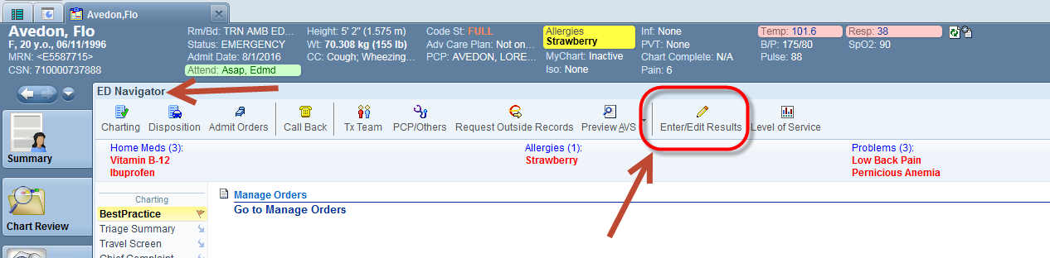
BSHR Point of Care Testing
Hemoccult Sensa Fecal Occult Blood Testing
ED PROVIDERS ONLY
Once the order has been signed, the screen will probably go back to the ED Navigator (if not, manually go back to the ED Navigator). The provider must then click the “Enter/Edit Results” activity at the top on the navigator.

Slide 7
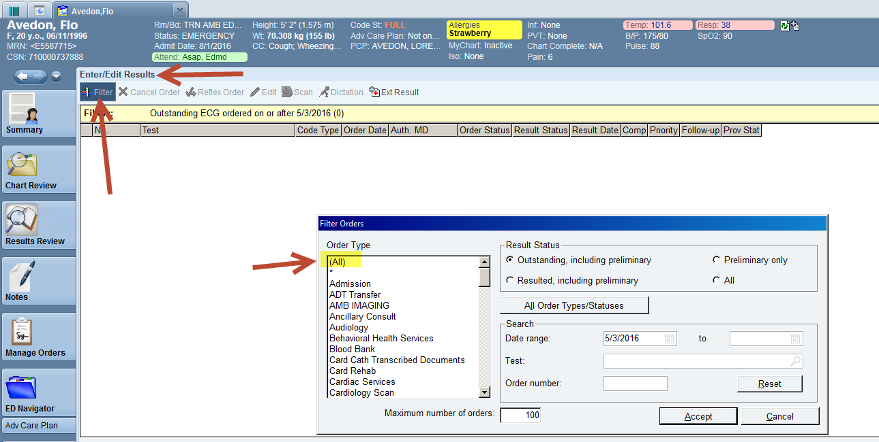
BSHR Point of Care Testing
Hemoccult Sensa Fecal Occult Blood Testing
ED PROVIDERS ONLY
Next, the provider must click on “Filter” and scroll to find and select “All” at the very top of the list. Once “All” has been selected, click “Accept”.

Slide 8
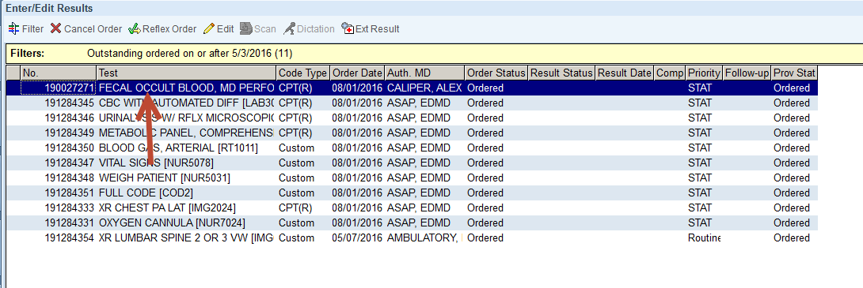
BSHR Point of Care Testing
Hemoccult Sensa Fecal Occult Blood Testing
ED PROVIDERS ONLY
This shows a list of all the orders. The provider must then double-click on the order he placed that needs to be resulted.

Slide 9
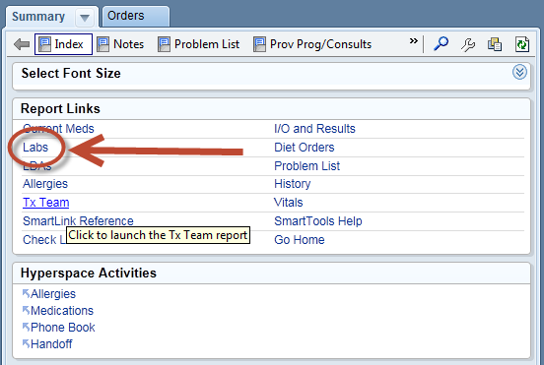
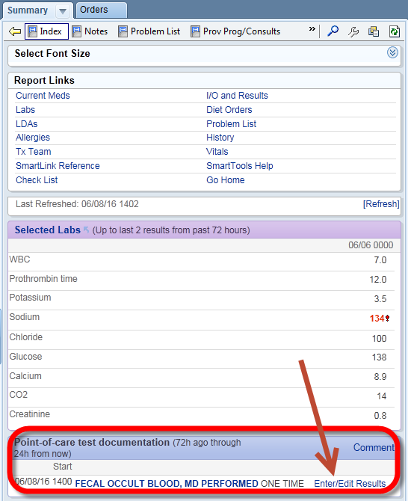
BSHR Point of Care Testing
Hemoccult Sensa Fecal Occult Blood Testing
Documenting Results
Once the order has been signed, go to the summary tab in the sidebar and click on the “Labs” hyperlink under Report Links.
A link will open to enter the results.

Slide 10
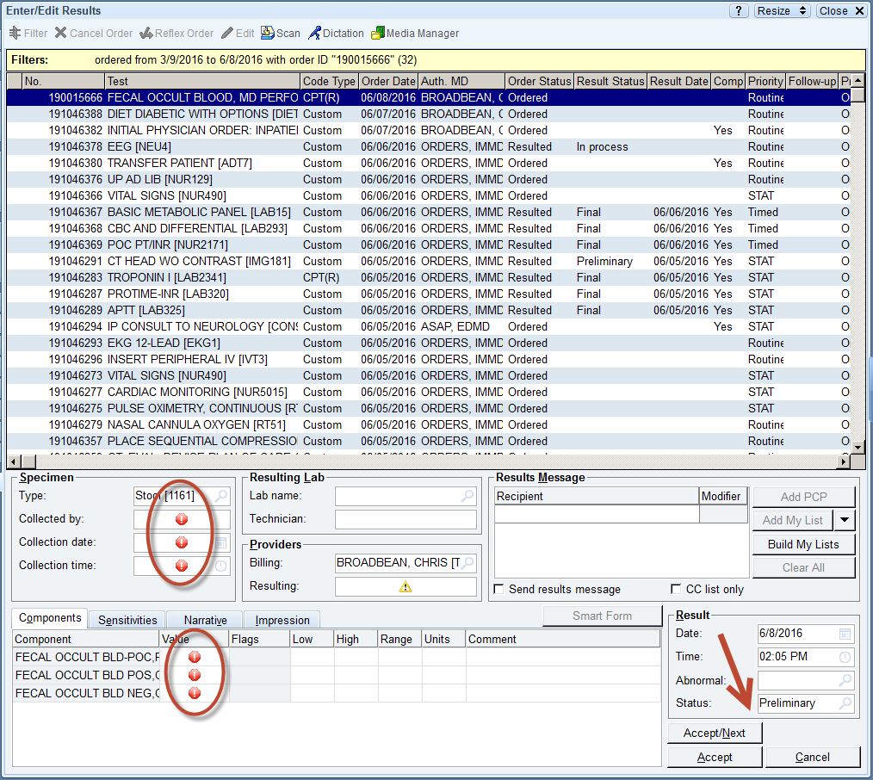
BSHR Point of Care Testing
Hemoccult Sensa Fecal Occult Blood Testing
Documenting Results
By clicking the “Enter/Edit Results” link, a screen will open for the results to be entered.
Fill in all of the hard stops.
Important: Change the Result Status from Preliminary to Final.

Slide 11
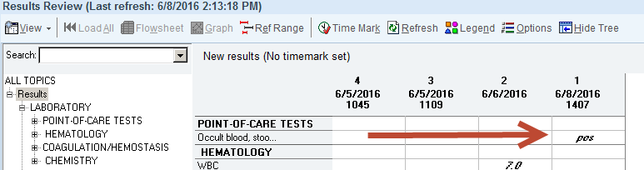
BSHR Point of Care Testing
Hemoccult Sensa Fecal Occult Blood Testing
Documenting Results
The results are now available in Results Review.

Slide 12
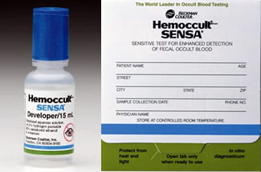
BSHR Point of Care Testing
Hemoccult Sensa Fecal Occult Blood Testing
Points to Remember
Any blue color in the patient test area indicates a positive result, regardless of the color intensity. Colored stripes on the card and the developer must match. It is not OK to test gastric samples with hemoccult developer or use gastroccult developer in the place of hemoccult developer. Personnel who are color blind may not interpret test results. Used hemoccult tests may be disposed of in the regular trash.

Slide 13
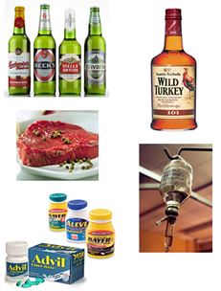
BSHR Point of Care Testing
Hemoccult Sensa Fecal Occult Blood Testing
False Positives
 | Some substances can cause false positive test results. Examples include: Red meat - beef, lamb and liver Aspirin NSAIDS - ibuprofen, indomethacin and naproxen Anticoagulants Chemotherapy Corticosteroids Alcohol in excess
 | Dietary iron supplements do not produce false positive test results.

Slide 14

BSHR Point of Care Testing
Hemoccult Sensa Fecal Occult Blood Testing
False Negatives
 | Some substances can cause false negative test results. Examples include: Ascorbic Acid (Vitamin C) in excess of 250 mg. per day Excessive amounts of citrus fruits Excessive amounts of citrus juices Iron supplements containing Vitamin C in excess of 250

Slide 15
BSHR Point of Care Testing
Hemoccult Sensa Fecal Occult Blood Testing
Interesting Facts to Know
Occasionally, a light blue discoloration can be on the test paper, this does not affect the accuracy or performance of test. Specimens with a high bile content will appear green. - A distinct green color appearing on or at the edge should be reported as negative. Hemoccult results can be positive on healthy patients. This can be due to interfering substances in the diet or medications.

