Slide 1
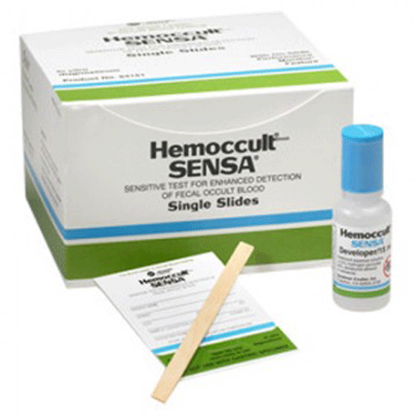
Welcome to the Learning Module: BSV Point of Care Testing Fecal Occult Testing using the Hemoccult Sensa Cards
Course Description: This training course presents an overview of the Hemoccult test, which is a rapid, convenient and qualitative method for detecting fecal occult blood which may be indicative of gastrointestinal disease. It is not a test for colorectal cancer or any other specific disease. It is considered a waived screening test.
Click Next to continue

Slide 2
Performing the Test
Retrieve card from kit.
Patients may be given cards to take home to inoculate with specimen and returned at a later date or specimen can be collected in the office.
Open front flap and inoculate card from 2 different sites.
Wait 3 to 5 minutes before developing.
Open back flap and apply 2 drops of developer to test windows.
Apply 1 drop in the Performance Monitor areas.
Interpret patient results and Performance Monitors.

Slide 3
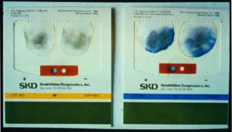
Quality Control
This test has it’s own built-in internal control, so no external control material is needed.
There is no QC log for this test, as you will result your control in CC (acceptable or unacceptable) along with your patient’s result.

Slide 4
Important Facts about fecal occult testing
Any blue color indicates a positive result, regardless of the intensity.
Colored stripes of the card and developer must match.
Testing personnel must not be colorblind.
Hemoccult cards can be disposed in the regular trash.

Slide 5
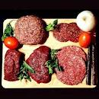
Substances that may cause False Positives
Red meat (beef, lamb and liver)
Aspirin, Ibuprofen, Indomethacin and Naproxen
Anticoagulants, Chemotherapy, Corticosteriods
Alcohol in excess
Dietary iron supplements will not produce false positive test

Slide 6
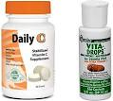
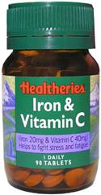
Substances that may cause False Negatives
Ascorbic Acid (Vitamin C) in excess of 250 mg per day
Excessive amounts of citrus fruits and juices
Iron supplements containing Vitamin C in excess of 250 mg per day

Slide 7
Limitations to the Test
Occasionally, a light blue discoloration may be on the guaiac test paper. This does not affect the accuracy or performance of test.
Specimens with a high bile content will appear green. A distinct green color appearing on or at the edge should be reported as negative.
Hemoccult results may be positive on healthy patients. This may be due to interfering substances in the diet or medications.

Slide 8
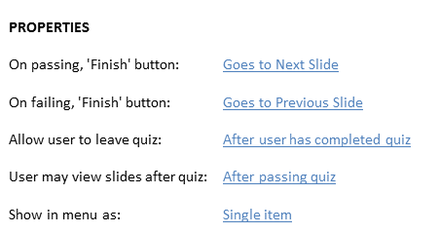
Agreement

Slide 9
1
Exit
2
To exit this course:
Click the “X” in the upper right corner of the page.
Once the course exits, you will see a green banner on the HealthStream web page, similar to the below image:

