Slide 1
OB Point of Care Testing
February 3, 2017 and February 10, 2017

Slide 2
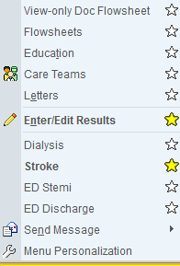
Add Enter/Edit Results to Activities
1- Select More Activities
2- Select the star next to Enter/Edit Results
3- The Enter/Edit Results option has now been added to your activities
2
3
1

Slide 3
Step #1: Enter the POC Order
1- Select the Orders Activity button
2- Select the Manage Orders button
3- Select
1
2
3

Slide 4
Step #1: Enter the POC Order
4- The orders preference list will open
5- Select the Lab section → Point of Care Tests
6- Order the appropriate point of care test
4
6
5

Slide 5
Step #2: Enter the Results for the Test
1- Select the Enter/Edit Results
2- You should see the point of care test(s) you ordered. Select the appropriate point of care test.
2
1

Slide 6
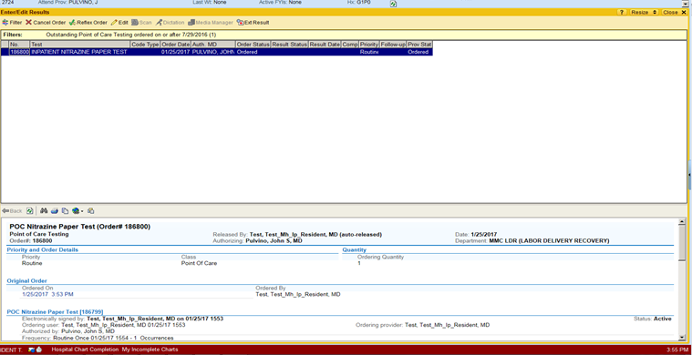
Step #2: Enter the Results for the Test
3- The Edit button should display → Select the Edit button
3

Slide 7
Step #2: Enter the Results for the Test
4- Enter the results of the point of care test
4

Slide 8
Step #2: Enter the Results for the Test

Slide 9
Step #3: Review Point of Care Results
1- Select the Results Review activity
2- Select POC
1
2

