Slide 1
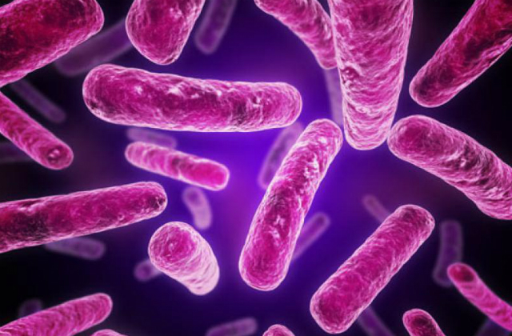
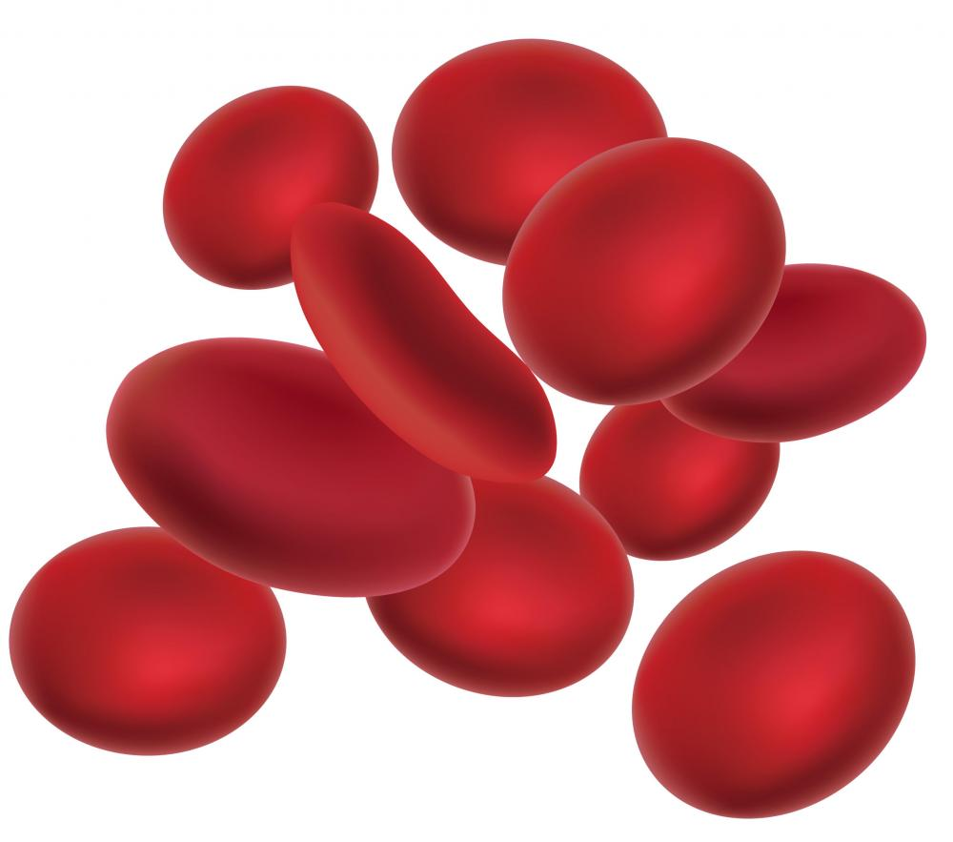
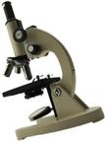
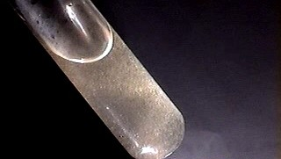
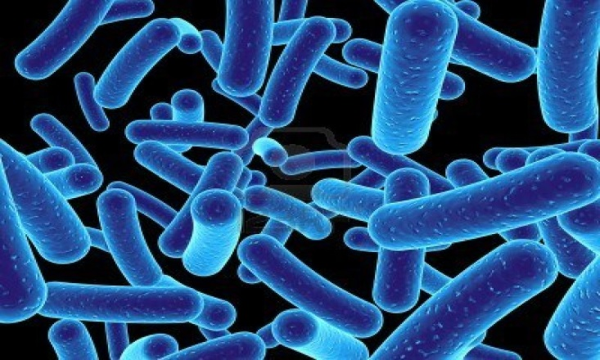
WET MOUNT
TESTING

Slide 2
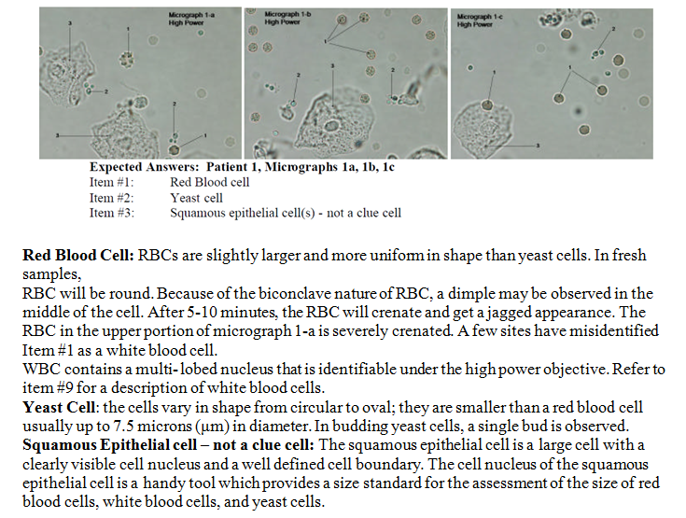

Slide 3
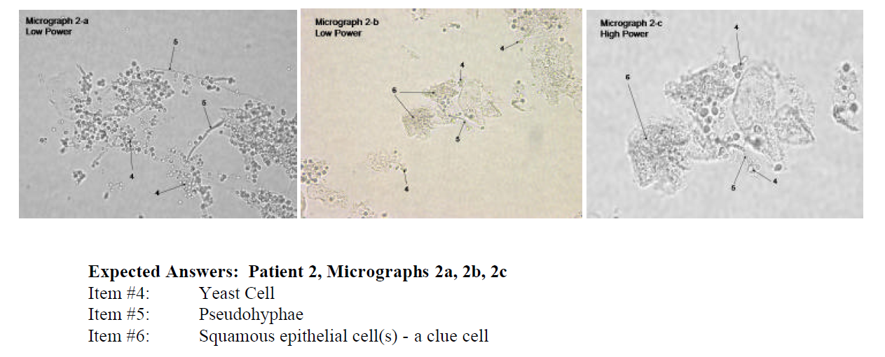
Yeast Cell: See the comments in Micrograph 1 for a description of yeast.
Pseudohyphae: These are fragile tube- like structures that arise through elongation of the yeast form of
Candida. They are called pseudohyphae because they lack true branching as seen with mold like fungi.
The side walls are parallel to each other which is an important characteristic that helps separate
pseudohyphae from artifact whose side walls vary in width. Small oval structures called bastoconidia are
often seen attached along the length of the pseudohyphae. The blastoconidia are smaller in size when
compared to the yeast form of Candida.
Clue Cell: Clue cells are squamous epithelial cells that are covered with a thick matte of bacterial cells
and is associated with bacterial vaginosis. The traditional definition of a clue cell is that the bacterial
overgrowth is so thick that all cell detail (such as the cell nucleus and the cellular edge) are totally
obscured. It is possible, however, to detect the nucleus in a clue cell by using the fine focus to focus
through several focal lengths.

Slide 4
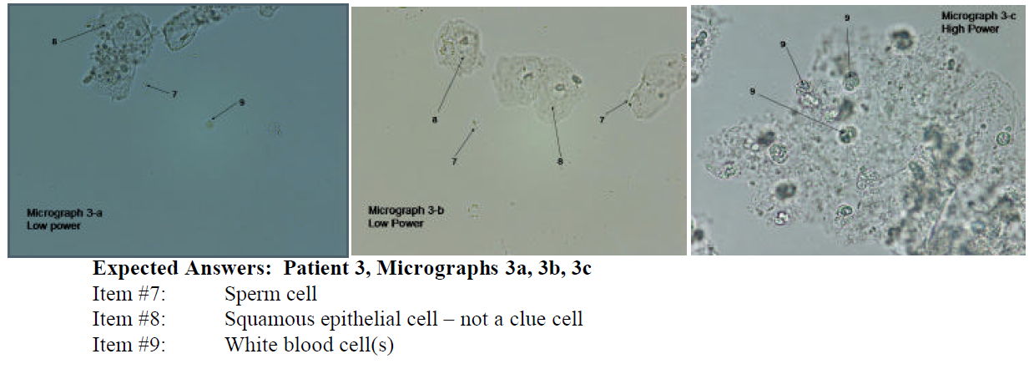
Sperm Cell: The characteristic shape of a sperm cell is a tapered tail attached to an oval head.
Squamous epithelial cell – not a clue cell: See the comment for item #3.
White Blood Cell: These cells are larger than Red Blood Cells and are approximately the same size as
the nucleus of a squamous epithelial cell. You can most easily compare the relative size of the white
blood cell with the size of the squamous epithelial cell nucleus by screening on low power. Switch to the
high power objective, however, to make a definitive identification of White Blood Cells. Under high
power, the nuclear detail of the WBC becomes apparent. The WBC is characterized by a multilobed
nucleus (usually three distinct lobes can be identified). A white blood cell is approximately the same size
as the nucleus of the squamous epithelial cell

Slide 5
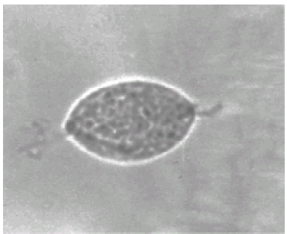
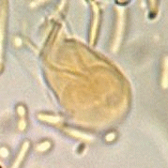
Trichomonas vaginalis
• Presents a very complex structure, with up to 4 flagella facing ‘forward’ and one facing ‘backward’ attached to an undulating membrane.
Trichomonas are parasitic protozoa.
• They can be very motile
• When they begin to die (within 10 minutes of specimen collection), they become sedentary and
begin to round up.

