Slide 1
Packing and Shipping Infectious Substances
2017
Self Study

Slide 2
Requirements
Read the procedures listed that are found in the Packaging and Shipping manual
SAF 1102.1
SAF 1103.1
Complete this presentation
Take the Post test. Passing score is 90%

Slide 3
Self Study Objectives
Upon completion of this training you will be able to:
Describe regulations that must be followed for packaging and shipping patient specimens from Hanover Hospital Laboratory
Demonstrate the procedure for packaging and shipping patient specimen to be shipped.

Slide 4
The Regulations
National and International agencies that transport infectious specimens (or potentially infectious) such as blood, body fluids, tissue and cultures to packaged according to published regulations.
Any person packaging these specimens must be trained by the employer.
Specimens are categorized as Category A, B and Exempt.

Slide 5
Category A Infectious Pathogens Infecting Humans
Capable of causing life threatening or fatal disease.
Example: Ebola virus
List can be found in the Packaging and Shipping Manual.
Must be triple packaged an a Shipper’s Declaration included.
Only Microbiology personnel may pack Category A pathogens.

Slide 6
Category A Packaging Requirements
Primary Container is leakproof
Secondary container is leakproof
Outer container is rigid
Shipper must be trained
Only Microbiology staff may pack Category A pathogens

Slide 7
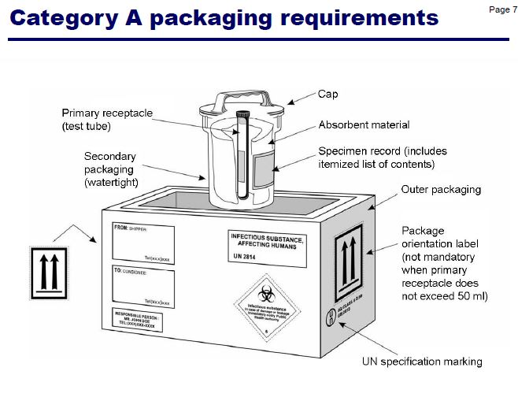

Slide 8
Category B UN3373, Biological Substance Category B
Include most specimens shipped from the laboratory.
Patient blood specimens
Unfixed tissue samples
Live cultures
Exception: Quest specimens picked up by the Quest courier.

Slide 9
Category B Packaging Requirements
Primary container is leakproof
Secondary container is leakproof
Either secondary or outer container is leakproof
If shipment is transported by air the outer container must be leakproof

Slide 10
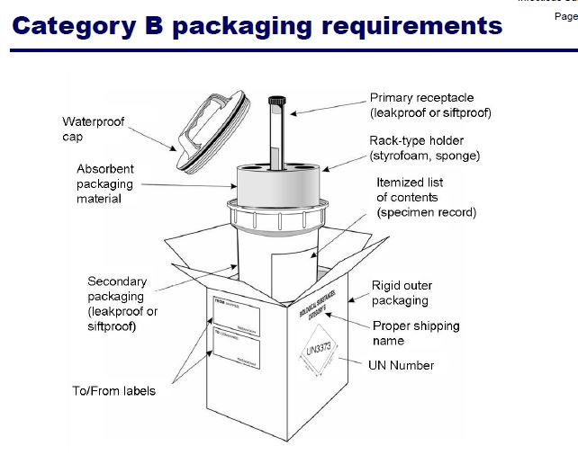

Slide 11
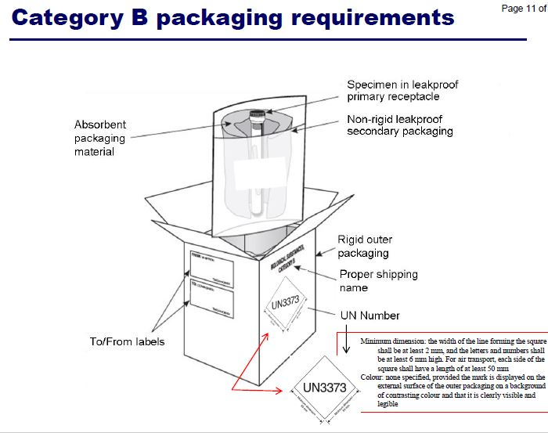

Slide 12
Exempt Specimens
Exempt specimens have minimal likelihood or containing pathogens.
Package using triple packing materials.
Examples:
Samples for therapeutic drug monitoring or testing for non infectious substances
Samples sent for employment purposes or are intended for drug or alcohol monitoring.
See the Packaging and Shipping manual for the complete list.

Slide 13
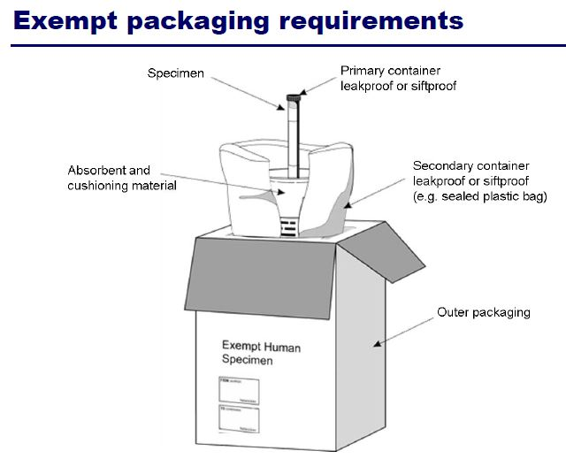

Slide 14
Hanover Hospital Policy
Packing and Shipping Patient Specimens
All specimens shipped from Hanover Hospital (with the exception of Quest specimens) will be triple packaged as described in the Packing and Shipping Manual. These instructions are based on international and national regulatory agencies. These instructions may be found in Appendix A of the Packaging and Shipping Manual.

Slide 15
References
Packing and Shipping Manual. Hanover Hospital Laboratory.
World Health Organization. Infectious Substances Training. Jan. 2015

