Slide 1
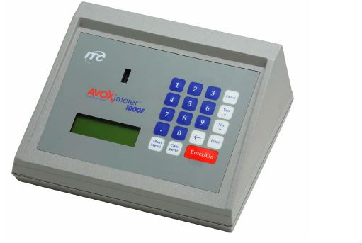
Learning Objectives When you have completed this course you will be able to:
Avoximeter 1000E Operator Training
State the intended use of the AVOXimeter 1000E
State the location of the Point of Care Manual and how to access it.
Explain requirements for Quality Control
Perform testing

Slide 2
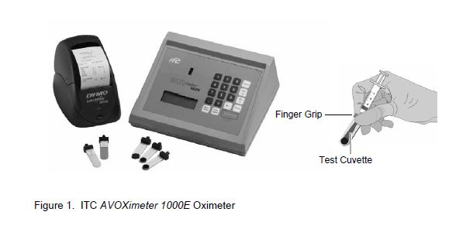
System Components
Avoximeter 1000E

Slide 3
Introduction
The intended use of the AVOXimeter 1000E (AVOX) is for the measurement of oxyhemoglobin saturation (%HbO2) and total hemoglobin concentration (THb) on freshly drawn, heparin or EDTA anticoagulated whole blood samples.
A complete procedure for testing may be found in the Point of Care manual on line in Docushare. “AVOXimeter 1000E: Oxyhemoglobin Saturation”.

Slide 4
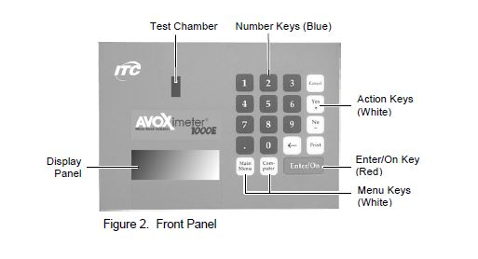
Front Panel
The front panel contains the test chamber, keypad and a display panel.
Operator instructions are shown on the display panel, the operator enters commands and information using the keypad.
When the test is completed, results are shown on the display panel and stored in system memory.

Slide 5
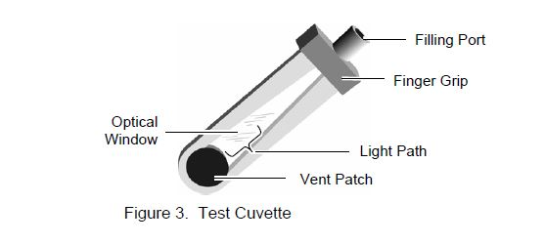
Test Cuvette
A whole blood sample is inserted in the test cuvette by connecting a syringe to the filling port and gently pressing the plunger.
Air escapes from the vent patch at the end of the cuvette.
Handle cuvette by the edges or by the finger grip.
Tests are performed in a single use disposable cuvette.
Each bag of cuvettes is labeled with a cuvette pathlength. For accurate results the pathlength must be entered in the instrument. See the Point of Care manual for instructions.

Slide 6
Running a Test
Verify the instrument is ready to run a test and that the “Ready” – “Insert Cuvette” screen is displayed.
Following appropriate policy, aspirate QC or collect patient specimen in a syringe.
Note: If EQC is being run, insert the yellow or orange filter instead of a cuvette.

Slide 7
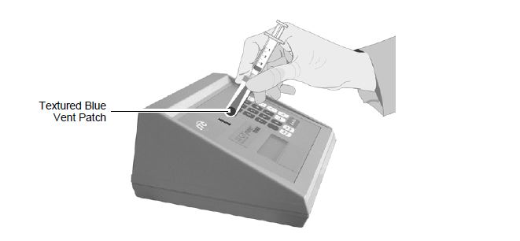
Running a Test
Holding the cuvette by the finger grip on the black cap, insert the cuvette (with the syringe still attached) into the test chamber (as shown below).
Important: Always keep the syringe attached. Removing the syringe may cause inaccurate results.

Slide 8
Running a Test
Test results are displayed within ten seconds
Holding the cuvette by the finger grip on the black cap, remove the cuvette from the test chamber.
Discard the cuvette in the appropriate biohazard container.

Slide 9
Quality Control (QC) Electronic QC
EQC using optical verification filters (orange and yellow) must be performed each 8 hour shift to verify the instrument is working properly.
Confirm that the instrument display reads "Ready“
Remove any debris on the filter surface by wiping with dry gauze.
Insert the filter into the cuvette slot. Results will appear in 7-10 seconds.
Record result on the QC log.
Repeat using the second filter.
If results do not fall within expected range notify the Point of Care Coordinator. Do not use the instrument for patient testing.

Slide 10
Quality Control (QC) Liquid QC
Liquid QC is performed at specified intervals to verify the accuracy of the AVOX.
Ampules are stored in the refrigerator and must be analyzed immediately after removal.
Record results on the liquid QC log.
Refer to the Point of Care manual for step by step instructions.

Slide 11
Notes of Testing
Cuvettes must be kept in sealed bag with dessicant.
Check the cuvette pathlength set in the AVOX to ensure it correct.
Run specimens immediately after collection. A delay may cause erroneous results.
Specimens must be whole blood drawn in a plastic syringe.
Make sure there are no bubbles in the cuvette, this may cause erroneous results.

