Slide 1
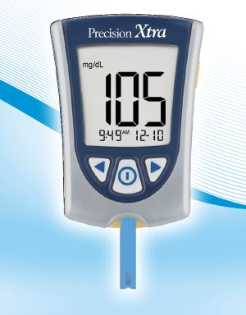
Learning Objectives When you have completed this course you will be able to:
Precision Xtra Operator
Review
State the intended use and limitations of the meter
State the location of the Point of Care manual and how to access it
Explain factors that may affect glucose results
State Quality Control (QC) requirements
State the policy for cleaning the meter
State where to find help for meters or test questions.
Define critical/action values

Slide 2
Precision Xtra BGM Intended Use and Limitations
The Precision Xtra BGM is intended to measure glucose in fresh capillary blood.
The Xtra BGM may not be used with arterial or venous blood samples or neonates.
Accurate readings are obtained when the hematocrit is between 30% and 60%.
Test results may be erroneously low if the patient is severely dehydrated, or severely hypotensive, in shock or in a hyperglycemic-hyperosmolar state (with or without ketoacidosis).

Slide 3
Need Help?
Call x4652, the Point or Care office
Access the Point of Care Manual in Healthstream. Located under “Policies and Procedures” – Point of Care
Check the Precision Xtra Operator’s manual

Slide 4
The BGM Meter Abbott Precision Xtra
For detailed instructions regarding meter set up such as time and date, refer to the Xtra Users manual
Operates on coin battery 2032

Slide 5
Precision Xtra BGM Strips
Do not use strips beyond the expiration date printed on the foil packet and outer box.
Do not use the strip if the foil packet has a puncture or tear.
Do not use the strips if they are wet, bent scratched or damaged.
Use the strip immediately after opening the foil packet.

Slide 6
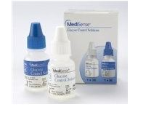
Medisense Quality Control Solutions
Low and High bottles
Do not use past expiration date on an unopened box.
Label bottle with the date it was opened
Open bottles expire 3 months
after bottle is opened
Discard all expired bottles

Slide 7
Quality Control (QC)
A low and a high QC is required to be performed every 24 hours
If the meter has been dropped
If patient symptoms do not match results
Record QC results on the QC log sheet.
Do not use controls that have expired.
Do not perform a patient test if QC result is not within the range on the QC log.

Slide 8
Critical/Action Values
Adult (18 years and older) - <70 mg/dl and >400 mg/dl
Child (12 months and older) <70 mg/dl and >400 mg/dl
All critically low values must be repeated.
Refer to Nursing Policies:
“Hypoglycemia”
“Hyperglycemia”
References:
Hypoglycemia Policy. Hanover Hospital
Pediatric Reference Values. American Association for Clinical Chemistry.

Slide 9
Trouble shooting Patient Results
Reasons Glucose May be Higher than Expected
Hematocrit is lower than 20%
Reasons Glucose May be Lower than Expected
Hematocrit is higher than 70%
Hyperglycemic-hyperosmolar state (with or without ketoacidosis)
Severe dehydration, hypotension or shock
Water or alcohol remaining on the puncture site

Slide 10
Cleaning the Meter
Meters must be cleaned between every patient using wipes available in your work area.

Slide 11
References
Point of Care Manual, UPMC Hanover.
Precision Xtra Operator’s Training Guide. 2008.
Precision Xtra Pro Blood Glucose Strip Package Insert. Abbott Diabetes Care. 2011.

