Slide 1
AVOXimeter 1000E
Self Paced Learning
UPMC Central Pa Hanover

Slide 2
The intent of this self paced education is to provide the foundation for performing accurate patient testing using the AVOXimeter 1000E.

Slide 3
The AVOXimeter 1000E provides vital information for the physician regarding the patient undergoing a Cardiovascular procedure. In order to provide quality results, you, as the operator must understand the steps to be taken to ensure that those results are accurate.

Slide 4
Sherilyn Solanick MSMT(ASCP) POCS
Point of Care Coordinator UPMC Hanover
Laboratory
By the end of this self-paced education, the Cardiovascular Laboratory staff will be able to:
State the location of the Point of Care manual and access the Avoximeter 1000E policy.
State the intended use of the AVOXimeter 1000E.
Define the steps to perform patient testing.
Describe the requirements for Quality Control.
Define the steps for performing Quality Control.
Susan Shatzer BSMT(ASCP) POCS
Medical Technologist UPMC Hanover
Laboratory
Point of Care Department, Clinical Laboratory

Slide 5
Introduction
The intended use of the AVOXimeter 1000E (AVOX) is for the measurement of oxyhemoglobin saturation (%HbO2) and total hemoglobin concentration (THb) on freshly drawn, heparin or EDTA anticoagulated whole blood samples.
No sample preparation is required. The sample is injected into the disposable cuvette and inserted into the instrument. Results are displayed in less than 10 seconds.
Data management capabilities include an optional interface or printer.
NOTE:
A detailed policy and procedure for testing may be found in the on line Point of Care manual found in MCN Policy manager, “AVOXimeter 1000E: Oxyhemoglobin Saturation”.

Slide 6
Section One: System Components
AVOXimeter 1000E

Slide 7
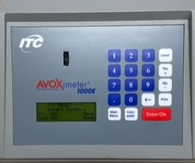
Instrument Diagram
The front panel contains the test chamber, keypad and a display panel.
Operator instructions are shown on the display panel.
The operator enters commands and information using the keypad.
When the test is completed, results are shown on the display panel and stored in system memory.
Test Chamber
Number Keys
Action Keys
Enter/On Key
Display Panel
Menu keys

Slide 8
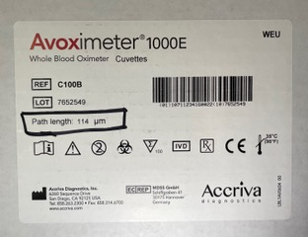
Test Cuvette
Disposable cuvettes are required to perform the test.
Each carton and bag of cuvettes is labeled with a cuvette pathlength. Prior to running a patient test or QC test, the correct pathlength must be entered in the instrument. Follow the steps below to check or enter a pathlength.
Press Main Menu on the keypad.
Press 1 Calibration then Enter/On.
Press 3 Cuvette Pathlength then Enter/On.
To change the value, press the arrow on the keypad to erase the existing value and enter a new value then Enter/On.
Press Cancel to return to the main screen.
Note:
The correct pathlength must be entered before testing to obtain accurate patient results.

Slide 9
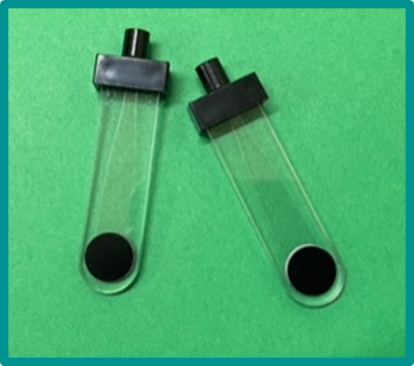
Test Cuvette
Tests are performed in a single use disposable cuvette.
A whole blood sample is inserted in the test cuvette by connecting a syringe to the filling port and gently pressing the plunger.
Air escapes from the vent patch at the end of the cuvette as the blood is inserted.
The cuvette has two vent patches, one rough and one smooth. Always insert the rough vent patch facing left when inserting into the test chamber.
Cuvettes should be handled by the edges or by the finger grip.
Finger grip
Vent patch

Slide 10
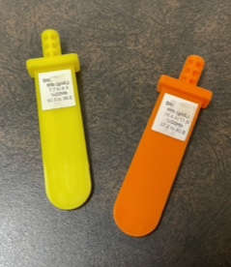
Optical Filters
The yellow and orange optical filters are used to verify that the optics of the Avoximeter 1000E are not obscured by blood or debris and that the instrument is properly calibrated.
Each set of optical filters is labeled with the serial number of the instrument it is matched with. Verify that the serial number on the filters matches the instrument serial number. Optical filter sets cannot be shared between different serial numbers.
The optical filters simulate a cuvette containing a blood sample of known composition. The serial number and expected values are printed on the label on the filter.

Slide 11
Section Two: Running a Patient Test
Avoximeter 1000E

Slide 12
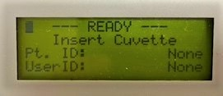
Running a Patient Test
Verify the instrument is ready to run a test and that the “Ready” – “Insert Cuvette” screen is displayed.
Following appropriate policy, collect the patient specimen in a plastic syringe.
Attach the syringe to the cuvette, hold the cuvette downward at a 45 degree angle and gently inject the sample.
Confirm the cuvette is free of bubbles.
Remove any debris or blood from the exterior of the cuvette.

Slide 13
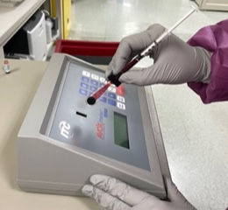
Running a Patient Test
Inspect the vent patch to ensure that it is not bulging. If so, discard the cuvette. Do not insert the cuvette in to the test chamber if the vent patch is bulging.
Holding the cuvette by the finger grip on the black cap, insert the cuvette (with the syringe still attached) into the test chamber.
NOTE: The textured patch must be inserted facing left.
Test results are displayed within 10 seconds.
Holding the cuvette by the finger grip on the black cap, remove the cuvette from the test chamber.
Discard the cuvette with the syringe attached in the appropriate biohazard container.
Important:
Always keep the syringe attached to the cuvette. Removing the syringe may cause inaccurate results

Slide 14
Section Three: Performing Quality Control (QC)
AVOXimeter 1000E

Slide 15
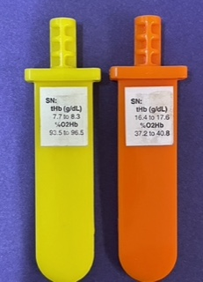
Optical QC
Optical filters must be run:
Once per every 8 hours of patient testing
After changing the pathlength of the cuvettes
After any maintenance performed on the AVOX
Expected ranges for the optical filters are found on the filter label. Values obtained by the AVOX must fall within the range on the filter label. Do not proceed with patient testing if values are not within the stated range.
Important:
The operator must verify that optical filter values are within the acceptable range. Report out of range values to the Point of Care department. Do not proceed with patient testing.

Slide 16
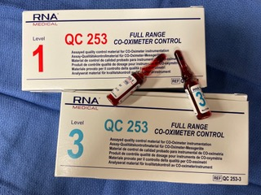
Liquid QC
Liquid QC ampules are stored in the refrigerator and must be analyzed immediately after removal.
Do not use part the expiration date stamped on each box. Discard expired product.
Liquid QC must be performed:
Weekly to verify the accuracy of the AVOX
With each new lot of cuvettes
After any maintenance is performed on the AVOX

Slide 17
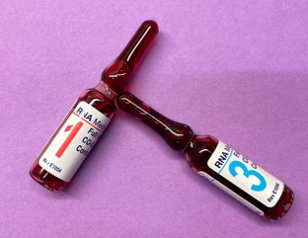
Running Liquid QC
Remove an ampule of Level 1 and Level 3 control from the refrigerator.
NOTE: Controls must be run immediately after removal from the refrigerator.
Hold the Level 1 ampule above the break line and invert gently to mix.
After mixing, tap the ampule to restore all liquid to the bottom.
Using a protective sleeve or 4x4 gauze square, snap open the ampule.
Using a syringe and needle, aspirate the contents of the ampule.
Using accepted safety technique, remove and discard the needle in an appropriate sharps container.

Slide 18
Running Liquid QC
Attach the syringe to the cuvette and gently inject the control solution, positioning the cuvette at approximately a 45 degree angle while injecting. There should be no air bubbles.
Insert the cuvette into the sample chamber. Results appear within 10 seconds.
Discard the syringe and cuvette in an appropriate sharps container.
Record results on the QC log.
NOTE: QC ranges are supplied by the Point of Care department.
Repeat using Level 3 control.
Important:
Results must fall within the expected ranges listed on the QC log. If results do not fall within this range, do not use the instrument for patient testing. Notify the Point of Care department.

Slide 19
After this training has been successfully completed, you are required to demonstrate your knowledge of the instrument by performing testing as you are observed by a certified instructor.
Contact your instructor or the Point of Care department for additional information regarding this portion of your required training.
For Questions Contact:
Point of Care Department, Laboratory

