Slide 1

i-STAT 1 Wireless Analyzer
i-STAT 1 System Orientation

Slide 2

Learning Objectives
i-stat 1 system orientation | i-STAT 1 wireless ANALYZER
Understand the following:
  i-STAT 1 analyzer and system components
  Anatomy of the i-STAT 1 Wireless analyzer
  Warning label locations on the analyzer
  Identify a wireless analyzer (optional)

Slide 3
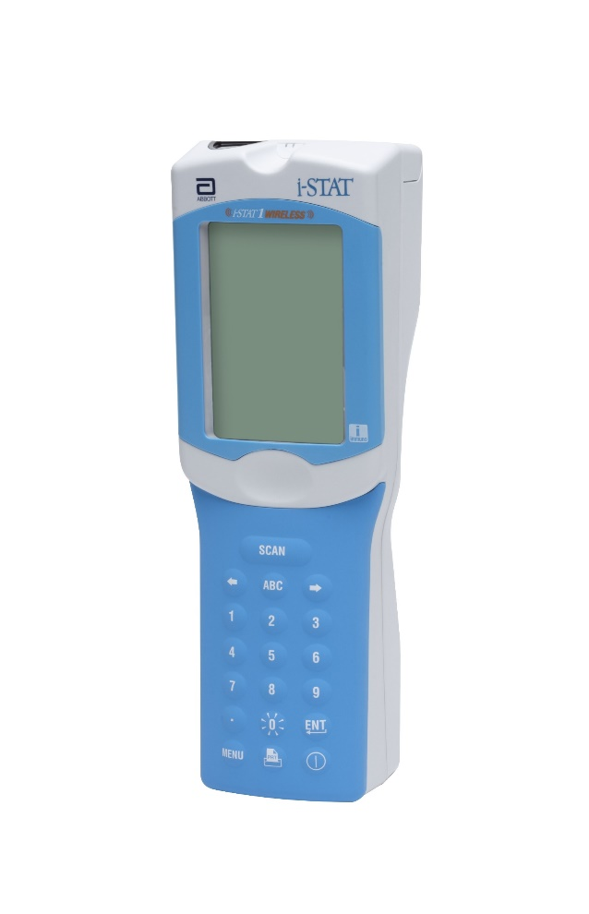
System Components
i-STAT 1 Wireless Analyzer
Used to perform blood analysis testing with
i-STAT cartridges, and conduct quality control (QC) testing.
Optional ability to transmit results via the
i-STAT 1 Downloader/Recharger.
Optional ability to transmit results via wireless network connectivity.
RESOURCE: i-STAT 1 System Manual, i-STAT 1 Analyzer.
Lesson: Patient testing with the i-STAT 1 System | i-STAT CREA Cartridge | i-STAT 1 Learning System Classroom Training Power Points – Pfizer
For in vitro diagnostic use. For intended use and product details, visit www.globalpointofcare.abbott NOTE: Not all products are available in all regions. Check with your local representative for availability in specific markets.
©2023 Abbott. All rights reserved. i-STAT is a trademark of Abbott.

Slide 4
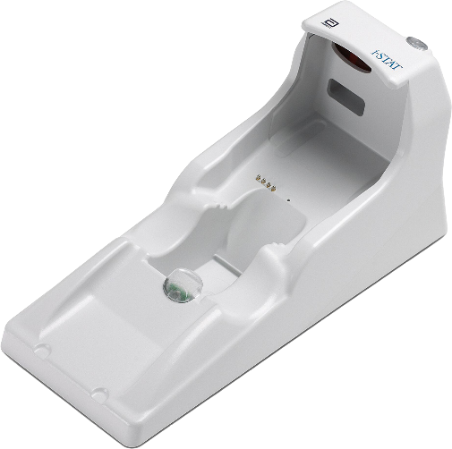
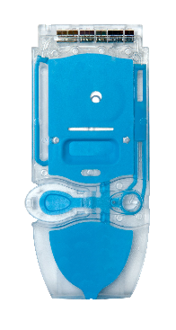
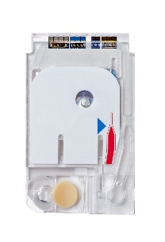
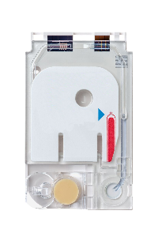
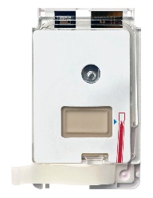
System Components - cont’d
i-STAT 1 Downloader/Recharger
Used to perform analyzer software updates.
Recharges the i-STAT 1 9-Volt NiMH Rechargeable Battery
Transmits results via wired network connection (Optional).
i-STAT Cartridges
Unit-use design
Contains sensors and reagents for testing patient samples and quality control fluids.
RESOURCE: i-STAT 1 System Manual, i-STAT 1 Downloader/Recharger.
RESOURCE: i-STAT 1 System Manual, i-STAT Cartridge.
Lesson: Patient testing with the i-STAT 1 System | i-STAT CREA Cartridge | i-STAT 1 Learning System Classroom Training Power Points – Pfizer
For in vitro diagnostic use. For intended use and product details, visit www.globalpointofcare.abbott NOTE: Not all products are available in all regions. Check with your local representative for availability in specific markets.
©2023 Abbott. All rights reserved. i-STAT is a trademark of Abbott.

Slide 5
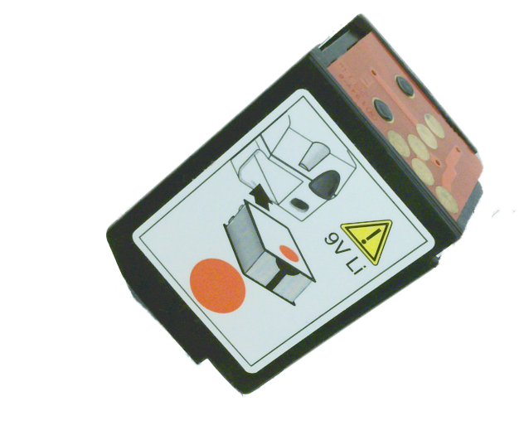


System Components - cont’d
Disposable Batteries and the
i-STAT 1 Battery Carrier:
The analyzer requires two Ultralife 9-Volt lithium batteries for use with the i-STAT 1 Battery Carrier.
CAUTIONS¹:
Battery carrier for use with two disposable Ultralife 9-volt lithium batteries; purchase from Abbott (List Number: 06F21-26).
The Ultralife 9-volt lithium battery has a safety feature that provides protection preventing the i-STAT 1 analyzer from overheating due to component failure within the analyzer circuitry.
RESOURCE: i-STAT 1 System Manual, i-STAT 1 Analyzer.
REFERENCE: 1. i-STAT 1 System Manual, i-STAT 1 Analyzer, Power.
Lesson: Patient testing with the i-STAT 1 System | i-STAT CREA Cartridge | i-STAT 1 Learning System Classroom Training Power Points – Pfizer
For in vitro diagnostic use. For intended use and product details, visit www.globalpointofcare.abbott NOTE: Not all products are available in all regions. Check with your local representative for availability in specific markets.
©2023 Abbott. All rights reserved. i-STAT is a trademark of Abbott.

Slide 6
System Components - cont’d
i-STAT 1 9-Volt NiMH Rechargeable Battery (optional):
Alternate power source that can be charged using the i-STAT 1 Downloader/Recharger.
CAUTIONS²:
Use only a rechargeable battery pack purchased from Abbott.
RESOURCE: i-STAT 1 System Manual, i-STAT 1 Analyzer.
REFERENCE: 2. i-STAT 1 System Manual, i-STAT 1 Analyzer, Rechargeable Battery.
Lesson: Patient testing with the i-STAT 1 System | i-STAT CREA Cartridge | i-STAT 1 Learning System Classroom Training Power Points – Pfizer
For in vitro diagnostic use. For intended use and product details, visit www.globalpointofcare.abbott NOTE: Not all products are available in all regions. Check with your local representative for availability in specific markets.
©2023 Abbott. All rights reserved. i-STAT is a trademark of Abbott.

Slide 7
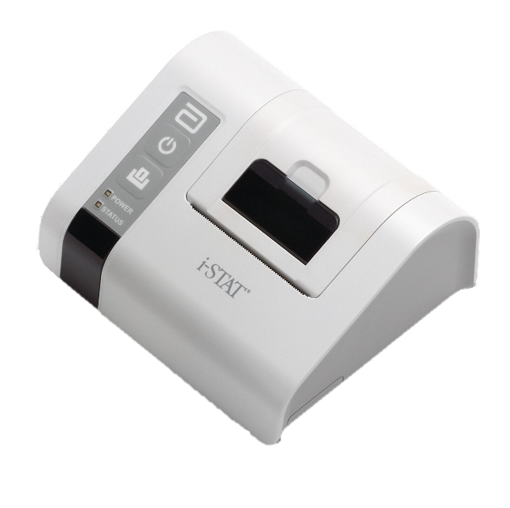
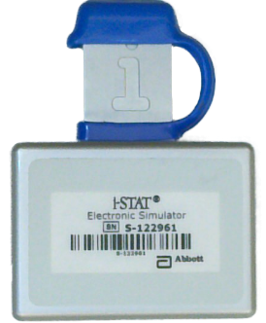
System Components - cont’d
i-STAT 1 Electronic Simulator:
A quality control device for the analyzer’s cartridge signal-reading function.
i-STAT 1 Printer:
Portable printer used to print records from the analyzer.
RESOURCE: i-STAT 1 System Manual, Electronic Simulator.
RESOURCE: i-STAT 1 System Manual, Portable Printer.
Lesson: Patient testing with the i-STAT 1 System | i-STAT CREA Cartridge | i-STAT 1 Learning System Classroom Training Power Points – Pfizer
For in vitro diagnostic use. For intended use and product details, visit www.globalpointofcare.abbott NOTE: Not all products are available in all regions. Check with your local representative for availability in specific markets.
©2023 Abbott. All rights reserved. i-STAT is a trademark of Abbott.

Slide 8
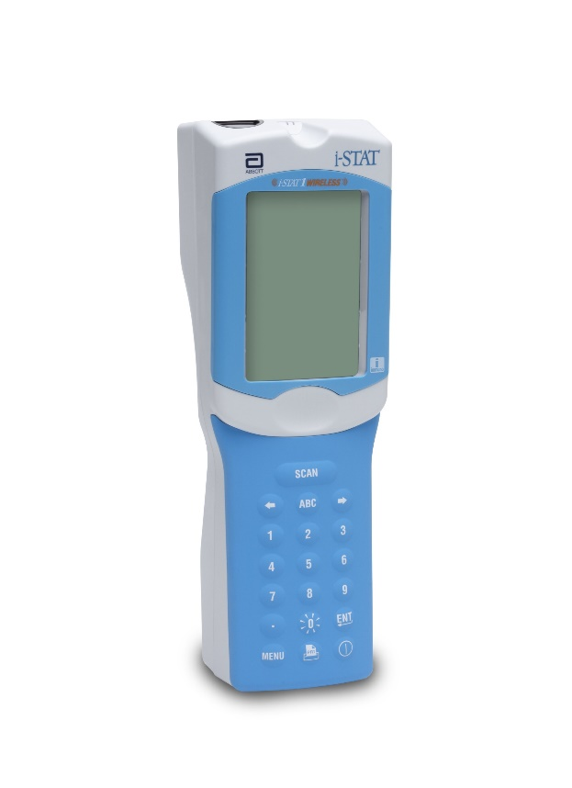




Anatomy of the wireless analyzer
Front of wireless analyzer
Display screen
Keypad
KEYPAD KEY & FUNCTION³ | Description
SCAN | Activates the barcode scanner.
 | Used as a page key to move from one screen to the next and navigate the alphabet when the ABC key is pressed.
ABC | Used to enter alpha characters on data entry screens.
0-9 | Used to enter a number or digits on data entry screen and to select menu options and stored records.
. | Enters a decimal point or a comma separator based on customization.
 | The back-light for the display is turned on and off by pressing the “0” key for one second.
 | Used to respond to a prompt to complete an action, such as entering an operator or patient ID via the keypad.
MENU | Used to return to the previous menu and switch between the Test and Administration Menus.
 | Used to print either directly to the i-STAT 1 Printer or to the i-STAT 1 Printer attached to the i-STAT 1 Downloader/Recharger.
 | Turns the analyzer on or off.
Display SCREEN
Keypad
RESOURCE: i-STAT 1 System Manual, i-STAT 1 Analyzer.
REFERENCE: 3. i-STAT 1 System Manual, i-STAT 1 Analyzer, Keypad.

Slide 9
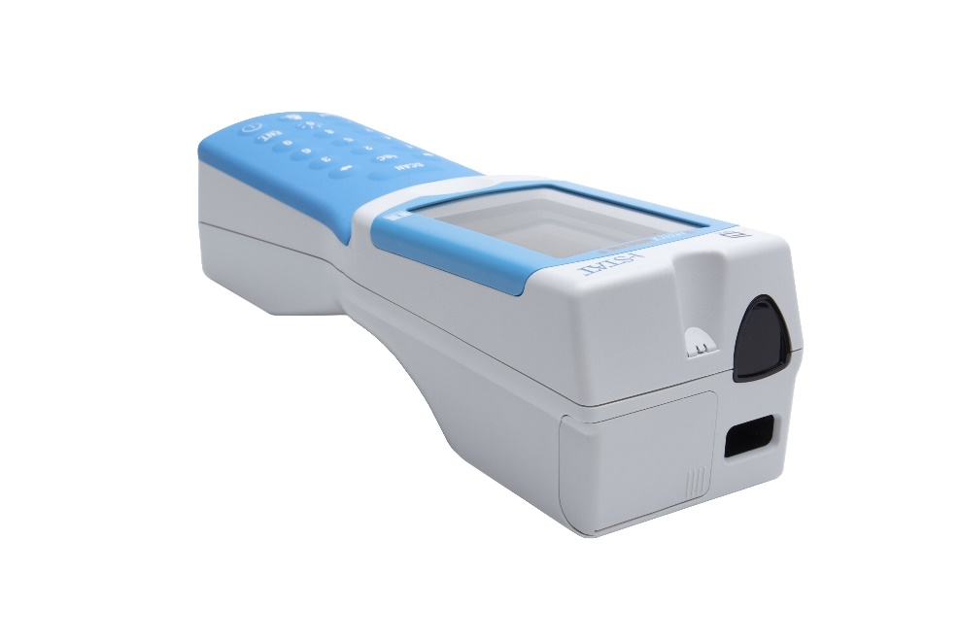
Anatomy of the wireless analyzer - cont’d
Top of wireless analyzer
Battery compartment
Infrared communication window
Laser barcode scan window
Infrared communication window
Battery compartment
Laser BARCODE SCAN WINDOW
RESOURCE: i-STAT 1 System Manual, i-STAT Analyzer.

Slide 10
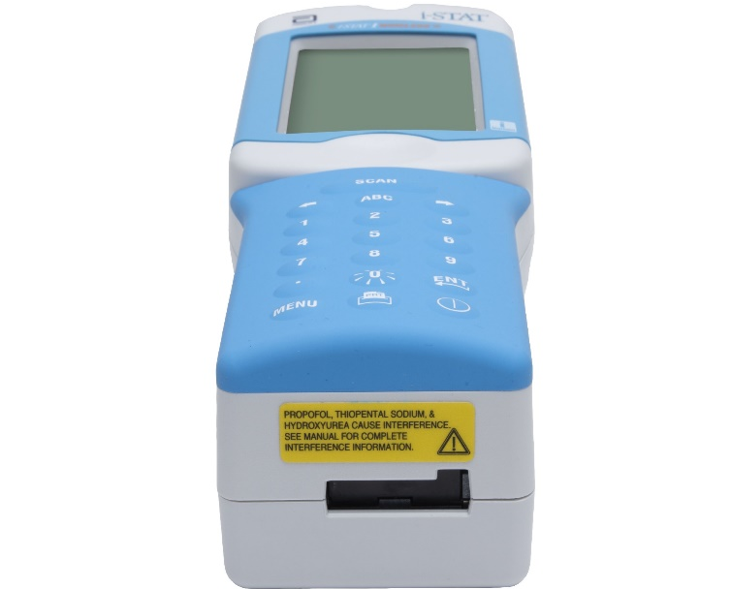
Anatomy of the wireless analyzer - cont’d
Bottom of wireless analyzer
Warning label (i-STAT EC8+ and
i-STAT CREA cartridges)
Cartridge port
CAUTIONS⁴:
Propofol, Thiopental Sodium & Hydroxyurea cause interference. See manual for complete interference information.
WARNING LABEL
RESOURCE: i-STAT 1 System Manual, i-STAT Analyzer.
REFERENCE: 4. i-STAT EC8+ Cartridge Instructions for Use (IFU); i-STAT CREA Cartridge Instructions for Use (IFU).
CARTRIDGE PORT

Slide 11
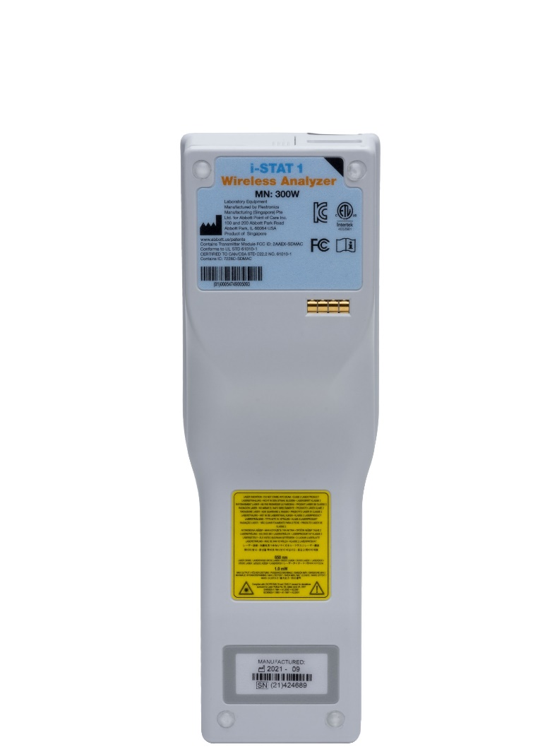
Anatomy of the wireless analyzer - cont’d
Back of wireless analyzer
Model number
Wireless module type
Warning label (barcode scanner)
Serial number
Model Number
Wireless Module type
CAUTIONS⁵:
DO NOT stare into the laser aperture or the laser beam or point the laser beam at others.
Class 2 laser scanners use a low power, visible light diode. As with any bright light source, such as the sun, the user should avoid staring directly into the laser beam. Momentary exposure to a Class 2 laser is not known to be harmful.
WARNING LABEL
RESOURCE: i-STAT 1 System Manual, i-STAT 1 Analyzer.
REFERENCE: 5. i-STAT 1 System Manual, i-STAT 1 Analyzer, Laser Barcode Scanner.
Serial Number

Slide 12
Identify a wireless analyzer
Wireless module type (optional)
Indicated by color designation on top corner or both top corners of the label.
Module type is used for:
  configuring the wireless analyzer for wireless network communication
  identifying security updates and supported algorithms
  troubleshooting wireless transmission of test results
Wireless Module type
RESOURCE: i-STAT 1 Wireless User Guide.

Slide 13
Training Complete | Congratulations!
i-stat 1 system orientation | i-STAT 1 WIRELESS ANALYZER
You have just completed
i-STAT 1 System Orientation
i-STAT 1 Wireless Analyzer

