Slide 1

i-STAT 1 Electronic Simulator
Quality Testing

Slide 2

Learning Objectives
QUALITY TESTING | i-STAT 1 ELECTRONIC SIMULATOR
Understand the following:
  Perform an external simulator test
  Interpret external simulator results
  Review stored simulator results
  Troubleshoot simulator results

Slide 3
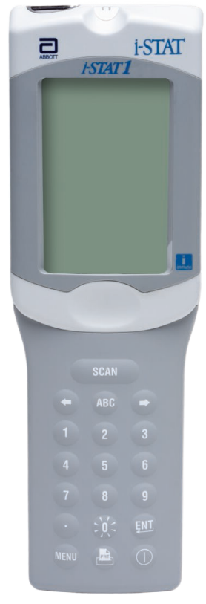

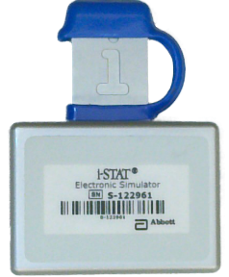
Prepare the analyzer
CAUTIONS¹:
When an analyzer is moved from a cold environment to a warm, humid environment, moisture may condense on the internal connector and may cause a quality check code or test failure.
  Allow the analyzer and external electronic simulator to sit for half an hour at room temperature.
REFERENCE: 1. i-STAT 1 System Manual, Quality Control, Troubleshooting Failed Electronic Simulator Test.

Slide 4
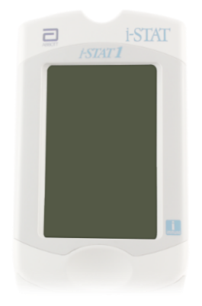
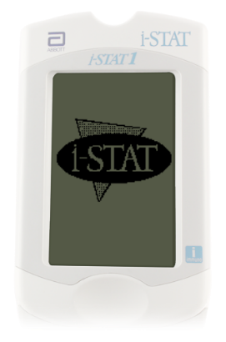
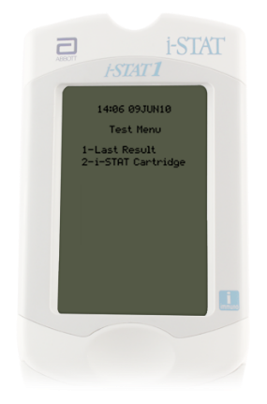
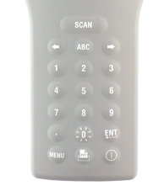
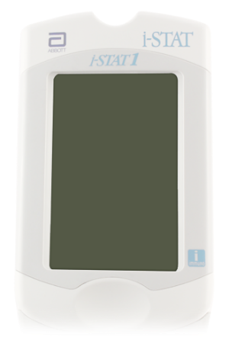
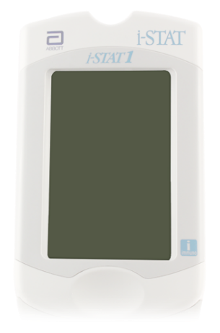
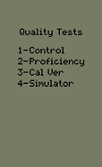
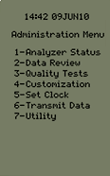
Prepare the analyzer - cont’d
1. Turn on the analyzer:
Press the power key, Test Menu will be displayed.
Press the MENU key for Administration Menu.
2. Select Quality Tests option:
Select option 3- Quality Tests by selecting ‘3’ on the keypad of the analyzer.
Select option 4- Simulator by selecting ‘4’ on the keypad of analyzer.
RESOURCE: i-STAT 1 System Manual, Quality Control

Slide 5
Prepare the analyzer - cont’d
3. Scan Operator ID:
Hold the analyzer 3 to 12 inches away from the barcode.
Press and hold down the SCAN key.
Laser beam must cover the entire length of the barcode.
Wait for the beep or for laser beam to disappear.
Release the SCAN key.
Repeat if prompted.
CAUTIONS²:
DO NOT stare into the laser aperture or the laser beam or point the laser beam at others.
Class 2 laser scanners use a low power, visible light diode. As with any bright light source, such as the sun, the user should avoid staring directly into the laser beam. Momentary exposure to a Class 2 laser is not known to be harmful.
3 – 9 inches
RESOURCE: i-STAT 1 System Manual, Quality Control, Troubleshooting Failed Electronic Simulator Test.
REFERENCE: 2. i-STAT 1 System Manual, i-STAT 1 Analyzer.

Slide 6
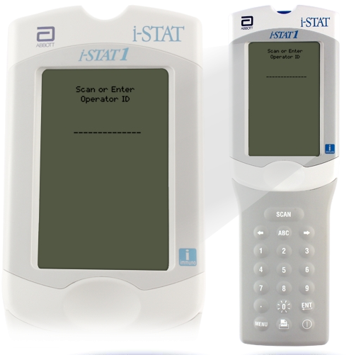
Prepare the analyzer - cont’d
3. Or, manually enter the Operator ID:
Use number keys on the keypad.
Press ENT key.
Repeat if prompted.
RESOURCE: i-STAT 1 System Manual, Quality Control

Slide 7
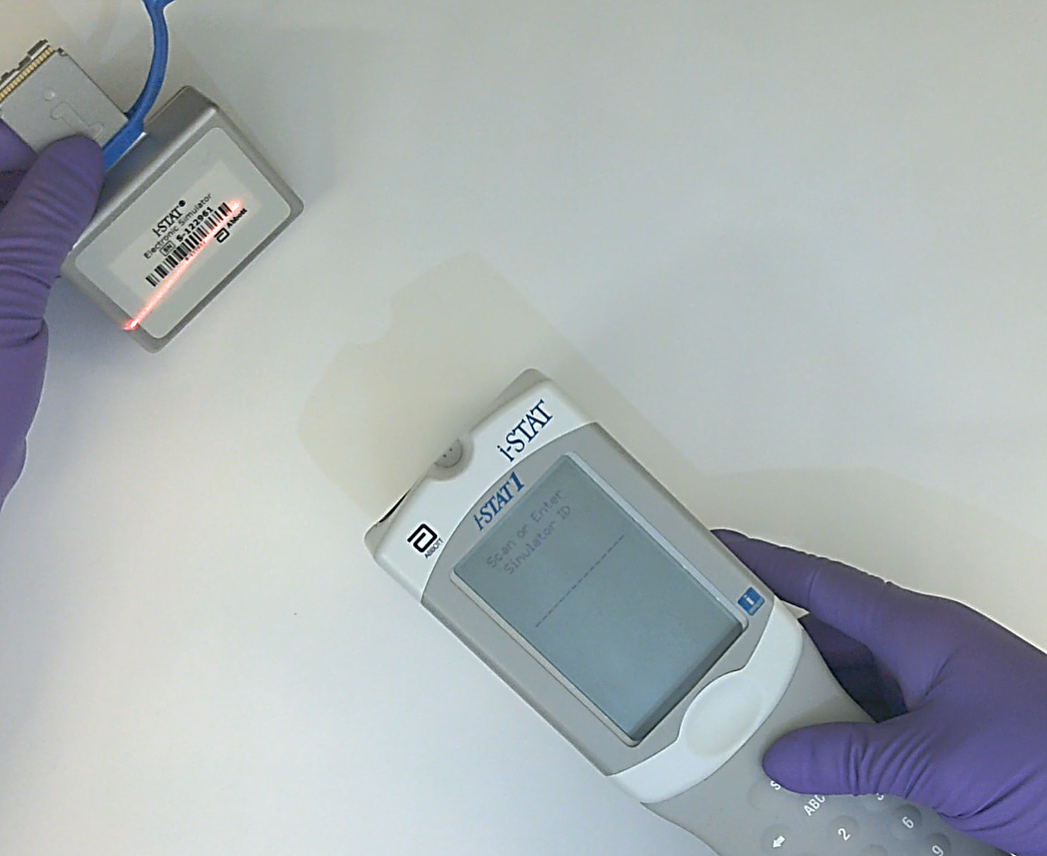
Prepare the analyzer - cont’d
4. Scan Simulator ID:
Hold the analyzer 3 to 12 inches away from the barcode.
Press and hold down the SCAN key.
Laser beam must cover the entire length of the barcode.
Wait for the beep and the laser beam to disappear.
Release the SCAN key.
Repeat if prompted.
CAUTIONS³:
DO NOT stare into the laser aperture or the laser beam or point the laser beam at others.
Class 2 laser scanners use a low power, visible light diode. As with any bright light source, such as the sun, the user should avoid staring directly into the laser beam. Momentary exposure to a Class 2 laser is not known to be harmful.
3 – 9 inches
RESOURCE: i-STAT 1 System Manual, Quality Control
REFERENCE: 3. i-STAT 1 System Manual, i-STAT 1 Analyzer.

Slide 8
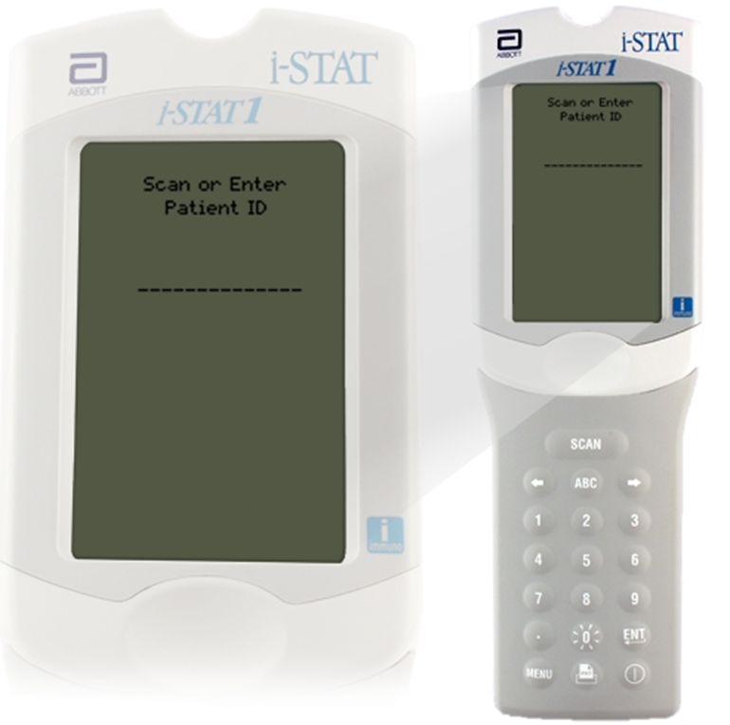

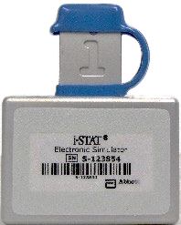
Prepare the analyzer - cont’d
5. Manually enter the Simulator ID:
Use number keys on the keypad.
Press ENT key.
Repeat if prompted.
Simulator id number
RESOURCE: i-STAT 1 System Manual, Quality Control

Slide 9
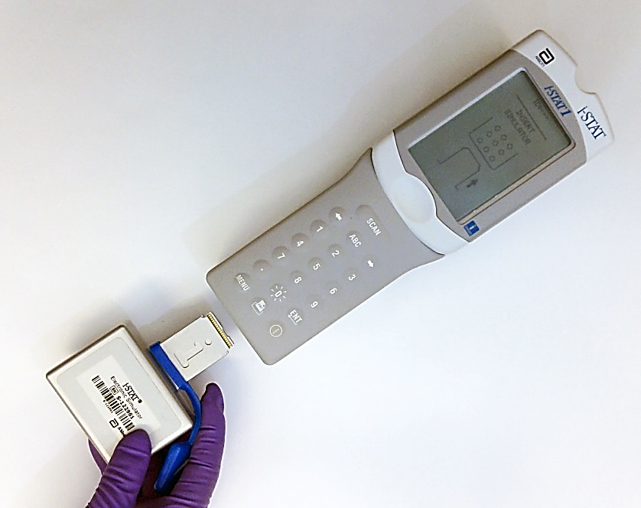
Perform an external simulator test
6. Insert the external electronic simulator:
Remove the cover protecting the contact pads.
Insert the simulator straight into the analyzer. Avoid touching the contact pads.
Contact pads
CAUTIONS⁴:
The Electronic Simulator test will fail if high humidity interferes with the measurements.
Inserting the simulator at an angle may cause a Quality Check message to be displayed.
RESOURCE: i-STAT 1 System Manual, Electronic Simulator. i-STAT 1 System Manual, Quality Control.
REFERENCE: 4. i-STAT 1 System Manual, Electronic Simulator. i-STAT 1 System Manual, Quality Control.

Slide 10
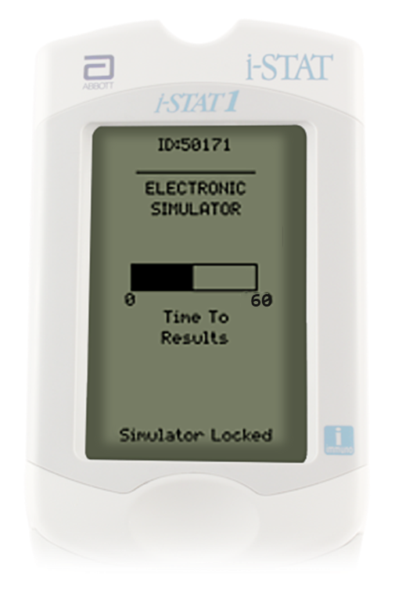
Perform an external simulator test - cont’d
6. Time to results:
Immediately after inserting the simulator, the message “Simulator Locked” will display.
The test cycle for the external electronic simulator is about 60 seconds.

Slide 11
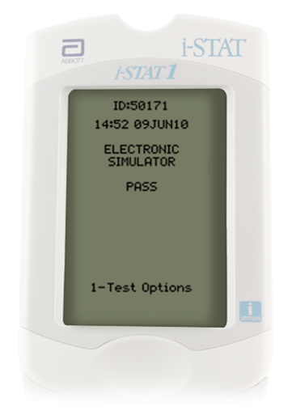
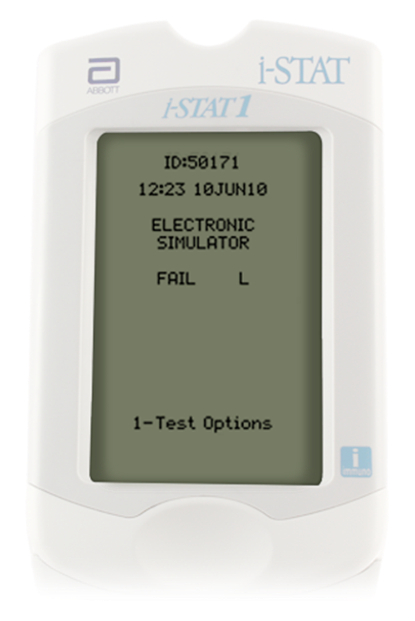
Interpret external simulator test result
7. If PASS is displayed,
continue to use the analyzer.
Remove the simulator and return it to its protective case.
8. If FAIL is displayed,
run the test again.
  If PASS is displayed, continue to use the analyzer.
  If FAIL is displayed, troubleshoot.
RESOURCE: i-STAT 1 System Manual, Quality Control.
RESOURCE: i-STAT 1 System Manual, Quality Control.

Slide 12
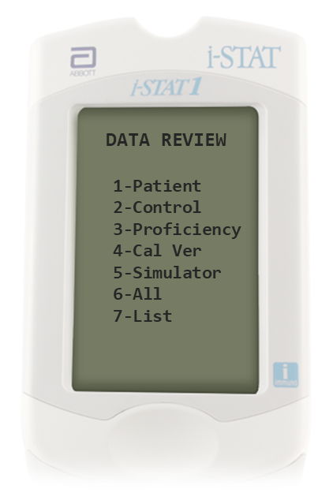
Review stored simulator results
1. Turn on the analyzer:
Press the power key, Test Menu will be displayed.
Press the MENU key for Administration Menu.
2. Select Data Review option:
Select option 2- Data Review by selecting ‘2’ on the keypad of the analyzer.
Select option 5- Simulator by selecting ‘5’ on the keypad of analyzer.
RESOURCE: i-STAT 1 System Manual, i-STAT 1 Analyzer.

Slide 13
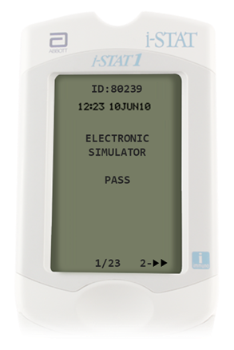
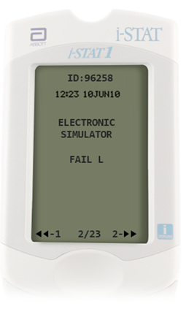
Review stored simulator results - cont’d
3. Select result to review:
Most recent result is first. To go to the next record, press ‘2’ on the keypad of the analyzer.
To return to the previous record, press ‘1’ on the keypad of the analyzer.
4. Return to the Test Menu:
Press the MENU key, to return to the Test Menu.
| 13
RESOURCE: i-STAT 1 System Manual, i-STAT 1 Analyzer.

Slide 14
Troubleshoot simulator results
FAIL “L”:
Can occur if moisture collects on the contact pins inside the analyzer when the analyzer is subjected to ambient temperature change.
Allow the analyzer to sit for half an hour to allow the moisture to evaporate, then repeat test.
  If the analyzer passes the second external electronic simulator test, continue using it.
CAUTIONS⁵:
The Electronic Simulator test will fail if high humidity interferes with the measurements.
The test can also fail if the external Electronic Simulator is malfunctioning such as after being dropped.
RESOURCE: i-STAT 1 System Manual, Electronic Simulator. i-STAT 1 System Manual, Quality Control.
REFERENCE: 5. i-STAT 1 System Manual, Electronic Simulator. i-STAT 1 System Manual, Quality Control.

Slide 15
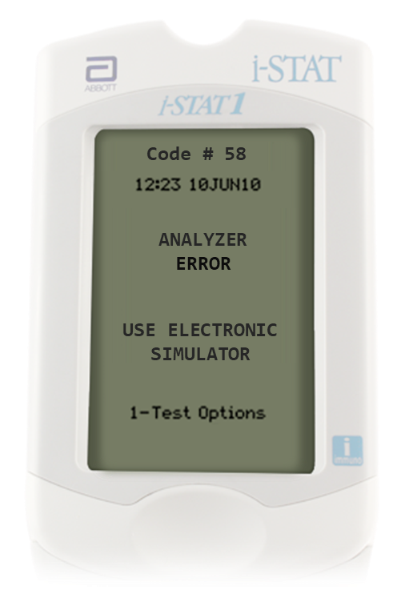
Troubleshoot simulator results – cont’d
Quality check code (QCC) #58
QCC related to an electronic or mechanical failure in the analyzer.
Repeat the external electronic simulator test.
  If PASS is displayed, continue to use the analyzer.
  If FAIL, is displayed, check the battery voltage and use another external electronic simulator to rule out a simulator problem.
  If the code persists, contact your support representative.
  Additional information on QCC’s can be found in the
  i-STAT 1 System Manual.
RESOURCE: i-STAT 1 System Manual, Analyzer Coded Messages.

Slide 16
Training Complete | Congratulations!
QUALITY TESTING| i-STAT 1 ELECTRONIC SIMULATOR
You have just completed
Quality Testing, External Simulator
i-STAT 1 Electronic Simulator

