Slide 1
Internal Electronic Simulator
Quality Testing, i-STAT 1

Slide 2
Learning Objectives
QUALITY TESTING | INTERNAL ELECTRONIC SIMULATOR
Understand the following:
Internal simulator testing process
Interpret internal simulator results
Review stored simulator results
Troubleshoot simulator results

Slide 3
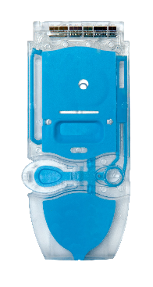
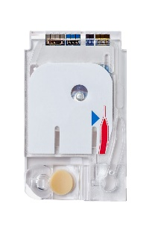
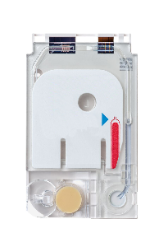
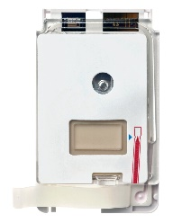
Internal simulator testing process
The internal electronic simulator test:
is performed automatically when a cartridge is inserted before the sample is tested.
The connector pins inside the analyzer, contact the biosensor chips in the cartridge.
default setting is to run every 24 hours of testing.
RESOURCE: i-STAT 1 System Manual, Quality Control

Slide 4
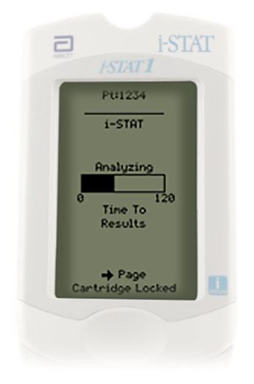
Internal simulator testing process - cont’d
Time to results:
During sample testing with an i-STAT cartridge, the internal simulator test adds 20 seconds to the test cycle.
CAUTIONS¹:
The Electronic Simulator test will fail if high humidity interferes with the measurements.
REOURCES AND REFERENCE: 1. i-STAT 1 System Manual, Electronic Simulator. i-STAT 1 System manual, Quality Control.

Slide 5
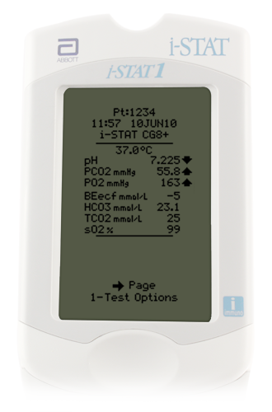
Interpret internal simulator results
If the internal simulator passes, cartridge test results are displayed.
Review test results.
Remove the cartridge and continue using the analyzer.
RESOURCE: i-STAT 1 System Manual, Quality Control.

Slide 6
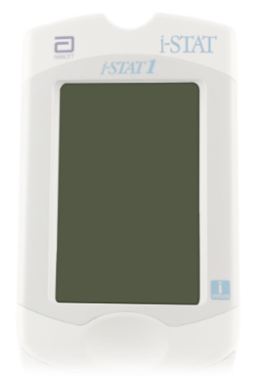
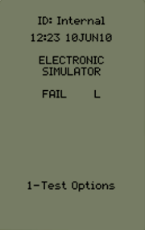
Interpret internal simulator results - cont’d
If the internal simulator fails, and lockout is enabled, FAIL is displayed.
If another analyzer is immediately available, rerun the patient test using the i-STAT cartridge that has been filled with the patient sample.
If not, verify the analyzer using an external Electronic Simulator and fill a new i-STAT cartridge to perform the patient test.
CAUTIONS²:
DO NOT run the cartridge if there is more than a three-minute delay from the time it is filled.
The test can fail if the contact pads have been contaminated in some way.
RESOURCE AND REFERENCE: 2. i-STAT 1 System Manual, Quality Control.

Slide 7
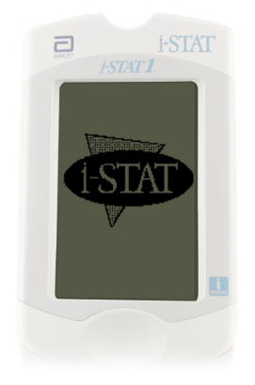
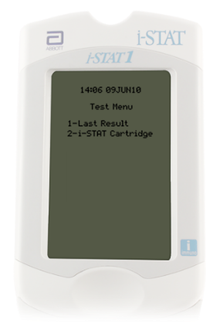
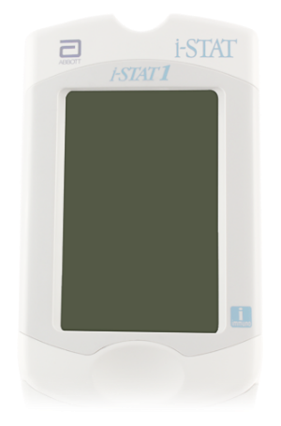
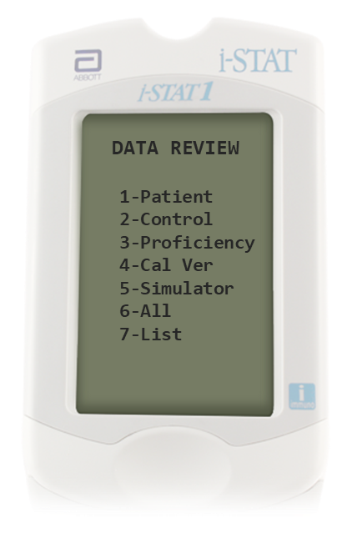
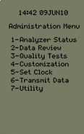
Review stored simulator results
1. Turn on the analyzer:
Press the power key, Test Menu will be displayed.
Press the MENU key for Administration Menu.
2. Select Data Review option:
Select option 2- Data Review by selecting ‘2’ on the keypad of the analyzer.
Select option 5- Simulator by selecting ‘5’ on the keypad of analyzer.
RESOURCE: i-STAT 1 System Manual, i-STAT 1 Analyzer.

Slide 8
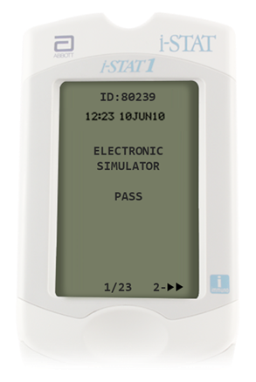
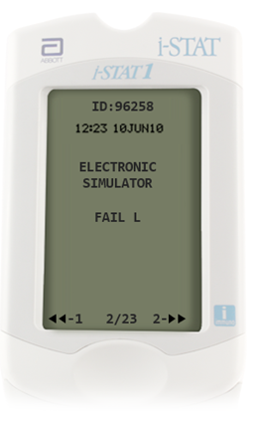
Review stored simulator results - cont’d
3. Select result to review:
Most recent result is first. To go to the next record, press ‘2’ on the keypad of the analyzer.
To return to the previous record, press ‘1’ on the keypad of the analyzer.
4. Return to the Test Menu:
Press the MENU key, to return to the Test Menu.
| 8
RESOURCE: i-STAT 1 System Manual, i-STAT 1 Analyzer.

Slide 9
Troubleshoot simulator results
FAIL “L”:
Can occur if moisture collects on the contact pins inside the analyzer when the analyzer is subjected to ambient temperature change.
Allow the analyzer to sit for half an hour to allow the moisture to evaporate, then repeat test.
If the analyzer passes the second internal electronic simulator test, continue using it.
CAUTIONS³:
The Electronic Simulator test will fail if high humidity interferes with the measurements.
RESOURCE AND REFERENCE: 3. i-STAT 1 System Manual, Quality Control.

Slide 10
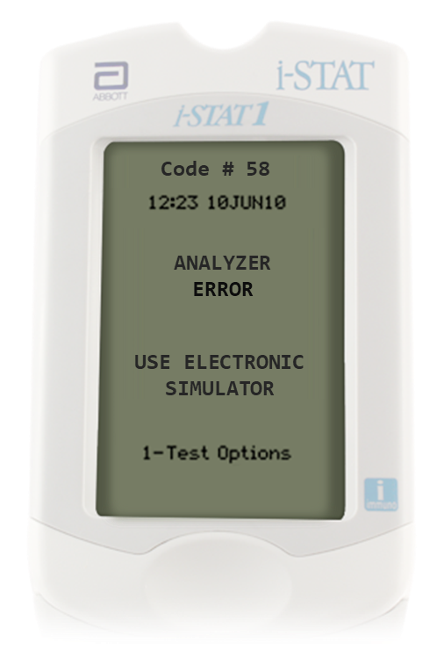
Troubleshoot simulator results – cont’d
Quality check code (QCC) #58
QCC related to an electronic or mechanical failure in the analyzer.
Perform test with the external electronic simulator.
If PASS is displayed, continue to use the analyzer.
If FAIL, is displayed, check the battery voltage and use another external electronic simulator to rule out a simulator problem.
If the code persists, contact your support representative.
Additional information on QCC’s can be found in the i-STAT 1 System Manual.
RESOURCE: i-STAT 1 System Manual, Analyzer Coded Messages.

Slide 11
Training Complete | Congratulations!
QUALITY TESTING| i-STAT 1 ELECTRONIC SIMULATOR
You have just completed Quality Testing, External Simulator
Internal Electronic Simulator

