Slide 1
i-STAT 1 Analyzer
Troubleshooting

Slide 2
Learning Objectives
TROUBLESHOOTING | i-STAT 1 ANALYZER
Understand the following:
Key elements and Operations monitored by the analyzer
Conditions related the battery
Startup and Alert messages
Quality check codes

Slide 3
Verification of key elements and operations
Key elements and Operations monitored by the analyzer:
A series of automatic checks is performed each time a cartridge is used that verifies
the function of the analyzer and cartridge.
handling of the cartridge by the operator.
Analyzer
Proper function of the motorized mechanical system.
Electrical measurement systems are acceptable
Proper control of chip temperature by the thermistors verified by using the i-STAT Electronic Simulator.
i-STAT cartridge
Sensors are present and characteristics are acceptable
Proper fluidic system function
Operator
Sample quality is acceptable
Avoid touching the cartridge sensors and contact pads.
Fill cartridge to the fill line and properly closed
RESOURCE: i-STAT 1 System Manual, Theory; i-STAT 1 System Manual, Procedure for Handling Cartridges.

Slide 4
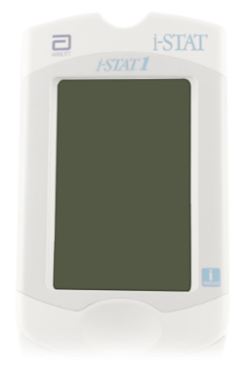
Conditions related to the battery
No display:
Change disposable batteries or recharge battery.
Data is not lost when batteries are fully discharged.
If issue persists, contact you support representative.
CAUTIONS¹:
Battery carrier for use with two disposable Ultralife 9-volt lithium batteries; purchase from Abbott (List Number: 06F21-26).
Use only a rechargeable battery pack purchased from Abbott (List Number: 06F23-55).
RESOURCE: i-STAT 1 User Guide; i-STAT 1 System Manual, Analyzer.
REFERENCE: 1. i-STAT 1 System Manual, Analyzer, Power.

Slide 5
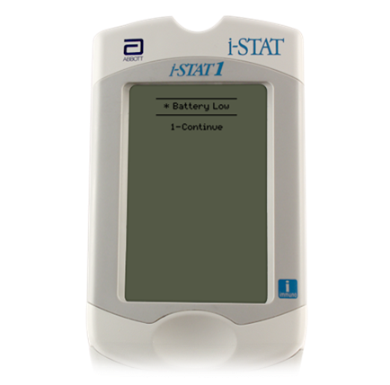
Startup and Alert Messages
Startup and Alert Messages:
The analyzer performs self-checks when it is turned on. If a condition that should be corrected soon, but that will not affect results, is detected, a warning is displayed.
The operator presses the 1 key on the analyzer keypad to continue to access the Test Menu.
RESOURCE: i-STAT 1 System Manual, Troubleshooting.

Slide 6
Startup and Alert Messages – cont’d
Battery Low:
Occurs when battery voltage has dropped to 7.4 volts.
Change the Ultralife 9-volt lithium batteries or recharge the i-STAT rechargeable battery.
If issue persists, contact you support representative.
CAUTIONS³:
Battery carrier for use with two disposable Ultralife 9-volt lithium batteries; purchase from Abbott (List Number: 06F21-26).
Use only a rechargeable battery pack purchased from Abbott (List Number: 06F23-55).
RESOURCE: i-STAT 1 System Manual, Troubleshooting.
REFERENCE: 3. i-STAT 1 System Manual, Analyzer, Power.

Slide 7
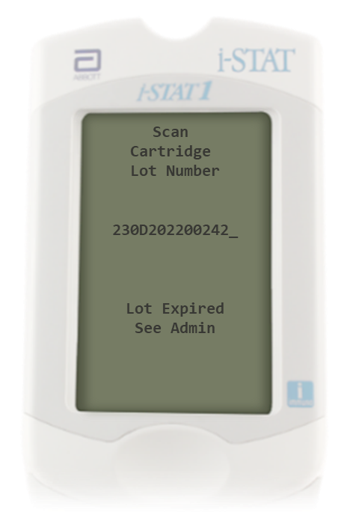
Startup and Alert Messages – cont’d
Lot Expired, See Admin:
Occurs when the cartridge lot number scanned is expired.
Scan a cartridge lot number that is not expired.
If issue persists, contact you support representative.
RESOURCE: i-STAT 1 System Manual, Troubleshooting.
.

Slide 8
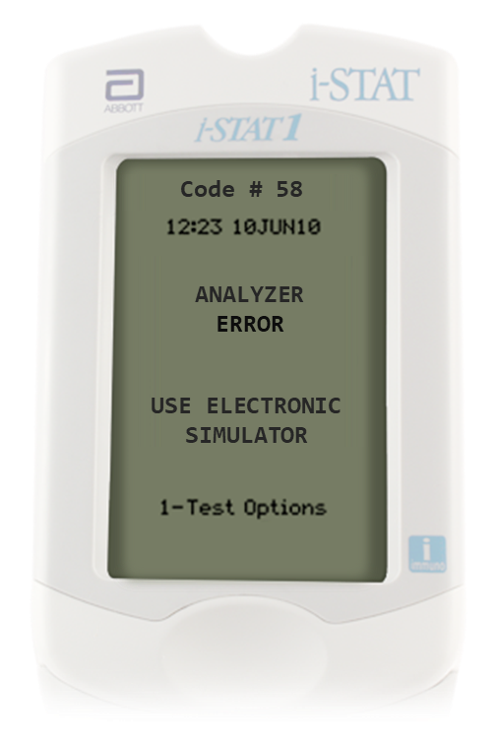
Quality Check Codes
Quality Check Codes:
The Numeric Code:
This is a numeric code associated with the failed quality check.
Since multiple codes can be associated with a single cause message, this is essential information when contacting your support representative.
The Cause Message:
This message describes the likely cause of the failed quality check.
The Action Message:
This message indicates the appropriate action.
Numeric Code
Cause Message
Action Message
RESOURCE : 3. i-STAT 1 System Manual, Analyzer Coded Messages.

Slide 9
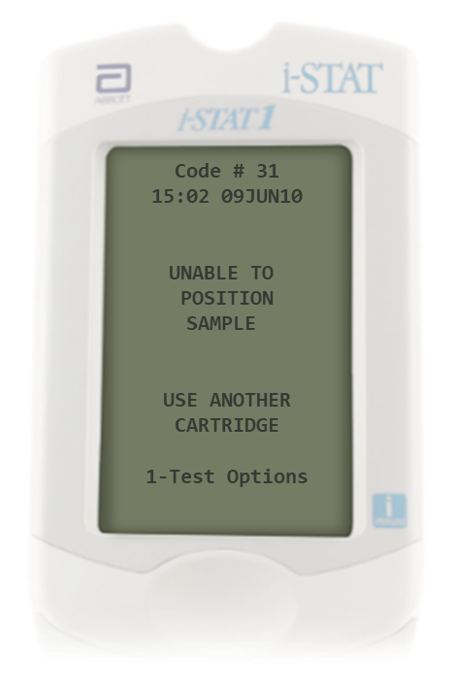
Quality Check Codes – cont’d
Code # 31, Unable to Position Sample:
The analyzer did not detect movement of sample across
the sensors.
This could be due to
a clot in the sample
not closing the closure of the cartridge
Repeat test using another cartridge
if clot is suspected use another sample
Ensure that the closure of the cartridge is closed.
If issue persists, contact you support representative
RESOURCE: 3. i-STAT 1 System Manual, Analyzer Coded Messages.

Slide 10
Quality Check Codes – cont’d
Code # 58, Analyzer:
Occurs when there is an electronic or mechanical failure in the analyzer.
Perform test with the external electronic simulator.
If PASS is displayed, continue to use the analyzer.
If FAIL, is displayed, check the battery voltage and use another external electronic simulator to rule out a simulator problem.
If the code persists, contact your support representative.
RESOURCE: i-STAT 1 System Manual, Analyzer Coded Messages.

Slide 11
Training Complete | Congratulations!
TROUBLESHOOTING | i-STAT 1 ANALYZER
You have just completed Troubleshooting
i-STAT 1 Analyzer

