Slide 1
i-STAT 1 Analyzer and System Components
CLEANING AND DISINFECTING

Slide 2
Learning Objectives
CLEANING AND DISINFECTING| i-STAT 1 Analyzer & system components
Understand the following:
Cleaning and disinfecting the analyzer
Cleaning and disinfecting the downloader/recharger
Cleaning the electronic simulator
Cleaning the printer

Slide 3
Cleaning and Disinfecting
CAUTIONS¹:
Always exercise universal safety precautions, when handling the analyzer, cartridges, and peripherals to prevent exposure to blood-born pathogens.
The use of any unapproved product to clean the i-STAT System may result in damage to system components.
The analyzer and downloader/recharger are NOT designed to be autoclaved or sterilized by any other method, including high heat, irradiation, or gaseous chemical processes.
REFERENCE: 1. i-STAT 1 System Manual, Routine Care of the Analyzer and Downloader, Cleaning the Analyzer and Downloader. i-STAT 1 System Manual, Routine Care of the Analyzer and Downloader, Caution.
Lesson: Patient testing with the i-STAT 1 System | i-STAT CREA Cartridge | i-STAT 1 Learning System Classroom Training Power Points – Pfizer
For in vitro diagnostic use. For intended use and product details, visit www.globalpointofcare.abbott NOTE: Not all products are available in all regions. Check with your local representative for availability in specific markets.
©2023 Abbott. All rights reserved. i-STAT is a trademark of Abbott.

Slide 4
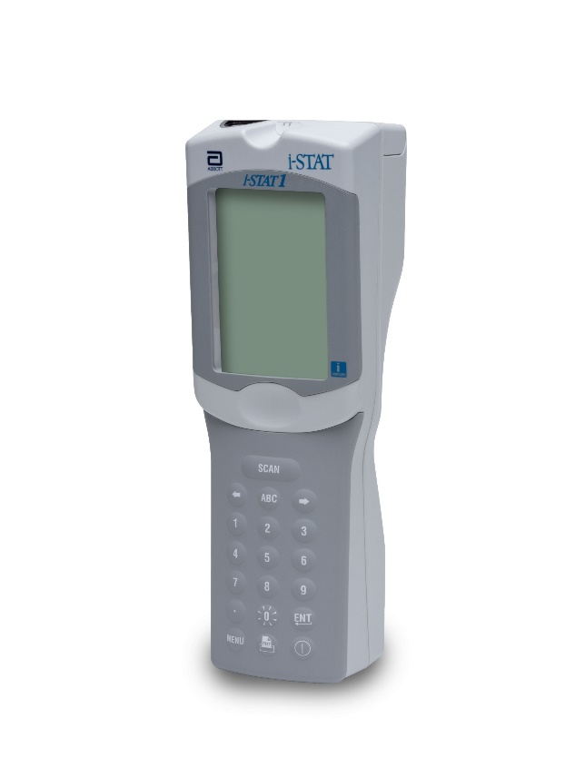
Cleaning and Disinfecting - cont’d
Cleaning the analyzer
Clean the display screen and the case with any of the following:
gauze pad moistened with
isopropyl alcohol (IPA) or
10% bleach
PDI® Super Sani-Cloth®
Rinse using a gauze pad moistened with water and dry
Display SCREEN
Case
CAUTIONS²:
Avoid getting excess fluids in the seam between the display screen and the case.
The analyzer and downloader/recharger MUST NOT be immersed in any liquid.
RESROUCE AND REFERENCE: 2. i-STAT 1 System Manual, Routine Care of the Analyzer and Downloader.
Lesson: Patient testing with the i-STAT 1 System | i-STAT CREA Cartridge | i-STAT 1 Learning System Classroom Training Power Points – Pfizer
For in vitro diagnostic use. For intended use and product details, visit www.globalpointofcare.abbott NOTE: Not all products are available in all regions. Check with your local representative for availability in specific markets.
©2023 Abbott. All rights reserved. i-STAT is a trademark of Abbott.

Slide 5
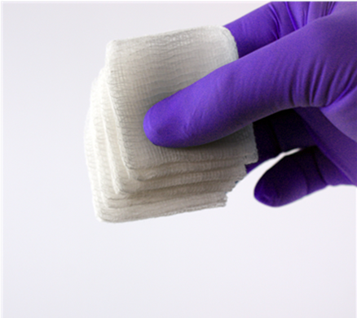
Cleaning and Disinfecting - cont’d
Decontaminating the analyzer
Prepare a 10% solution of bleach.
Soak a few gauze pads in the bleach solution. Squeeze the pads to remove excess solution.
Soften, then remove any dried blood with one or two of the gauze pads soaked in the bleach solution. Avoid scraping dried blood as contaminated particles may become airborne.
CAUTIONS³:
Decontaminate the analyzer whenever a specimen is spilled onto it or if the item is to be returned to Abbott.
Wear gloves while performing the procedure.
RESOURCE AND REFERENCE: 3. i-STAT 1 System Manual, Routine Care of the Analyzer and Downloader.
Lesson: Patient testing with the i-STAT 1 System | i-STAT CREA Cartridge | i-STAT 1 Learning System Classroom Training Power Points – Pfizer
For in vitro diagnostic use. For intended use and product details, visit www.globalpointofcare.abbott NOTE: Not all products are available in all regions. Check with your local representative for availability in specific markets.
©2023 Abbott. All rights reserved. i-STAT is a trademark of Abbott.

Slide 6
Cleaning and Disinfecting - cont’d
Decontaminating the analyzer – cont’d
Clean the entire surface of the device twice with gauze pads soaked in the bleach solution.
Rinse the surface of the device with gauze pads moistened with tap water and dry. If the device is to be shipped, place it in a plastic bag.
Display SCREEN
Case
CAUTIONS⁴:
To protect from nosocomial infections, decontaminate analyzers periodically and whenever blood is spilled or transferred to an analyzer.
Avoid getting excess fluids in the seam between the display screen and the case.
RESOURCE: i-STAT 1 System Manual, Routine Care of the Analyzer and Downloader.
REFERENCE: 4. i-STAT 1 System Manual, Procedure for Cartridge Testing, Caution. i-STAT 1 System Manual, Routine Care of the Analyzer and Downloader, Cleaning the Analyzer and Downloader.
Lesson: Patient testing with the i-STAT 1 System | i-STAT CREA Cartridge | i-STAT 1 Learning System Classroom Training Power Points – Pfizer
For in vitro diagnostic use. For intended use and product details, visit www.globalpointofcare.abbott NOTE: Not all products are available in all regions. Check with your local representative for availability in specific markets.
©2023 Abbott. All rights reserved. i-STAT is a trademark of Abbott.

Slide 7
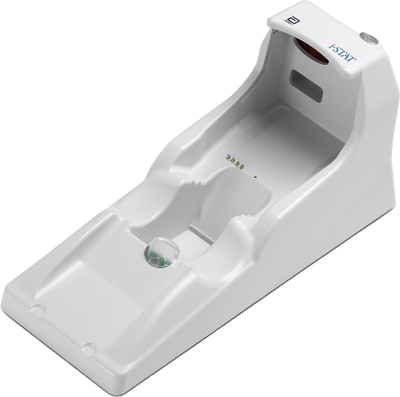
Cleaning and Disinfecting - cont’d
Cleaning the downloader/recharger
Clean the downloader/recharger with any of the following:
gauze pad moistened with
isopropyl alcohol (IPA) or
10% bleach
PDI® Super Sani-Cloth®
Rinse using a gauze pad moistened with water and dry.
CAUTIONS⁵:
The downloader/recharger may also be damaged by liquid contamination. Unplug the power supply from the outlet and dry the downloader/recharger completely.
REOURCE AND REFERENCE: 5. i-STAT 1 System Manual, Routine Care of the Analyzer and Downloader.
Lesson: Patient testing with the i-STAT 1 System | i-STAT CREA Cartridge | i-STAT 1 Learning System Classroom Training Power Points – Pfizer
For in vitro diagnostic use. For intended use and product details, visit www.globalpointofcare.abbott NOTE: Not all products are available in all regions. Check with your local representative for availability in specific markets.
©2023 Abbott. All rights reserved. i-STAT is a trademark of Abbott.

Slide 8
Cleaning and Disinfecting - cont’d
Decontaminating the downloader/recharger
Prepare a 10% solution of bleach.
Soak a few gauze pads in the bleach solution. Squeeze the pads to remove excess solution.
Soften, then remove any dried blood with one or two of the gauze pads soaked in the bleach solution. Avoid scraping dried blood as contaminated particles may become airborne.
CAUTIONS⁶:
Decontaminate the downloader/recharger whenever a specimen is spilled onto it or if the item is to be returned to Abbott.
Wear gloves while performing the procedure.
RESORUCE AND REFERENCE: 6. i-STAT 1 System Manual, Routine Care of the Analyzer and Downloader.
Lesson: Patient testing with the i-STAT 1 System | i-STAT CREA Cartridge | i-STAT 1 Learning System Classroom Training Power Points – Pfizer
For in vitro diagnostic use. For intended use and product details, visit www.globalpointofcare.abbott NOTE: Not all products are available in all regions. Check with your local representative for availability in specific markets.
©2023 Abbott. All rights reserved. i-STAT is a trademark of Abbott.

Slide 9
Cleaning and Disinfecting - cont’d
Decontaminating the downloader/recharger – cont’d
Clean the entire surface of the device twice with gauze pads soaked in the bleach solution.
Rinse the surface of the device with gauze pads moistened with tap water and dry. If the device is to be shipped, place it in a plastic bag.
CAUTIONS⁷:
The downloader/recharger may also be damaged by liquid contamination. Unplug the power supply from the outlet and dry the downloader/recharger completely.
RESOURCE AND REFERENCE: 7. i-STAT 1 System Manual, Routine Care of the Analyzer and Downloader.
Lesson: Patient testing with the i-STAT 1 System | i-STAT CREA Cartridge | i-STAT 1 Learning System Classroom Training Power Points – Pfizer
For in vitro diagnostic use. For intended use and product details, visit www.globalpointofcare.abbott NOTE: Not all products are available in all regions. Check with your local representative for availability in specific markets.
©2023 Abbott. All rights reserved. i-STAT is a trademark of Abbott.

Slide 10
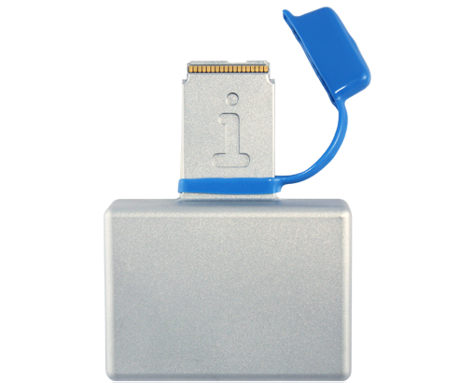
Cleaning and Disinfecting - cont’d
Cleaning the electronic simulator
Clean the electronic simulator with any of the following:
gauze pad moistened with
isopropyl alcohol (IPA) or
10% bleach
PDI® Super Sani-Cloth®
Rinse using a gauze pad moistened with water and dry.
Rubber boot
Connector
Rubber boot
CAUTIONS⁸:
Before cleaning, cover the connector area with the blue rubber boot. This will minimize the possibility of any cleaning fluid getting into the simulator housing, thus contaminating the internal circuitry.
RESOURCE: i-STAT 1 System Manual, Routine Care of the Analyzer and Downloader. i-STAT 1 System Manual, Electronic Simulator.
REFERENCE: 8. i-STAT 1 System Manual, Electronic Simulator, Cleaning the Simulator.
Lesson: Patient testing with the i-STAT 1 System | i-STAT CREA Cartridge | i-STAT 1 Learning System Classroom Training Power Points – Pfizer
For in vitro diagnostic use. For intended use and product details, visit www.globalpointofcare.abbott NOTE: Not all products are available in all regions. Check with your local representative for availability in specific markets.
©2023 Abbott. All rights reserved. i-STAT is a trademark of Abbott.

Slide 11
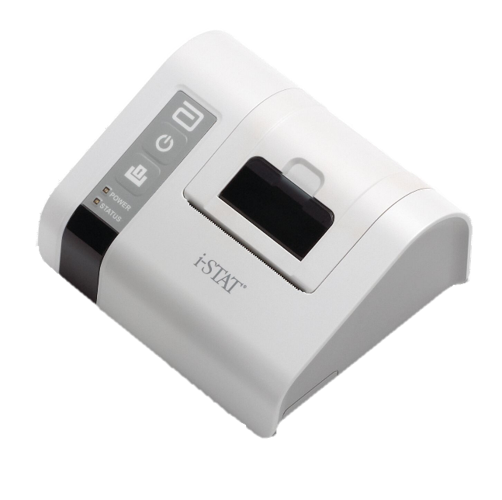
Cleaning and Disinfecting - cont’d
Cleaning the printer
Clean the printer using a with any of the following:
gauze pad moistened with
isopropyl alcohol (IPA) or
10% bleach
PDI® Super Sani-Cloth®
Rinse the printer using another gauze pad moistened with water and dry.
CAUTIONS¹¹:
Do not immerse the printer in any fluid, at any time.
RESOURCE AND REFERENCE: 11. i-STAT 1 System Manual, Portable Printer.
Lesson: Patient testing with the i-STAT 1 System | i-STAT CREA Cartridge | i-STAT 1 Learning System Classroom Training Power Points – Pfizer
For in vitro diagnostic use. For intended use and product details, visit www.globalpointofcare.abbott NOTE: Not all products are available in all regions. Check with your local representative for availability in specific markets.
©2023 Abbott. All rights reserved. i-STAT is a trademark of Abbott.

Slide 12
Training Complete | Congratulations!
CLEANING AND DISINFECTING| i-STAT 1 Analyzer & system components
You have just completed Cleaning and Disinfecting
i-STAT 1 Analyzer and System Components

