Slide 1

Principles of Paternity Testing

Slide 2

Performs Genetic Testing to establish relationships between family members
Paternity
Maternity
Siblings
Uncle/Aunts
For Immigration
For child support or custody
Notes:
GENETWOR_{x} Pharmacogenetics is the identification of genetic was formed with patients as our central focus and the ultimate goal of improving patient care by empowering healthcare practitioners with information to optimize drug therapy for increased efficacy, and reduced adverse events.
Delivering targeted therapy to patients, based on their individual genetic profile.
Utilize collective knowledge to develop new assays that will improve patient outcome
Collaborate with strategic partners to drive assays from R&D to commercialization

Slide 3
GENETWOR_{x} History/Evolution
2011 GENETWORx concept was born
2012 Began to create and market services
2013 Federal Licensure for Clinical Testing
  CAP Accreditation November 2013
2014 Completed all States individual certification
  State
  California COS 00800451 1/28/2018
  Florida 800027056 12/18/2018
  Maryland Approved 7/24/2015
  New York 8826 7/14/2015
  Rhode Island LCO00781 12/30/2014
2015 – Opened GENETWORx-ID, division for relationship (paternity) testing
  Obtained Certification from American Association of Blood Banks (AABB) in July 2015
CAP Reaccreditation in December of 2015
New York State Reaccreditation in July of 2016

Slide 4
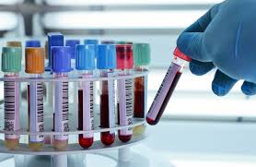
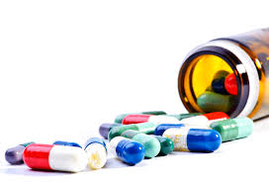


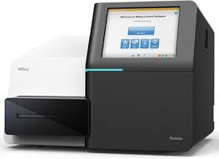

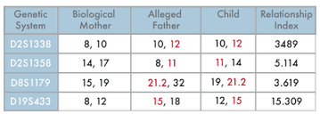
GENETWOR_{x} Team
Laboratory
Chemistry/Hospital Labs
Pharmacy
Clinical Trials
Research
Operations/Billing/Logistics
Notes:
Core Success of GENETWORx is in the laboratory. Executive Team has decades of business experience in managing day to day operations across all facets of healthcare bases organizations. Managed national reference laboratories, clinical chemistry laboratories, research laboratories. Our operational expertise is in not only day to day operations, but also billing and laboratory logistics from kit building to sales distribution. One of the things that differentiates GENETWORx from other clinical laboratories. Is that most of the assays in place here were developed by either Matt or myself. So we have the potential to develop an assay and take it from implementation to validation to clinical practice.

Slide 5
GENETWOR_{x} Management
Matthew J. Beckman PhD – Manager of Molecular Diagnostics: Dr. Beckman is the contact for questions on pharmacogenetics, women’s health testing, and wound panel analysis
Lori Downum, MT (ASCP) – Manager of Clinical Chemistry: Mrs. Downum is the contact for questions on clinical chemistry, blood analysis and urine drug analysis
Charnetta Williams – Director of Operations: Mrs. Williams will be the contact for all operations and logistical questions for customer service.
Sarah Jacobs-Helber PhD, HCLD (ABB) - Laboratory Director: Dr. Jacobs-Helber is the contact for questions on laboratory operations, compliance, certifications and the Human Identity Division
Damon Faulkner- VP of Sales contact for business development
Bill Miller, HTL (ASCP), MBA – CEO: Fields questions on contracts and business development
Notes:
Brings the best of research and clinical together for an ideal combination for future growth.
Lori- Already assembled an amazing team that are working on the current build out.
Char- understanding of logisitics within the lab and coordinates sample shipment, accessioning and delivery to the laboratory to insure patient results are reported in a timely and accurate manner.

Slide 6
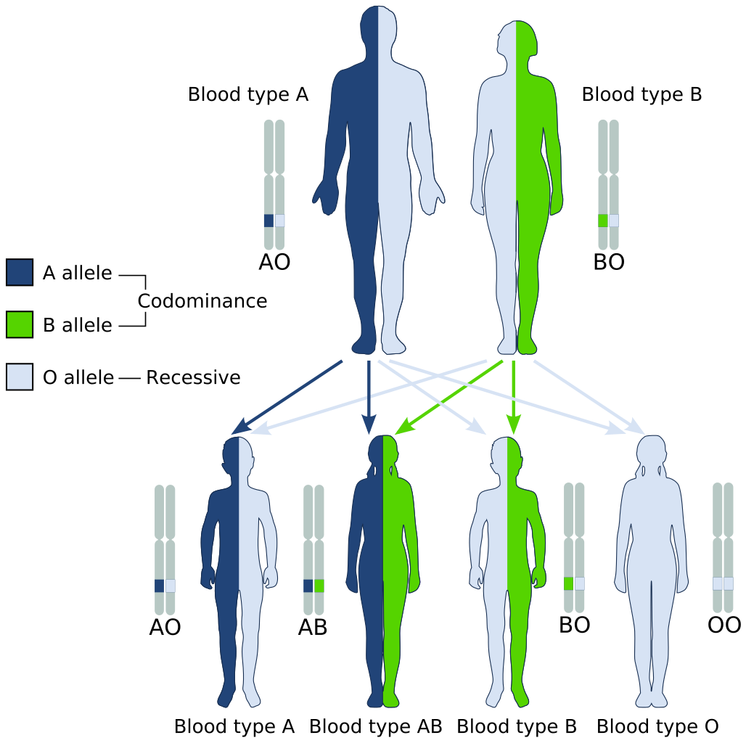
Establishing Paternity-Blood Type
Notes:
Get one gene from Mother and one gene from father

Slide 7
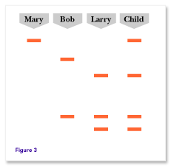
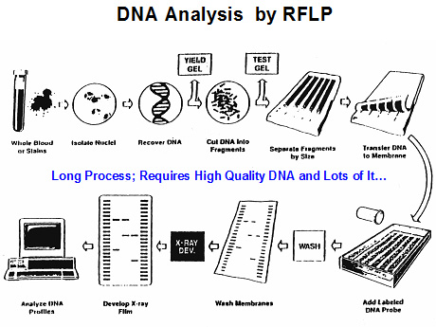
Restriction Fragment Length Polymorphisms (RFLP)
Process
Result

Slide 8
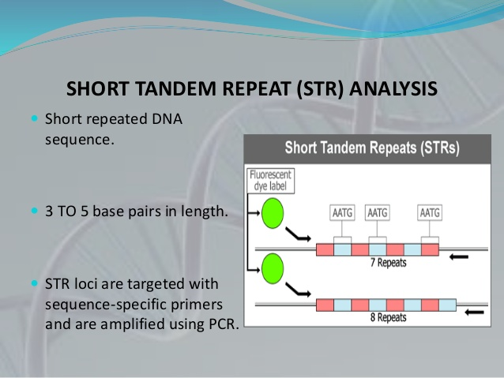
Short Tandem Repeat (STR) Analysis
Repeated sequences in genome
One copy of the repeated sequences from each parent(may or may not be different numbers of repeats)
Easy to amplify
Low mutation rate so can be used for relationship testing
1996: FBI established 13 core STR loci that could be used for identification
Notes:
hort Tandem Repeats (STRs)
The human genome is full of repeated DNA sequences. These repeated sequences come in various sizes and are classified according to the length of the core repeat units, the number of contiguous repeat units, and/or the overall length of the repeat region. DNA regions with short repeat units (usually 2-6 bp in length) are called Short Tandem Repeats (STR). STRs are found surrounding the chromosomal centromere (the structural center of the chromosomes). STRs have proven to have several benefits that make them especially suitable for human identification.
STRs have become popular DNA markers because they are easily amplified by polymerase chain reaction (PCR) without the problem of differential amplification; that is, the PCR products for STRs are generally similar in amount, making analysis easier. An individual inherits one copy of an STR from each parent, which may or may not have similar repeat sizes. The number of repeats in STR markers can be highly variable among individuals, which make these STRs effective for human identification purposes.
For human identification purposes, it is important to have DNA markers that exhibit the highest possible variation in order to discriminate between samples. It is often challenging to obtain PCR amplification products from forensic samples because either the DNA in those samples is degraded, or mixed, such as in a sexual assault case.
The smaller size of STR alleles make STR markers better candidates for use in forensic applications, in which degraded DNA is common. PCR amplification of degraded DNA samples can be better accomplished with smaller target product sizes.
Because of their smaller size, STR alleles can also be separated from other chromosomal locations more easilyto ensure closely linked loci are not chosen. Closely linked loci do not follow the predictable pattern of random distribution in the population, making statistical analysis difficult.
STR alleles also have lower mutation rates, which makes the data more stable and predictable.
Because of these characteristics, STRs with higher power of discrimination are chosen for human identification in forensic cases on a regular basis. It is used to identify victim, perpetrator, missing persons, and others.
Beginning in 1996, the FBI Laboratory launched a nationwide forensic science effort to establish core STR loci for inclusion within the national database known as CODIS (Combined DNA Index System). The 13 CODIS loci are CSF1PO, FGA, TH01, TPOX, VWA, D3S1358, D5S818, D7S820, D8S1179, D13S317, D16S539, D18S51 and D21S11. These loci are nationally and internationally recognized as the standard for human identification.
The DDC Forensic Laboratory routinely uses the 13 CODIS loci and has additional loci for an extensive and powerful STR testing battery if required.

Slide 9
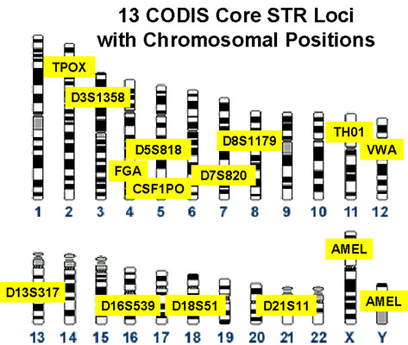
13 Core CODIS LOCI (Alleles)

Slide 10
Laboratory Process
Sample Receipt
DNA Extraction
Amplification: 19 different loci + Amelogenin (Sex)
Report

Slide 11
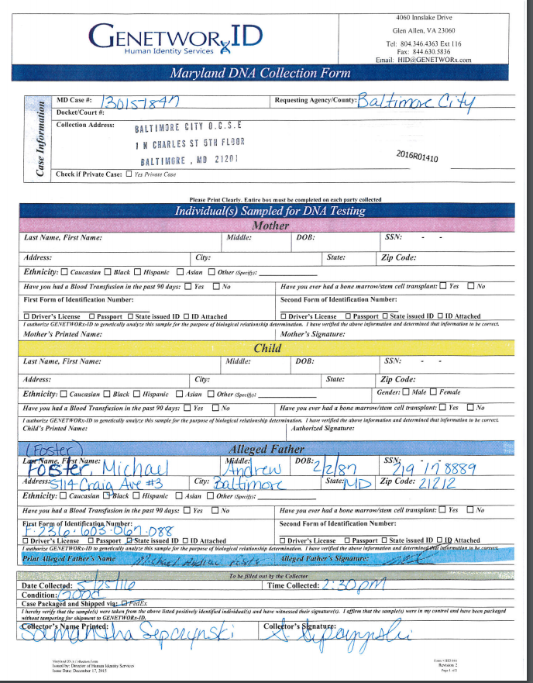
How Do we Make Sure that the Parties are All Who They Say They Are?
Chain of Custody
All samples must be collected according to AABB guidelines
Photographs
Picture Identification
Signatures
Parties MUST be collected by trained, impartial individual

Slide 12
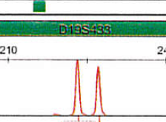
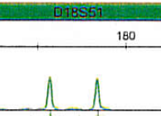
Short Tandem Repeat (STR) Analysis
Polymerase Chain Reaction (PCR)
Uses fluorescently labeled Primer to generate labeled Products
DNA fragments are separated by size and detected by a laser that identifies the fluorescently labeled DNA fragment
P1
6 Repeats
P1
8 Repeats
P2
6 8
P2
P3
4 Repeats
P3
6 Repeats
P4
P4
4 6
Notes:
hort Tandem Repeats (STRs)
The human genome is full of repeated DNA sequences. These repeated sequences come in various sizes and are classified according to the length of the core repeat units, the number of contiguous repeat units, and/or the overall length of the repeat region. DNA regions with short repeat units (usually 2-6 bp in length) are called Short Tandem Repeats (STR). STRs are found surrounding the chromosomal centromere (the structural center of the chromosomes). STRs have proven to have several benefits that make them especially suitable for human identification.
STRs have become popular DNA markers because they are easily amplified by polymerase chain reaction (PCR) without the problem of differential amplification; that is, the PCR products for STRs are generally similar in amount, making analysis easier. An individual inherits one copy of an STR from each parent, which may or may not have similar repeat sizes. The number of repeats in STR markers can be highly variable among individuals, which make these STRs effective for human identification purposes.
For human identification purposes, it is important to have DNA markers that exhibit the highest possible variation in order to discriminate between samples. It is often challenging to obtain PCR amplification products from forensic samples because either the DNA in those samples is degraded, or mixed, such as in a sexual assault case.
The smaller size of STR alleles make STR markers better candidates for use in forensic applications, in which degraded DNA is common. PCR amplification of degraded DNA samples can be better accomplished with smaller target product sizes.
Because of their smaller size, STR alleles can also be separated from other chromosomal locations more easilyto ensure closely linked loci are not chosen. Closely linked loci do not follow the predictable pattern of random distribution in the population, making statistical analysis difficult.
STR alleles also have lower mutation rates, which makes the data more stable and predictable.
Because of these characteristics, STRs with higher power of discrimination are chosen for human identification in forensic cases on a regular basis. It is used to identify victim, perpetrator, missing persons, and others.
Beginning in 1996, the FBI Laboratory launched a nationwide forensic science effort to establish core STR loci for inclusion within the national database known as CODIS (Combined DNA Index System). The 13 CODIS loci are CSF1PO, FGA, TH01, TPOX, VWA, D3S1358, D5S818, D7S820, D8S1179, D13S317, D16S539, D18S51 and D21S11. These loci are nationally and internationally recognized as the standard for human identification.
The DDC Forensic Laboratory routinely uses the 13 CODIS loci and has additional loci for an extensive and powerful STR testing battery if required.

Slide 13
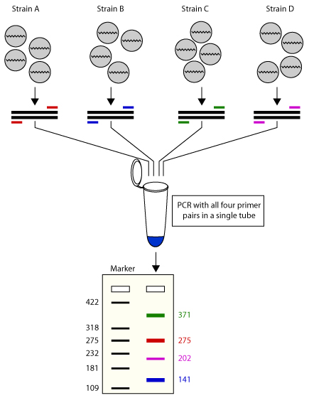
PowerPlex 21 STR kit
D3S1358 THO1 PENTAD D16S359
Amplifies 20 different STR Loci in one tube + Amelogenin (XY/XX)
Uses four different fluorescent dyes
Amplifies different size fragments for each locus so they can be separated

Slide 14
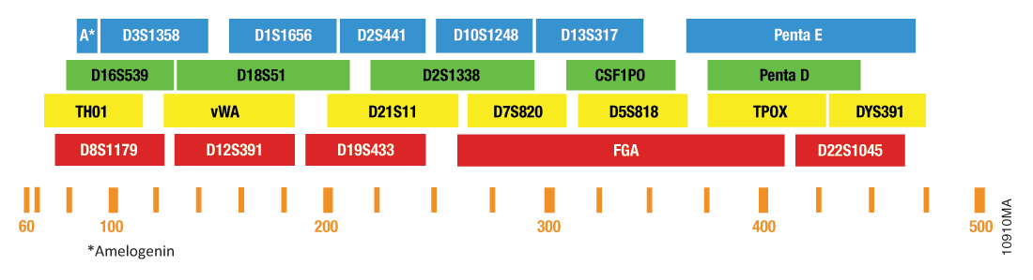
PowerPlex 21

Slide 15
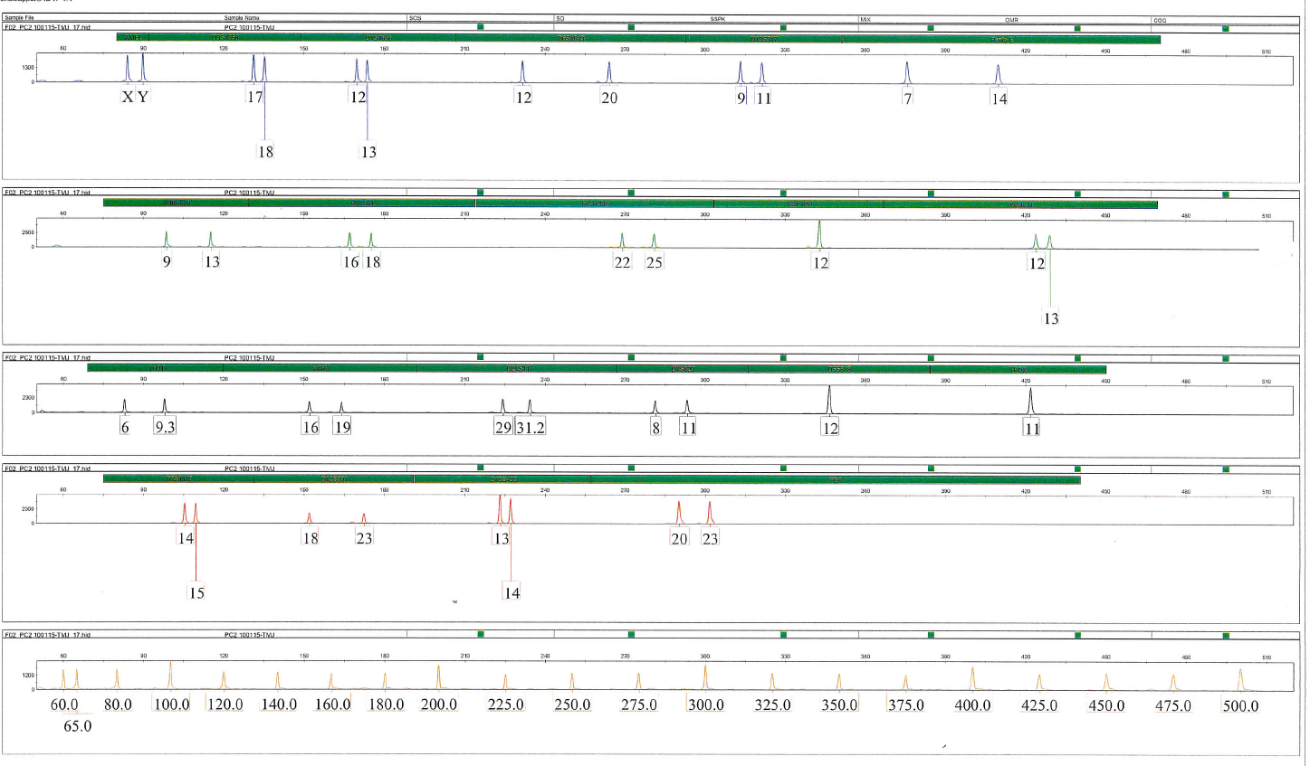
PowerPlex 21 Profile
Notes:
Capabilities lie

Slide 16
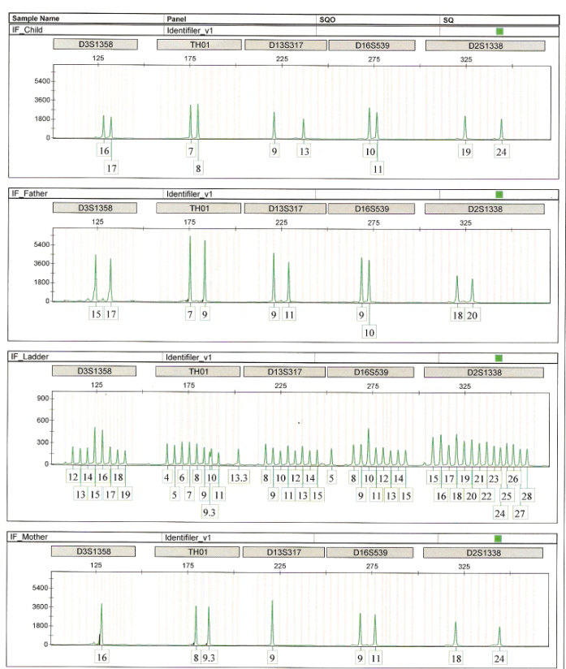
How Do We Compare the Profiles?
 | Mother |  | Child |  | Alleged Father
System | Allele | Allele | Allele | Allele | Allele | Allele | RI
D3S1358 | 16 |  | 16 | 17 | 15 | 17 | 1.8325
D13S317 | 9 |  | 9 | 11 | 9 | 11 | 1.5362
D16S539 | 10 | 11 | 10 | 11 | 9 | 10 | 1.5903
D2S1338 | 18 | 24 | 19 | 24 | 19 | 20 | 4.1494
TH01 | 8 | 9.3 | 7 | 8 | 7 | 9 | 4.1978
RED-Contributed by Mother
Black-Contributed by Alleged Father

Slide 17
Paternity Index and Combined Paternity Index
Paternity or Relationship Index:
Combined Paternity Index (CPI
The value generated for a single genetic marker or locus and is associated with the statistical strength or weight of that locus in favor of or against parentage given the phenotypes of the tested participants and the inheritance scenario.
Used to calculate the combined Paternity Index
Also known as the likelihood Ratio (LR)
Calculated by the product of the individual Paternity Index
More loci=higher CPI

Slide 18
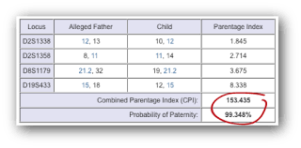
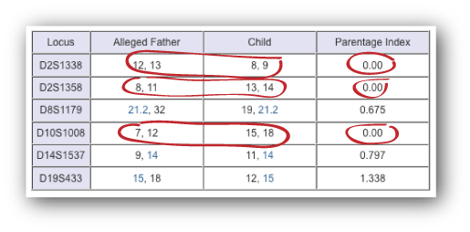
How Do We Calculate Paternity?
Not Excluded
Excluded
Products of all LR for all loci generates the CPI
CPI=1.845*2.714*3.635*8.338=153.435
CPI>100= Not Excluded
A likelihood ratio of 0 generates
a CPI of 0 = EXCLUSION

Slide 19
Formulas used to Calculation RI
 | Child |  | Alleged Father
System | Allele | Allele | Allele | Allele | RI
D3S1358 |  | 17 | 15 | 17 | 1.8325
D13S317 | 9 | 11 | 9 | 11 | 1.5362
D16S539 | 10 | 11 |  | 10 | 1.5903
D2S1338 | 19 | 24 | 19 | 20 | 4.1494
TH01 | 7 |  | 7 |  | 4.1978
Trio
Cases
(M,C,AF)
Locus | Alleged Father | Child | Formula to use
D2S1338 | A | AC | 1/2a
D13S317 | AB | AC | 1/4a
D16S539 | AB | A | 1/2a
D2S1338 | AB | AC | 1/4a
THOI | A | A | 1/a
Single Parent Cases
(M/AF,C)

Slide 20
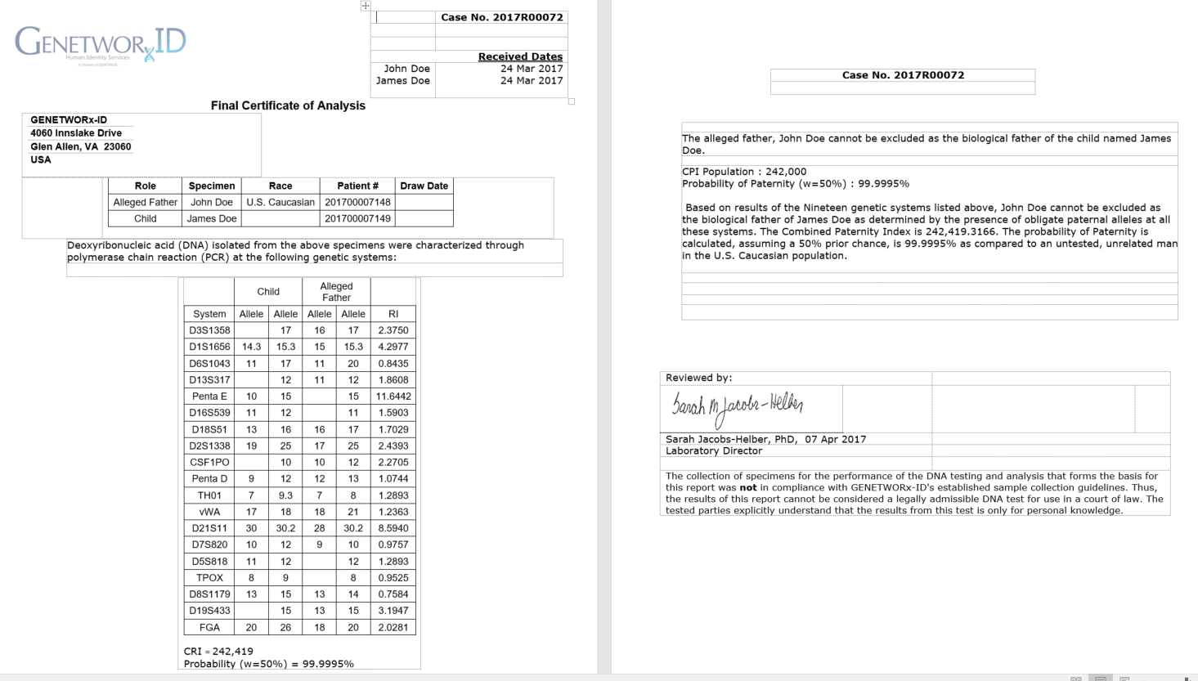
Not Excluded: Requires >99.5% Probability for Immigration

Slide 21
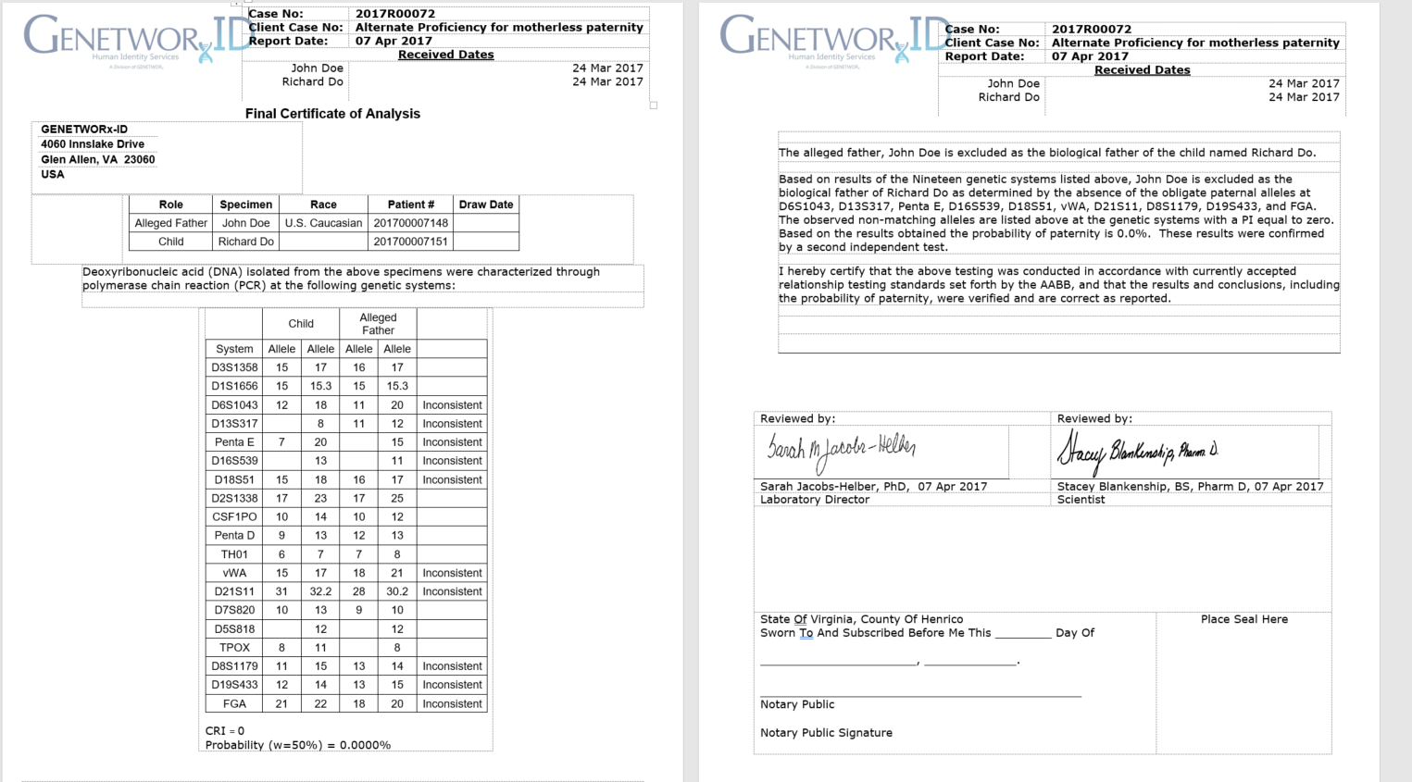
Exclusion-Minimum of 3 Inconsistencies

Slide 22
Mutation: One or Two Inconsistencies
Single or double Locus inconsistency is considered a mutation
Probability and CRI is lower
Can drop below 99%

Slide 23
Pharmacogenetics
Matthew J. Beckman, PhD
Manager – Molecular Diagnostics Division

Slide 24
GENETWOR_{x} :
Focus: Was formed with patients as our central focus and the ultimate goal of improving patient care
Goal: Empower healthcare practitioners with information to optimize drug therapy for increased efficacy and reduced adverse events.
Providing personalized diagnoses by combining clinical information with pharmacy driven therapeutic and drug recommendations.
Notes:
GENETWOR_{x} Pharmacogenetics is the identification of genetic was formed with patients as our central focus and the ultimate goal of improving patient care by empowering healthcare practitioners with information to optimize drug therapy for increased efficacy, and reduced adverse events.
Delivering targeted therapy to patients, based on their individual genetic profile.
Utilize collective knowledge to develop new assays that will improve patient outcome
Collaborate with strategic partners to drive assays from R&D to commercialization

Slide 25
GENETWOR_{x} History/Evolution
History
Licensure
2011 GENETWORx concept was born
2012 Began to create and market services
2013 Federal Licensure for Clinical Testing
  CAP Accreditation November 2013
2014 Completed all States individual certification
Federal: College of American Pathologists (CAP)
American Association of Blood Banks
States
  California
  Florida
  Maryland
  New York
  Rhode Island
  Pennsylvania

Slide 26

Proprietary Software developed by and owned exclusively by GENETWORx.
Captures patients’ prescription information from pharmaceutical administrators
Combines current and future drug history with patient diagnosis or pharmacogenetic information
Pharmacist provides personalized analysis of drug/drug, drug/genotype interactions and makes therapeutic recommendations
Applications in Pharmacogenetics, Molecular Diagnostics, Toxicology, Chemistry

Slide 27
Terminology
Amplification: An event that produces multiple copies of a gene or of any sequence of DNA. Gene amplification plays a role in cancer. Amplification can occur in vivo (in the living individual) or in vitro (in the laboratory).
Polymerase chain reaction (PCR) is a technique used in molecular biology to amplify a single copy or a few copies of a segment of DNA across several orders of magnitude, generating thousands to millions of copies of a particular DNA sequence.
Single Nucleotide Polymorphism (SNP) is a variation in a single base pair in a DNA sequence.
Genotype- The genetic constitution of an organism
Phenotype- the set of observable characteristics of an individual resulting from the interaction of its genotype with the environment.

Slide 28
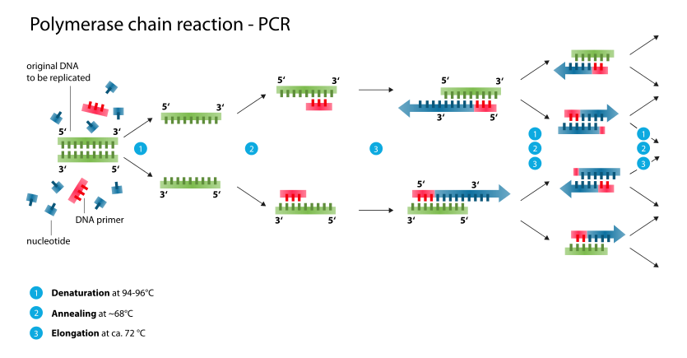
Polymerase Chain reaction

Slide 29
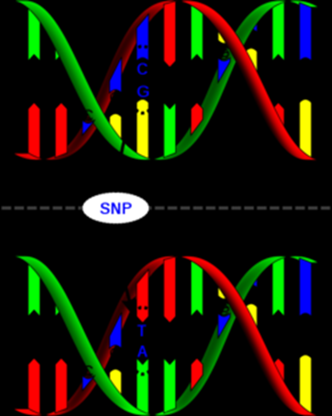
Single nucleotide polymorphism (SNP)
Single Base differences
Two copies of each gene
So three possibilities
Both Wild type Homozygous WT
Both mutant Homozygous Mutant
One of each: Heterozygote
For SNP genotyping:
  One probe Fluorescent dye 1
  Second probe dye 2

Slide 30
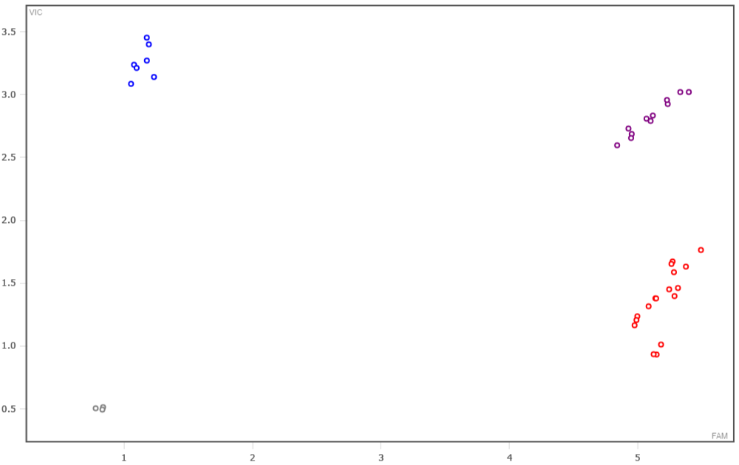
Wild Type, Heterozygote, Homozygous Mutant
A/A “Blue dye”
A/G “Blue and Red=Purple”
G/G “Red dye”

Slide 31
Pharmacogenetics Terminology
cytochrome P450 enzymes: (found in the liver) are responsible for the metabolism of a large number of pharmaceutical compounds. These enzymes function to detoxify xenobiotics (foreign molecules in the body, including drugs). The various genetic polymorphisms in cytochrome P450 can result in increased enzymatic activity, decreased enzymatic activity, or complete loss of enzyme activity. These changes can, in turn, lead to increased (or decreased) activation of pro- drugs, or to increased (or decreased) metabolism and excretion of drugs.
drug response phenotype: SNPs are also useful in pharmacogenomics for matching an individual’s genotype with a drug- response phenotype. It is possible, in this context, to identify individuals who cannot adequately metabolize the drug and must be dosed accordingly, or those with a compromised drug target, who could not benefit from the drug.

Slide 32
GENOTYPE→Phenotype
For CYP450 genes, the genotype translates to a metabolizer status (phenotype)
Normal Metabolizer
Intermediate Metabolizer
Poor Metabolizer
Rapid Metabolizer
For other genes that are not enzymes, results come through as WT, HET and MUT
May be transporter, receptor etc.

Slide 33
PGX Sample Workflow-Buccal Swab
Sample Receipt
Registration
DNA extraction
SNP Genotyping
Copy Number analysis
Data Analysis
Upload into LIMS
Review by Technologist
Review By Pharmacist
Report Released

Slide 34
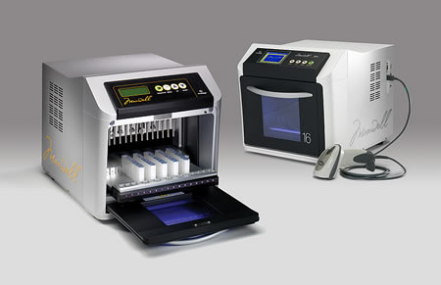
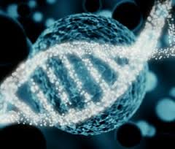
Rapid Extraction of Highly Purified DNA
Targeted Nucleic Acids
Human Genomic DNA
Human RNA
Viral DNA/RNA
Bacterial DNA
FFPE
Wide Variety of Specimens
Buccal Swabs
Universal Transport Medium
PreservCyt
Urine/Blood

Slide 35
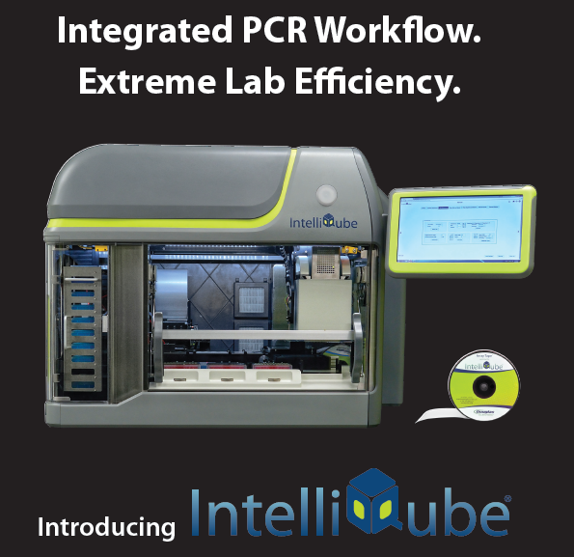
Platforms: Douglas Scientific IntelliQube
Pharmacogenetics/Women’s Health
- Walk-away operation
- Increased efficiency of lab personnel
- Reduced reaction volume
- Increased throughput
- Reduced consumable costs
- Current Tests on the IntelliQube
  Pharmacogenetics
  Personalized Health Panel

Slide 36
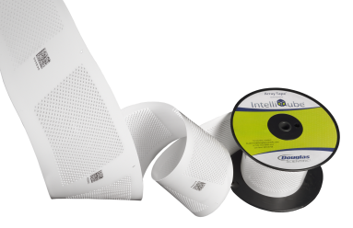
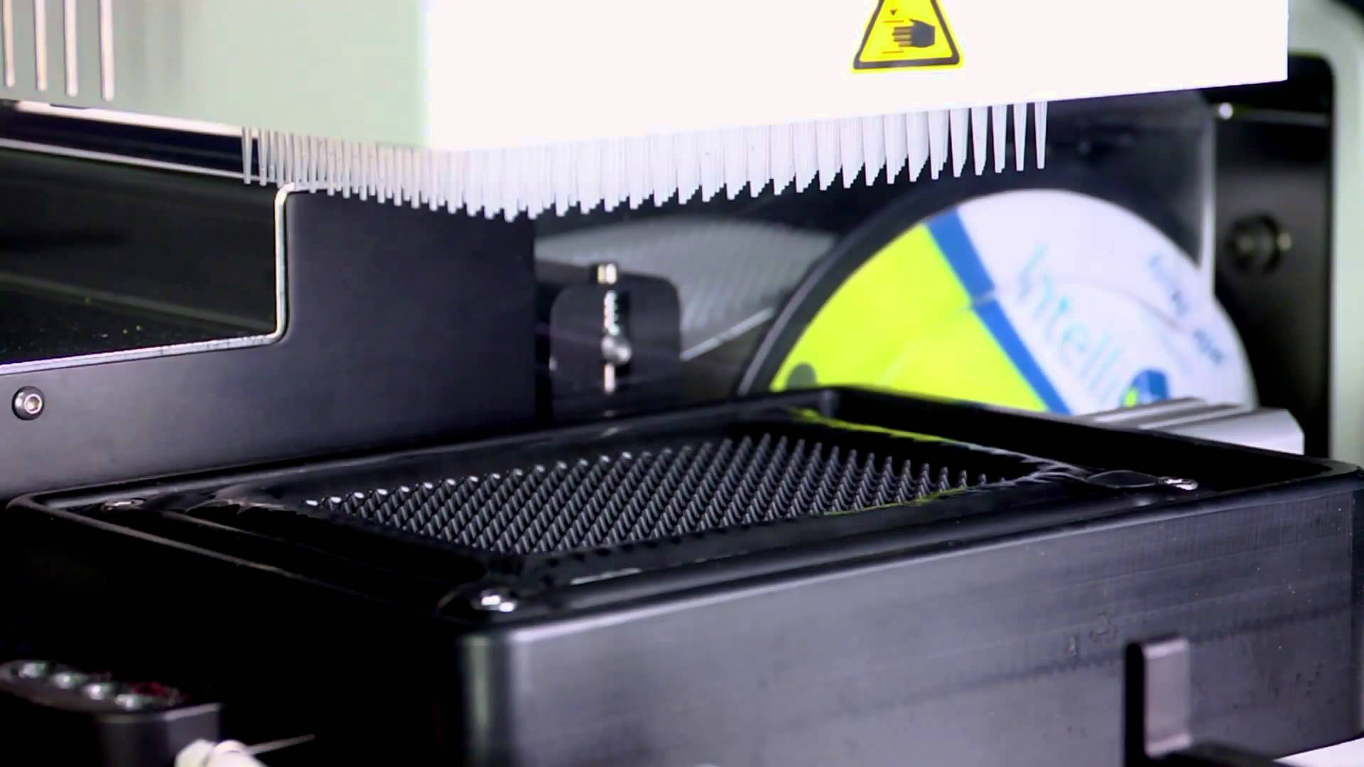
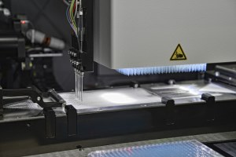
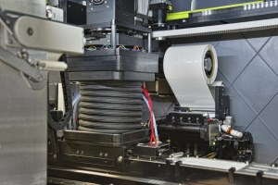
Platforms: Douglas Scientific IntelliQube

Slide 37
PGX Markers
Additional Markers
ABCB1** | GRIK4*
ABCG2** | HTR2A*
ADRA2A* | HTR2C*
DRD2/TAQA* | IL28B
Apolipoprotein E | ITGB3*
COMT | OPRK1*
CYP1A2 | OPRM1*
CYP2B6 | SLCO1B1**
CYP2C8 | UGT1A1**
DBH | UGT2B15**
DPYD
Previous Markers
CYP450 2C19
CYP450 2D6
CYP450 2C9
VKORC1
CYP450 3A4
CYP450 3A5
Factor II
Factor V
MTHFR
*Receptor
** Transporter

Slide 38
Value of Expanded PGX Panel
Gene | Drugs Affected |  | Gene | Drugs Affected
ABCG2 | Allopurinol |  | DPYD | cepecitabine fluorouracil
APOE | atorvastatin pravastatin simvastatin |  | GRIK4 | fluvoxamine paroxitine sertraline | citalopram escitalopram fluoxamine
DRD2/TAQA | clozapine venlafaxine resipridone | Olanzapine amisulpride haloperidol | IL28B | peginterferon alfa-2a | peginterferon alfa-2b ribavirin
CYP2B6 | metoprolol paroxetine tamoxifen | amitriptyline doxepin | ITGB3 | aspirin
HTR2C | citalopram |  | OPRK1 | methadone buprenorphine
DBH | levodopa naltrexone |  | UGT1A1 | irinotecan
COMT | Nicotine dependence Oxycodone Antidepressents opioids |  | UGT2B15 | oxazepam lorazepam
More Genes Surveyed
Additional Drugs Affected
Three additional CYP450 genes for drug metabolism
Additional Pharmacodynamic genes
Additional Drug classes
  Statins
  Anti inflammatory
  Anti metabolites
Pharmacist review with current medications

Slide 39
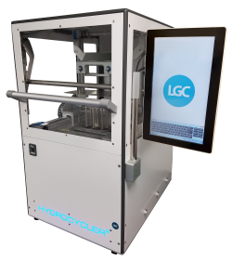
Improved SNP Throughput: Douglas Scientific IntelliCycler
Ability to process more than 145,000 samples in an eight-hour day.
Multi-bath system delivers precise temperature control, enhances cycling time, and eliminates temperature fluctuations.
Supports all common end-point PCR chemistries and protocols as well as emulsion PCR (ePCR).

Slide 40
Molecular Analysis
Sarah Jacobs-Helber, PHD HCLD(ABB)
Laboratory Director

Slide 41
Molecular Diagnostics
Women’s Health
Leukorrhea, BV, CV, HSV
Gastrointestinal Pathogen Testing
Luminex GPP
Wound Care Analysis
Intelliqube
Nail Fungal Analysis
Respiratory Pathogens

Slide 42
Culture Procedure
Collection
Bacteria
Viruses
Fungi
Mycoplasma
Culture
2-3 days
Culture
2-3 days
Positives
Culture
2 weeks
Plating
2-3 days
Antibiotic Resistance
2-3 days
Total Time: 1-2 weeks and multiple tests for one sample

Slide 43
Molecular testing
Collection
Total Time: 1-2 DAYS
DNA Extraction
Molecular analysis
Pharmacist Review/Therapeutic
Recommendations
REPORT

Slide 44
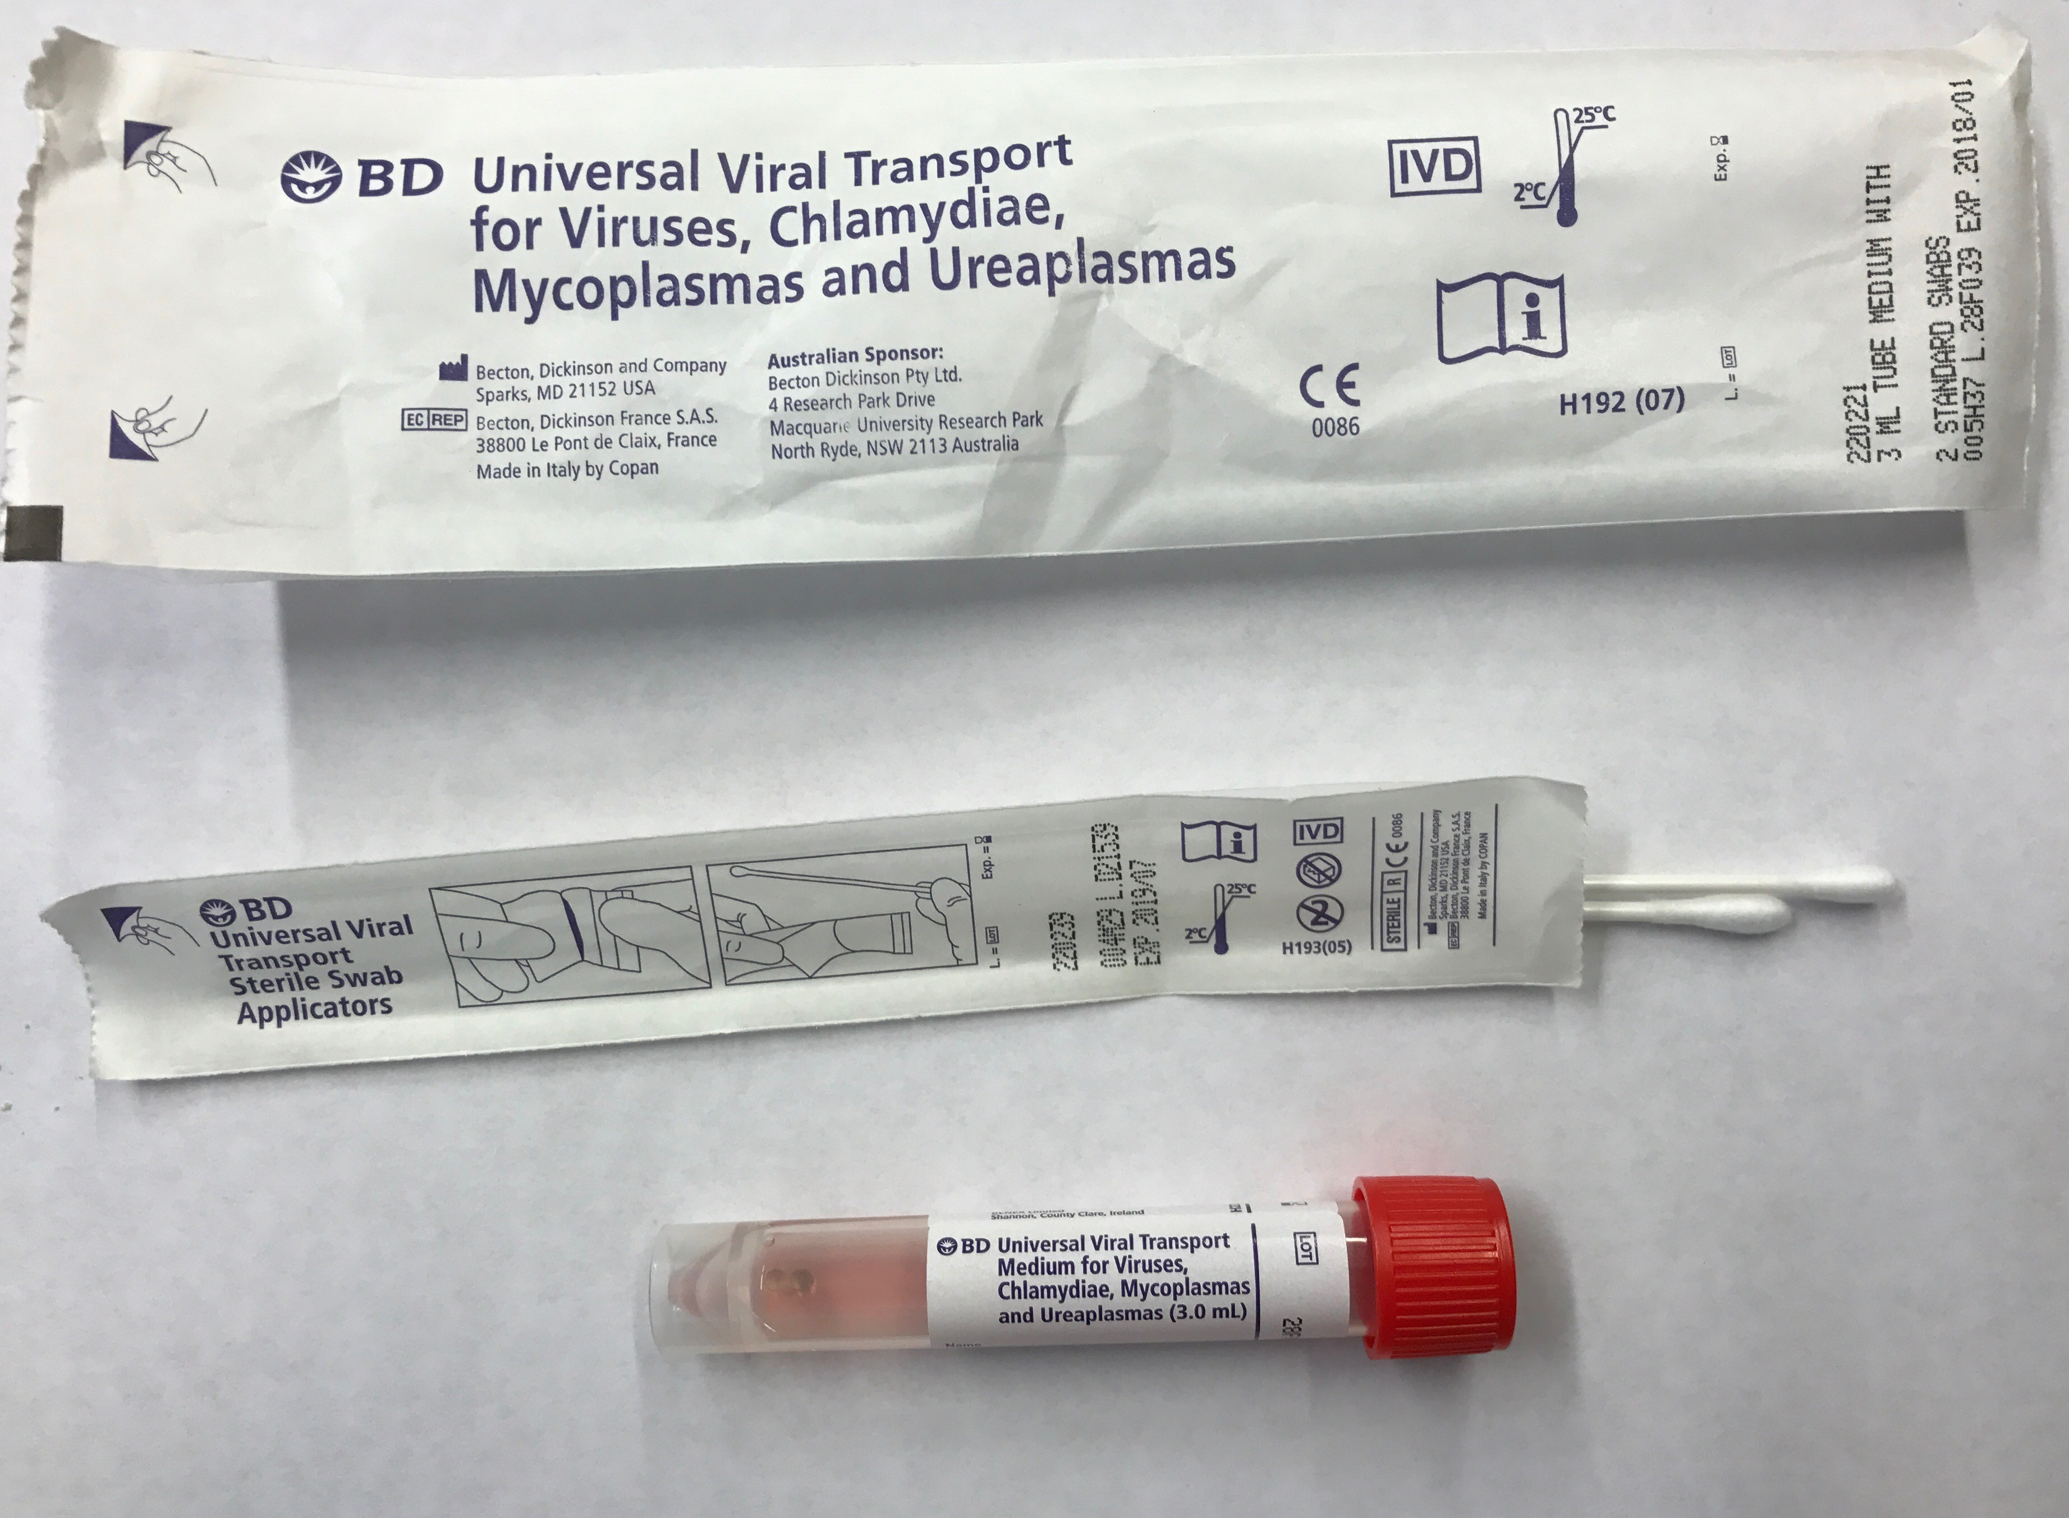
Sample Type
GEN SWAB
  Universal Transport Media with Collection swab
  Can be used for all Molecular Diagnostic collections (Except Fungus)

Slide 45
Sample Type
URINE
  Do not instruct to dip swab in the urine cup and add to the UTM
  May add 1-2 cc of urine to the UTM media and invert

Slide 46
Molecular Diagnostics Workflow
Sample Receipt
Registration
DNA Extraction
Leukorhea
Bacterial Vaginosis
Urogen
HSV
HPV
Candida
Gastrointestinal Pathogen Panel
H pylori
GBS

Slide 47
Molecular Diagnostics Workflow
Data Review by Technologist
Upload into LIMS
Data Results
Leukorhea
Bacterial Vaginosis
Urogen
HSV
HPV
Candida
Gastrointestinal Pathogen Panel
REPORT RELEASED

Slide 48
Women’s Health Testing-INTELLIQUBE
Bacterial Vaginosis
6 Pathogens associated with BV
Leukorrhea
Chlamydia
Gonorrhea
Candida
5 Candida species
HPV
Urogen
Trichomonas vaginalis
15 High Risk HPV including
HPV 16
HPV18
HPV45
Four Ureaplasma Mycoplasma species

Slide 49
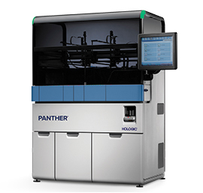
HOLOGIC-PANTHER
Sample to Answer Instrument
Fully Automated
FDA Approved
Move Leukorrhea, Candida, HPV Assays to free space on the Intelliqube
Installation this week

Slide 50
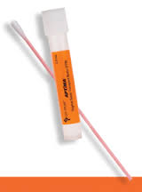
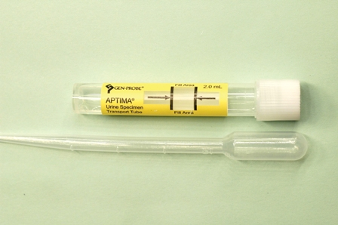
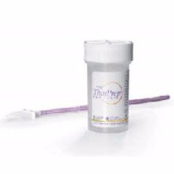
Hologic Sample Types

Slide 51
Additional Platforms
7500 rtPCR
Aires
LX200
GBS
H Pylori
HSV1
HSV2
Gastrointestinal Pathogen Panel

Slide 52
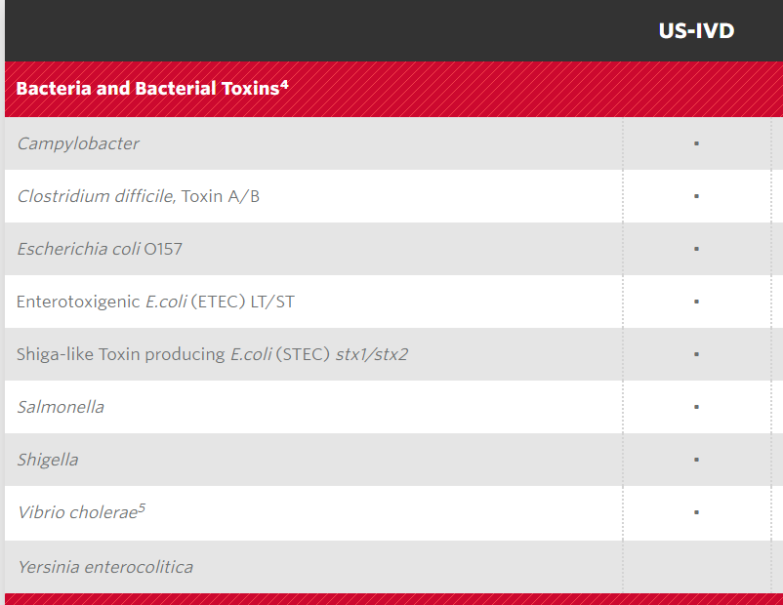
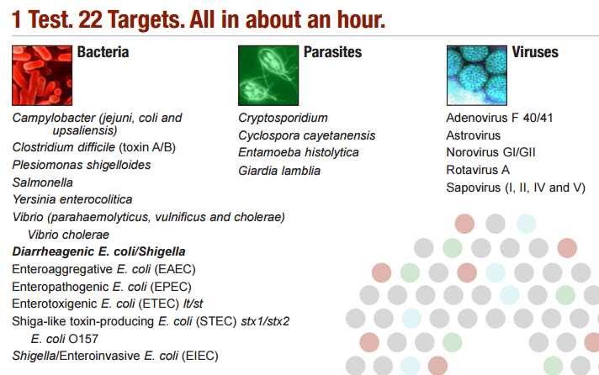
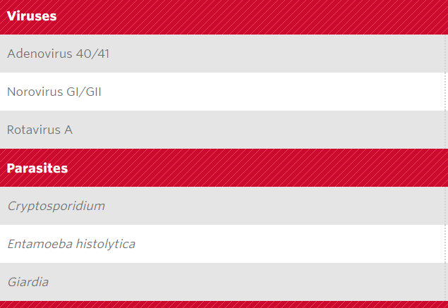
Luminex GPP vs Biofire

Slide 53
Advantages of GENSWAB
One collection can be used to test all analytes
Positive results come with therapeutic recommendations

Slide 54
WOUND CARE ANALYSIS
Sarah Jacobs-Helber, PhD HCLD(ABB)

Slide 55
GENETWOR_{x}: Wound Care Analysis
Rapid, specific assessment of 25 infectious agent that prevent wound healing
Reduces time to treatment
Reduces costs
Pharmacist –driven recommendations to assist in treatment
Goal: Empower Health Care physicians to optimize drug therapy and improve patient care
Notes:
GENETWOR_{x} Pharmacogenetics is the identification of genetic was formed with patients as our central focus and the ultimate goal of improving patient care by empowering healthcare practitioners with information to optimize drug therapy for increased efficacy, and reduced adverse events.
Delivering targeted therapy to patients, based on their individual genetic profile.
Utilize collective knowledge to develop new assays that will improve patient outcome
Collaborate with strategic partners to drive assays from R&D to commercialization

Slide 56
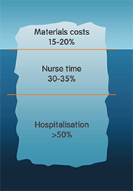
Cost of wound care
2% of population in US has chronic non-healing wound
Average wound costs $4000.00 to heal
Annual cost to US is $25 billion
Incidence is increasing as boomers get older and rate of diabetes increases
Most improvements in care are in treatment not diagnostics

Slide 57
Wound Culture Procedure
Collection
Bacteria
Viruses
Fungi
Mycoplasma
Culture
2-3 days
Culture
2-3 days
Positives
Culture
2 weeks
Plating
2-3 days
Antibiotic Resistance
2-3 days
Total Time: 1-2 weeks and multiple tests for one sample

Slide 58
Wound GENIE
Collection
Total Time: 1-2 DAYS
DNA Extraction
Wound GENIE analysis
DNA Extraction
Wound GENIE analysis
Pharmacist Review/Therapeutic
Recommendations
REPORT

Slide 59
Analytes
Gram Positive Bacteria
Enterococcus feacalis,
Gram Negative Bacteria
Bacteroides fragilis,
Viruses
HSV1
Mycobacteria
Methicilllin Resistant Staphloycoccus aureus (MRSA),
Staphloycoccus epidermidis,
Streptococcus pyogenes (Group A Strep),
Streptococcus dysgalactiae (Group A Strep),
Streptococcus alagactiae (Group B Strep)
Bartonella henselea,
Klebsiella pneumoniae,
Proteus mirabilis,
Pseudomonas aeriginosa,
Bartonella quintana
Fungi
Candida albicans,
Candida glabrata,
Candida parapsilopsis,
Candida dubliniensis,
Candida tropicalis
Mycobacteria fortuitum
Mycoplasma hominus
Ureaplasma urealyticum
Ureaplasma parvum
HSV2
HSV-3(Varicella zoster)

Slide 60
Collection information
GEN-Swab can be used for collection
Specific collection instructions will be provided for wound

Slide 61
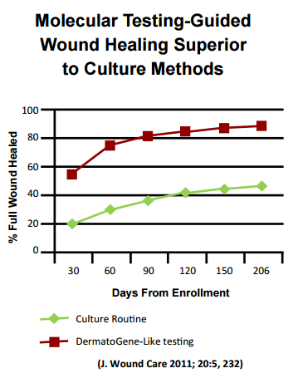
Advantages: Wounds close faster
Molecular identification allows wound to be treated with greater accuracy
  Wounds close faster!
  Greater than 50% healed within one month
Molecular Analysis
Standard of Care

Slide 62
Advantages: Treatment costs less
Personalized therapy of infected wound is 1/3 cost of normal treatment
  Wolcott, R. J Wound Care 24:2015
Identification of multiple pathogens in wound results in more comprehensive treatment

Slide 63
Nail Fungal analysis
Sample type Toenail clippings
Analysis
  Dermatophytic fungi
  Candida fungi
  Aspergillus fungi

Slide 64
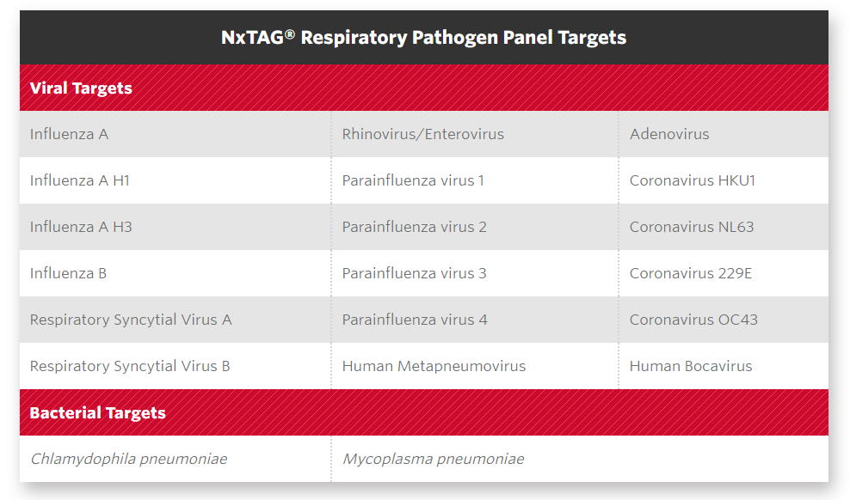
Respiratory Analysis

Slide 65
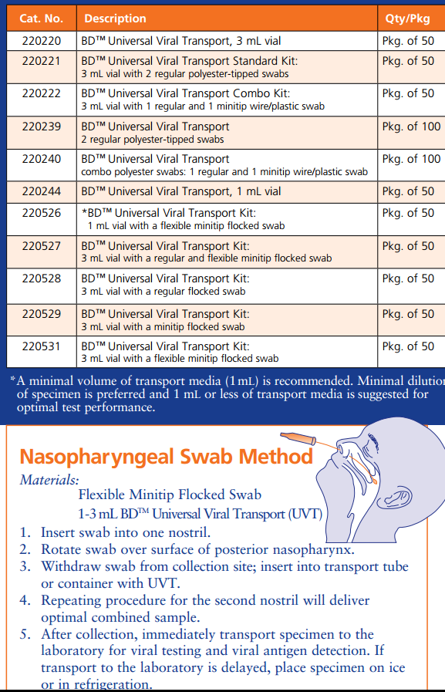
Respiratory Analysis
Sample Type: UVT with flexible Minitip flocked swab for Nasopharyngeal collections

Slide 66
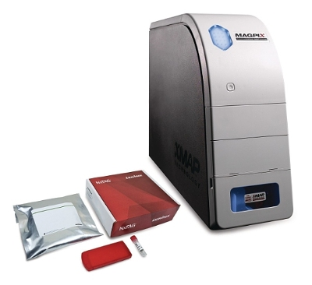
Analysis: Luminex MagPix
- Multiplexing: Up to 50 analytes per sample.
- Read Time: 96-well plate in ≤ 60 min
(up to 4,800 tests/hour).
- Foot Print: three linear feet of bench space.

Slide 67
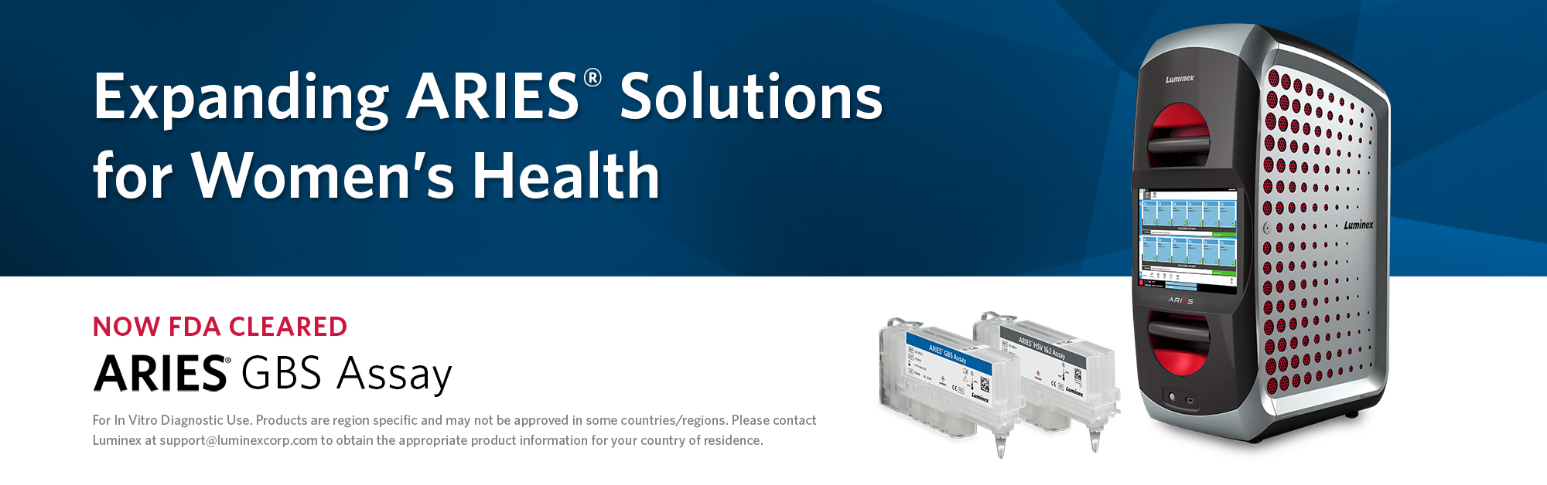
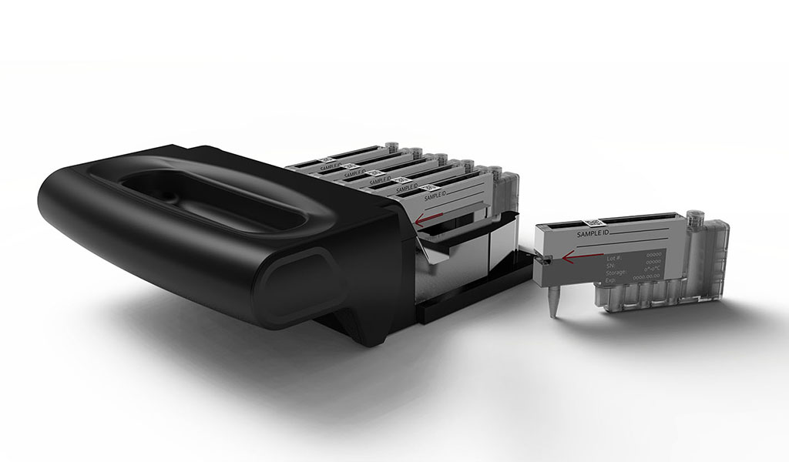
Platforms: Luminex ARIES and Melting Curve Analysis-HSV1
- Sample to answer, real time PCR systems
crafted to increase laboratory efficiency,
ensure result accuracy, and fit seamlessly into
today’s lean laboratory.

Slide 68
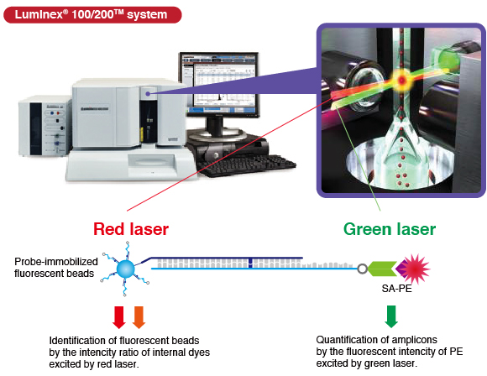
Platforms: Luminex xMAP® (Luminex®) Technology-GI Pathogen Assay
-Bead sets are used to immobilize
a probe to detect a specific analyte.
-DNA samples are amplified by PCR
using biotinylated primers.
-52 types of DNA probes can be
used in a multiplex assay of a single
specimen.
-streptavidin-phycoerythrin (SA-PE)
binds to the bead-amplification
product complex.
-A Red laser excites the internal
dyes of the bead set to identify
each bead.
-A green laser quantifies the analyte.

Slide 69
Summary
The Molecular Diagnostics Laboratory currently processes 100,000 tests per year in Pharmacogenetics and Personalized Health Panels.
Several state of the art platforms are being utilized to rapidly process and turnover analyte detection and reporting.
In the near term, test procedures will ramp to a 250,000 test per year rate.
Long range, we plan to see an even more dramatic expansion to both our test menu and test volume.
Projections have the lab reaching as much as 1,000,000 individual tests per year within 1-2 years time.
Advances in Platform high throughput processing, multiplex operation, and walk-away robotics will bridge our ability to cope with significant increases in sample numbers and tests run.

