Slide 1
Sample Collection for Relationship Testing
Notes:
Welcome to GENETWORx ID Human Identity Services training on sample collection for relationship testing.
This training will prepare you to correctly and efficiently collect the necessary samples for relationship testing for paternity, maternity, sibship, avuncular, grandparentage, identical versus fraternal twin determination, tribal enrollment, and immigration.

Slide 2
Why is Training for Sample Collectors Needed?
The AABB standards requires that laboratories only provide relationship testing for samples with a valid chain of custody.
Accurate sample collection is needed to ensure results can be admitted in a court of law.
Notes:
To begin, why is it important for sample collectors to be trained? (HIT ENTER)
GENETWORx ID follows the AABB standards which state that laboratories should only provide relationship testing for samples with a valid chain of custody when submitting samples for immigration and legal purposes.
A valid chain of custody helps to assure that there is accuracy in the testing and sample collection. (HIT ENTER)
This is critical to ensuring that the results of the relationship testing can be admitted in a court of law.
Having accurate sample collection also promotes quality control in our laboratory.
So to help guarantee this quality we will discuss step by step in this training what is needed for a complete and accurate sample collection.
We require that you follow each of these steps with every sample collection.

Slide 3
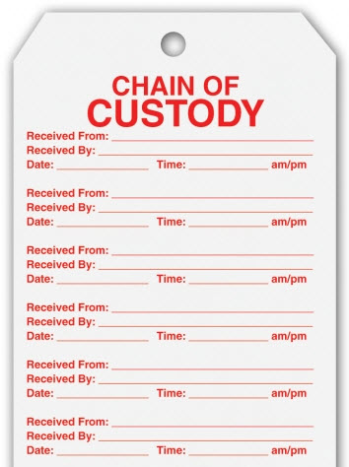
Chain of Custody
A formal means of tracing a sample.
A chronological written record of those who have had custody of the sample at any point.
A chain of custody is a legal document.
Notes:
Sample collection begins the chain of custody. (HIT ENTER)
The chain of custody is the formal means of tracing a sample from its source to its final location. (HIT ENTER)
It is a chronological record that documents in writing all the individuals whom have had custody of the samples from the time of collection and on. (HIT ENTER)
This chain of custody is a legal document.
All individuals in the chain of custody must be identified.

Slide 4
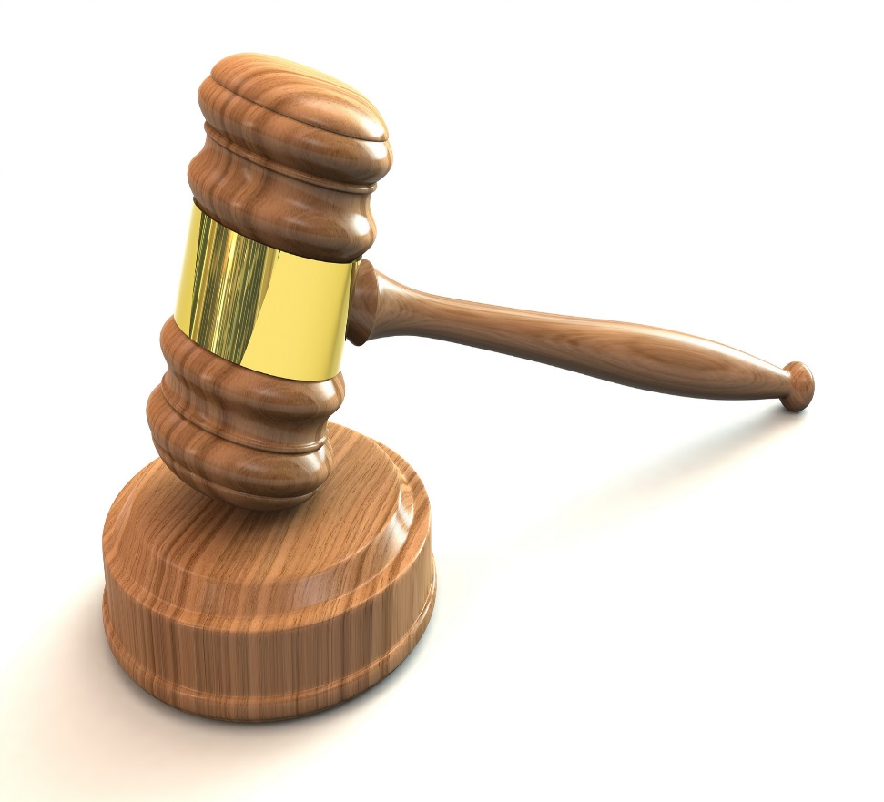
Chain of Custody
The chain of custody is scrutinized by lawyers.
Errors in the chain of custody or the handling of sample collection can cause results to be excluded in court.
Notes:
This legal document if often scrutinized by lawyers looking to invalidate evidence. (HIT ENTER).
If there are errors in the chain of custody or in sample collection it can result in the DNA results being excluded in court.

Slide 5
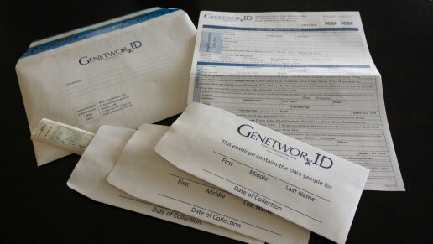
Establishing a Chain of Custody
Sample collection must be performed by an individual without an interest in the testing outcome.
Collection kits will only be sent to the authorized sample collector.
Notes:
Therefore, the chain of custody is very important. To establish a chain of custody and ensure it’s integrity, sample collection needs to be performed by an individual without an interest in the outcome of testing.
That means that family members and friends cannot collect their own or their family/friends samples. (HIT ENTER)
For legal and immigration casework, GENETWORx ID will only send collection materials to an authorized sample collector. We will not send collection kits to the individual being tested. They, or any individual with a relationship to them, should never have possession of the collection material before the time of collection.
This helps to reduce the chances of sample tampering and maintains the chain of custody.

Slide 6
Relationship Testing Submission Form
A sample that is not sent with a completed submission form will not be tested.
Notes:
Included in the collection kit sent to authorized sample collectors is the DNA Test Submission Form. This Submission Form requires multiple signatures and dates that help to document the collection process and is the collectors formal chain of custody. (HIT ENTER)
Because the chain of custody is so pivotal, GENETWORx ID will not perform testing on a sample that is received without an accurately completed submission form. If the form is not complete at the time of submission, a new sample would need to be collected.

Slide 7
Collection Instructions
Use the DNA Collection Instruction checklist on the back of the submission form.
Notes:
To help reduce the chance that a new sample would need to be collected and to ensure a complete and accurate sample collection each time, we have included DNA Collection Instructions on the back of the DNA Test Submission Form.
Please use this checklist with each and every sample collection.

Slide 8
Confidentiality
The collection process should be confidential.
Discuss and perform the collection in an area where others will not overhear personal information.
Do not discuss the case or the individuals you meet for collection with others.
Notes:
As you begin the sample collection, please remember that the collection process should be confidential. (HIT ENTER)
Discuss and perform the collection in an area where others will not overhear personal information. (HIT ENTER)
Do not discuss the cases or individuals you meet for collection with others

Slide 9
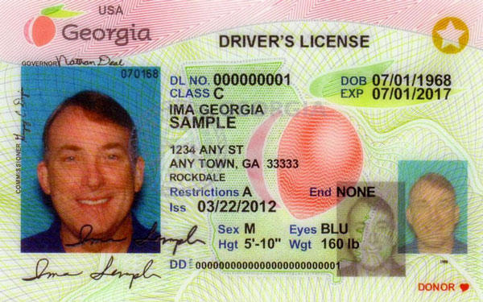
ID Verification
Verify that you are swabbing the correct individual.
Ask for a photo identification, such as a driver’s license or a passport. Photograph or copy this identification.
Photograph the individual(s) being sampled and attach to the submission form.
Notes:
With confidentiality in mind, you are now ready to begin the collection process. The first step is ID verification. (HIT ENTER)
First you will verify that you are swabbing the correct individual. (HIT ENTER)
Ask for a photo identification, such as a driver’s license or a passport. Photograph or copy this identification.
Be sure to look at the picture, name, description, and date of birth on the identification and look for anything that appears incorrect.
You will also need to photograph the individual(s) being sampled and attach the photographs to the submission form

Slide 10
Form Completion
Ask the individual requesting the DNA test to complete the top portion of the DNA Test Submission Form.
Notes:
After you have verified the identification of the individual being tested, you will move on to completing the DNA Test Submission Form. (HIT ENTER)
Check the Purpose of the Test as a Legal case or as a non-legal/self collected case.

Slide 11
Making a Change on the Form
WRONG – Do not scribble through the mistake.
RIGHT – Draw a single line though the mistake and then initial and date the change.
Notes:
If a mistake is made in this section or any section of the form, do not use correction fluid and do not scribble through the mistake. Instead use a single cross out. Whoever makes the change should date and initial where the change has been made.
Be certain the person completing the form understands what to do in case they make a mistake.

Slide 12
Person Collecting DNA Sample(s)
Sign in the signature box verifying that you collected the DNA samples being submitted.
Notes:
You will now flip to the back of the DNA Test Submission Form and complete the section entitled Person Collecting DNA Sample(s).
You will begin by indicating whether you are a medical practioner, attorney, or other specialty.
Then, please record your name, address, email, phone, and fax. (HIT ENTER)
Be certain to sign in the signature box verifying that you collected the DNA samples being submitted.
This information establishes you as the first custodian of the sample in the chain of custody.

Slide 13
Individuals for DNA Testing
Complete the information about each individual who is being tested.
Be certain to:
record the race of the individual
have the tested individual sign the consent
Notes:
Next you’ll complete the information about each individual who is being tested.
Be certain that the individual’s name is legible and accurately spelled. Compare the spelling on the form to the spelling on the identification they provided. An accurately spelled name is needed to ensure the final report is legal.
As you complete this section you will need to: (HIT ENTER)
record the race of the individual. This information is used in calculating the probability of a relationship. The individual being tested should provide the information about their racial background. Refrain from guessing their race. (HIT ENTER)
have the individual sign the consent. If the individual being sampled is a child the consent signature must be obtained from the legal guardian. This consent should be obtained before collecting the sample.
You will also notice that in this section you are asked to indicate whether the individual has EVER had a stem cell transplant or undergone a blood transfusion within the last 90 days. If a blood sample is submitted this notifies the laboratory that there may be multiple DNA profiles present in the individual’s blood sample. Please complete this section, even when submitting a cheek swab because the presence of any blood in the mouth may also result in multiple profiles.

Slide 14
Payment Information
Payment must be sent with the sample. Case results will not be released without payment.
Notes:
Finally, you will complete the payment section of the DNA Test Submission Form.
Payment must be sent with the sample. You may include a check or money order. If the individual is paying by credit card please double check the credit card information recorded on the form for accuracy.
Please note that case will not be processed without payment.

Slide 15
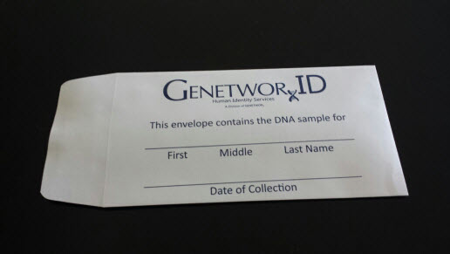
Sample Collection
Start by preparing the collection envelope.
Notes:
You are now ready to begin the actual sample collection. You will start by preparing the collection envelope.

Slide 16
Sample Collection
Record the following:
Name of the individual sampled for DNA
Date of the DNA collection
Initials/Signature of the collector who performed the DNA collection
Notes:
You’ll record the following on the envelope: (HIT ENTER)
The name of the individual sampled for DNA testing
The date of the DNA collection. This date of collection initiates the chain of custody.
On the back initial and/or sign as the collector who performed the DNA collection

Slide 17
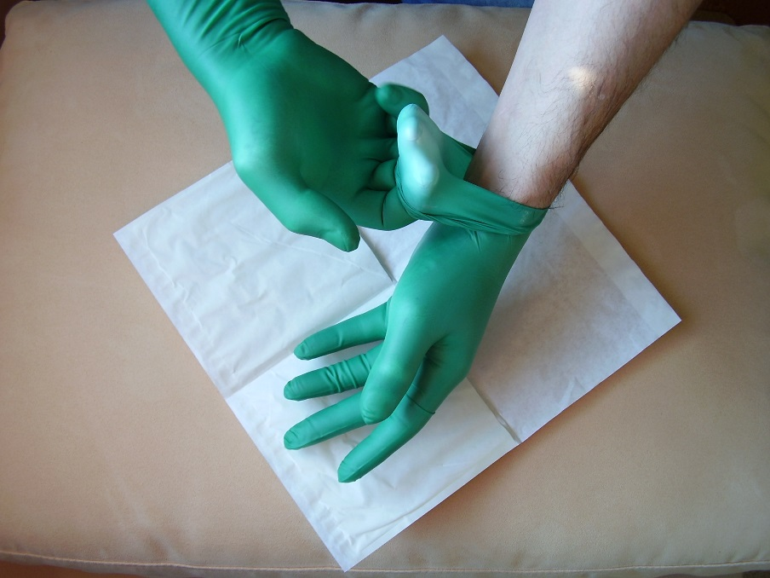
Sample Collection
Avoid contamination
Put gloves on to avoid contamination with your DNA
Avoid coughing, sneezing, or blowing on samples
Notes:
With the collection envelope complete you are ready to collect the actual sample. (HIT ENTER).
You will need to take care to avoid contamination. (HIT ENTER)
To do this, be certain to put gloves on to avoid contamination with your DNA. Even a single touch could leave behind enough DNA to create another DNA profile in the sample.
When multiple family members are being tested for one case, change your gloves after collecting each individual. (HIT ENTER)
Do your best to also avoid coughing, sneezing, or blowing on samples which can lead to aerosol contamination of the sample with your DNA.

Slide 18
Sample Collection
Explain the procedure to the individual being tested
You will be placing a cotton tipped swab on the inside of the check and gently rubbing to collect the DNA sample
It is non-invasive and they will not experience any pain
Notes:
As you are preparing for the collection, you will need to explain the procedure to the individual being tested. (HIT ENTER)
Notify them that you will be placing a cotton tipped swab on the inside of their check and gently rubbing to collect the DNA sample. (HIT ENTER)
Make certain to tell them that the collection is non-invasive and they will not experience any pain.

Slide 19
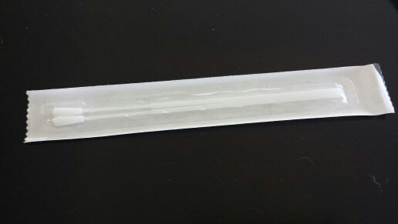
Sample Collection
Open the outer packaging of the swabs.
Remove the swabs completely from the sleeve without touching the cotton tipped swab.
Notes:
Next, you’ll open the outer packaging of the swabs. (HIT ENTER)
Remove the swabs completely from the sleeve without touching the cotton tipped swab. This will again reduce the risk of contamination.

Slide 20
Sample Collection
The swabs should not touch anything before entering the subjects mouth.
With the 1st, swab the inside of the left cheek for 15 seconds rotating the swab in a circular motion.
With the 2nd, swab the inside of the right cheek in the same manner
Notes:
The swabs should not touch anything before entering the subjects mouth. (HIT ENTER)
With the 1st swab, swab the inside of the left cheek for 15 seconds rotating the swab in a circular motion to ensure the swab is moistened. (HIT ENTER)
With the 2nd swab, swab the inside of the right cheek in the same manner

Slide 21
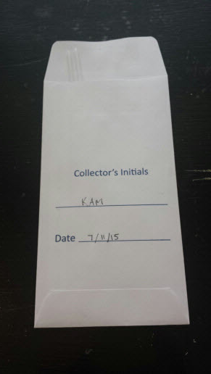
Sample Collection
After swabbing, place the swab directly into the appropriately labeled envelope.
Do not set the swab down on any surface.
Place the swabs into the paper envelope to dry.
Notes:
After swabbing, place the swab directly into the appropriately labeled envelope. (HIT ENTER)
Be certain not to set the swab down on any surface. (HIT ENTER)
Instead, place the swabs into the paper envelope, tip down, to dry.

Slide 22
Sample Collection
Close the envelope using the self-adhesive strip.
Do not moisten the envelope with saliva to close.
Do not put more than one individual’s sample in a collection envelope.
Notes:
Close the envelope using the self-adhesive strip. If necessary, you may also use tape. (HIT ENTER)
Do not moisten the envelope with saliva to close. This can lead to contamination. (HIT ENTER)
Only one individual’s sample should be placed in a collection envelope. Use a separate envelope for each individual being sampled. To avoid confusion, complete the collection of each individual and seal and label their envelope before beginning the collection of a sample from another individual.

Slide 23
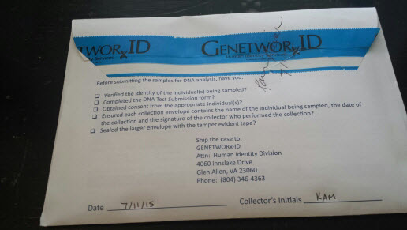
Sample Collection
Place each individually sealed collection envelope and the DNA Test Submission Form into the larger envelope.
Tape, seal, initial, and date the outer packaging for chain of custody purposes.
Notes:
Then, place each individually sealed collection envelope and the DNA Test Submission Form into the larger envelope. (HIT ENTER)
Tape, seal, initial, and date the outer packaging for chain of custody purposes.
The outer package must be sealed so any tampering would be evident.
If the outer seal is not placed on this envelope the laboratory will not perform the DNA testing on the samples.
The collector must sign and date the tamper evident tape on the outer package. Make certain that the signature and date cross the tape as shown in the picture.
Please note that the individual being tested should never handle the samples after they are collected or aid in the packaging of the samples.

Slide 24
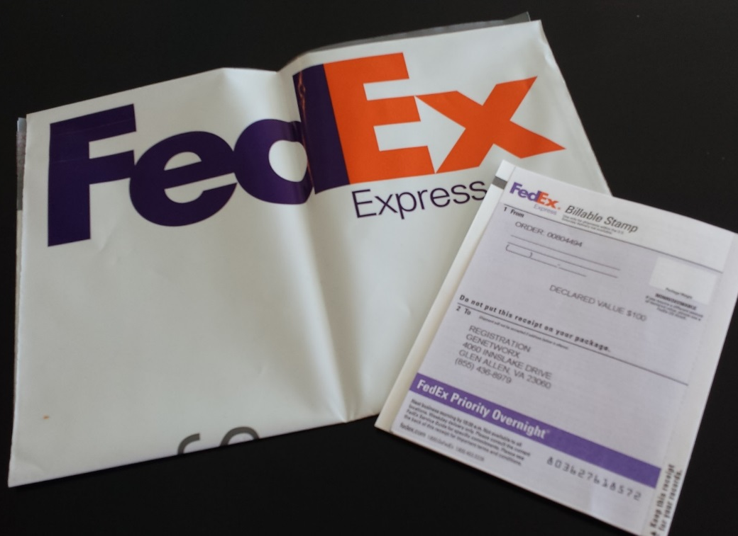
Shipment to the Laboratory
Store the swab package at room temperature until shipment.
Place the sealed envelope in the FedEx packaging provided.
Notes:
The samples are now ready to ship to the lab. (HIT ENTER)
Store the swab package at room temperature until it is shipped.
To ship the collection package, please place the sealed envelope into the FedEx packaging provided with your collection kit.

Slide 25
Questions? Call us at 804-346-GENE HID@GENETWORx.com
Notes:
Following each of these steps, each and every time, leads to an accurate and complete sample collection.
Please use the DNA Collection checklist on the back of the DNA Test Submission Form to ensure that you have completed each important step.
If you have any questions about the collection process, please call us at 804-346-4363.

