Slide 1

Molecular Diagnostics Overview

Slide 2

Managed Account vs Transactional Selling
Building relationships with existing clients to transform them into key strategic accounts is a crucial
Become part of the fabric of your strategic account’s organization — in other words, you want them to be dependent on you.
Dependence can be built in many ways including operational dependence through channel partnerships (expand your portfolio)
Technological dependence through systems integration
Contractual dependence through multi-year contracts or automatic renewals
Sellers who strategically manage key accounts shape and create opportunities within their accounts and benefit by mitigating competition, reducing price sensitivity, and building deeper and higher-level relationships in the account.

Slide 3
What is Molecular Diagnostics (MDx)?

Slide 4
What is PCR?

Slide 5
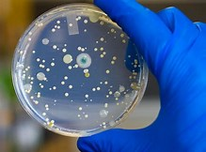
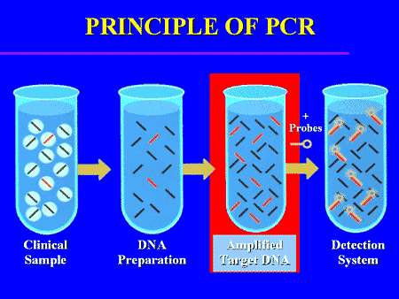
Culture Vs Molecular (PCR)
Culture (Gold Standard)
  Patient sample is taken and grown in a petri dish to determine pathogen presence
  Could take 72hours up to 28 days
  Limited amount of detection capability
Molecular Diagnostics (New Way)
  Patient sample is taken, and Polymerase Chain Reaction (PCR) is used to analyze the entire sample for pathogen presence, quantity and patient resistance to available therapies

Slide 6
Why Should a Facility Choose MDx instead of culture/sensitivity
Traditional Culture-
Outdated Technology (1887)
<2% Microbes can be detected
Samples need to be plated within 2 hours to prevent false positives
Antibiotics can mask positive results
Results ready 72 hours- 20 days (Fungal)
Looks for 5-6 pathogens with 29% error rate
Evaluates only 6-7 antibiotics for sensitivity

Slide 7
What Does Genetworx Offer that Can change this paradigm?
Accurate Diagnosis within 48 Hours
Detects 30+ Pathogens (Bacterial/Fungal)
Unaffected By concurrent antibiotic use
Detects multiple pathogens simultaneously
Detects pathogens that may not be detectable in culture
Decrease healthcare cost significantly
Identifies 9 classes of antibiotic resistance markers
Reduces unnecessary drug exposure and adverse events

Slide 8

Genetworx MDx Products
Urinary Tract Infections (UTI)
Nail
Wound
Respiratory Flu A/B
GYN
CancerGenetics (CGx)
Toxicology
Pharmacogenetics (PGx)

Slide 9
Resources Available to Promote Genetworx Services
Sample Report
Pathogen Panel Marketing Piece
Specimen Collection Procedures
Articles/White Papers

Slide 10
Why Should a Facility Choose Genetworx MDx?
Antibiotic Stewardship
  helps clinicians improve clinical outcomes and minimize harms by improving antibiotic prescribing
  coordinated program that promotes the appropriate use of antimicrobials (including antibiotics), improves patient outcomes, reduces microbial resistance, and decreases the spread of infections caused by multidrug-resistant organisms.
  CDC estimates more than 2.8 million antibiotic-resistant infections occur in the U.S. each year, and more than 35,000 people die as a result.

Slide 11
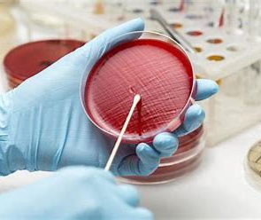
C&S Patient vs MDX Example
Typical C&S UTI Patient- Jacky Jones
Presents with UTI and is given standard C&S
Comes out negative
Comes back two later with continued symptoms
  Given ABx
Two weeks later still symptomatic gets 3rd C&S
Ends up in the ER with pain
3 courses of Abx still no resolution and is now in the hospital

Slide 12
C&S Patient vs MDX Example
MDx Patient- Becky Blueberry
Presents with UTI symptoms
Physician orders a Genetworx MDx UTI Panel
Report is turned around within 48 hours
Has the right information to make an accurate decision for the right Abx to treat the infection.
Patient is better within 10-14 days
Healthcare costs
rises exponentially the more treatment is prescribed
Patient can endure unnecessary pain and diminished quality of life until infection is resolved.

Slide 13

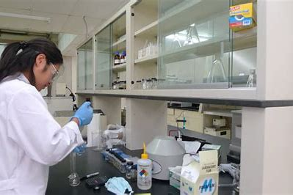
Resolved Past Issues
Turn Around Time- (48-72 hours)
Increased Focus on MDx Specimens
Improved communications from lab to sales

Slide 14

Additional Products & Services
Detailed Pathogen Panel Specific Training in Jan 2021
Competitor comparison charts for each pathogen panel
l
Patient At Home Kits for patient/office convenience
National/Sectional conferences
Additional product offerings (chemistry, CGX, Pathology)

Slide 15

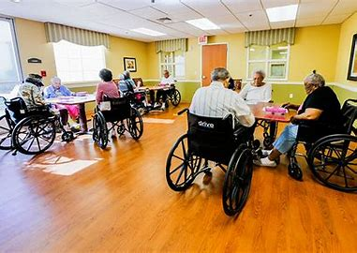
Genetworx MDx Sites of Service
Long Term Care (LTC)
Nursing Homes
Assisted Living
Private Office
Hospital

Slide 16
Where Can Genetworx MDx Begin to Help
The most common indication for initiation of antibiotics in nursing homes is UTI
Studies suggest that a substantial number of these events represent unnecessary treatment of asymptomatic bacteriuria
60–90 % of the antibiotics prescribed for UTI in nursing homes are initiated only after urine cultures results are available
  Optimizing Antibiotic Stewardship in Nursing Homes: A Narrative Review and Recommendations for Improvement Christopher J. Crnich1,2 • Robin Jump3,4 • Barbara Trautner5,6 • Philip D. Sloane7,8

Slide 17

Opportunities & Targets
Existing clients (LTC, provider offices)
Lost Clients
Previous Relationships/Contacts
Pathogen Specific targets (example; UTI)
LTC Facilities
Urologists
UroGyns
Urology NPs
Internal Medicine
Family Practice
Gynecologists
Insurance Coverage (By State)

Slide 18
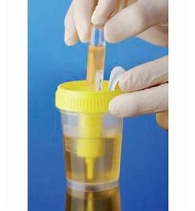
Genetworx UTI Collection Method
Traditional UTI Collection Method
Genetworx Brief Swabbing Technique

Slide 19
Long Term Care Rules to Know
Long Term Care facility types
  Independent living
  Assisted living
  Memory care
  Skilled nursing facilities
  Long term acute care
Long Term Care (LTC)
Chain-stakeholders
  Facility level- DON, Admin, and nurses
  Regional level- Regional Ops, Regional clinical nurses
  Corp- CFO, COO, compliance
  Providers- MDs, NPs, DPMs, and PAs
We have to cover all stakeholders in the sales process

Slide 20

2021 Call To Action
Contact LTCs sending COVID; upsell our molecular program
Contact and close lost molecular clients
Contact and close any office where you have a relationship

