Slide 1

Molecular Deep Dive Training
UTI/RPP

Slide 2

UTI/RPP Deep Dive Training Agenda
AURA: Transition from Copia To AURA with LTC’s
Why Molecular?
Antibiotic Stewardship
Urinary Tract Infections (UTI): Urinary Pathogen Panel (UPP)
Respiratory Infections: Respiratory Pathogen Panel (RPP)
Long Term Care Facilities: Upsell with Molecular Diagnostics
Billing
Call to Action

Slide 3
AURA Landscape
New Client Orientation and Adoption Training this Week
Conversions From COPIA
Client Dashboard Training

Slide 4
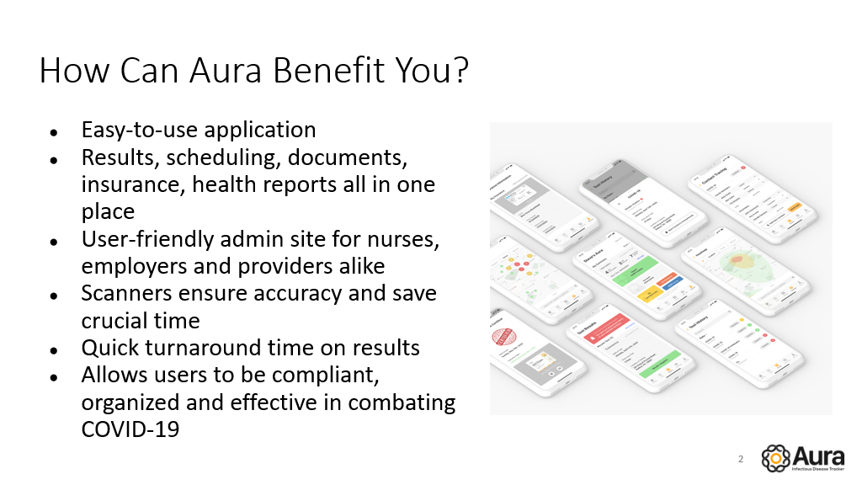
AURA Benefits

Slide 5
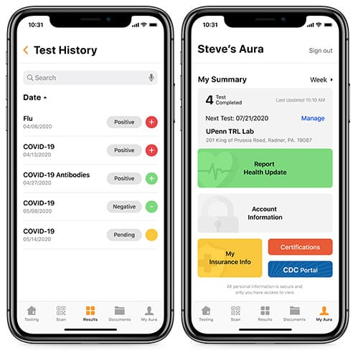
AURA Benefits
Electronic Manifest- easier for the lab, provides tracking info, and never have to worry about losing a sample again! (Copia: handwritten manifest)
Positive Alert notifications sent to assigned Admin (Copia: Have to log in to constantly check for positive results)
Reporting- (TAT, positives, negatives, invalids) all easily exported to CSV (Copia: Reports are hard to pull, not always accurate and do not have all of that info)
Self and Pre-registration through a unique link or QR Code (Copia: Must use a CSV upload or manually register on-site via OSRA)
Scan in Patients (Copia: Ask for their Info and type in their name to pull up their account)
Preloaded Provider/NPI, diagnosis code and collection method – this can be changed per acct or on a patient by patient basis (Copia: OSRA have to manually type this in each time to create an order and print a requisition form)

Slide 6
AURA Benefits Cont’
Paperless besides the manifest (Copia: Requistion form and Consents have to be signed and placed in the Biohazard bag with the sample)
Consent Forms Automatically Uploaded in Aura (Copia: Consents are signed on-site and then lab uploads them to the patient’s Copia Account)
CSV Upload is on the Aura website and easy to use. Populations can be segmented! (Copia: Must use Zip File, or SFTP to transport the file from the client to Copia)
Unique Policies for sequential testing Ex: Students Athletes are tested 3x a week while students are only tested once. This is set up via CSV. (Copia: This isn’t possible)
Aura App- patients use to scan, track symptoms, get results/notifications etc. (Copia: This doesn’t exist.)

Slide 7
Molecular Diagnostics

Slide 8

Culture & Sensitivity
Traditional Culture-
Outdated Technology (1887)
<2% Microbes can be detected
Samples need to be plated within 2 hours to prevent false positives
Antibiotics can mask positive results
Results ready 72 hours- 20 days (Fungal)
Looks for 5-6 pathogens with 29% error rate
Evaluates only 6-7 antibiotics for sensitivity

Slide 9
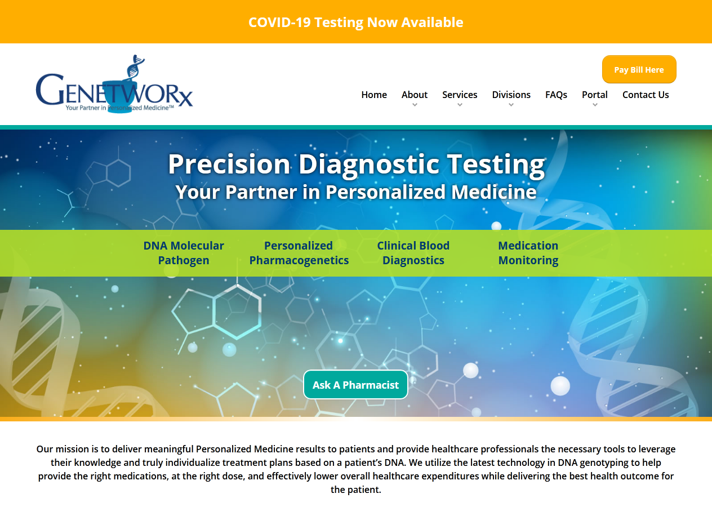
Genetworx Mdx
Accurate Diagnosis within 48 Hours
Detects 30+ Pathogens (Bacterial/Fungal)
Unaffected By concurrent antibiotic use
Detects multiple pathogens simultaneously
Detects pathogens that may not be detectable in culture
Decrease healthcare cost significantly
Identifies 9 classes of antibiotic resistance markers
Reduces unnecessary drug exposure and adverse events

Slide 10

Five Main Causes of Antibiotic Resistance
Over-prescription of antibiotics
Patients not finishing the entire antibiotic course
Overuse of antibiotics in livestock and fish farming
Poor infection control in health care facilities
Poor hygiene and sanitation

Slide 11
Antibiotic Stewardship
  Helps clinicians improve clinical outcomes and minimize harms by improving antibiotic prescribing
  Coordinated program that promotes the appropriate use of antimicrobials (including antibiotics), improves patient outcomes, reduces microbial resistance, and decreases the spread of infections caused by multidrug-resistant organisms.
  CDC estimates more than 2.8 million antibiotic-resistant infections occur in the U.S. each year, and more than 35,000 people die as a result.

Slide 12
UTI

Slide 13
UTI Background
Advanced diagnostics are needed to rapidly and accurately identify the culprit pathogen(s) and rule out the presence of antibiotic resistance. Can no longer assume first or second-line antibiotics will adequately treat most common infections.
UTIs may lead to sepsis if not treated appropriately. Total cost for sepsis due to urinary tract infections is > $6 Billion annually
Average hospital stay per admission UTI admission costs an average of $1947 per night
Urinary Tract Infections are one of the most commonly diagnosed illnesses in older adults and the # 1 reason antibiotics are prescribed in Long Term Care Facilities
UTIs are responsible for 10.5 million office visits/year
UTI complications result in 9—11 days longer for each hospital stay
UTIs constitute $13B impact to US Economy with significant morbidity and Mortality
Microbial infections are common and result in increased rates of virulence and antibiotic resistance
Up to 1/3 of infections illustrate resistance to an antibiotic
The development of MDROs (Multi-Drug Resistant Organisms) has complicated the clinical diagnosis and the ease of just following prior evidence-based guidelines for diagnosis treatment

Slide 14
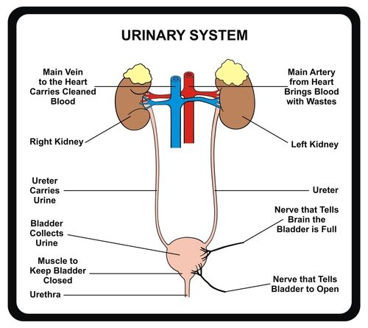
Uncomplicated (simple) Cystitis
Urinary Tract Infection
Definition
Diagnosis
Urinalysis, Urine culture
Further labs, if appropriate
Females with comorbid medical conditions
All male patients
Indwelling foley catheters
Urosepsis/hospitalization
Upper urinary tract Infections:
  Pyelonephritis
Lower urinary tract infections
  Cystitis (“traditional” UTI)
  Urethritis (often sexually-transmitted)
  Prostatitis

Slide 15
Common UTI Symptoms
Cloudy Discolored Urine
Left
Quadrant Pain
Painful Urination
Bloody Urine (Hematuria)
Frequent Urination
Flank Pain Low Abdominal
Right Quadrant Pain
Abnormal Urine Odor
Altered Mental State
Chills
Fever
Nocturia

Slide 16
UA PANEL
16
Glucose
Bilirubin
A urinalysis is a common method of analyzing urine that is used to assess your health, and to help diagnose renal, systemic, inflammatory, and neoplastic diseases, and urinary tract infections.
Ketone
Specific Gravity
Blood
pH
chlamydia Treponema
trachomatis pallidum
Neisseria Mycoplasma
gonorrhoeae genitalium
Protein
Urobilinogen
Nitrite
Leukocytes

Slide 17
Molecular Requisition Form

Slide 18
Genetworx Panels

Slide 19
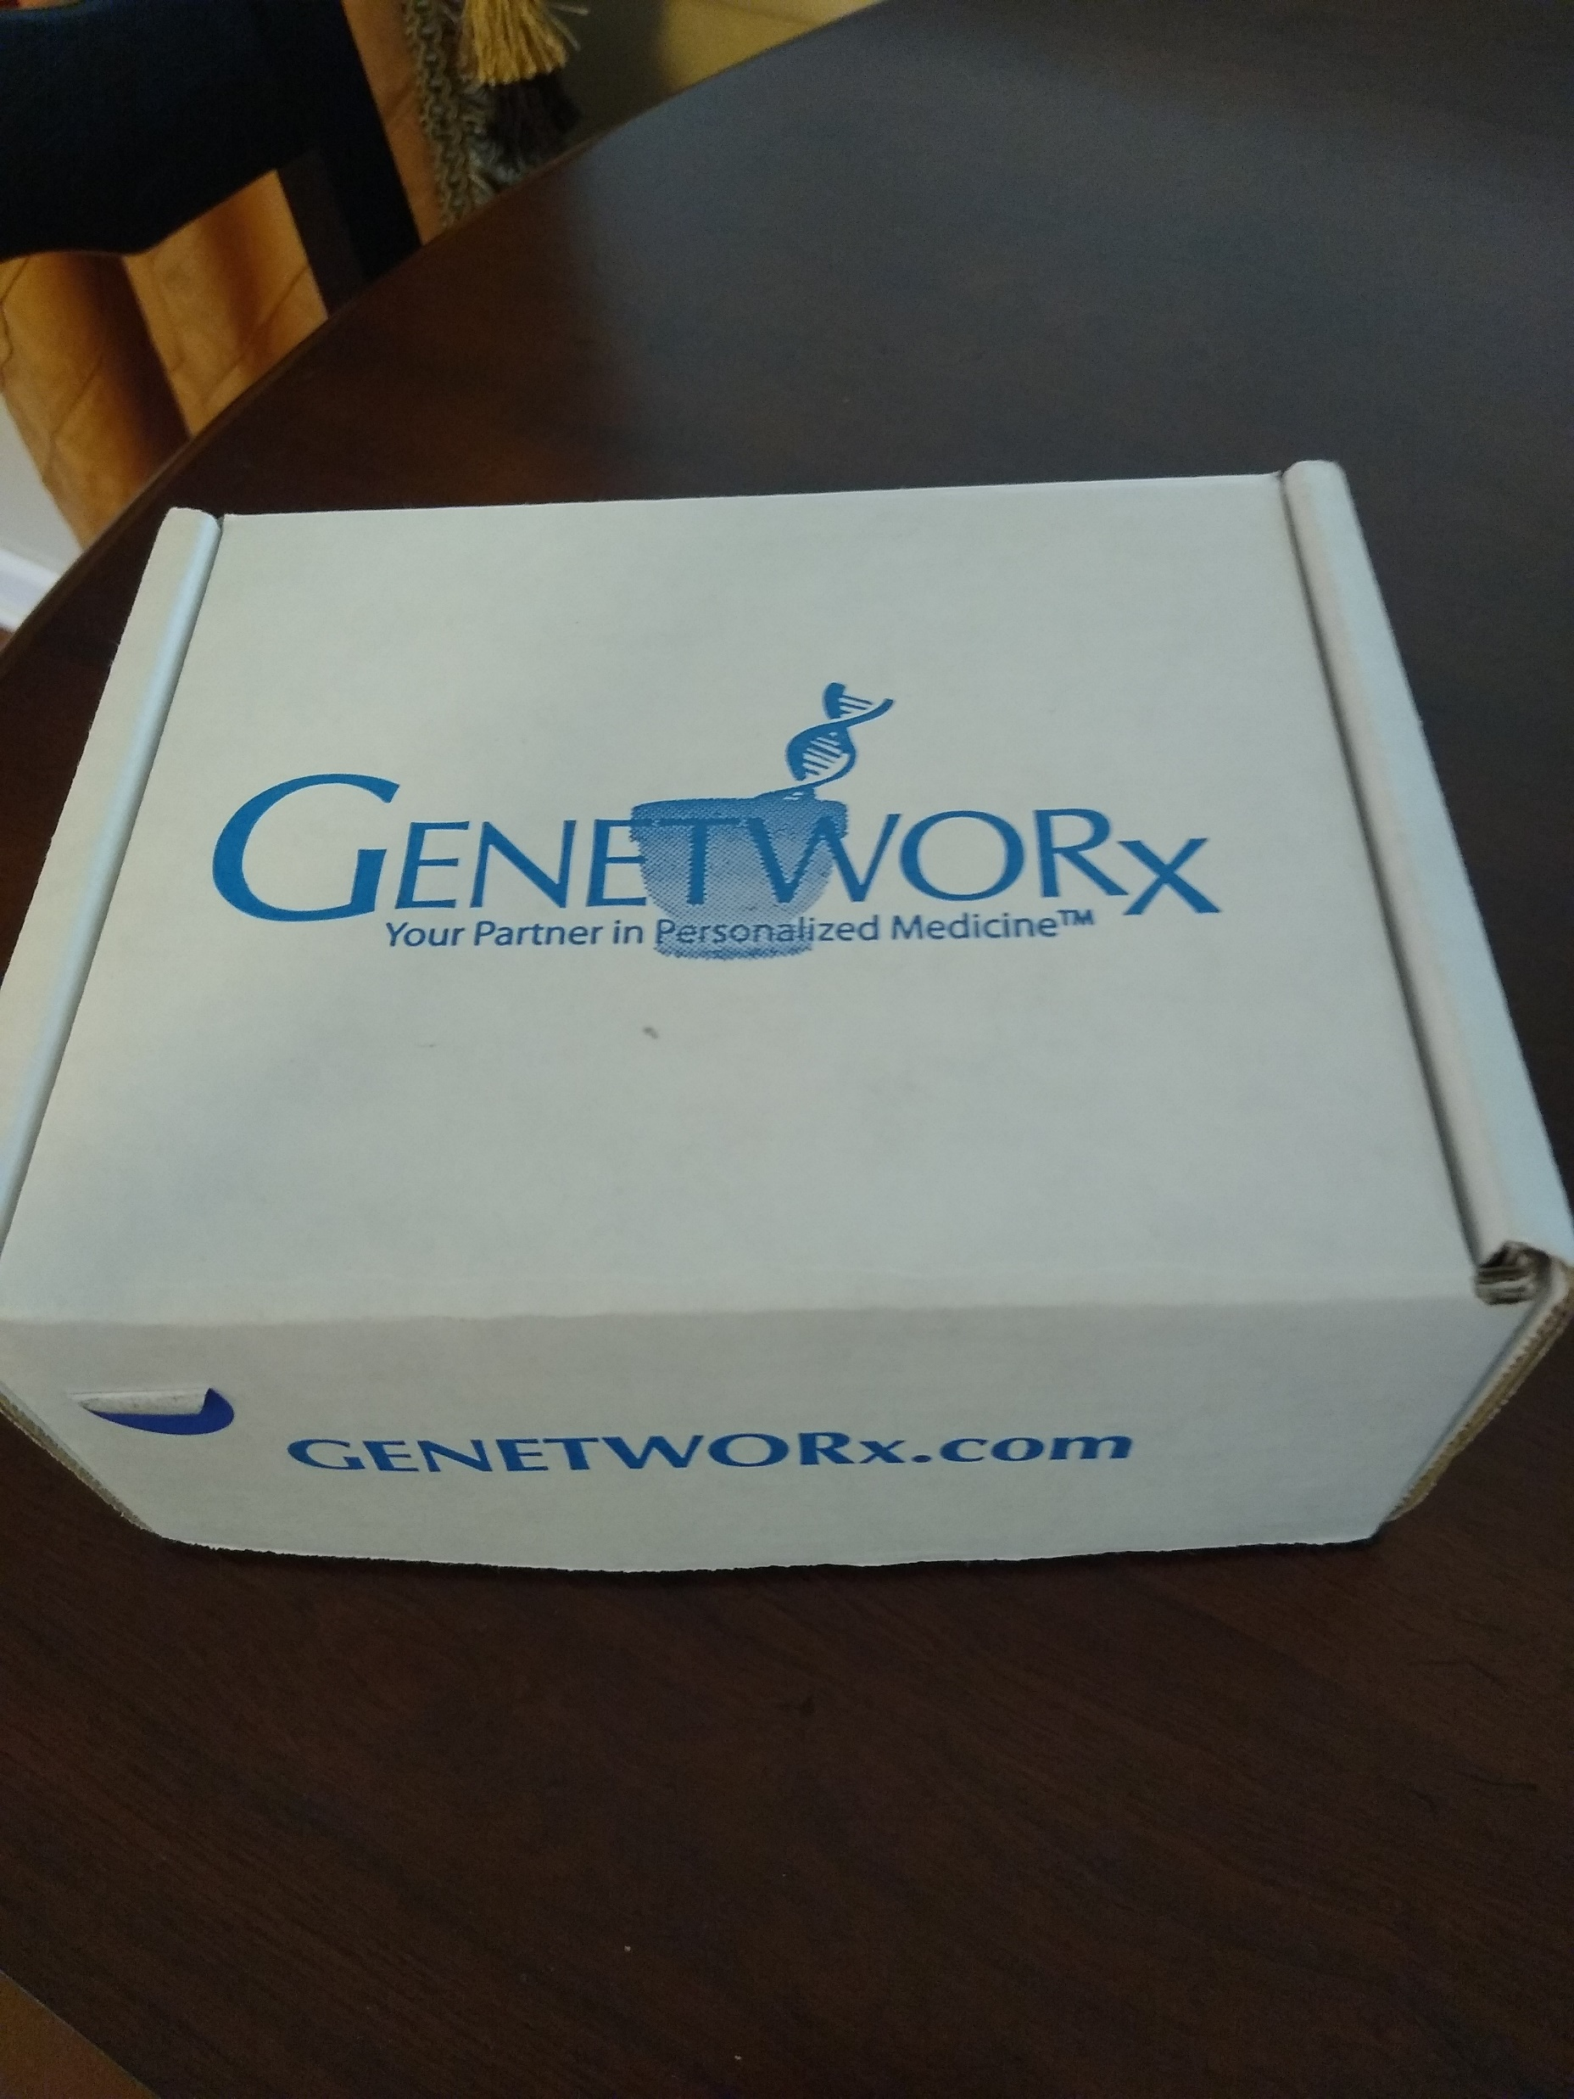
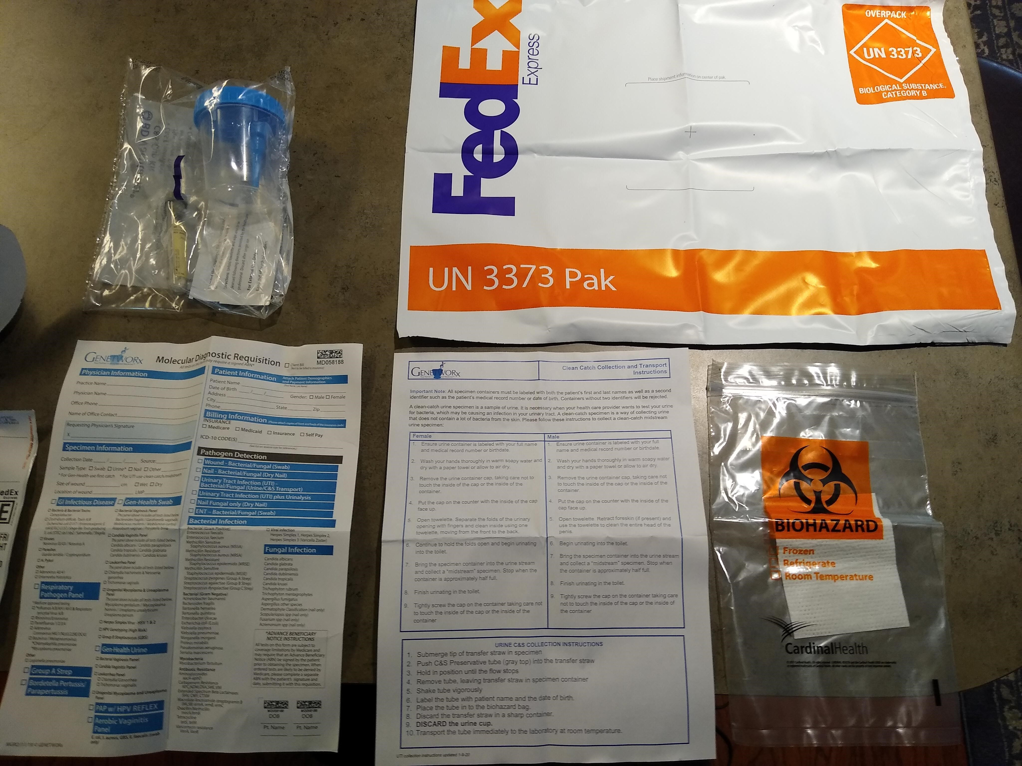
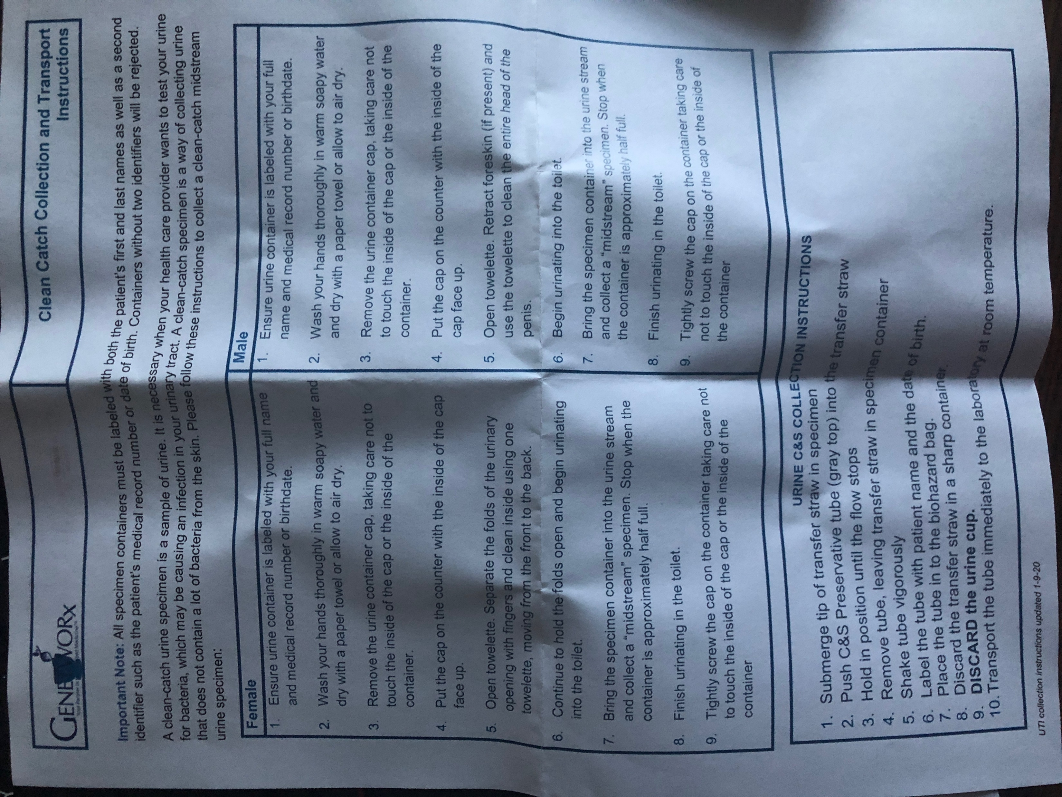
What is in the Box?

Slide 20

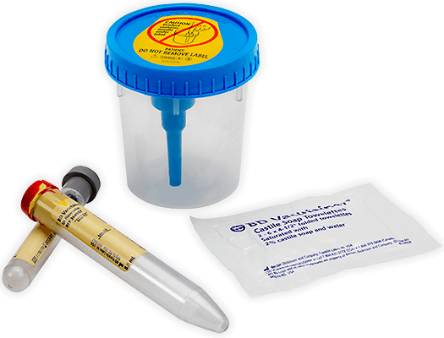
UTI Collection Supplies
19
Straw or sterile screw-cap collection cup with integrated transfer device.
Plus plastic C&S preservative tube (gray top).
Optional: Plus plastic conical
tube with preservative for urinalysis (red/yellow top).
Castile soap towelette.

Slide 21
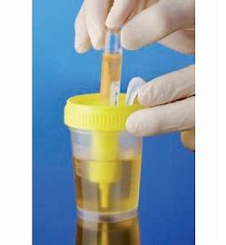
Genetworx UTI Collection Method
Traditional UTI Collection Method
Genetworx Brief Swabbing Technique

Slide 22
UTI Male Clean Catch
WE NEED CLEAN CATCH SPECIMENS!!!
UTI Female Clean Catch
Wash your hands, do not touch the inside of the cup or lid.
Separate the folds of the urinary opening, cleanse using towelette wiping from front to back.
While holding folds open begin to void. Allow first urinary flow to escape (first portion of urine washes out the urethra and any debris).
Collect midstream urine specimen in the sterile container. Do not touch the inside of the container or the lid.
Once the urine specimen is collected, finish voiding.
Wash your hands, do not touch the inside of the cup or lid.
Cleanse around urinary area using towelette.
Begin to void. Allow first urinary flow to escape (first portion of urine washes out the urethra and any debris).
Collect midstream urine specimen in
the sterile container. Do not touch
the inside of the container or the lid.
Once the urine specimen is
collected, finish voiding.

Slide 23
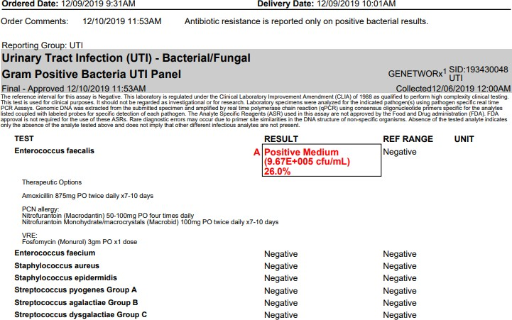
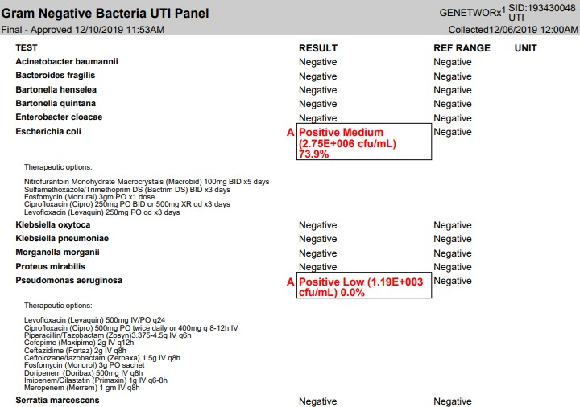
Interpretation of GENETWORx Bacterial/Antibiotic Resistance Report
 | The amount of each bacteria is shown as colony forming units (cfu/mL), similar to a culture report. The number is shown as exponential (ie 9.67E005= 967,000 cfu/mL)
 | The percentage of each bacteria is shown so that you will know which are the most prevalent bacteria in the patient sample Each positive result is accompanied by therapeutic options developed by our pharmacists using the most up to date guides for antimicrobial therapy.

Slide 24
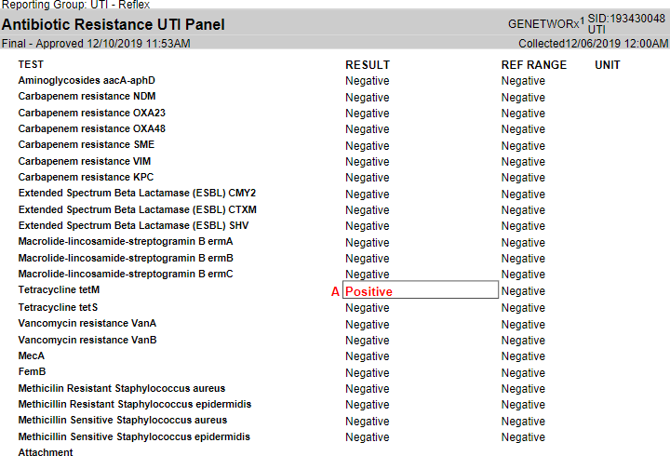
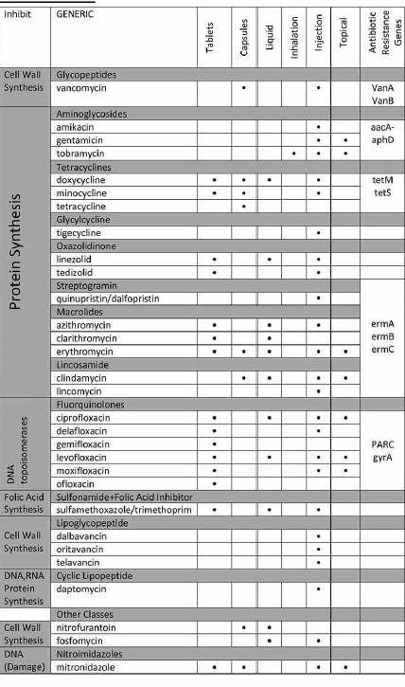
Interpretation of GENETWORx UTI Bacterial/Antibiotic Resistance Report
 | The antibiotic class for each gene is listed.
 | A positive result indicates that that the physician should consider avoiding antibiotics in this class.
 | If the report has an antibiotic resistance marker Positive on the Antibiotic Classification Chart, the physician should consider avoiding antibiotics in this class.

Slide 25
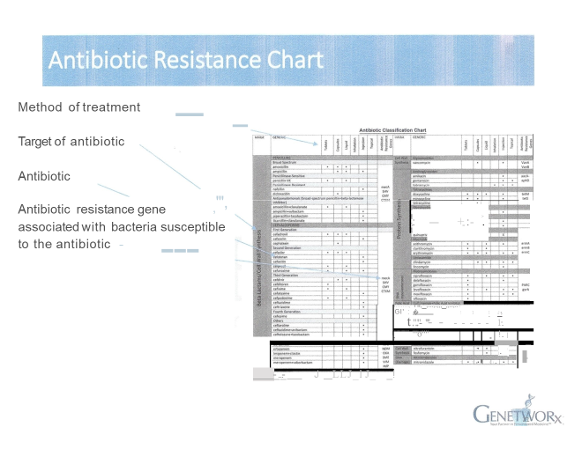
Antibiotic Resistance Chart

Slide 26

Opportunities & Targets
Existing clients (LTC, provider offices)
Lost Clients
Previous Relationships/Contacts
Pathogen Specific targets (example; UTI)
LTC Facilities
Urologists
UroGyns
Urology NPs
Internal Medicine
Family Practice
Gynecologists

Slide 27
Competitors

Slide 28
Mdx UTI Competitors
 | GENETWORx | Labcorp/Quest | MD Labs | Vikor | MicroGenDx
Turn Around Time | 24-48 Hours | 72 Hours Plus | 72 Hours Plus | 24-48 Hours | 24-48 Hours
Pharmacy Based Diagnostics | Yes | No | No | Yes | No
LTC Focus | Yes | Yes | No | Yes | No
Suceptibility Testing (AST) | No | Yes | Yes | No | No
Antibiotic Resistance Gene Testing | Yes | No | No | Yes | Yes
Collection Devices | Urine/Swab | Urine | Urine | Swab | Urine
Can Run UA with UTI by PCR | Yes | No | Yes | No | No

Slide 29
RPP

Slide 30
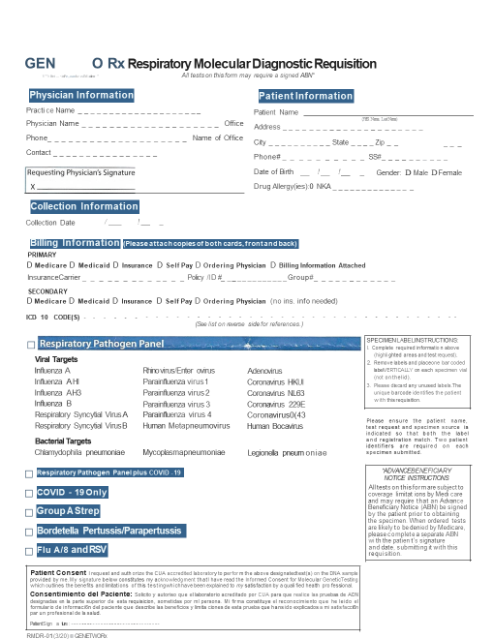
Genetworx RPP Mdx Requisition Form

Slide 31
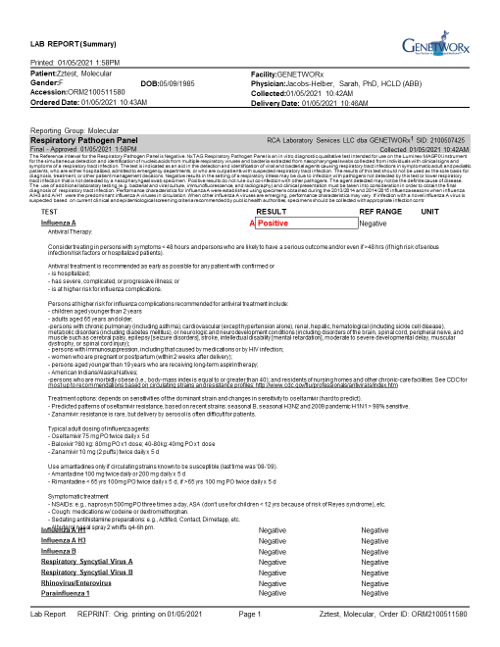
RPP Sample Report

Slide 32
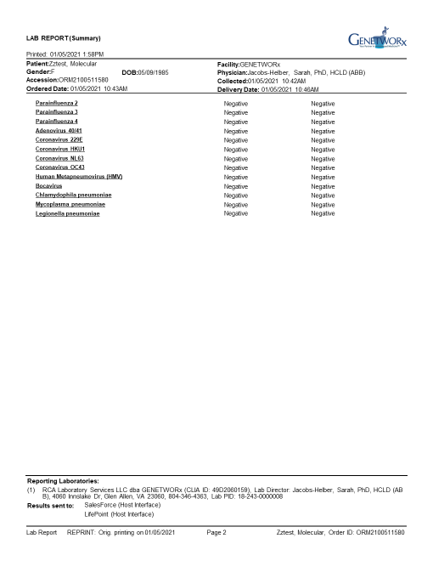
RPP Sample Report Page 2

Slide 33
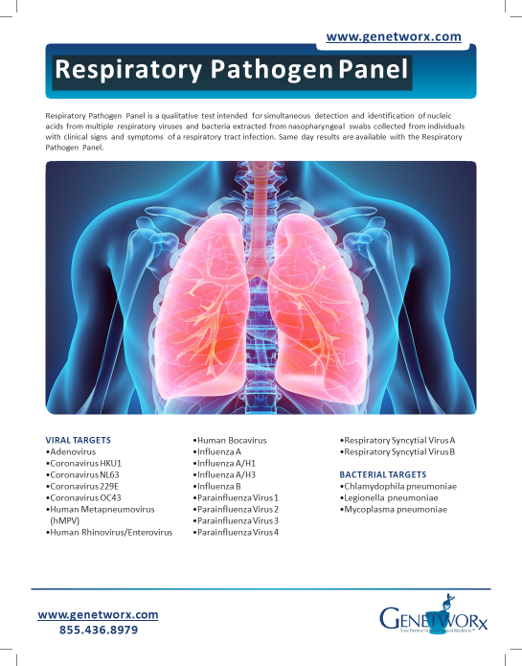
Respiratory Pathogen Panel Marketing Piece

Slide 34


CoVid & RPP Combination Panel
Significantly scaled down compared to RPP+ COVID
  Covid
  Flu A
  Flu B
  Respiratory Syncytial Virus (RSV)
Can be taken from one swab, one collection
  NP or Mid-turbinate collection methods
Run together as one panel on the same machine, which means these samples will result at the same time.
Reagents are stocked for launch

Slide 35

Influenza A/B Breakdown
Influenza A
  Major cause of the US Flu epidemic each year, mostly due to its speed to mutate
  Can infect humans and animals
  Avian and Swine Flu were both type A flu viruses
  Responsible for 75% of all flu cases
Influenza B
  Only affects humans
  Typically less severe than type A
  Slow to mutate
  Responsible for 25% of all flue cases

Slide 36
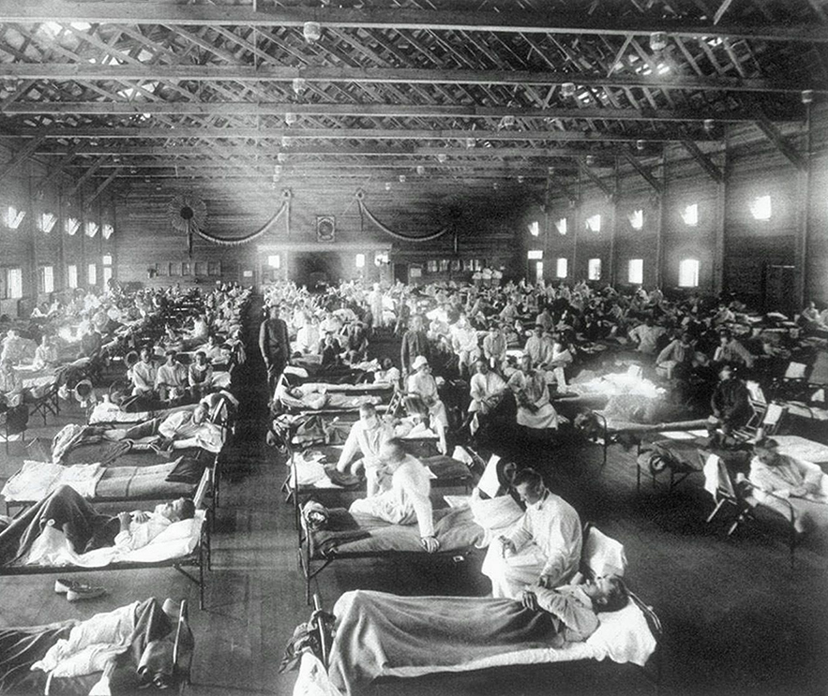
Influenza: Impact in the U.S
Most at risk groups for severe flu symptoms/death
  Women who are pregnant
  People with chronic medical conditions
  Children younger than 5
  Adults over the age of 65
Medications are most effective if initiated 1-2 days post first symptoms
Annual impact of influenza in the United States:
  39M-56M cases
  18M-26M medical visits
  410,000-740,000 hospitalizations
  24,000-62,000 deaths annually

Slide 37
Respiratory Syncytial Virus (RSV)
Common respiratory virus that usually causes mild, cold-like symptoms.
RSV can be serious, especially for infants and the elderly
The most common cause of bronchiolitis and pneumonia in children younger than 1 year old in the US and a significant cause of respiratory illness in older adults
Impact in the United States (children less than 5 years old)
  500,000 yearly emergency department visits
  57,000 hospitalizations
Impact in the United States (elderly adults)
  177,000 hospitalizations
  14,000 deaths

Slide 38
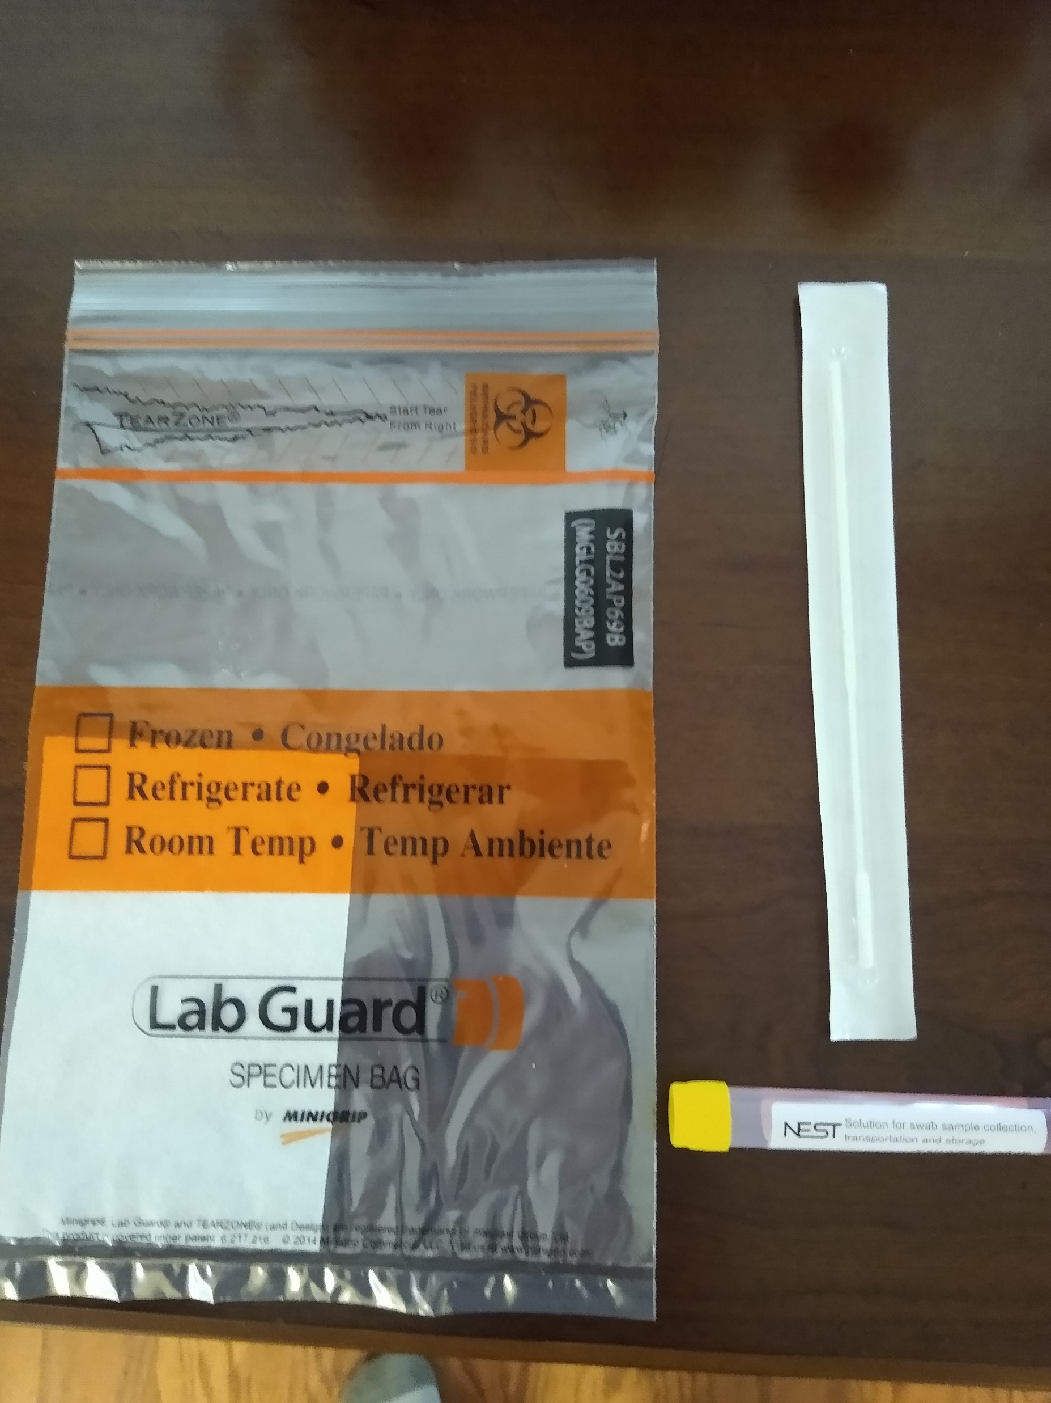
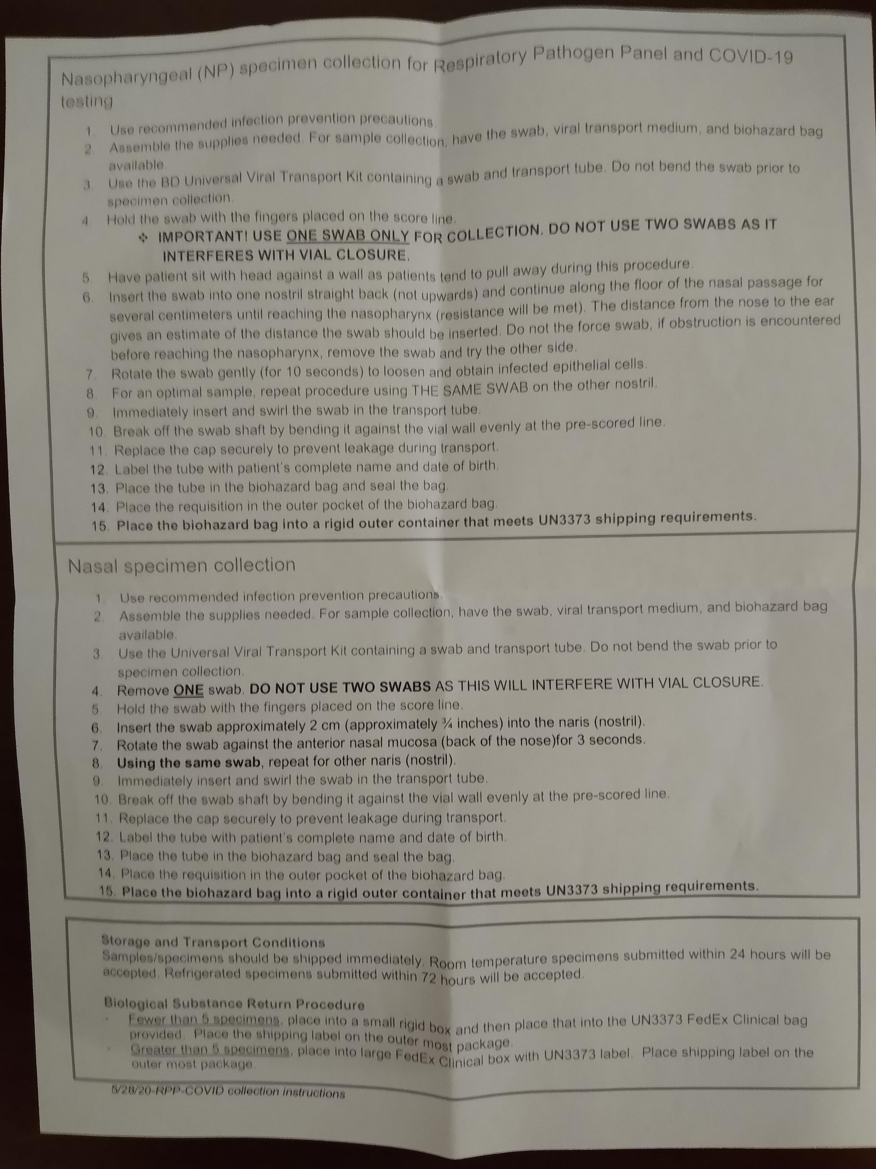
What’s In The RPP Box?

Slide 39



Receive
Flu A-B/COVID-19
test kits within 24 hours
Receive test results within 72 hours
The GENETWORx Flu A-B/COVID-19
Combination Test
A Single Sample Test for inﬂuenza A/B, RSV and COVID-19
Leverage Aura: The software solution for sequential testing, rapid diagnosis,
and contact tracing
Is your facility prepared for the fall surge of Flu and COVID-19? Genetworx can help.
With many Americans returning to school and work and more people spending more time indoors due to the change in weather, now is the time to be vigilant when it comes to inﬂuenza, RSV, and COVID-19 testing.
GENETWORx tests are the gold standard in COVID-19 diagnostic and antibody testing for communities and populations of all sizes, allowing them to resume operations, and return to “life as we knew it.” GENETWORx has processed over 1 million tests, completes thousands of tests every day, and continues to increase laboratory space to provide more expansive testing, helping the country return to work, school, events and more.
The GENETWORx Flu A-B/COVID-19 combination test is a molecular assay including RT-PCR that detects inﬂuenza A and B, RSV, and COVID-19. The combination test has an accuracy rate of >96%. The COVID-19 portion of the test has 99% speciﬁcity and sensitivity, detecting the presence of SARs-CoV-2, the virus responsible for COVID-19 with accuracy.
The capability to test for inﬂuenza A/B, RSV, and COVID-19 from a single nasal swab sample means less discomfort for patients, fewer resources used, and less time for testing.
With the GENETWORx Flu A-B/COVID Combo Test, healthcare providers can provide an accurate diagnosis to patients and treat them with the appropriate measures. Patients then can observe appropriate quarantine measures to stop the spread.
GENETWORx also oﬀers the COVID-19 Total Antibody (IgM & IgG) blood test, also known as a Serology test. The assay has a 99.8% speciﬁcity and 100% sensitivity.
GENETWORx’s COVID-19 testing capacity can grow with demand and guarantees a continuous supply of tests to meet your needs.
GENETWORx tests can be used in all 50 states.
Based in Virginia, GENETWORx is certiﬁed by the College of American Pathology (CAP). The CAP accreditation is the gold standard awarded to clinical laboratories that exceed inspection qualiﬁcations and ensures a consistent level of service that positively impacts patient care. GENETWORx is both CAP-accredited and Clinical Laboratory Improvement Amendment (CLIA)-certiﬁed for high complexity laboratory testing in all ﬁelds of service. Achieving the CAP accreditation combined with the CLIA certiﬁcation demonstrates GENETWORx’s unwavering commitment to patient care.
Disclosure required by Section 3202(b) of the CARES Act:
Cash price of a single PCR Flu A-B/COVID Combo diagnostic test without collection or other services: $225
Cash price of a single PCR COVID-19 diagnostic test without collection or other services: $100
Cash price of a single COVID-19 serology test without collection or other services: $85

Slide 40





GENETWORx is your one-stop solution for regular-interval testing, real-time data reporting,
and on-site testing for your entire population.
A Single Flu A-B/COVID-19 Combination Test
The GENETWORx Flu A-B, RSV and COVID-19 combination test is highly accurate. The single swab collection of the patient sample eases the patient experience, while providing peace of mind in your diagnosis.
Highly Accurate, Rapid COVID-19 Diagnostic Tests
GENETWORx oﬀers the nasal test and the saliva test for COVID-19 diagnosis. With either test, you receive 98%+ accurate rapid results in less than 72 hours.
COVID-19 Total Antibody Tests
Quickly and accurately determine if you’ve been exposed to COVID-19 and developed an immune response with our 99% speciﬁcity and 100% sensitive antibody test.
Experts at Conducting On-Site Testing and Collection
GENETWORx sets up on-site testing and collection sites that have people in and out in less than 6 minutes. Why wait 6 hours when you can be tested in 6 minutes? GENETWORx provides full-service on-site testing management and consultation for your location.
Test Supplies and Results-Guaranteed
GENETWORx is building a laboratory with the capacity to conduct hundreds of thousands of tests per day, so you never have to worry about receiving your test supplies or test results. GENETWORx can support ongoing, frequent, and sequential testing for your population.
COVID-19 Testing, Prevention, and Mitigation with Aura
The Aura software includes daily symptom tracking technology, test scheduling capabilities, results reporting, and optional contact tracing. Manage sequential testing for your population, get results quickly, and know exactly where your population stands each day.

Slide 41
Long Term Care (LTC)

Slide 42




Diagnostic Testing for Senior Living Facilities
When you need testing for your senior living facility residents, GENETWORx should be the first choice that comes to mind. GENETWORx Laboratory was formed with the specific purpose of impacting and improving people’s lives by empowering them and their physicians with the information and results they need regarding their health.
GENETWORx is a one stop shop provider with our comprehensive testing capabilities, quality reports, and quick turnaround times. If you have testing needs for your patient population, turn
to GENETWORx.
Diagnostic Testing for Senior Living Facilities
Trust GENETWORx with Your Molecular Pathogen Diagnostics
Molecular pathogen diagnostics has been a core focus of GENETWORx for years and has led to faster and more accurate diagnoses for patients and their providers when compared with traditional culture testing. We work with many senior living facilities that depend on GENETWORx for the accuracy and specificity needed for patients to become or continue to be healthy.
GENETWORx provides a full range of molecular testing panels including, but not limited to:
A Full Respiratory Pathogen Panel UTI Pathogen Panel with UA Wound Pathogen Panel
GYN Pathogen Panel Gastrointestinal Pathogen Panel
Nail Pathogen Panel Pharmacogenetic Testing COVID Diagnostic
COVID plus Flu A/B and RSV Diagnostic COVID Blood Antibody
These comprehensive diagnostic tests are covered by Medicare
Continued on next page
Partner with GENETWORx
for all your molecular testing needs
866-409-2204
GENETWORX.COM

Slide 43




Why Molecular Instead of Culture?
Molecular pathogen diagnostics offers the promise for a more swift and complete assessment when compared with culture methods that can take several days to obtain a final result. Review the comparisons below to fully realize the difference.
Traditional Culture | GENETWORx Molecular PCR
Outdated technology from 1887 (Petri/Koch) | May reduce unnecessary drug exposure and adverse events
Looks for 5-6 pathogens with 29% error rate | Detects 26+ pathogens (bacterial/fungal)
Samples need to be plated within 2 hours to prevent false positives | Detects multiple pathogens simultaneously
Antibiotics can mask positive results (false negatives) | Unaffected by concurrent antibiotic use
Results ready 72 hours-20 days (fungal) | Accurate diagnosis within 48 hours. Faster turnaround time may decrease time to healing
<2% of microbes can be detected | Detects pathogens that may not be detectable in culture
Evaluates only 6-7 antibiotics for sensitivity | Identifies 9 classes of antibiotic resistance markers
GENETWORx and COVID-19
GENETWORx became a leader in COVID-19 diagnostic and antibody testing in 2020 and provides unparalleled support, fast and accurate results, and on-site testing expertise for our customers. With our data management software Aura, we have provided thousands of senior living facilities expedited turnaround times with COVID-19 results. Aura software provides patients and customers a total end to end digital management and medical data system offering:
Test locations Test scheduling Sample tracking
Daily symptom tracking Contact tracing assistance
Dashboard compliance reporting Government reporting
This has allowed large population customers like senior living facilities to mitigate and suppress COVID-19 cases and help protect the health of their entire workforce and patient population.
Experience the GENETWORx Difference
GENETWORx is certified according to the Clinical Laboratory Improvement Amendment (CLIA) for high complexity laboratory testing in all fields of service. Achieving the CAP accreditation combined with the CLIA certification demonstrates GENETWORx’s unwavering commitment to patient care.
When you need a partner that provides the benefits of a 1-stop shop for all your molecular pathogen diagnostic needs in a fast and efficient manner, think GENETWORx.
Call us today at 866-409-2204 to discuss beginning testing
or expanding your testing regimen for your senior living facility.
Partner with GENETWORx
for all your molecular testing needs
866-409-2204
GENETWORX.COM
11/20/20

Slide 44
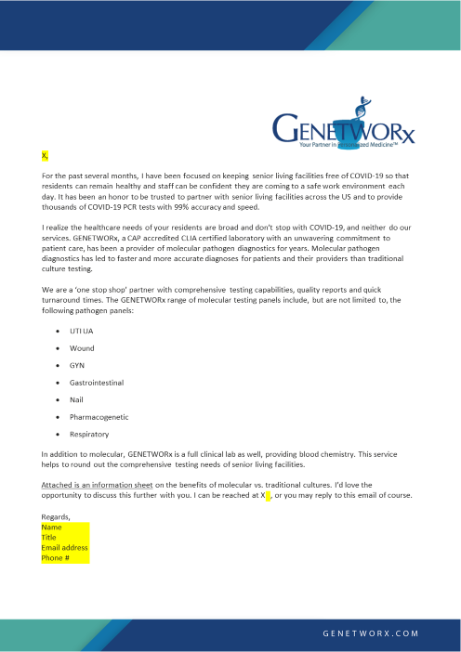
Letter from Rep to LTC

Slide 45
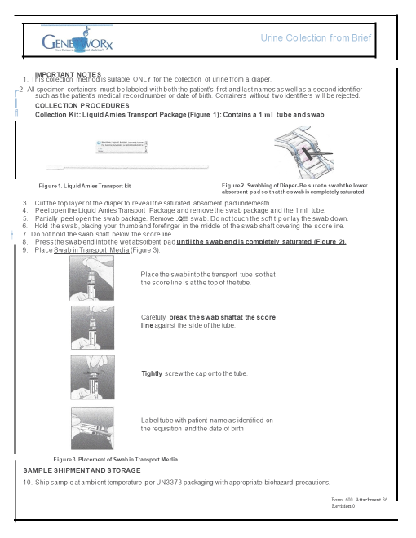
Collection Procedures for Brief

Slide 46
Billing

Slide 47

Billing Overview
Long Term Care Facilities
--Types of Insurances
--Part A
--Part B
--Client Billing Agreement
Provider Offices
--Types of Insurances
--In-Network/Out of Network Insurances
List of full agreements

Slide 48

Call to Action
Complete your Mdx Plan to gain Moldx business
Identify and contact MolDx Targets
LTC
Currently sending COVID
New LTCs
Track daily with Salesforce on your progress
Provider Offices
Lost clients
New prospects

