Slide 1
Blood Group Testing with Gel on the Vision ; Interpretations & ABO Discrepancies
May 8, 2019

Slide 2
Objectives
To answer some of the most FAQs about the interpretation and follow up actions required with ABO /Rh testing using MTS gel
Grading?
Acceptable or unacceptable results?
Reporting and documenting actions in Meditech
Review Case Studies

Slide 3
Review ABO Gel Card
Review reactions and Assess grading
Forward and reverse group must agree
Review blood group interpretation

Slide 4
Interpretation and Actions with Forward Group Reactions with Anti-A and Anti-B using Gel
Grading with Anti-A & Anti-B | Interpretation & Action
4+ | Acceptable
3+ | Acceptable
2+ | Not acceptable. Reject results and perform complete blood group by tube method and report in Result Entry. Follow method OP-TM-211A ABO/Rh Typing.
1+ | Not acceptable. Reject results and perform complete blood group by tube method and report in Result Entry. Follow method OP-TM-211A ABO/Rh Typing.
Weak | Not acceptable. Reject results and perform complete blood group by tube method and report in Result Entry. Follow method OP-TM-211A ABO/Rh Typing.
†Negative | Not acceptable. Reject results and perform complete blood group by tube method and report in Result Entry. Follow method OP-TM-211A ABO/Rh Typing.
Mixed Field | Review transfusion history –follow SOP OP-TM-319A If consistent with recent transfusion history: Grading remains MF Edit ABO result on Vision as appropriate to define blood group Add comments describing the relevant patient transfusion history Accept results and send to LIS Report from Vision analyzer batch and document relevant transfusion history in Meditech when prompted. If NOT consistent with recent transfusion history: Reject and perform complete blood group by tube method (follow method OP-TM-211A ABO/Rh Typing) and report in result entry. Follow OP-TM-319A for assessing mixed field results and ABO discrepancies if mixed field is still present.

Slide 5
Interpretation and Actions with Forward Group Reactions with Anti-D using Gel
Grading with Anti-D | Interpretation & Action
4+ | Acceptable
3+ | Acceptable
2+ | Not acceptable. Reject results and perform complete ABO & Rh blood group by tube method and report in Result Entry. Follow method OP-TM-211A ABO/Rh Typing.
1+ | Not acceptable. Reject results and perform complete ABO & Rh blood group by tube method and report in Result Entry. Follow method OP-TM-211A ABO/Rh Typing.
Negative | Negative
Mixed Field | Review transfusion history –follow SOP OP-TM-320A for mixed field If consistent with recent transfusion history with different Rh: Grading remains MF Edit Rh group result on Vision as appropriate to define blood group Add comments describing the relevant patient transfusion history Accept results and send to LIS Report from Vision analyzer batch and document relevant transfusion history in Meditech when prompted. If NOT consistent with recent transfusion history: Reject result and perform complete ABO & Rh blood group by tube method and report in result entry (follow method OP-TM-211A ABO/Rh Typing). Follow SOP OP-TM-320A for assessing mixed field results and Rh discrepancies if MF is still present.

Slide 6
Interpretation and Actions with Reverse Group Reactions using Gel
Grading with A₁ & B cells | Interpretation & Action
4+ | Acceptable
3+ | Acceptable
2+ | Acceptable but must perform reverse group by tube method to determine if AHG XM is required. Do not change grading. Document additional testing and results in Meditech. Add canned text “TM2 AHG Crossmatch must be performed on this specimen” if required.
**1+ | Acceptable but must perform reverse group by tube method to determine if AHG XM is required. Do not change grading Document additional testing and results in Meditech. Add canned text “TM2 AHG Crossmatch must be performed on this specimen” if required.
Weak | Not Acceptable. Reject results and perform complete ABO & Rh blood group by tube method and report in Result Entry. Follow method OP-TM-211A ABO/Rh Typing.
†Negative | Not Acceptable. Reject results and perform complete ABO & Rh blood group by tube method and report in Result Entry. Follow method OP-TM-211A ABO/Rh Typing.
** Weak 1+ Reactions are not acceptable

Slide 7
1+ Reaction Grading
Variation seen in 1+ grading from the Vision
Ortho Interpretation
Guide
It is very important to review and interpret each gel reaction !!

Slide 8
Pathway for Problem Solving with Grading & Interpretation
Gel
Manual Tube Method
ABO Problem Solving (OP-TM-319A) or Rh Problem Solving (OP-TM-320A) methods

Slide 9
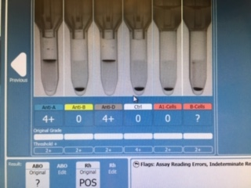
Example 1
Reverse group results not acceptable
Reject results on the Vision
Perform testing using manual tube method & report in “Result Entry”
If results are less than 2+ by tube method - follow OP-TM-319A ABO discrepancies/problem solving
Additional drops for enhancement
Incubation 30 min.
Temp 4°C

Slide 10
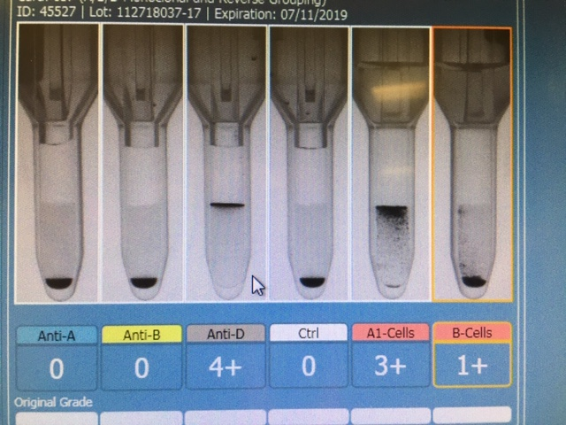
Example 2
Reverse group results not acceptable
Must meet requirements for 1+ grading!
Reject results on the Vision
Perform complete blood group testing using manual tube method and enter results in “13. Result Entry”
If results are <2+ by tube method - follow OP-TM-319A ABO discrepancies/problem solving
Additional drops for enhancement
Incubation 30 min.
Temp 4°C

Slide 11
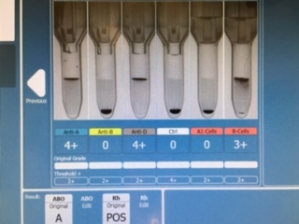
Example 3
Acceptable ☺

Slide 12
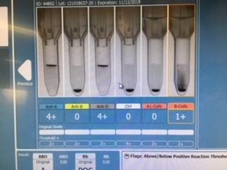
Example 4
1+ Reaction is acceptable.
Must perform reverse group by manual tube method to determine if IS XM will be acceptable.
Do not change grading on the Vision
Document the tube method results in meditech.
If results are <2+ by tube method add comment that IAT XM is required.

Slide 13
Example 4

Slide 14
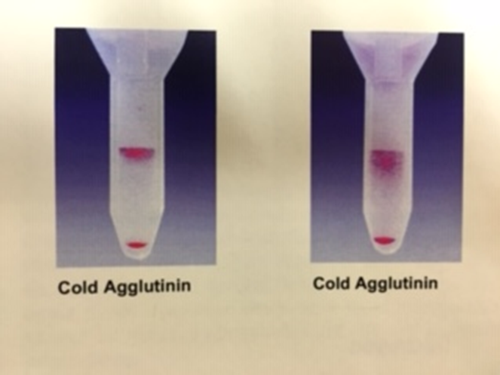
Troubleshooting Other Reactions
Might be seen in reverse group columns
Reject results on the Vision and perform ABO/Rh testing using manual tube method.
If present in the ABO card – likely also present in the antibody screen.

Slide 15
Rouleaux vs Cold Antibody
Perform ABO/Rh testing by manual tube method
Review under the microscope for rouleaux appearance.
Use saline replacement
If true agglutination consider cold reactive antibody
Consider Anti-A1 if patient is group A or AB
Cold reactive allo-antibody or cold auto-antibody
*MF will only be present in forward grouping of the ABO*

Slide 16
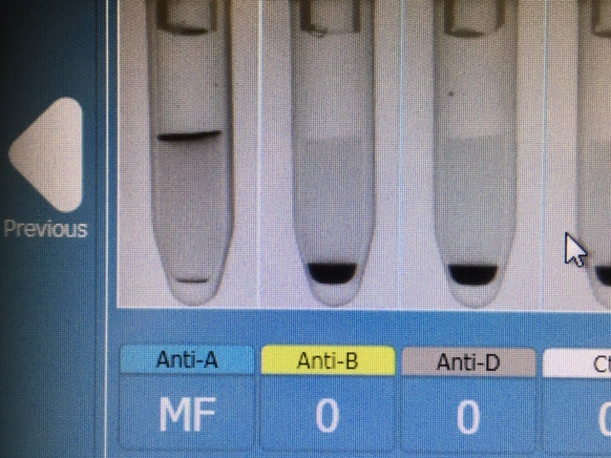
Patient Case 1
Cord Profile Sample
Detecting maternal cells
Reject the blood group results on Vision (ok to use the IgG DAT if acceptable)
Perform blood group testing by manual tube method
If MF still present:
Cancel the specimen
Order ABO/Rh to be recollected by heel prick

Slide 17
Patient Case 2
MDC Patient
Review patient blood group and transfusion history
Previous blood group B+. Received 2 units O+ red cells at CMH last week.
Do not change grading on Vision
Edit the BT result : B+
Accept and send to LIS
In Meditech you will be prompted to explain the grading – document “patient received 2 units O+ with date”

Slide 18
Patient Case 2

Slide 19
Patient Case 3
Patient in ED with lower extremity injury
68 year old male
No previous history in Meditech
No BBK history found in Clinical Connect
What do we do next??

Slide 20
Perform BT using Manual Tube method
Reagent | Result
Anti-A | 1+ MF
Anti-B | 0
Anti-D | 4+
6% albumin | 0
A1 Cells | 0
B Cells | 2+

Slide 21
Common causes of Mixed Field reactions
Recent transfusion of non-identical ABO red cells
Recipient of bone marrow or stem cell transplant
Fetal-maternal hemorrhage
Chimerism
A₃ or other weak subgroup of A

Slide 22
Some Common Causes of Weak or Missing Reactions in Forward Grouping
Weak subgroups or A or B
Disease states that results in decreased expression of A or B antigen on the red cell. May be seen in leukemia, Hodgkin disease and other malignancies.
Very high levels of A or B substance in the patient’s plasma may neutralize the anti-sera giving a weakened or negative reaction.

Slide 23
Additional Tests
Test | Result
A1 Lectin | 0
Anti-AB | 1+ MF
DAT | 0
Send out to CBS for Blood Group Investigation
Report Blood group as ‘Unknown’’
Send to CBS for further testing

Slide 24
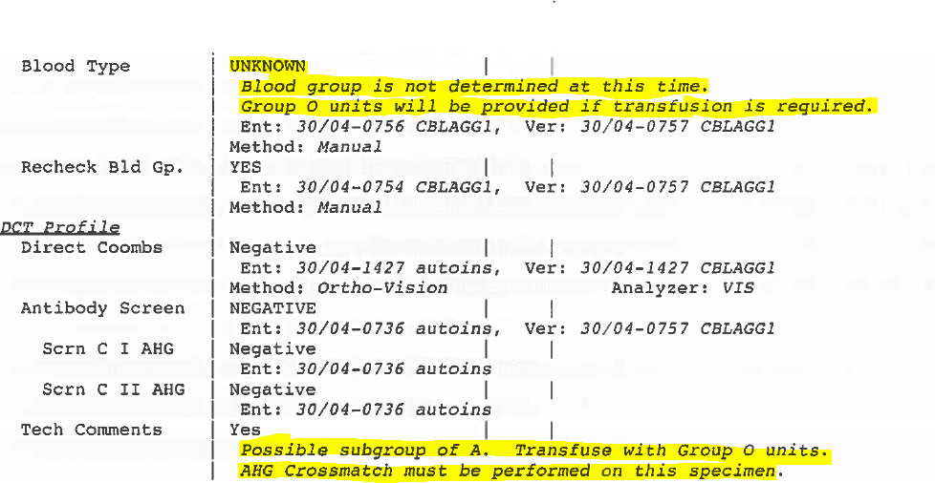
Reporting in Meditech

Slide 25
CBS Report
Testing was performed with 4 drops plasma incubated at 22°C for 60 minutes
Patient is identified as being group A Positive, subgroup A₃
Reagent | Results
Anti-A | 2+ MF
Anti-AB | 2+MF
Anti-B | Non-reactive

Slide 26
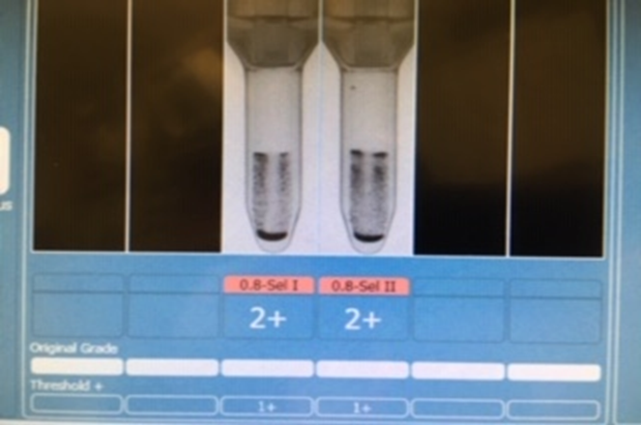
Patient Case 4
Discrepancy between forward & reverse group.
Reject this result & perform ABO/Rh by tube method.
Perform antibody panel
Review Transfusion History
Review Previous BT history
DAT

Slide 27
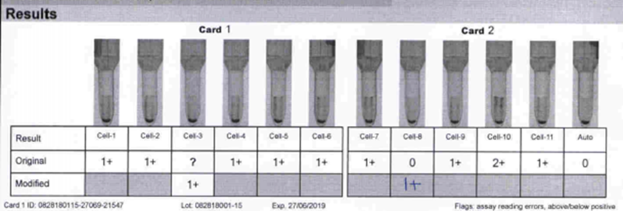
Patient Case 4

Slide 28
Patient Case 4
Discrepancy still present
What are the possible causes of the discrepancy?
Rouleaux
Perform saline replacement
Cold reacting antibodies
Anit-A1
Alloantibodies, M, P1
Cold agglutinin
Perform cold antibody screen OP-TM-313A
Reagent | Result
Anti-A | 0
Anti-B | 4+
Ant-D | 4+
6% Alb | 0
A1 Cells | 2+
B Cells | 2+

Slide 29
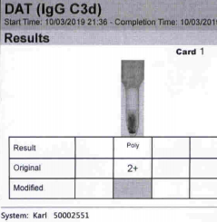
Patient Case 4
DAT Results
Reagent | Result
Poly | 2+
IgG | Weak
C3d | Weak

Slide 30
Patient Case 4

Slide 31
Patient Case 4
How do we resolve the discrepancy in the blood group?
Repeat the reverse group cells using the Pre-warm method.
Reagent | Result
A1 Cells | 2+
B Cells | 0

Slide 32
Patient Case 4

Slide 33
Patient Case 4

Slide 34
Some Take-Away Thoughts
Very important for us to assess the reactions and grading on the gel cards for blood groups.
If you have a discordant result with Gel on the Vision (MF, weaker than expected reactions, rouleaux or other discrepancy:
Manual Tube Method is the first step of investigation
then follow:
ABO Problem Solving (OP-TM-319A) & Rh Problem Solving (OP-TM-320A)

