Slide 1

alethia C.difficile Refresher Training
Cambridge Memorial Hospital
2021

Slide 2
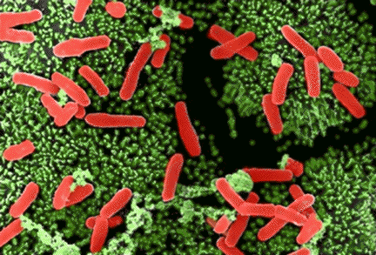

Disease State Overview
Clostridioides difficile (or C. diff) is a spore-forming, gram-positive anaerobic bacillus
Can produce two clinically relevant exotoxins:
  Toxin A and B
Only causes disease if it produces toxin
Can also change into a spore
  Can survive in hot and cold temperatures
  Resistant to the action of many chemicals, including the alcohol-based hand sanitizers often found in hospitals
  Can be found on countertops, door handles, faucets, toilet seats for years and can infect others, especially immunosuppressed, elderly or children
It is a common cause of antibiotic-associated diarrhea (AAD)
  Not all diarrhea while taking antibiotics is caused by C. difficile
  Accounts for 15-25% of all episodes of AAD
Notes:
There are 2 forms of the bacterium vegetative which is usually killed off by the acid in the stomach and the then the spores.

Slide 3

MOLECULAR ASSAY WORK-FLOW CONSIDERATIONS
Reducing Contamination Risk
Best Clinical Practices recommend separate specimen handling and amplification areas for molecular assays. The greatest contamination risk in a molecular lab is the “amplicon” or amplified DNA. Due to severe space limitations, many labs require these two areas to be in close proximity to one another. Adherence to the following precautions can minimize the risk of contamination

Slide 4

Designate a ONE way work-flow direction, and reserve counter area as a “clean space”.
Remove supplies from testing kit with clean gloves/hands – change gloves before returning to box for additional supplies
Handle stool containers and testing materials in progress in the fumehood only.
Use care when handling specimen collection brushes, taking only what you need from the package. Do not touch brush tip with fingers or place on any surface.
Use a DEDICATED pipette and clean before and after use.
Use disposable micro-aerosol barrier FILTERED pipette tips
CLEAN each area and sample tray with a cleaning product that effectively kills DNA/RNA and C. diff spores before and after testing.
Change gloves as necessary and be mindful that dirty gloves may be a source of contamination.

Slide 5

Amplification begins when the extracted specimen is added to the alethia™ device. The alethia™ device contains a safety cap or “lock mechanism” to remind lab personnel NOT to open the device AFTER it has been closed. This feature minimizes the likelihood of “accidental” opening and helps prevent amplicon contamination.
Once the assay is completed, the alethia™ device should be removed from the alethia ™ instrument and discarded IMMEDIATELY in a biohazard bag – do not leave devices inside the alethia ™ instrument.
The alethia™ devices should not be allowed to accumulate in the biohazard bags. The biohazard bags should be disposed of daily.

Slide 6
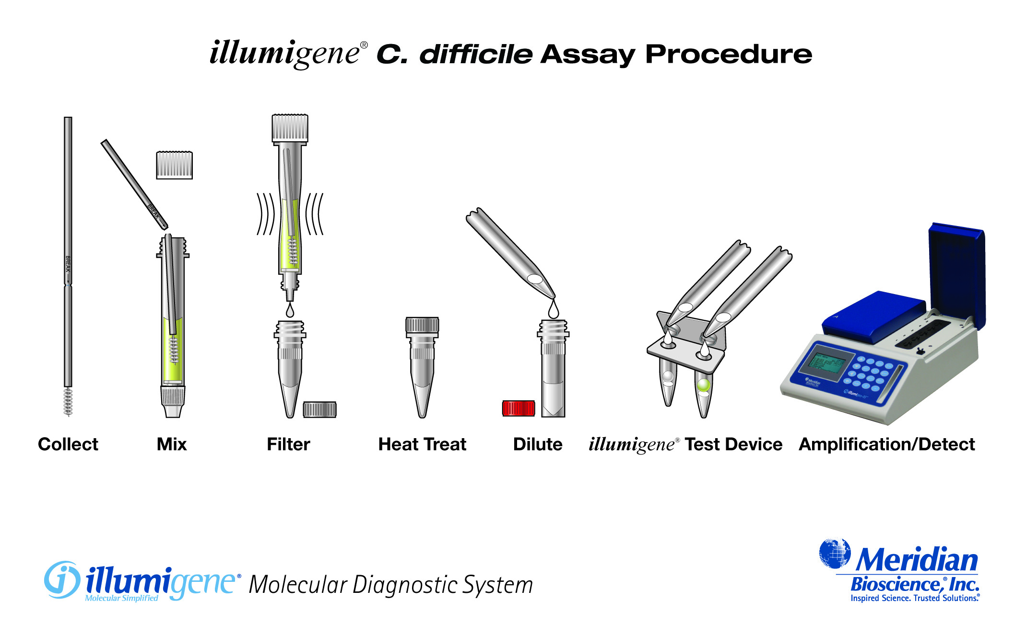


Amplification
Sample preparation
Heat Treatment

Slide 7
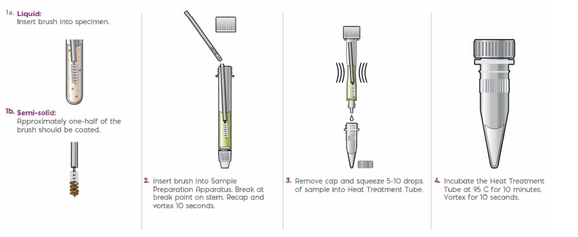

Product Review
Assay Protocol
After completion of sample preparation step, thoroughly clean area and change gloves

Slide 8
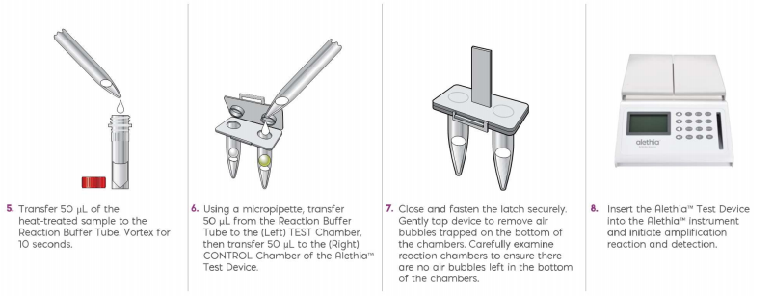
Product Review
Assay Protocol

Slide 9
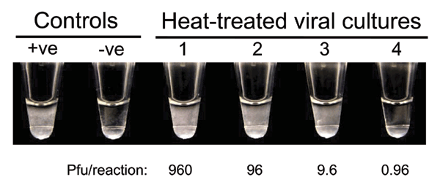

  By-product of DNA amplification is magnesium pyrophosphate
  Amount of magnesium pyrophosphate reaches saturation and precipitates out of solution causing turbidity
  Sample read with specially designed turbidity meter (alethia optics) for greater speed and accuracy
  All tubes blanked at beginning of assay run to eliminate any potential interferences
  Possible source of error – bubbles in device or placing on alethia analzyer too quickly after mixing

Slide 10
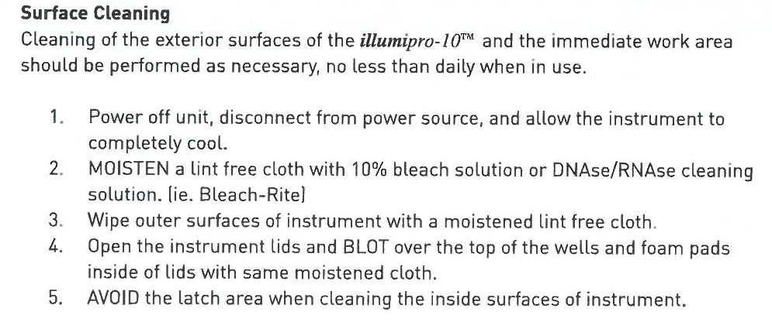


Cleaning Procedures
In the event of suspected well contamination, labs are advised to contact technical support for instructions on cleaning the wells.

Slide 11
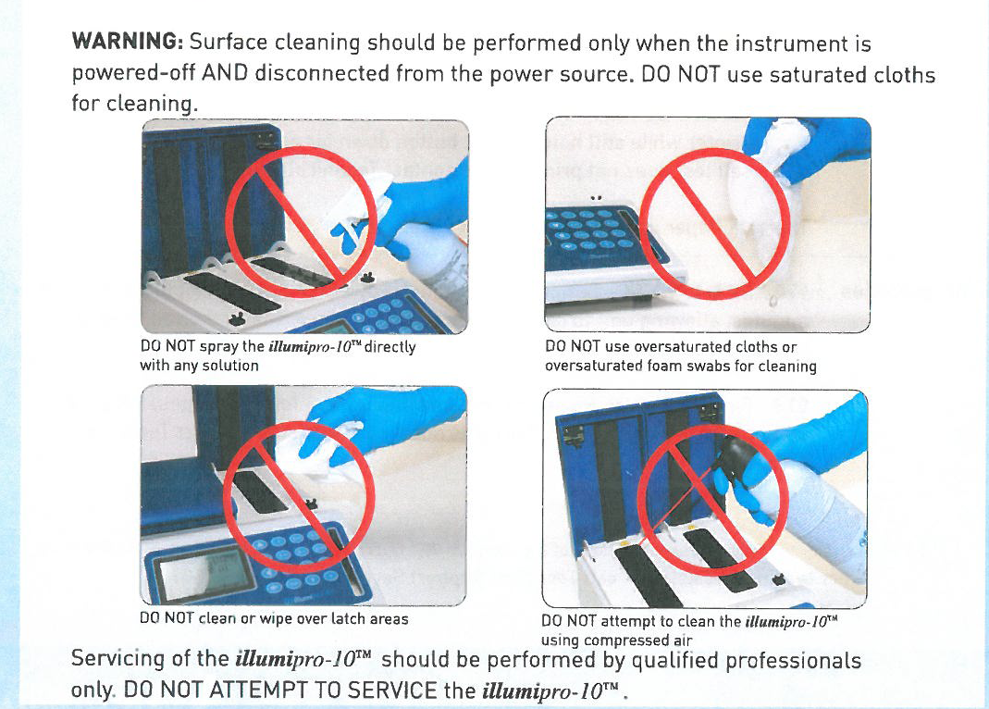

Cleaning Precautions

Slide 12

Well Cleaning Procedures
Non-DNA Contamination Cleaning Protocol:
  Only to be performed as advised by technical support .
  Power off instrument and ALLOW TO COOL COMPLETELY.
  Gently wipe heat block chamber (ie. Well) with a dry foam swab only.
  Gently wipe heat block chamber with a foam swab moistened (NOT SATURATED) with 70% alcohol.
  Gently wipe heat block chamber with a dry foam swab.
  If DNA contamination is suspected, a dry foam swab and then a 10% bleach moistened swab are used prior to the above steps.

