Slide 1
Anti-D: Testing Protocol Update
January 2021

Slide 2
Objectives
Review Weak D vs Partial D
Describe Anti-D Reagents and how they work
Provide background/rationale for implementing changes to our current process
Describe the new additional Anti-D Testing

Slide 3
Weak D vs Partial D
‘Weak D’ are generally those with fewer copies of the Rh protein on the cell membrane. Depending on the reagent- may see weaker reactions or negative reactions at IS.
Then most common are :
Type 1
Type 2
Type 3
Appear as Rh+ to the immune system and can be called Rh positive. These patients will not develop an Anti-D

Slide 4
Weak D vs Partial D
‘Partial or variant D’ have missing epitopes of the D protein or have altered epitopes
These patients can make an anti-D to the part of the D protein that they are missing.
“Normal” D protein is different from their own and can stimulate anti-D formation.
Type VI is one of the most commonly encountered

Slide 5
Weak D vs Partial D
More than 200 different alleles of RHD gene have been identified to date
Cause decrease amount of protein in membrane
Can alter protein and abolish or create novel epitopes where conventional or normal RHD will be foreign
The distinction between a “weak D” and “partial or variant D” category cannot be determined by routine serological testing. Genotyping must be performed in order to differentiate patients with partial D vs Weak D
The terminology ‘weakened expression of D’ is becoming more adopted.

Slide 6
Anti-D Reagent Reagents
Anti-D reagents are made of 2 components:
IgM monoclonal antibody which react at immediate spin
IgG monoclonal or polyclonal antibody which react at IAT
Ideally a reagent will react at IS for all Rh+ patients including ‘Weak D’ Type 1, 2 and 3
Ideally a reagent will react at IAT for all weak and variant Ds including type VI for detecting D antigens with cord samples.
Ideally we will not see reactivity in testing for any patients who have an abnormal RHD protein, are capable of developing anti-D and need to be classified as Rh negative

Slide 7
Anti-D Reagents
The IgM antibody in the reagent is a monoclonal antibody directed against a specific epitope of the large RhD antigen on the red cell. It is expected that samples from Rh positive patients demonstrate strong positive results with monoclonal anti-D reagents : 3+ to 4+ with both gel method and immediate spin tube methods.
If reactions are less than 3+, this is considered a weaker than expected reaction and hints that there is something ‘different’ about the patient’s D antigen.

Slide 8
Anti-D Reagents
If an individual possesses a D antigen that has fewer copies, is altered or missing proteins – they may react with some monoclonal D anti-sera but not others or may only react weakly with some.

Slide 9
Anti-D Reagent Reactivity

Slide 10
Anti-D Reagent Reactivity

Slide 11
Anti-D Reagent Reactivity

Slide 12
In- House Anti-D Reagents
Ortho Gel Card IgM clone MS-201
Ortho BioClone (IgM MAD2 and polyclonal human IgG
Immucor Anti-D (series 5)-IgM clone TH28 /IgG clone MS26

Slide 13
Since we have implemented anti-D testing with gel cards, numerous patients have been identified as having abnormal RHD genotypes
genotype testing for discordant D results we have identified less commonly encountered examples of D genotypes i.e. RHD 30 and RHD *01W.5 which should be treated as Rh negative individuals.
However, in cases where the patient types 3+ or 4+ with the Vision gel card method – the only way we can identify these patients is if there is a discrepancy with previous results or discrepancy with another lab

Slide 14
What’s our Goal?
Knowledge that certain Weak/Variant D phenotypes may demonstrate 3+ or 4+ reaction with gel testing
We want to prevent women of childbearing age from being miss-typed as Rh+ in these situations
Therefore: repeat testing using a second monoclonal anti-D anti-sera with tube method in order to detect abnormal D antigens. Performed for female patients < 45 years of age.

Slide 15
AD2CHECK
The AD2CHECK second anti-sera check will automatically reflex in Meditech when the patient is female < 45 years and vision grading is 3+ or 4+

Slide 16
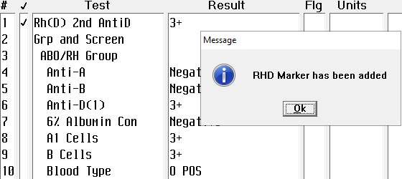
AD2CHECK
Perform testing with Ortho Bio Clone anti-sera using tube method and report grading results.
Once AD2CHECK test is completed the RHD marker will automatically be added to the patient.

Slide 17
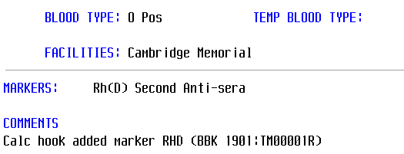
AD2CHECK
The RHD marker can be viewed in PCI as part of the patient history
The RHD marker will prevent the AD2CHECK from being reflexed to any additional blood type tests for the patient. AD2CHECK is a ‘one-time’ test.

Slide 18
AD2CHECK
What if the testing results of the 2nd anti-sera do not correlate with the grading of the Vision gel testing?
Grading results of 2+ or less with the 2nd anti-sera will be flagged for investigation in Meditech
The patient should be temporarily typed as Rh negative.
The patient would be considered a candidate for Rhig if appropriate
The patient would be provided Rh negative red cells if transfusion is necessary
Genotype testing is considered and performed to confirm the patient’s Rh status is appropriate

Slide 19
Updated SOPs for Review
ABO & Rh Typing Gel Method OP-TM-611A
Rh Typing Problem Solving OP-TM-320A

