Slide 1
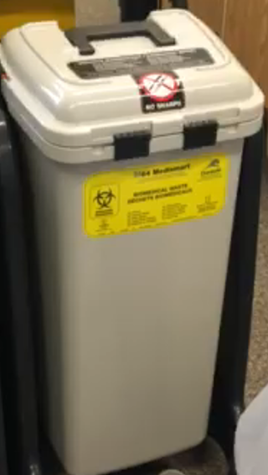
M – 64 Medismart Biomedical Waste Bin Tutorial

Slide 2
Biomedical Waste Disposal
Our Laboratory currently uses three types of receptacles for disposing of biomedical waste:
1. The cylindrical yellow buckets with sealable lids used (usually white in colour) for non-anatomical waste
2. The M64 grey waste bin.
3. The cylindrical red buckets with sealable lids (usually white in colour) are used for Human anatomical waste consisting of tissue, organs and body parts not including teeth, hair and nails as these three items are not considered biomedical waste by Environment Canada
Biomedical waste sharps materials are placed in puncture resistant, leak proof biohazard containers. These containers must have lids that lock, cannot be removed once closed. These containers should be clearly indicated for sharps usage only.
All other medical waste must be placed in the biomedical waste container in the media room. This biomedical waste is sent to a licensed facility for autoclaving.
It is the responsibility of laboratory staff to place smaller biomedical waste such as consumable waste items produce from the Vitros Analyzers (microslides, microwells, and microtips) into biomedical waste buckets. These buckets must have the sealed lids applied with a rubber mallet prior to setting aside in designated waste area/calling for pickup.
At no point should Non-anatomical waste be placed into red buckets.
Larger biomedical waste such as specimen tubes, 24 hour urine containers should be disposed of in the Medismart M64 Waste Bin.

Slide 3
M – 64 Medismart When the M64 waste bin is correctly positioned into it’s cradle, the lid is fully operational from a foot pedal. During routine use, no manipulation of the lid should be required by hand. Incorrect placement of the bin into the cradle will reduce the effectiveness of the foot pedal or could render the foot pedal inoperative.

Slide 4
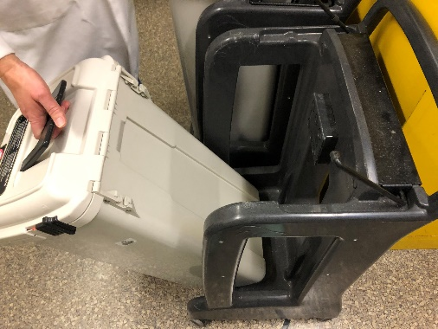
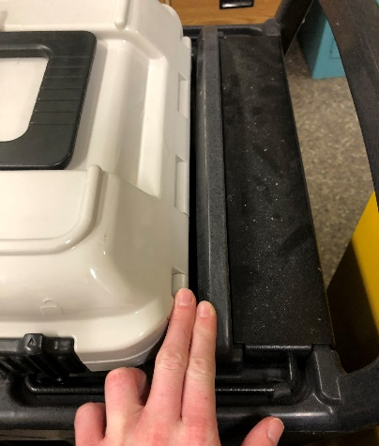
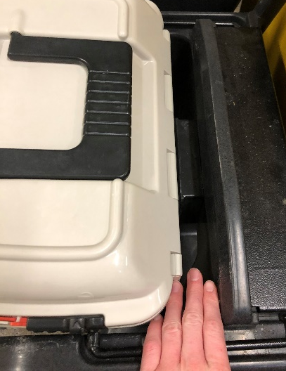
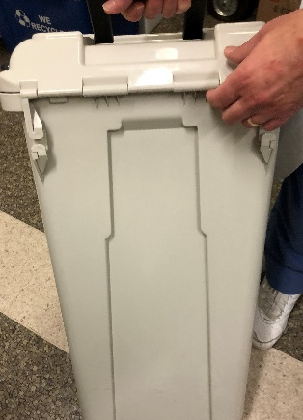
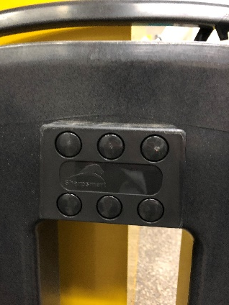
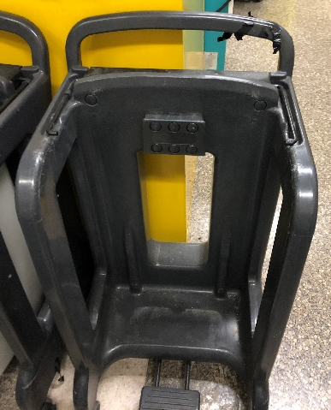
Setting Up
Place the container on the stand ensuring that the back of the container is up against the stand.
To achieve this, be sure to lift up so back of the container fits into the front part of the stand. Container should slide into the stand if correctly aligned.
Gap
No Gap

Slide 5
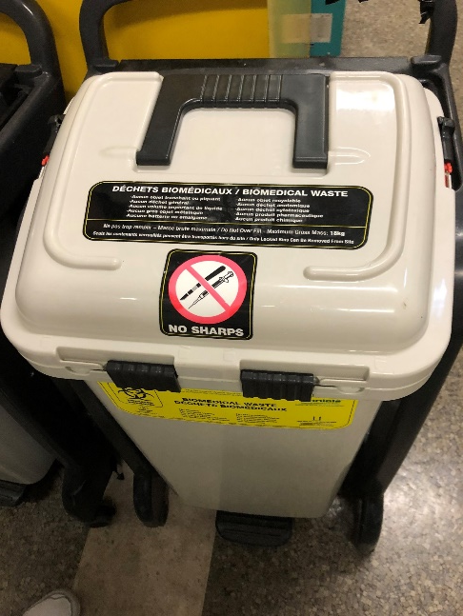
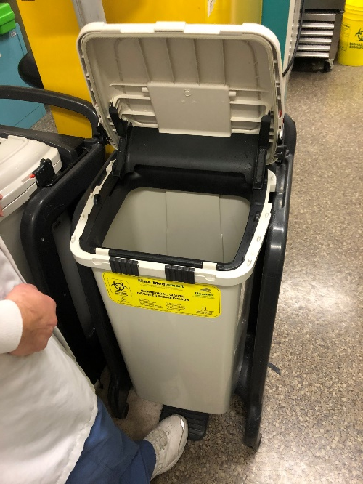
Getting Ready
Push black locks at the front of lid, toward one another to unlock. This will allow you to step on the pedal to lift lid. Do not lift by hand!

Slide 6
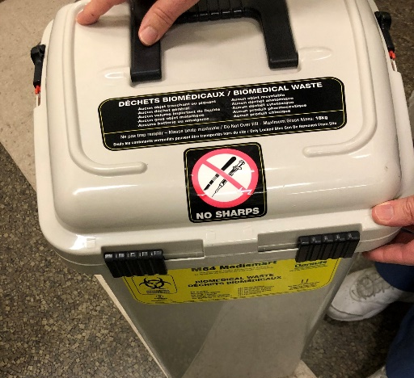
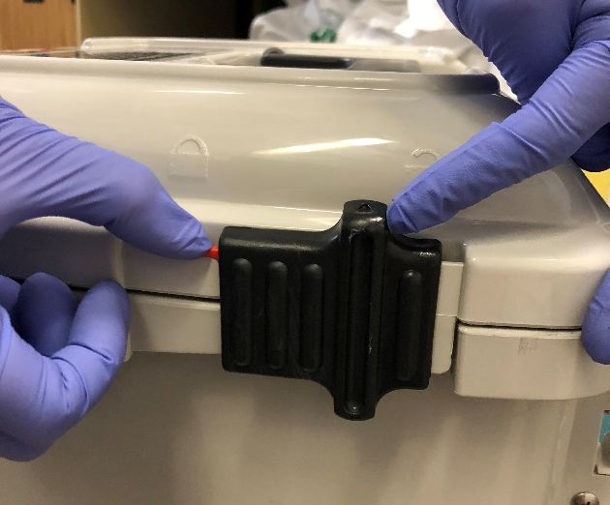
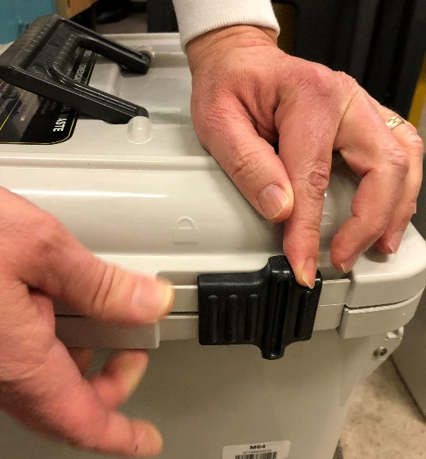
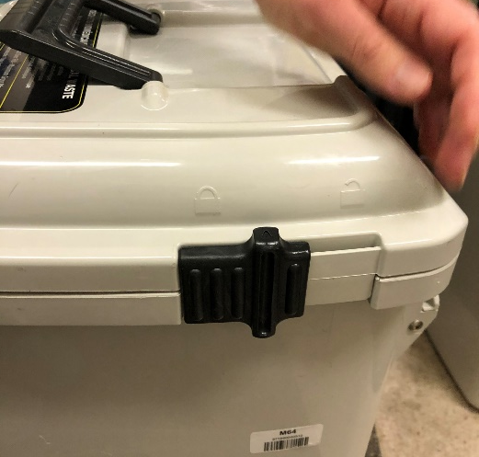
Locking Container
Switch out the container when 3/4 full. Please DO NOT overfill! Lid must be able to close without resistance.
Slide the front locks on lid away from one another to engage locking mechanism and lift container off the holder
Lock the side locks by holding the red tab down while pushing the lock towards the red tab. Once lid is secured, leave container aside for housekeeping to collect.

