Slide 1
Antibody reactions

Slide 2
Phases
ABO blood grouping
Most commonly IgM phase (IgG phase negligible)
Antibody screen
IgG phase

Slide 3
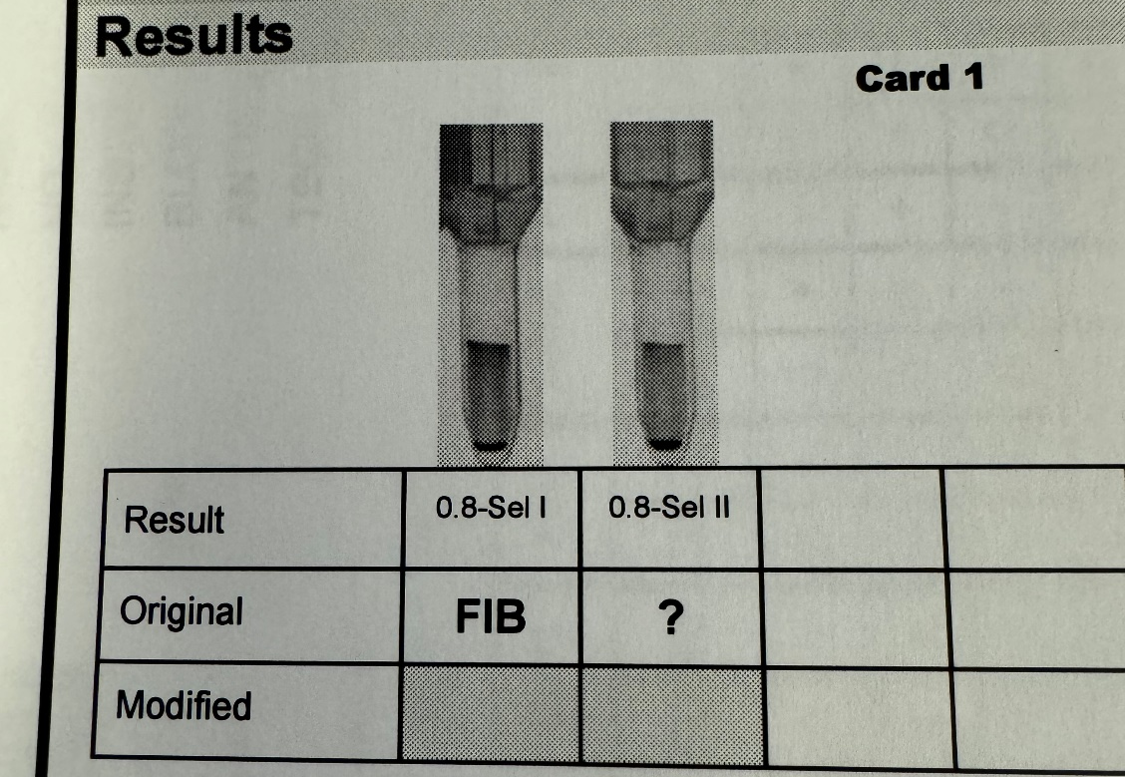
Cold antibodies
What testing should be run?
Normal process + DAT – IgG
Cold panel - IgM

Slide 4
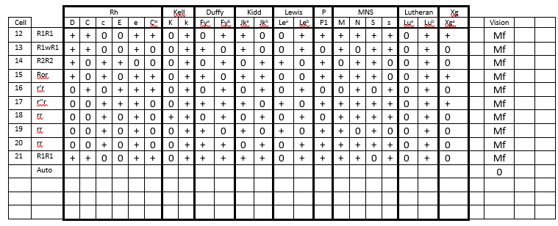
Normal panel
What should be done now?

Slide 5
Cold panel

Slide 6
What should we do now?
Exclusions cannot be made using the cold panel (IgM)
If Panel A is nonspecific MF, don’t waste resources and test another whole panel
Exclusions must be made using a phase that tests the IgG phase
Gel
Gamma N HANCE
Only when exclusions have been completed is when the sample can be resulted

Slide 7
Exclusions – tube method

Slide 8
Let’s look back at the cold panel results
When should I result it as a cold antibody?
Most healthy individuals will have a cold agglutinin
If it is a cold antibody, it will react strongly (think IgM), at IS or at 15 minutes RT
For results such as this, it is not to be reported as a cold antibody, it just means that the antibody present is not cold specific (IgM)

