Slide 1
CLA Training Receiving Samples
Overview Training on Lab Tests and Novius

Slide 2
Agenda
Novius Label
Color Guide
Add-On Orders
Priority
CSF
OCCULT BLOOD
NOVIUS Troubleshooting Guide

Slide 3
Novius Label
Overview
Section Review
Detailed Review

Slide 4
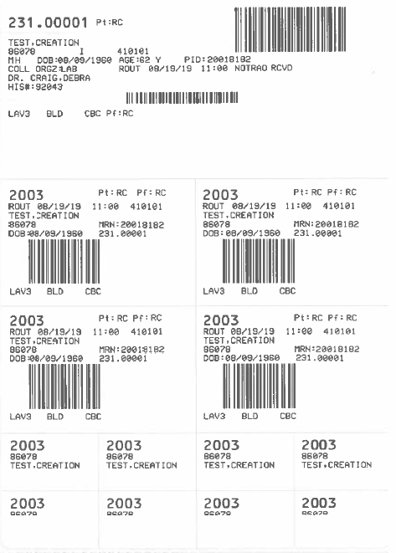

Slide 5
Tubes Order of Draw
Red
Blood Culture
Blue
Gold
Green (Light Green Heparin)
Lavender (Sodium Fluoride)(Potassium Oxalate)
Gray

Slide 6
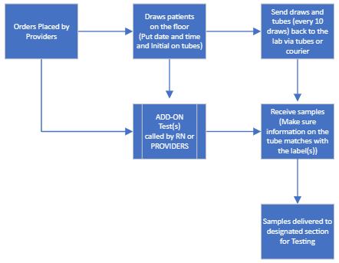
GENERAL WORKFLOW

Slide 7
Color Guide for Tubes Pt. 1
PANELS
Electrolyte = Na, K, Cl & CO₂
Basic Metabolic Panel (BASIC) = Na, K, Cl, CO2, Glu, BUN, Creat, Ca
Comprehensive Metabolic Panel (CMP) = Na, K, Cl, CO2, Glu, BUN, Creat, Ca, TP, Alb, Alk Phos, AST, ALT, TBil
Hepatic Function Panel (HEPFUN) = TP, Alb, TBil, DBil, Alk Phos, ALT, AST
Renal Panel (RENAL) = Na, K, Cl, CO2, Glu, BUN, Creat, Ca, Alb
Comp Panel, Infant = Na, K, Cl, CO2, Glu, BUN, Creat, Ca, TP, Alb, Alk Phos, AST, ALT, NeoBili - includes DBil
Hep Panel, Infant = TP, Alb, NeoBili, Alk Phos, ALT,AST
Neonatal Bilirubin = Total Bilirubin, Direct Bilirubin, Indirect Bilirubin-Calculated
Hepatitis Acute Panel = Hepatitis A, Hepatitis B Surface Ag, Hepatitis B Core IgM, Hepatitis C
Lipid Panel = Cholesterol, HDL, LDL, Triglycerides, VLDL (Calculated)
CHEMISTRY
Amylase (AMY)
Lipase
CK-Total (CKT)
CK-MB (CKMB)
High Sensitivity Troponin I (TROPHS)
Random Glucose (GLURND)
Fasting Glucose (GLUFST)
2 Hr PP Glucose (GLU2PP)
1 Hr Glucose Challenge (GLUCHL)
CO2
Chloride
Sodium (Na)
Potassium (K)
BUN
Creatinine
Bilirubin, Total
Bilirubin, Direct
Bilirubin, Total (Cord Blood)
Bilirubin, Neonate
Alk Phos
AST (SGOT)
ALT (SGPT)
GGT
LDH
Calcium
Phosphorus
Magnesium
Uric Acid
Total Protein (TP)
Albumin
Alcohol, Ethyl (ETOH)
Ferritin
TIBC (Include % Saturation)
Ammonia (on Ice)
Osmolality, Serum
Beta Hydroxybutyrate
Lactic Acid (on Ice)
Cholesterol, Total
Triglycerides
HDL Cholesterol
LDL Cholesterol
HCG QUANT
HCG QUAL (Serum)
CRP
Prealbumin
C3
C4
Vitamin B12
Folate
TSH
T4, Total
T4, Free
PSA, Total
Acetaminophen
Carbamazepine
Digoxin
Valproic Acid (Depekene)
Gentamicin, Peak
Gentamicin, Random
Gentamicin, Trough
Lithium
Phenobartital
Phenytoin (Dilantin)
Salicylate
Tobramycin, Peak
Tobramycin, Random
Tobramycin. Trough
Vancomycin, Peak
Vancomycin, Random
Vancomycin, Trough
MonoSpot
Rheumatoid Factor (RF)
RPR
Hemoglobin A1c
Procalcitonin (PCT)
Hepatitis A
Hepatitis C
Hepatitis B, Surface Ag
Hepatitis B, Surface Ab
Hepatitis B Core, IgM
CHIV
Syphilis, Total (>=18 Years)
CEA
CA19-9
CA-125
AFP
3 Hr Glucose Tolerance
5 Hr Glucose Tolerance

Slide 8
Color Guide for Tubes Pt. 2
HEMATOLOGY
CBC
Hemogram
H & H
Platelet Count
Reticulocyte Count
Sedimentation Rate (ESR)
Malaria Smear
Kleihauer-Betke
Blood Smear Path Review
Citrated Platelet Count
COAGULATION
PT, Protime and INR
PTT
Fibrinogen
D-Dimer, Quant
Mixing Study – PT and/or PTT
LYSIS TEG
PLATELET MAPPING TEG
URINALYSIS
UA Screen
Microalbumin
Myoglobulin Screen
Specific Gravity only, Urine
Specific Gravity only, Body Fluid
Eosinophils, Microscopy (Urine)
pH only, Body Fluid (if Stool is sent then the criteria is as follows: Stool must not be formed; loose/liquid only)
URINE CHEM
Drug Screen Panel, EIA (UDS) = Amph, Barb, Benzo, Coc, Opi, PCP, THC
HCG QUAL (Urine)
Osmolality, Urine
Total Protein (Urine) - Random
Urine Sodium - Random
Urine Potassium - Random
Urine Chloride - Random
Total Protein (Urine) - 24 Hours
Urine Sodium - 24 Hours
Urine Potassium - 24 Hours
Urine Chloride - 24 Hours
Blood Bank
Type and Screen
Type and Cross
DAT Mono
DAT Poly
Rhogam Screen
Cord Blood

Slide 14
Hepatitis A​
Hepatitis C​
Hepatitis B, Surface Ag​
Hepatitis B, Surface Ab​
Hepatitis B Core, IgM​
CHIV​
Syphilis, Total (>=18 Years)​
Lithium
Salicylate

Slide 18
Add-On Orders
Refer to Color Guide for Tubes
Most Add-On orders can be combined to a recently drawn sample
If the sample was collected more than 4-hours after the Add-On order was placed confirm with a CLS to see if the sample is still viable for the analyte that is needed to be tested.
2. Notify CLS of Add-On Order

Slide 19
Unit Priority
TRAUMA DEPARTMENT WILL ALWAYS TAKE PRIORITY OVERALL
ER > OR > L&D > ICU (Adults, Peds, NeoNatal) > 2500 > Med Surg Units > Outpatient Labs
SAMPLE PRIORITY
CSF > Blood > Body Fluids > Urine

Slide 20
CSF Receiving Protocol
CSF Samples are considered STAT Always
TUBE #1: CHEMISTRY – Total Protein, Glucose, and Lactate (Optional)
TUBE #2: MICROBIOLOGY – CSF Culture, Meningitis Panel (MEBIO)
TUBE #3: HEMATOLOGY – CSF Cell Count
TUBE #4: CYTOLOGY
**PM/GRAVEYARD: FOR TUBE #2 MICROBIOLOGY SEND TO HEMATOLOGY CLS STAT**
**IF ONLY 1 SPECIMEN SEND TO MICROBIOLOGY FIRST!**
PM/GRAVEYARD – SEND TO HEMATOLOGY CLS

Slide 21
OCCULT BLOOD STOOL & GASTRIC
STAT!
OCCULT BLOOD STOOL – OCBLSTL
OCCULT BLOOD GASTRIC - OCBLGAST
**PM/GRAVEYARD – PLEASE SEND TO HEMATOLOGY CLS STAT**

Slide 22
Novius Troubleshooting Reference Guide
Test Order Entry
Receiving Specimen
Specimen Add On
Specimen Cancel
Sample Tracking

Slide 23
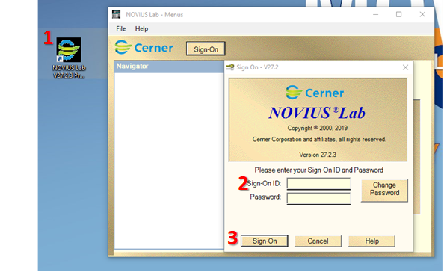
TEST ORDER ENTRY
TERMINOLOGY:
Novius EPIC
Patient ID MRN(Medical Record Number)
VIsit ID CSN (Contact Serial Number)
Double click on Novius Icon on your desktop(Novius Production)
Log into Novius by putting in your Username and Password (E
Click Sign On

Slide 24
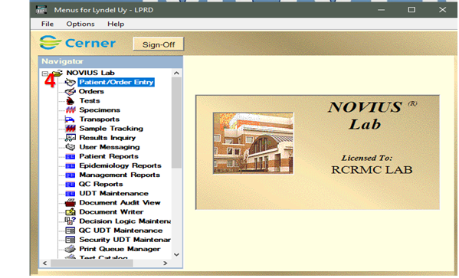
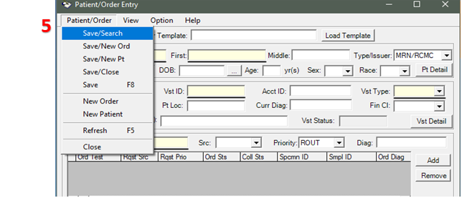
4. Double click on Patient/Order Entry
5.) Patient/Order Entry window opens, then click on Patient/Order then click Save/Search

Slide 25
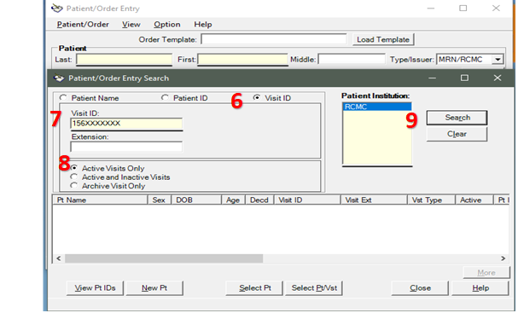
6.) Search patient orders by using Visit ID
7.) Enter Visit ID(as seen example below)
8.) Click Active Visits only
9.) Then Click Search

Slide 26
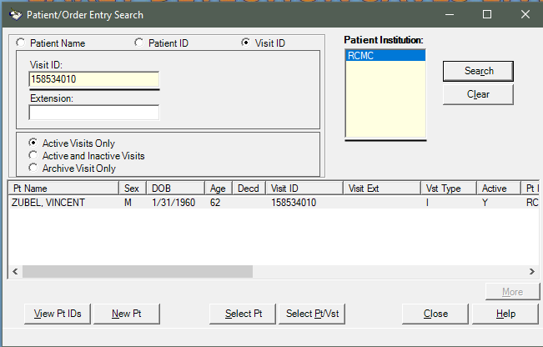
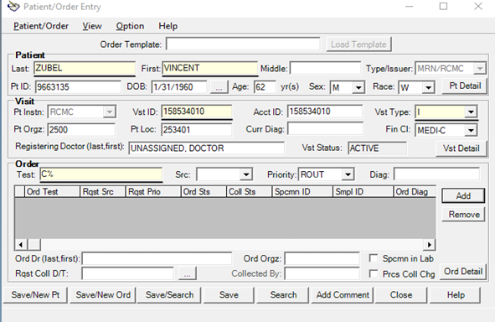
10) Novius will prompt patient if found from searching Visit ID (CSN) which includes all of patient information
11) If Patient is right, click Select Pt/Vst
12) Patient/Order Entry window will open and you can add desired Test under Order by typing it on the Test field.

Slide 27
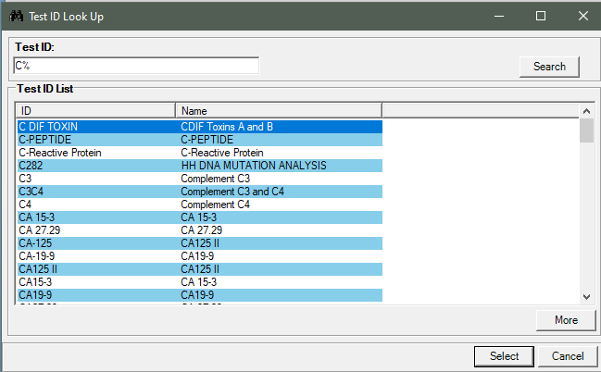
13) If you’re not familiar the Test ID or name, you can do a Test ID look up by typing the first letter of the test in upper case then % sign then enter. Then start browsing the test wanted and click Select
14) Don’t forget to select the right Source (SRC), Priority :( ROUTINE OR STAT)

Slide 28
RECEIVING SPECIMEN
Two Ways:
Receiving Specimens using Specimen Number(ID)
Receiving Specimens using CSN

Slide 29
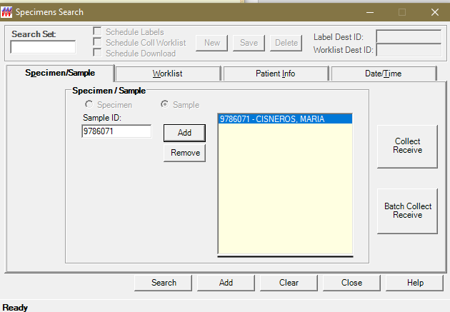
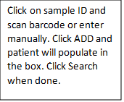
Receiving Specimens using Specimen Number

Slide 30
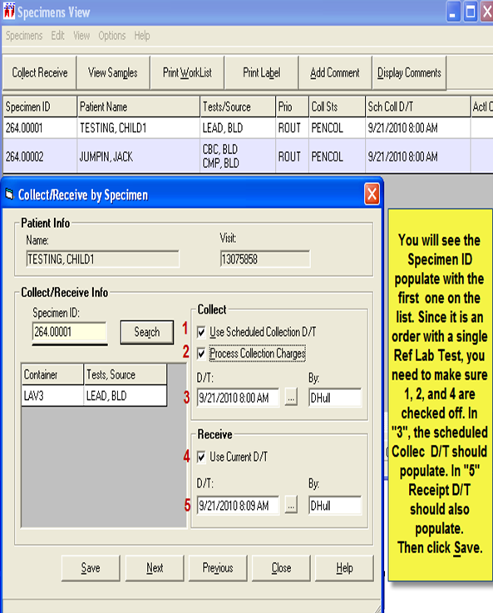
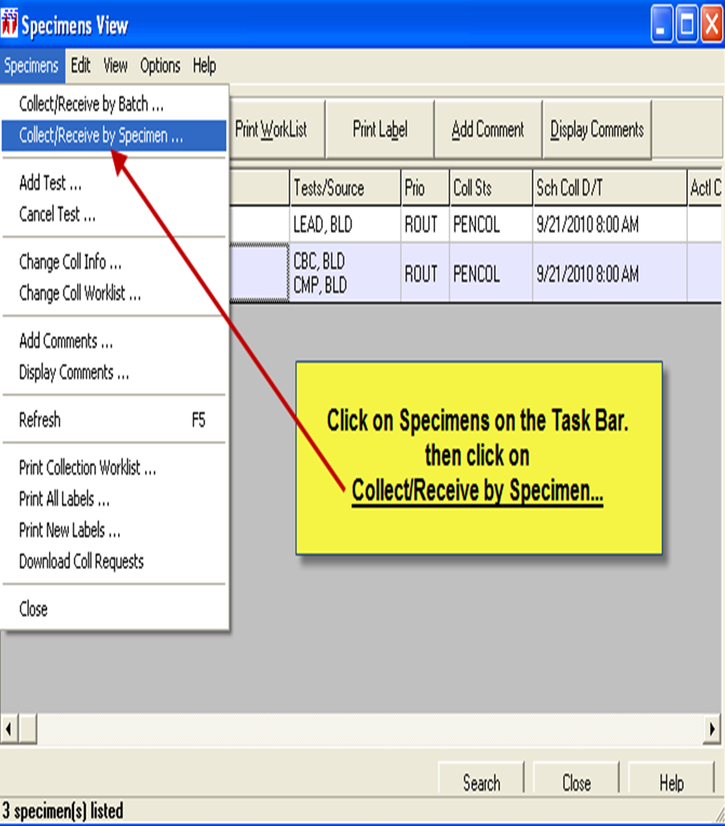

Slide 31
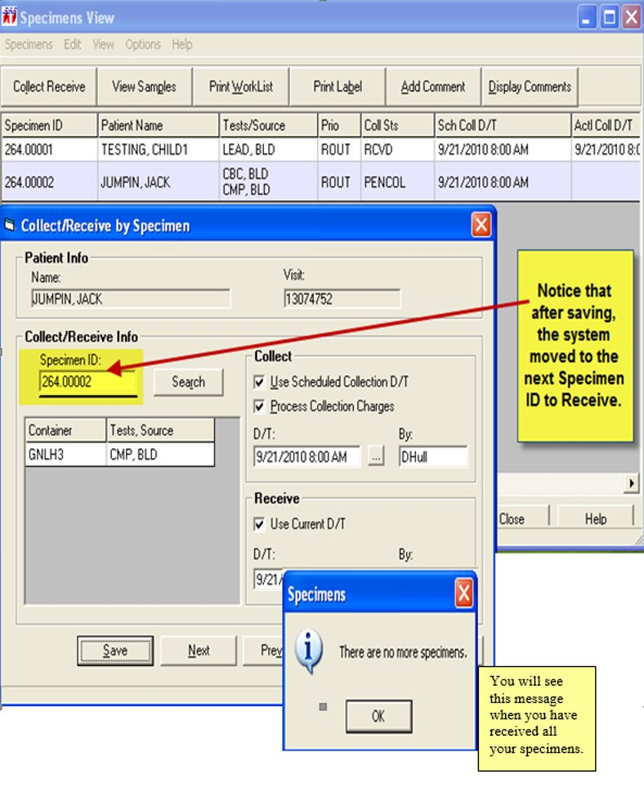

Slide 32
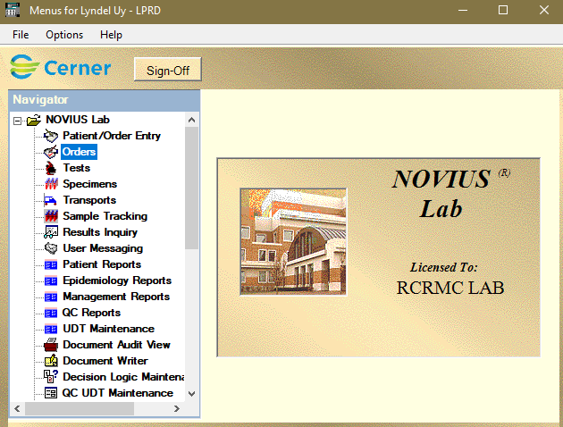
Receiving Specimens using CSN

Slide 33
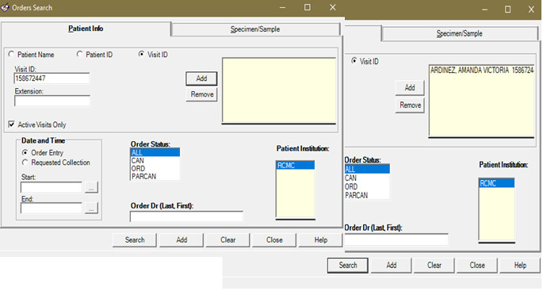

Slide 34
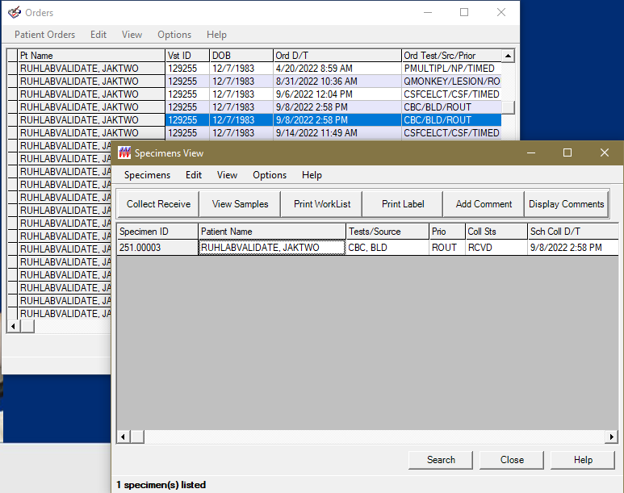
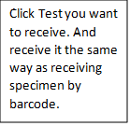

Slide 35
REMEMBER!!!
1) Make sure your patient specimen has a barcode printed or/and must be attached to the tube itself.
2.) For some patients with Ammonia test (Chemistry) please double check for additional Chemistry test ordered for patients. Usually, CMP and Basic are also ordered for the same patient. Use CSN to check on patient’s orders so that nothing is missed. Then print CMP, Basic or other Chemistry test label and put "SHARE with Ammonia. So that testing techs are aware of it.
3.)Don’t forget to reprint patient’s tests labels. The machines utilize the barcode to run the tests.

Slide 36
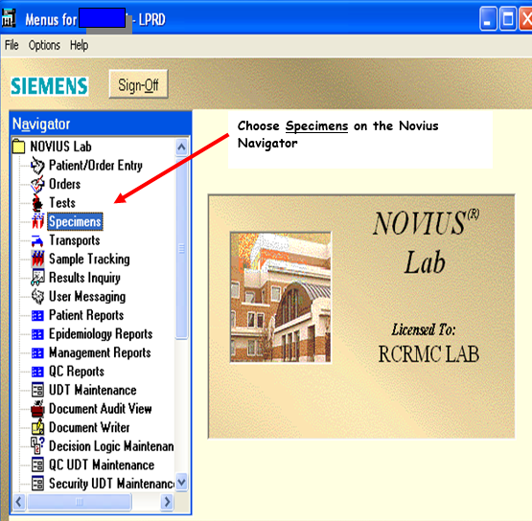
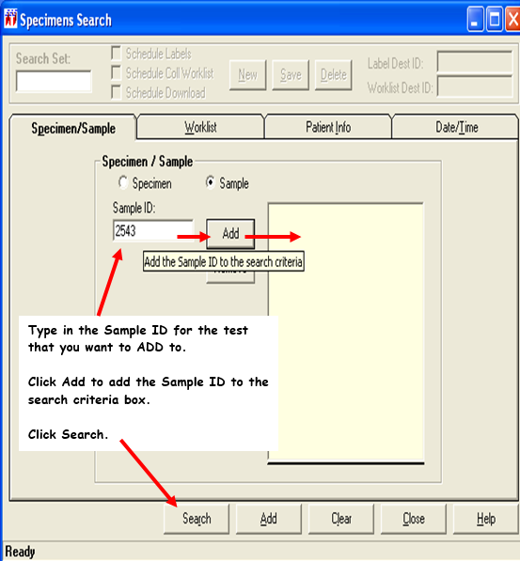
SPECIMEN ADD ON
To add a test to a sample that is already in the laboratory

Slide 37
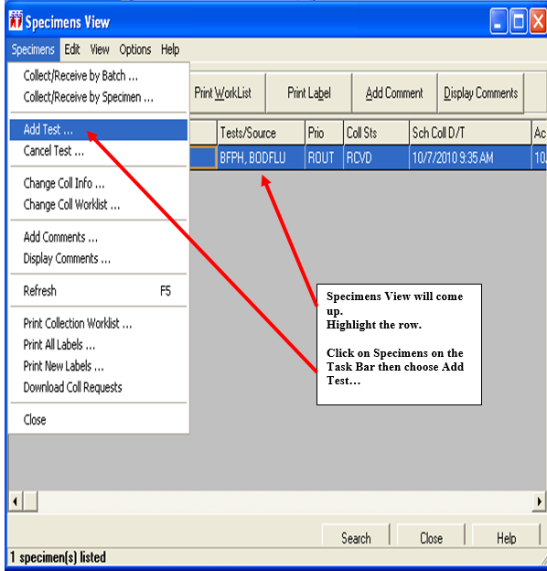
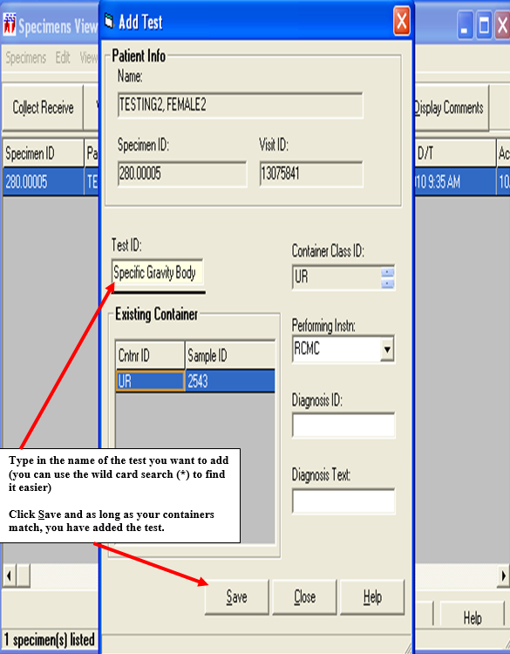

Slide 38
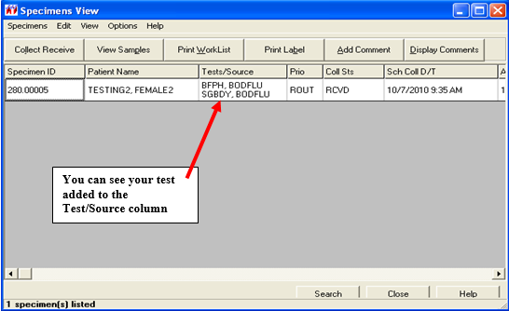
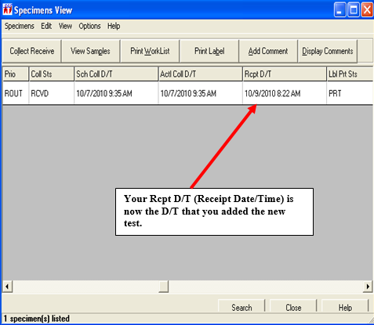

Slide 39
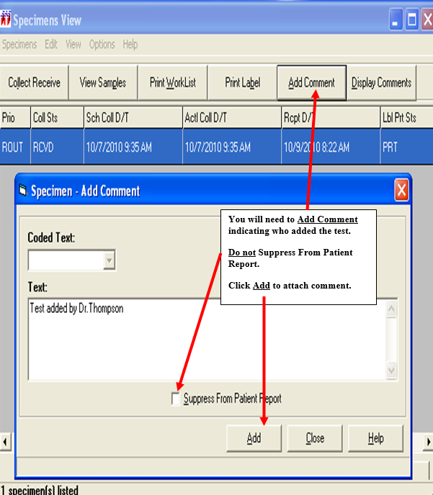
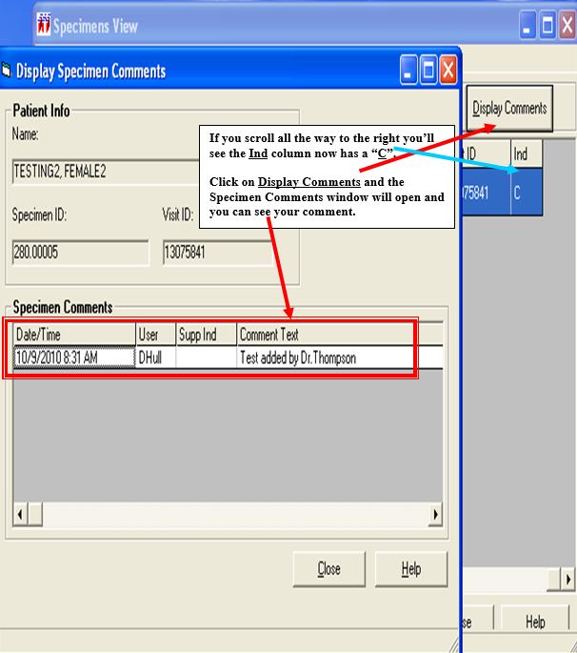
Note: It is important to merge add on to existing ACCESSION NUMBER to avoid confusion and to help easily navigate specimen that was already tested

Slide 40
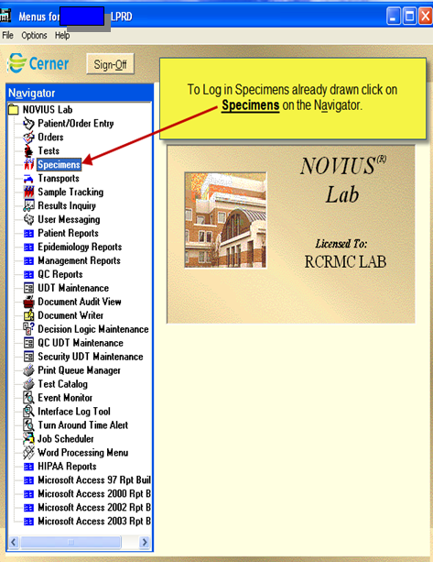
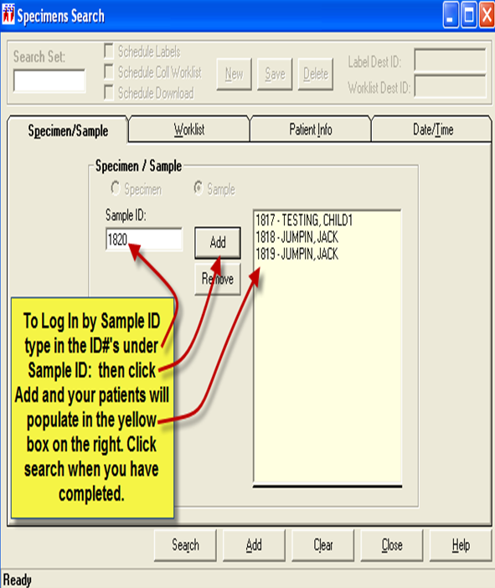
SPECIMEN CANCEL
To cancel specimen that is hemolyzed, short drawn. etc
Same process is use for DUPLICATE orders.

Slide 41
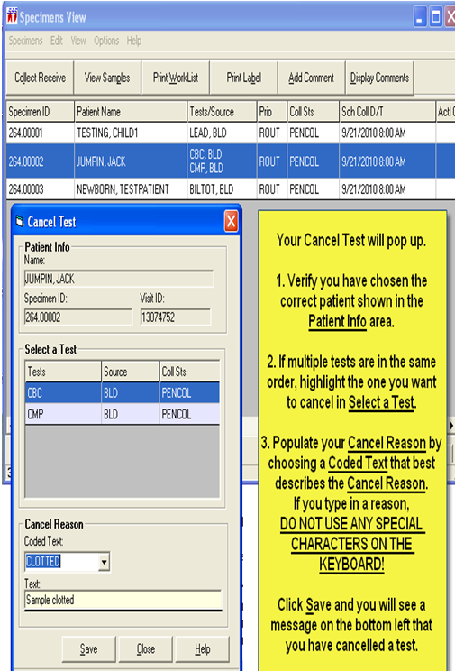
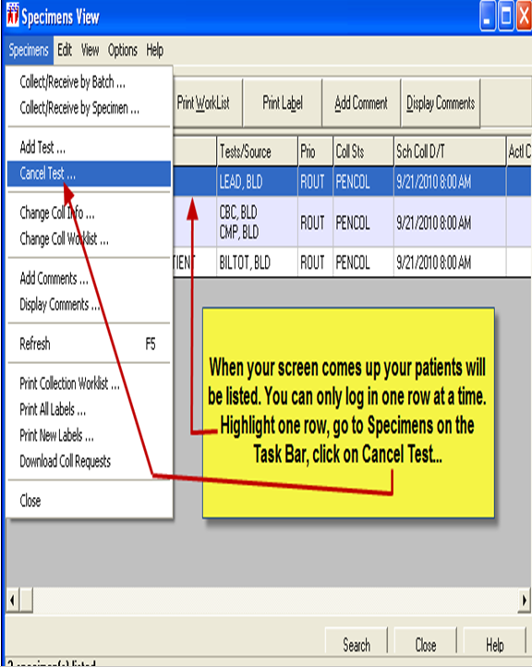

Slide 42
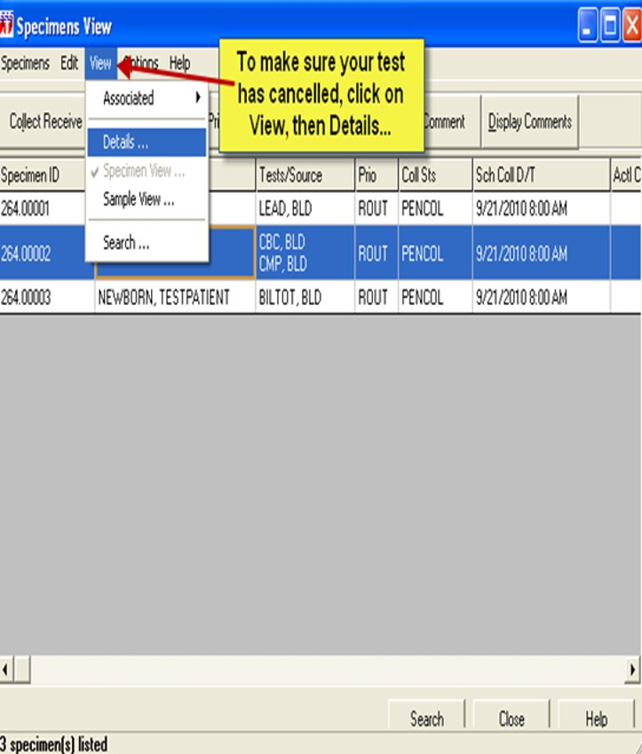
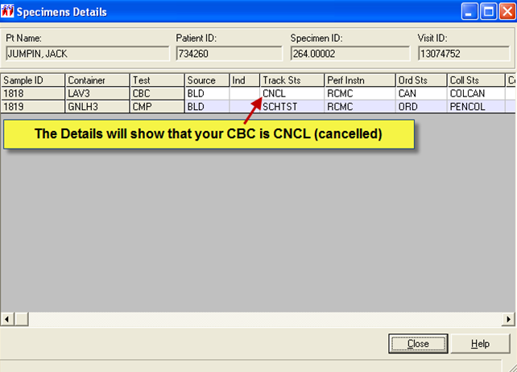
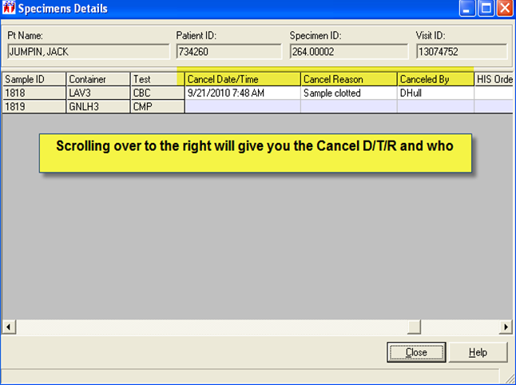
Note: Make sure to ADD COMMENT to the specimen view window.

Slide 43
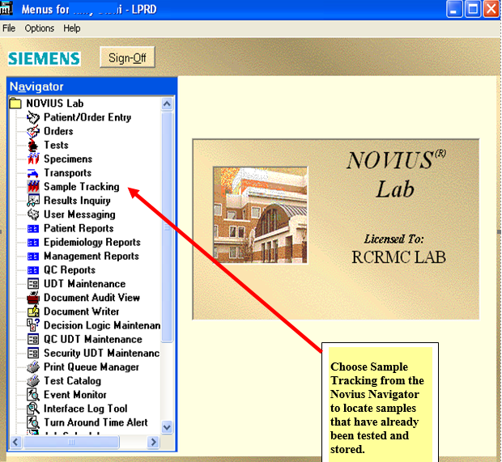
SAMPLE TRACKING
Is used to store and track sample after they are tested

Slide 44
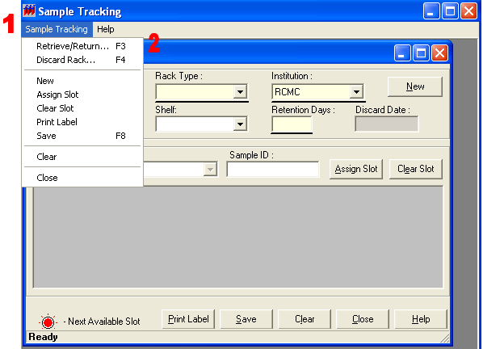
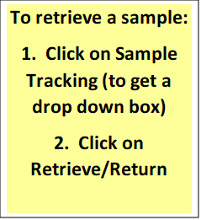

Slide 45
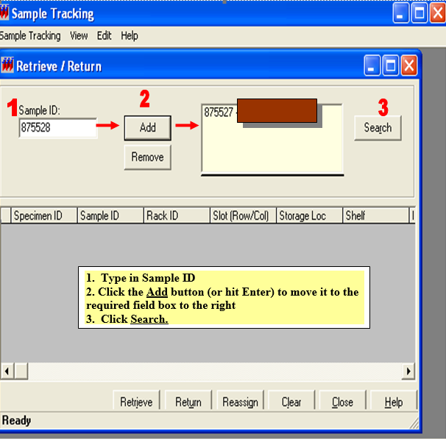
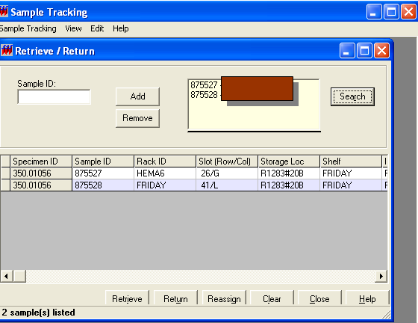

Slide 46
THANK YOU!

