Slide 1
CLA Training Receiving Samples
Overview Training on Lab Tests and Beaker

Slide 2
Agenda
Beaker Label
Color Guide
Add-On Orders
Priority
CSF
OCCULT BLOOD
Beaker

Slide 3
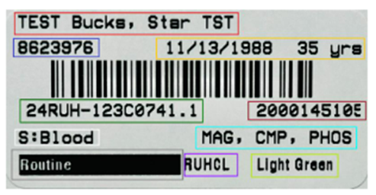
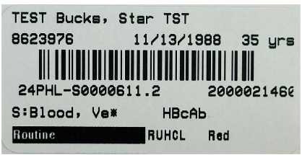
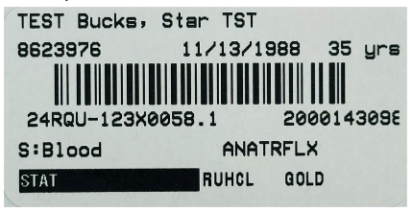
Beaker Label
RUHS
Public Health
Quest

Slide 4
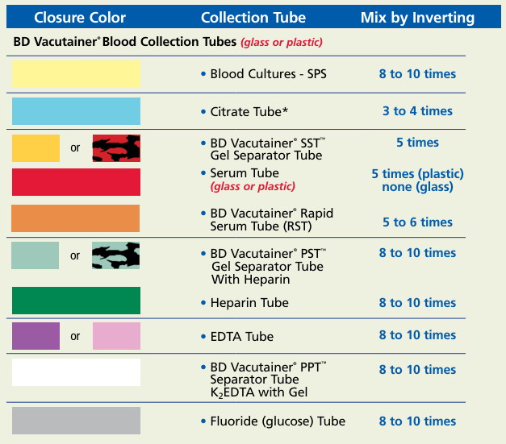
Tubes Order of Draw

Slide 5
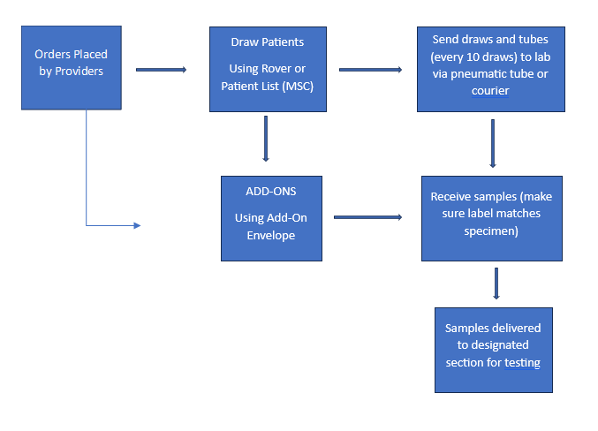
GENERAL WORKFLOW

Slide 6
Color Guide for Tubes Pt. 1
PANELS
Electrolyte = Na, K, Cl & CO₂
Basic Metabolic Panel (BASIC) = Na, K, Cl, CO2, Glu, BUN, Creat, Ca
Comprehensive Metabolic Panel (CMP) = Na, K, Cl, CO2, Glu, BUN, Creat, Ca, TP, Alb, Alk Phos, AST, ALT, TBil
Hepatic Function Panel (HEPFUN) = TP, Alb, TBil, DBil, Alk Phos, ALT, AST
Renal Panel (RENAL) = Na, K, Cl, CO2, Glu, BUN, Creat, Ca, Alb
Comp Panel, Infant = Na, K, Cl, CO2, Glu, BUN, Creat, Ca, TP, Alb, Alk Phos, AST, ALT, NeoBili - includes DBil
Hep Panel, Infant = TP, Alb, NeoBili, Alk Phos, ALT,AST
Neonatal Bilirubin = Total Bilirubin, Direct Bilirubin, Indirect Bilirubin-Calculated
Hepatitis Acute Panel = Hepatitis A, Hepatitis B Surface Ag, Hepatitis B Core IgM, Hepatitis C
Lipid Panel = Cholesterol, HDL, LDL, Triglycerides, VLDL (Calculated)
CHEMISTRY
Amylase (AMY)
Lipase
CK-Total (CKT)
CK-MB (CKMB)
High Sensitivity Troponin I (TROPHS)
Random Glucose (GLURND)
Fasting Glucose (GLUFST)
2 Hr PP Glucose (GLU2PP)
1 Hr Glucose Challenge (GLUCHL)
CO2
Chloride
Sodium (Na)
Potassium (K)
BUN
Creatinine
Bilirubin, Total
Bilirubin, Direct
Bilirubin, Total (Cord Blood)
Bilirubin, Neonate
Alk Phos
AST (SGOT)
ALT (SGPT)
GGT
LDH
Calcium
Phosphorus
Magnesium
Uric Acid
Total Protein (TP)
Albumin
Alcohol, Ethyl (ETOH)
Ferritin
Vitamin D
Cortisol
Tacrolimus
TIBC (Include % Saturation)
Ammonia (on Ice)
Osmolality, Serum
Beta Hydroxybutyrate
Lactic Acid (on Ice)
Cholesterol, Total
Triglycerides
HDL Cholesterol
LDL Cholesterol
HCG QUANT
HCG QUAL (Serum)
CRP
Prealbumin
C3
C4
Vitamin B12
Folate
TSH
T4, Total
T4, Free
PSA, Total
Acetaminophen
Carbamazepine
Digoxin
Valproic Acid (Depekene)
Gentamicin, Peak
Gentamicin, Random
Gentamicin, Trough
Lithium
Phenobartital
Phenytoin (Dilantin)
Salicylate
Tobramycin, Peak
Tobramycin, Random
Tobramycin. Trough
Vancomycin, Peak
Vancomycin, Random
Vancomycin, Trough
MonoSpot
Rheumatoid Factor (RF)
RPR
Hemoglobin A1c
Procalcitonin (PCT)
Hepatitis A
Hepatitis C
Hepatitis B, Surface Ag
Hepatitis B, Surface Ab
Hepatitis B Core, IgM
CHIV
Syphilis, Total (>=18 Years)
CEA
CA19-9
CA-125
AFP
3 Hr Glucose Tolerance
5 Hr Glucose Tolerance

Slide 7
Color Guide for Tubes Pt. 2
HEMATOLOGY
CBC
Hemogram
H & H
Platelet Count
Reticulocyte Count
Sedimentation Rate (ESR)
Malaria Smear
Kleihauer-Betke
Blood Smear Path Review
Citrated Platelet Count
COAGULATION
PT, Protime and INR
PTT
Fibrinogen
D-Dimer, Quant
Mixing Study – PT and/or PTT
LYSIS TEG
PLATELET MAPPING TEG
URINALYSIS
UA Screen
Myoglobulin Screen
Specific Gravity only, Urine
Specific Gravity only, Body Fluid
Eosinophils, Microscopy (Urine)
pH only, Body Fluid (if Stool is sent then the criteria is as follows: Stool must not be formed; loose/liquid only)
URINE CHEM
Drug Screen Panel, EIA (UDS) = Amph, Barb, Benzo, Coc, Opi, PCP, THC, FENT
HCG QUAL (Urine)
Osmolality, Urine
Total Protein (Urine) - Random
Urine Sodium - Random
Urine Potassium - Random
Urine Chloride - Random
Total Protein (Urine) - 24 Hours
Urine Sodium - 24 Hours
Urine Potassium - 24 Hours
Urine Chloride - 24 Hours
Blood Bank
Type and Screen
Type and Cross
DAT Mono
DAT Poly
Rhogam Screen
Cord Blood

Slide 13
Hepatitis A​
Hepatitis C​
Hepatitis B, Surface Ag​
Hepatitis B, Surface Ab​
Hepatitis B Core, IgM​
CHIV​
Syphilis, Total (>=18 Years)​
Lithium
Salicylate

Slide 16
REMEMBER!!!
1) Make sure your patient specimen has a barcode printed or/and must be attached to the tube itself.
2.) For some patients with Ammonia test (Chemistry) please double check for additional Chemistry test ordered for patients. Usually, CMP and Basic are also ordered for the same patient. Use CSN to check on patient’s orders so that nothing is missed. Then print CMP, Basic or other Chemistry test label and put "SHARE with Ammonia. So that testing techs are aware of it.

Slide 18
Add-On Orders
Click the Add-ons Envelope
2. Review specimens in the pool and choose to Add to Suggested Specimen if it is viable for the requested test.
3. Select Sent for New Collection if it not viable for add-on.

Slide 19
Add-On Orders
If a specimen has been collected and received. Print the Label, highlight the Add-on Test, and document the storage location. Place in the Add-on box for the department.
If specimen has been collected and received but no storage location. Print the Label, highlight the Add-on Test and hand to CLS.
If a specimen has been collected but not received. Do not process until the specimen has been received into the Lab.
Make sure all Labs are accounted for and then distribute to the department.

Slide 20
Unit Priority
TRAUMA DEPARTMENT WILL ALWAYS TAKE PRIORITY OVERALL
ER > OR > L&D > ICU (Adults, Peds, NeoNatal) > 2500 > Med Surg Units > Outpatient Labs
SAMPLE PRIORITY
CSF > Blood > Body Fluids > Urine

Slide 21
CSF Receiving Protocol
CSF Samples are considered STAT Always
TUBE #1: CHEMISTRY – Total Protein, Glucose, and Lactate (Optional)
TUBE #2: MICROBIOLOGY – CSF Culture, Meningitis Panel (MEBIO)
TUBE #3: HEMATOLOGY – CSF Cell Count
TUBE #4: CYTOLOGY
**PM/GRAVEYARD: FOR TUBE #2 MICROBIOLOGY SEND TO HEMATOLOGY CLS STAT if NO MICRO CLS on PM Shift**
**IF ONLY 1 SPECIMEN SEND TO MICROBIOLOGY FIRST!**

Slide 22
OCCULT BLOOD STOOL & GASTRIC
STAT!
OCCULT BLOOD STOOL – OCBLSTL
OCCULT BLOOD GASTRIC - OCBLGAST
**PM/GRAVEYARD – PLEASE SEND TO HEMATOLOGY CLS STAT if NO MICRO CLS **

Slide 23
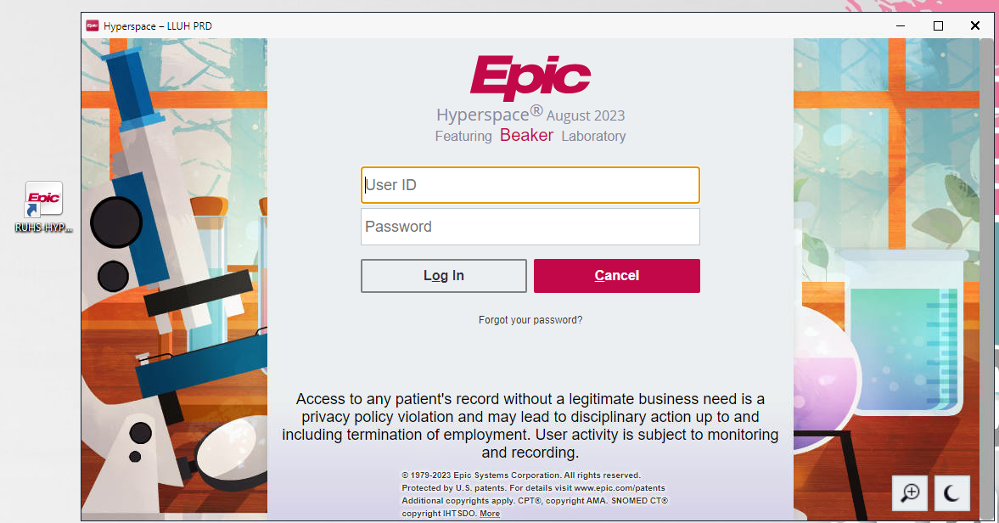
EPIC BEAKER

Slide 24
RECEIVING SPECIMENS
Record that a specimen has arrived at the lab
Open the Receiving Activity.
Scan the label for each specimen you are receiving into the Lab.
The collection information entered by other staff appears, and the specimen is automatically marked as received.
The tests for the specimens you received now appear on the Outstanding List.

Slide 25
RECEIVING SPECIMENS
Update collection information from Receiving
Scan the specimen and review the collection details.
Enter the missing information.
You can use the speed buttons on the right where appropriate.
Click

Slide 26
RECEIVING SPECIMENS
See expected and recently received specimens
In the Receiving activity, select the view you want to open:
The Recent view shows all specimens received in the last hour.
The Expected view shows all collected specimens that are accessioned into your lab.

Slide 27
RECEIVING SPECIMENS
Cancel or redraw a specimen
In the Receiving activity, find and select the specimen that needs to be cancelled or redrawn.
Click to see the actions you can take on this specimen.
Click Cancel or Redraw as appropriate.
Cancel a test if it is no longer needed or was entered in error. For example, this may be the case if the wrong order was released. Always make a comment with who was notifed for cancelled tests
Redraw a specimen if the original is unusable. For example, if specimen was contaminated or spilled in transit.
In the window that appears, select a reason and click Yes.

Slide 28
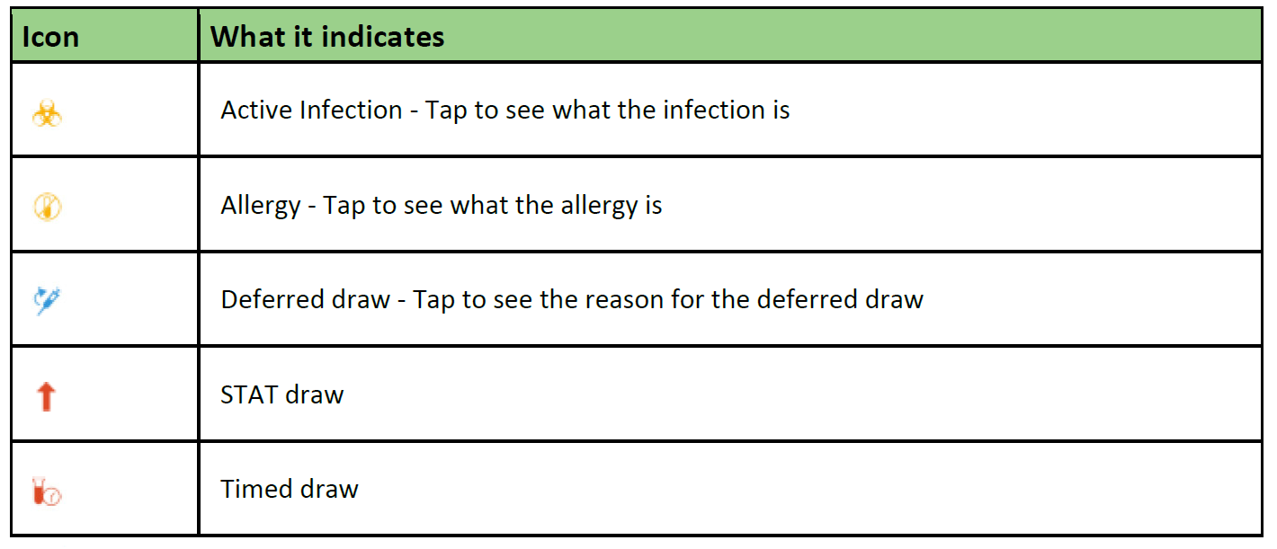
Collect a Specimen Using Rover
What do the icons mean?

Slide 29
Collect a Specimen Using Rover
Print labels and collect a specimen
When you go the patient’s room to collect the specimens, scan the patient’s armband to open the chart.
To view the orders that need to be collected for the selected patient, tap the Collection Sequence header.
Scan the patient label to print labels and achieve positive patient identification.
If needed, you can:
Tap Skip to skip collecting an order at this time.
Tap Show Printed to see the list of orders for which you’ve already printed labels. You can reprint labels from this screen and choose a printer.
Collect the specimens in the order shown by scanning each container’s barcode.
Review the information that appears in the Collection screen. If you need to make updates, tap the specimen you want to update, make your changes, and tap Accept to save your work.

Slide 30
Collect a Specimen Using Rover
Redraw a specimen
In Order Inquiry, tap the order for the specimen you need to redraw
Tap Redraw
Select a reason and tap Accept
Add orders on to a specimen
In Order Inquiry, tap the order to which you are adding a specimen.
Tap Add-On
Tap Continue
Reprint a label
In Order Inquiry, tap the orders you want to reprint labels for.
Select Reprint Labels
In the Print screen, select the number of copies and the printer
Tap Print
Defer a draw
In Order Inquiry, tap the orders you want to defer
Select Defer Draw
On the menu that appears, tap the reason for deferring the draw.

Slide 31
Collect an Outpatient Specimen
Identify which specimens to collect for a patient
Select the tab to open the Schedule.
Find and select the patient and double-click the patient’s name.
Review the Lab Status column to verify which orders need to be collected.
Collect a Specimen
In Order Inquiry, select an order.
Click Collect Specimens.
Review the specimen information and answer any collection questions.
Click Print Labels
Collect the specimens.
Scan each specimen’s barcode to add collection information automatically.
Receive the specimens or close the activity and click Accept to save your work.

Slide 32
Collect an Outpatient Specimen
Document a redraw
To redraw a received specimen, open the Receiving activity and select the specimen.
Click and select Redraw.
In the window that appears, enter a reason for the redraw.
Click Yes.
Collect the redraw specimen.
Reprint specimen labels
In the Collection activity, click Reprint Labels.
If you’ve left the Collection activity, open the specimen in Specimen Inquiry and click Labels.
Select the printer you want to use.
Click Print Labels

Slide 33
Send Out Specimens
Verify Quest Packing Lists
When packing tests for Quest, it is important to verify that the correct label has been scanned and the test code is listed for EVERY test on the packing list.
Quest will reject any specimen without a test code.
If a test code is missing, you must find the Quest test code and write it with the appropriate test. Quest does not accept anything except the test code.

Slide 34
Send Out Specimens
Create a packing list
Open the Packlist List Editor and click Create New.
Select an appropriate Packing List Type.
The Packing List ID is created automatically.
Click Create New
Scan the specimen barcodes to add specimens to the packing list.
In the Details report, select the test(s) to ship for the specimen.
Select the destination of your packing list if appropriate one does not default into the destination field.
Add missing specimens to a packing list
To find any specimens that need to be added to a certain packing list, click Sendout Bench and confirm that your list is selected.
Select the test(s) that need to be added and click Add Tests to Packing List.
Confirm that all containers you selected are listing on the packing list and are no longer included on the list of specimens to send out.

Slide 35
Send Out Specimens
Send a packing list to another lab
To indicate that your packing list is ready for pickup, click Ready. With this step, a few things happen:
The packing list is locked in the system, no more containers can be added.
The packing list’s status changes to Ready.
The packing list prints.
When the package is picked up, click Picked Up. the packing list is closed and can no longer be unlocked for editing.

Slide 36
Send Out Specimens
Sendout Bench – Pending List
Review the Sendout Bench to ensure all specimens are on a packing list.
Locate specimens that are on the Sendout Bench that are not on a packing list.
Specimens may need to be redrawn if left on the Sendout Bench

Slide 37
THANK YOU!

