Slide 1
Laboratory Preceptor Training Course

Slide 2
What is a preceptor?
An expert or specialist who gives practical experience and training to a preceptee
What does a preceptor do?
Preceptors facilitate orientation, growth, and development of students that will one day work side by side with them and who will eventually become their peers, colleagues, and leaders.

Slide 3
Roles of a Preceptor
Educator
Socializer
Evaluator
Facilitating the learning experience
Modelling desired skills and behaviors
Guiding preceptee in mastery of clinical skills
Orientation of facility, department, and workflow
Introduction to team members
Provide opportunities to assess competency
Continuously assess progress
Competency verification

Slide 4
Expectations of a Preceptor

Slide 5
Appearance and Attire
Set the example for how your students should present themselves by adhering to professional appearance guidelines of Baptist Health.
Professional Appearance
Uniform
scrubs
closed-toed shoes
no t-shirts unless Baptist approved
lab coat when in lab or patient areas
Baptist ID Badge
must be worn at all times
above the waist, preferably shoulder/lapel area
displayed with employee name visible at all times

Slide 6
Appearance and Attire
Nails
lab employees that provide direct patient care are not allowed artificial, tips, gel, or overlays on their nails.
nails must be no longer than ½ inch in length from base
Hair
extreme hair coloring and styles must be avoided
Tattoos
must be covered
exception: small, inoffensive, and discrete tattoos

Slide 7
Student Expectations of Preceptor
welcoming
encouraging
advocate
role model
provide learning opportunities
give constructive feedback

Slide 8
Teaching Adult Learners

Slide 9
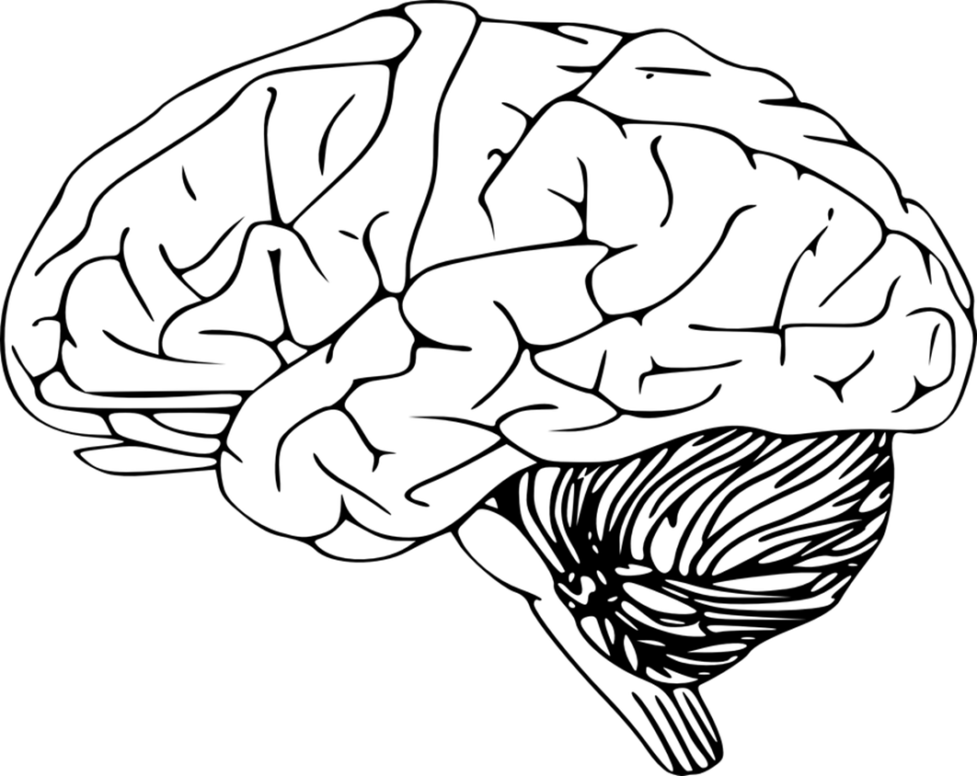
Domains of Learning
Cognitive
Affective
Psychomotor
Knowledge and Intellectual skill
Teaching strategies
Lectures
Exams
Case Studies
Emotional based behaviors
Teaching strategies
Discussions
Storytelling
Physical skills and abilities
Teaching strategies
Return demonstration
Skill performance testing

Slide 10
As a preceptor, you are responsible for facilitating the learning process
Determining and adapting to the learning style of your preceptee is vitally important to their success.
You will need to use teaching strategies that engage each preceptee to maximize retention of learning.

Slide 11
There are 4 major adult learning styles. Click on each style to learn more.
Visual
Auditory
Intellectual
Learn by seeing, observing, and picturing things or events
Kinesthetic
Learn by talking, hearing, and reading out loud
Learn by critical thinking, problem-solving, and reflecting
Learn by actively doing or moving

Slide 12
Preceptor Strategies for Learning Types
Visual
Auditory
Illustrate processes with pictures or drawings
Provide charts or diagrams
Use visual words (describe what things looks like)
Use peripheral learning objects such as bulletin boards or posters
Tell stories with embedded information (case studies, reflective discussion)
Have preceptee perform a skill while saying the steps aloud
Let preceptee describe to you what they have learned
Make eye contact, slow your speech, and resist urge to interrupt

Slide 13
Preceptor Strategies for Learning Types
Kinesthetic
Intellectual
Provide hands-on activities
Prevent sitting for long periods of time
Take frequent breaks and leave lights on during sedentary classroom-based learning
Limit distractions
Allowing preceptee to multitask
Allow time for information processing
Incorporate problem solving
Analyze experiences
Create personal meaning
Formulate questions about processes
Learner may need to receive the information, reflect on it, pull it apart, and restructure it before they can accept this learning for application

Slide 14
Let’s take a look at techniques each style learner may use to learn a new policy.
A visual learner may need to read the policy.
An auditory learner may need to have the policy read aloud and discussed.
A kinesthetic learner may have to implement the policy.
An intellectual learner may need time to reflect on the policy before being able to implement it.

Slide 15
When teaching a new skill, use the Tell-Show-Do approach to appeal to all types of learners.
Tell
Tell the preceptee what all is involved and expected.
Show
Show the preceptee how to perform the task step-by-step.
Do
Have the preceptee do the task with supervision to ensure successful performance.

Slide 16
Time Management

Slide 17
Barriers to Time Management
Workload and productivity expectations
Competing priorities
Increased number of learners
Lack of experience
Time!

Slide 18
Time management can be improved by
Prioritization
Delegation
Assignment
Deciding the relative importance or urgency of a thing or things
Entrusting a task or responsibility to another person
Designation of a task to a person

Slide 19
Time Management Considerations
Prioritization | What activities must be done versus “nice to be done”? What activities need to be completed first (stat, timed study, routine)? What activities do learners need to develop early in the rotation?
Delegation | What activities can learners do independently? With supervision? How can delegating activities increase amount of student learning or productivity? Is adequate staff present to allow a workload suitable for student learning?
Assignment | What tasks do the learner need to complete each day? Each week? Before the end of the rotation? Who will be responsible for teaching the task? How and when will the learner be evaluated? By whom?

Slide 20
Establishing a plan early on and accounting for barriers you may encounter will help maximize effective learning time spent with your preceptee.

Slide 21
Conflict Recognition and Resolution

Slide 22
Sources of conflict
When differences are encountered between preceptor and preceptee, a conflict may arise.
Diversity
Common Sources of Conflict
Role/Relationship Confusion
Communication/ Misinformation
Environment

Slide 23
Types of Diversity
Internal
External
Organizational
World View
Interests
Education
Appearance
Citizenship
Geographic Location
Family Status
Spiritual / Religion
Relationship Status
Socioeconomic Status
Experiences
Job function
Place of work
Management status
Employment status
Pay type
Seniority
Union affiliation
Political beliefs
Moral compass
Outlook on life
Race
Age
Sexual Orientation
Gender Identity
Physical Ability
Mental Ability

Slide 24
Advantages of Diversity
varied perspectives
faster problem-solving
better decision making
creativity
innovation
insight

Slide 25
How to prevent
diversity-based conflicts
create an inclusive culture
have standardized procedures
avoid making assumptions
be open-minded
be respectful of differing opinions
embrace and learn from differences

Slide 26
Communication and Misinformation
Lack of communication between preceptor and preceptee and unclear expectations
lead to unintended conflict.
Communication and Misinformation conflicts stem from:
Information not being communicated
Unclear communication of instructions
Misinterpretation of instructions or situation
How to prevent these types of conflicts:
Fully inform preceptee of your expectations
Use clear, easy to understand instructions
Encourage preceptee to ask questions
Check for understanding

Slide 27
Role/ Relationship Confusion
?
This type of conflict is often a result of unclear roles.
Role/relationship confusion can be avoided by:
Defining clear expectations of learning objectives, student behaviors, roles, scope of practice, and responsibilities
Ensuring understanding of preceptor’s role regarding meetings, feedback, evaluation, communication, and performance

Slide 28
Environment
Conflict can occur because of the learning and working environment created for your preceptee.
Enviornmental stressors
Busy and stressful work environment
Lack of resources
Negative attitude of team members
Unwillingness to help
Create an environment of learning by:
Encouraging student to ask questions
Being patient and taking time to explain processes
Clearly communicating
Maintaining a positive attitude

Slide 29
Select each conflict to reveal the underlying issue.
Taylor is struggling with blood bank concepts more than her peers because a blood bank course was not offered at her school prior to her clinical rotation.
Environment
Diversity
Beth went to stick the patient on her own. When she came out of the room, her preceptor was upset she stuck the patient without him there.
Communication/ Misinformation
Scott overheard his preceptor talking to a coworker about how she dislikes teaching the students.
Role/ Relationship Confusion
Perry was told by the supervisor to clean the stock room before going to bench. His preceptor was not informed of this and scolded him for being late to bench.

Slide 30
Confronting an issue with a student can be challenging… try B.E.E.R!
The B.E.E.R method is a four step model for criticizing and correcting behavior and performance problems.
This method is based on a process that involves asking yourself about your preceptee’s behavior.
The B.E.E.R method is used as a guide to giving constructive feedback when problems arise.

Slide 31
When a problem arises, use the B.E.E.R model!
Behavior
Effect
Results
B
E
E
R
Expectation
What is the student doing that is unacceptable?
What effect does the behavior have on you, the student, and others?
What changes do you expect the student to make?
What will happen if the student’s behavior changes or continues?

Slide 32
Let’s look at a scenario and determine how to use the B.E.E.R. method to resolve the issue.
A student is half way through their clinical training and appears to be disengaged and uninterested in learning. The student is not completing assigned work, and you decide to address the behavior with the student.

Slide 33
Use the B.E.E.R method to reflect on the behavior of the student and formulate a response.
Behavior
Effect
B
Describe the behavior from your perspective. Use “I” instead of “you”. Avoid using “we” when describing observations of a behavior to prevent the student from feeling “ganged up” on .
“I noticed that assignments are not being completed, and I feel
there is a lack of interest in what I am teaching.”
E
Describe the effect the behavior is having on you. Address the
behavior, not the person.
“I feel frustrated that assignments are not being turned in on time,
and I am unsure about your interest in this career.”

Slide 34
Results
E
Discuss what behavior you would like to see instead.
“Assignments need to be completed on time to make sure you are
understanding the material appropriately. You can engage in learning by
asking questions and showing your preceptor you understand what is being
taught.”
Expectation
R
Describe the results that will occur if behavior is or is not corrected.
“When interest is expressed in what an instructor is teaching, they are likely to
share more information, giving you more learning opportunities. If work is
completed on time, I can address areas that you may be struggling with and get
you back on track. If you do not turn your work in on time, you could fall behind
and miss out on valuable information.”

Slide 35
Utilizing the B.E.E.R method in this scenario has presented a behavior that needs to be corrected and the effect it is having on the student and preceptor. You have clearly defined expectations and outcomes if expectations are not met.

Slide 36
Considerations when Managing Conflict
Be kind, patient, and professional
Be aware of your attitude and behavior
View the situation from the other individual’s perspective
Be mindful of the other individual’s feelings and behavior
Do not interrupt
Avoid becoming defensive
Ask questions to ensure your understanding and clarify misunderstandings
Apologize if you have hurt or disrespected the other individual
Work collaboratively to find a solution

Slide 37
Moving Past Conflict
When a relationship has been established where the student knows all corrections are made with the goal of ensuring their success, moving past conflict will be easier.
Moving past conflict may take longer for others. Allow time for the student to let go and move beyond the conflict in their own time.
Conflicts are not usually one-sided. Taking ownership of your responsibility in the conflict and admitting when you are wrong allows for faster and complete conflict resolution.
Continuously bringing up the conflict once resolved prevents the student from moving on. Remember, you are a role model and moving on helps the student to move past the conflict as well.

Slide 38
Workplace Violence
Baptist Health does not and will not tolerate any acts or threats of violence by a team member or anyone on Baptist Health premises. It is a violation for any team member to engage in any verbal or physical conduct of a violent or threatening nature or that endangers, or gives the appearance of endangering, others or the property of others.

Slide 39
Workplace Violence Includes
1.
2.
3.
4.
Physical assaults or threats of physical assault, whether verbal or nonverbal, made in person or by other means (e.g., in writing, by phone, fax, e-mail or text message)
Verbal or nonverbal conduct that results in a reasonable apprehension of imminent violence by the person or persons to whom the conduct is directed
Use of obscene, abusive or threatening language or gestures
Possession of firearms or any other weapon on company property, in a vehicle being used on Baptist Health business or at a work-related function unless expressly permitted by applicable local, state or federal law
5.
Any other threats, conduct or acts that leadership believes represent an imminent or potential danger of violence

Slide 40
Evaluations and Competencies

Slide 41
What is a competency?
A competency is the ability to apply knowledge and skills required to successfully perform critical work functions or tasks in a defined work setting.
Why do I need to know about competencies?
Competency validation is the ultimate goal of the preceptoring process.
How do I document competencies?
Competencies are documented in the form of a checklist signed by the preceptor as tasks are successfully completed.

Slide 42
Elements of Competencies
TECHNICAL
INTERPERSONAL
CRITICAL THINKING
Ability to perform a task correctly
Communication with coworkers and patients
Problem solving and viewing events as part of a larger whole

Slide 43
Select each element to view an example
Successful performance of venipuncture blood collection
Recognized specimen integrity issue and initiated recollect process
critical thinking
technical
Properly addressed patient upon entering room
interpersonal

Slide 44
Evaluation using competencies
Competencies should be clearly defined and presented to the preceptee.
Competencies should only be marked completed when the preceptee has successfully completed the task or skill being evaluated.
Competency checklists should be reviewed daily with the preceptee to ensure tasks completed that day are signed and dated appropriately.

Slide 45
Preceptors should frequently check with the preceptee to ensure adequate understanding of skills and processes. Correcting mistakes as they are made will correct behavior and set expectations upfront rather than at the end of clinical training. If a student does not discover a problem exists until the end of their clinical training or rotation, the student is not given a fair chance to improve their skills and become entry-level ready.

Slide 46
When giving feedback:
1
2
Describe specifically what was observed- who, what, when, where, and how
Avoid generalizing and making assumptions

Slide 47
Negative feedback can be demoralizing, discouraging, and reduces motivation to learn.
Constructive feedback addresses the problem but reinforces desired performance while enhancing motivation for learning.

Slide 48
Click on each app to reveal qualities of constructive feedback
1
2
specific
factual
3
4
descriptive
easily understood

Slide 49
Feedback Scenario
Your student attempted a venipuncture and accidentally pulled out the needle prior to filling the blood tubes.
How do you respond?

Slide 50
Select each response that provides constructive feedback.
This response is negative and does not offer an opportunity for improvement.
“What are you doing?! Just let me do it.”
“What would you try differently next time to keep the needle in place?”
Correct! This response allows the student to think about how they can improve instead of pointing out their mistakes.
“You did a good job finding the vein. Next time try holding the needle steady with one hand while preparing your supplies with the other hand.”
Correct! This response provides the student with guidance on how to improve their skill.
This response is negative and does not offer an opportunity for improvement.
“Why can you not do this correctly?”
“ Let me show you what techniques I use to hold the needle steady while filling the tubes. You can try it next time to see if it works for you.”
Correct! This response allows the student to find techniques they can use to avoid making the mistake again.

Slide 51
Tips for Success

Slide 52
Take time to get know your student and their learning style
Establish goals for each day
Encourage your student to ask questions
Show confidence in your ability as a preceptor
Provide timely feedback
Be sincere in both praise and criticism
Ask how you can improve teaching style and strategies
Don’t be afraid to say “I don’t know but will find the answer.”

Slide 53
Remember how you felt at the start of your career when everything and everyone was new…
YOU are the person your preceptee will remember when they think back to the start of their career. Make it an experience they will look back on and strive to provide for any students they will teach in the future.

Slide 54
References
Alliant International University. (2020, November 29). What Are the 4 Types of Diversity? Retrieved June 28, 2022, from https://www.alliant.edu/blog/what-are-4-types-diversity
Dictionary.com. (n.d.). Definition of preceptor. Www.Dictionary.Com. Retrieved June 15, 2022, from https://www.dictionary.com/browse/preceptor
Ricee, S. (2022, January 31). Types of Diversity in the Workplace & Examples - The Definitive Guide [2022] by Diversity.Social. Diversity for Social ImpactTM. Retrieved June 28, 2022, from https://diversity.social/workplace-diversity-types/#1-four-diversity-types-dimensions-in-the-workplace
Rose, V. (2022, January 8). Diversity and Conflict Management. Pollack Peacebuilding Systems. Retrieved July 1, 2022, from https://pollackpeacebuilding.com/blog/diversity-and-conflict-management/

Slide 55
References
Swihart, D. (2014). The Effective Preceptor Handbook for Nurses: The Pocket Companion for Effective Preceptors (1st ed.). HCPro, a division of BLR.
University of Texas Health Science Center at Houston. (2012, January). Competencies and Learning Objectives. Retrieved June 17, 2022, from https://sph.uth.edu/content/uploads/2012/01/competencies-and-learning-objectives.pdf
Whitehead, J. (n.d.). Preceptor Education Program for Health Professionals and Students. Preceptor Education Program. Retrieved June 14, 2022, from https://preceptor.ca/PEP-modulespage.html

Slide 56
Thanks!

Slide 57
There are 4 major adult learning styles.
Visual
Auditory
Kinesthetic
Intellectual
Learn by seeing, observing, and picturing things or events
Learn by talking, hearing, and reading out loud
Learn by critical thinking, problem-solving, and reflecting
Learn by actively doing or moving

Slide 58
See below for examples of each type of conflict.
Taylor is struggling with blood bank concepts more than her peers because a blood bank course was not offered at her school prior to her clinical rotation.
Beth went to stick the patient on her own. When she came out of the room, her preceptor was upset she stuck the patient without him there.
Perry was told by the supervisor to clean the stock room before going to bench. His preceptor was not informed of this and scolded him for being late to bench.
Scott overheard his preceptor talking to a coworker about how she dislikes teaching the students.
Diversity
Role/ Relationship Confusion
Communication/ Misinformation
Environment

Slide 59
Below are examples of each element
Successful performance of venipuncture blood collection
Recognized specimen integrity issue and initiated recollect process
critical thinking
technical
Properly addressed patient upon entering room
interpersonal

Slide 60
specific
factual
Qualities of Constructive Feedback
3
descriptive
easily understood

Slide 61
The following responses provide constructive feedback.
“What would you try differently next time to keep the needle in place?”
This response allows the student to think about how they can improve instead of pointing out their mistakes.
“You did a good job finding the vein. Next time try holding the needle steady with one hand while preparing your supplies with the other hand.”
This response provides the student with guidance on how to improve their skill.
“ Let me show you what techniques I use to hold the needle steady while filling the tubes. You can try it next time to see if it works for you.”
This response allows the student to find techniques they can use to avoid making the mistake again.

Slide 62
The following responses provide negative feedback.
This response is dismissive and does not offer an opportunity for improvement.
“What are you doing?! Just let me do it.”
This response does not guide reflective thought on improvements that can be made.
“Why can you not do this correctly?”

