Slide 1
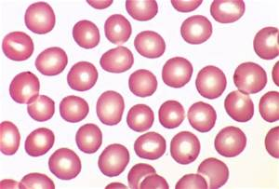
2019
Consistency of Morphology
Baptist Medical Center South

Slide 2
BLOOD CELL IDENTIFICATION
BCP 01 – BCP 30

Slide 3
BCP-01

Slide 4
BCP-02

Slide 5
BCP-03

Slide 6
BCP-04

Slide 7
BCP-05

Slide 8
BCP-06

Slide 9
BCP-07

Slide 10
BCP-08

Slide 11
BCP-09

Slide 12
BCP-10

Slide 13
BCP-11

Slide 14
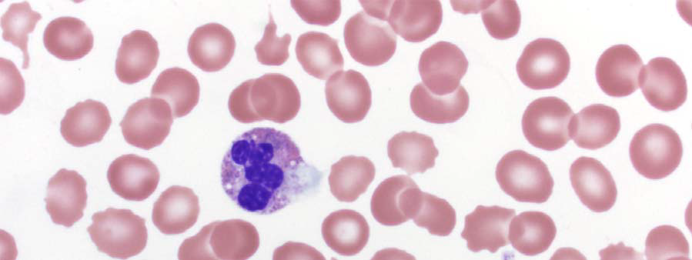
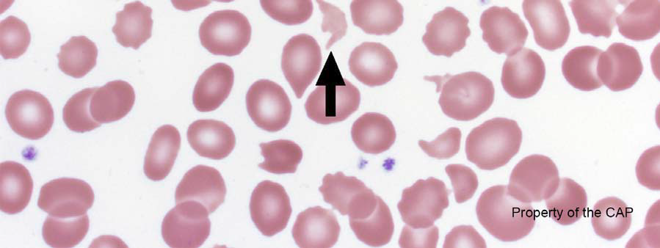
BCP-12

Slide 15
BCP-13

Slide 16
BCP-14

Slide 17
BCP-15

Slide 18
BCP-16

Slide 19
BCP-17

Slide 20
BCP-18

Slide 21
BCP-19

Slide 22
BCP-20

Slide 23
BCP-21

Slide 24
BCP-22

Slide 25
BCP-23

Slide 26
BCP-24

Slide 27
BCP-25

Slide 28
BCP-26

Slide 29
BCP-27

Slide 30
BCP-28

Slide 31
BCP-29

Slide 32
BCP-30

Slide 33
URINE SEDIMENT
IDENTIFICATION
CMP 04 – 06, 13 – 15
UPS 01 – 06

Slide 34
CMP-04

Slide 35
CMP-05

Slide 36
CMP-06

Slide 37
CMP-13

Slide 38
CMP-14

Slide 39
CMP-15

Slide 40
USP-01

Slide 41
USP-02

Slide 42
USP-03

Slide 43
USP-04

Slide 44
USP-05

Slide 45
USP-06

Slide 46
BODY FLUID CELL IDENTIFICATION
CMP 07 – 09
CMP 16 – 18

Slide 47
CMP-07

Slide 48
CMP-08

Slide 49
CMP-09

Slide 50
CMP-16

Slide 51
CMP-17

Slide 52
CMP-18

Slide 53
BLOOD PARASITE
IDENTIFICATION
BP 01 - 05

Slide 54
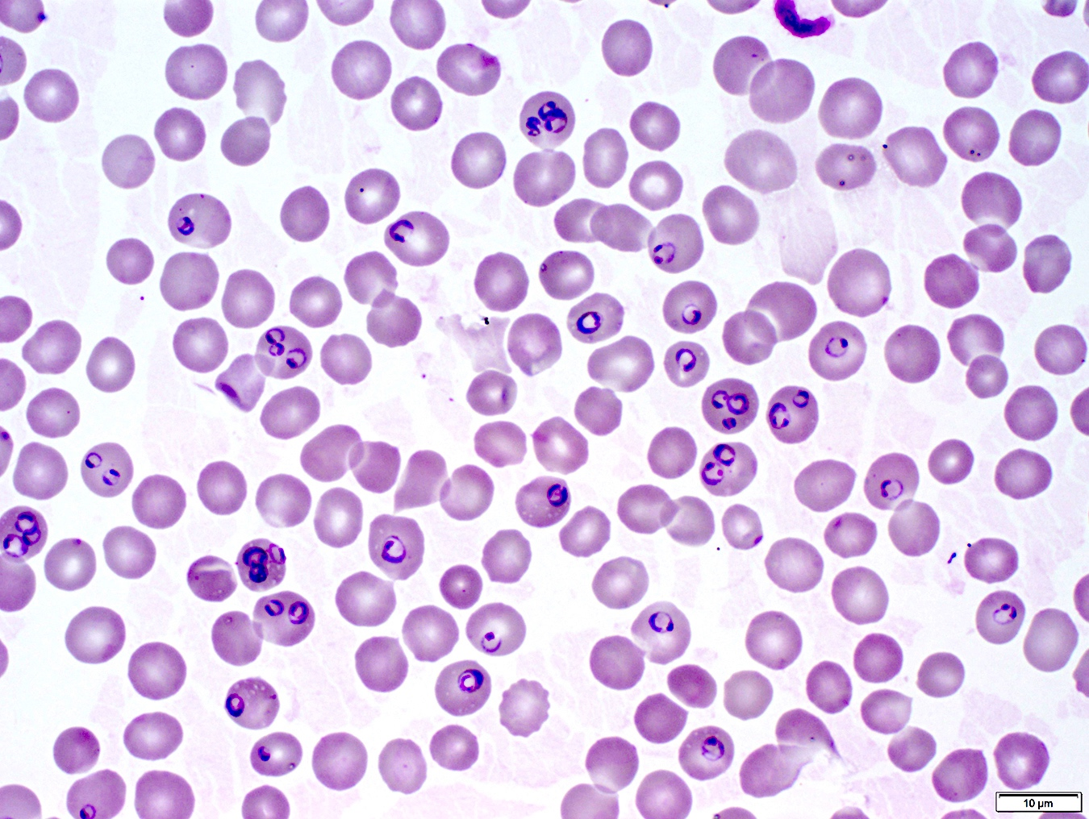
BP-01

Slide 55
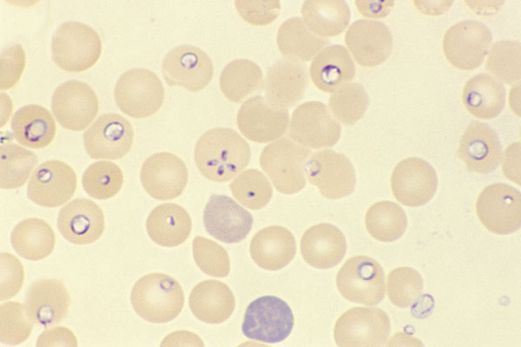
BP-02

Slide 56
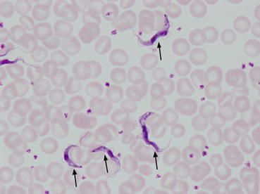
BP-03

Slide 57
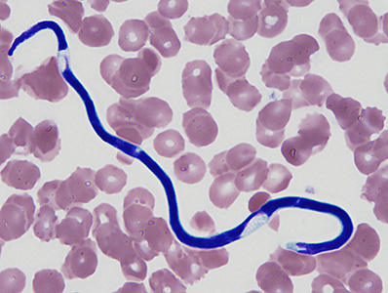
BP-04

Slide 58
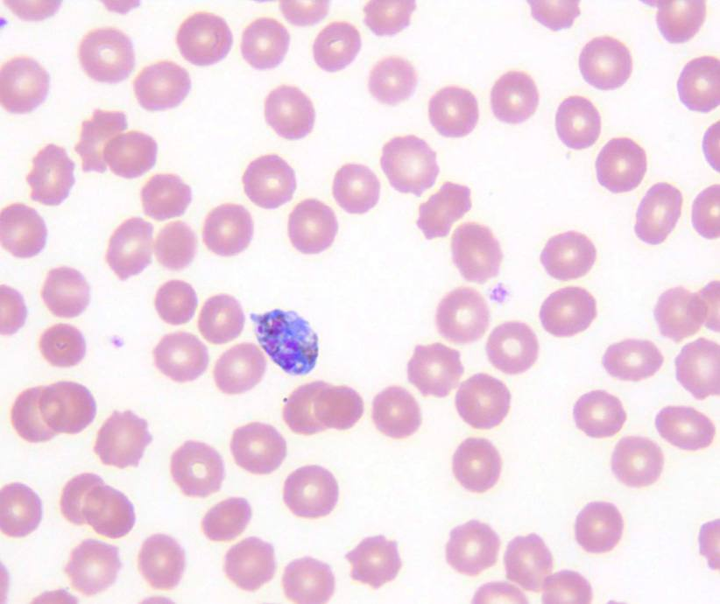
BP-05

