Slide 1
Lab Education for Nursing blood drawS

Slide 2
Beginning April 18, 2023 @ 9 am, ED nursing staff will be responsible for drawing all lab work for patients within their department
All other nursing departments will be responsible for drawing all patient lab work for patients within their department in summer of 2023

Slide 3
Label Printing
Labels from the nursing units will no longer print in the Lab.
Labels will now be printed on the nursing units by the nurses.
The nursing worklist will now show Stat and Timed lab draws and they will be responsible for collection.

Slide 4
LABORATORY PHLEBOTOMIST DESKTOP
The Laboratory will regularly check the Phlebotomist Desktop to identify specimens that did not get collected or received.
At a minimum, this must be checked halfway through your shift and at the end of your shift.
This should be checked by techs, TLAs, and phlebotomists.

Slide 5
To Get to the Phlebotomist Desktop:

Slide 6
Next Click OK

Slide 7
Now the report can be filtered for more detailed information
0700 = Morning Draws that Need Collected by Lab
CBN = All Specimens that Need to be Collected by Nursing
Outpatient = Outpatient Draws that Need Collected
Timed = Timed Draws that Need Collected by Lab
There may occasionally be a Timed draw that Lab needs to collect in the CBN batch.
These 4 batches should be reviewed between now and June.
In June, the 0700 and Timed batches will cease in when all nursing units take over responsibility for draws.

Slide 8
Choose the Categories you want to look at by check marking the box and clicking Work List

Slide 9
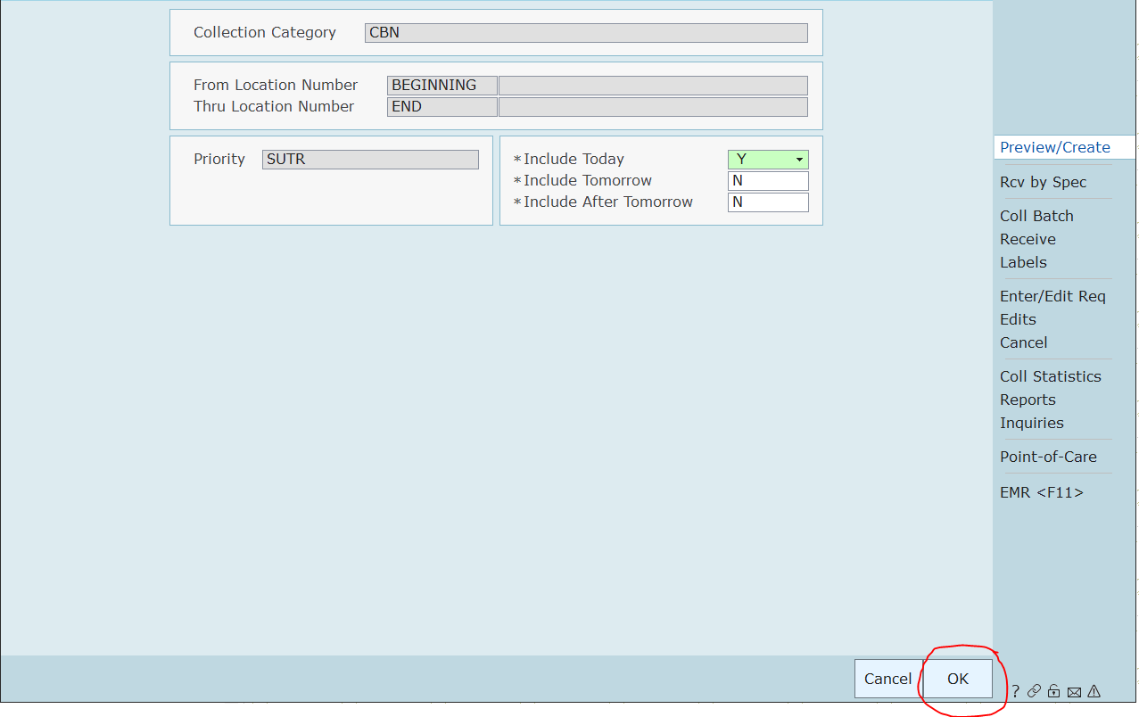
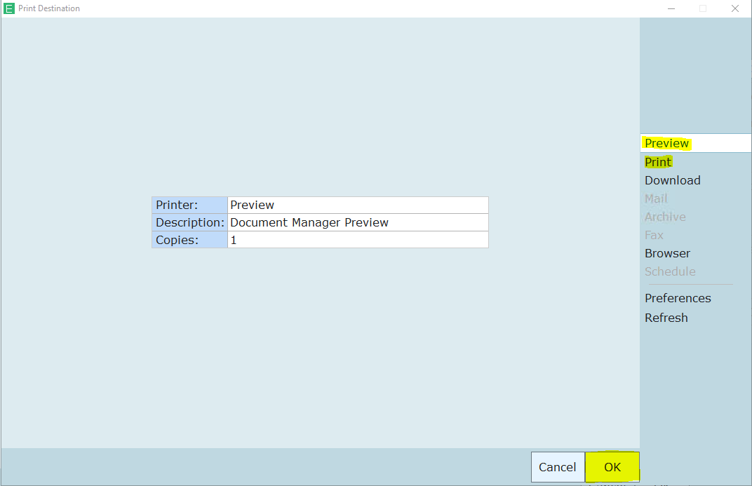
Click OK on the next screen
Then choose if you want to Preview or Print and click OK

Slide 10
Review the report for any draws that may have been missed

Slide 11
Call the nursing unit if you find draws that are overdue

Slide 12
SPECIMEN TRACKING DESKTOP
The Specimen Tracking Desktop is another tool that can be used. This will be most useful for 2nd and 3rd shift.
All techs should already be using this desktop.
Instructions on the next slide demonstrate how to change the report to see specimens that are ORDERED and received.

Slide 13
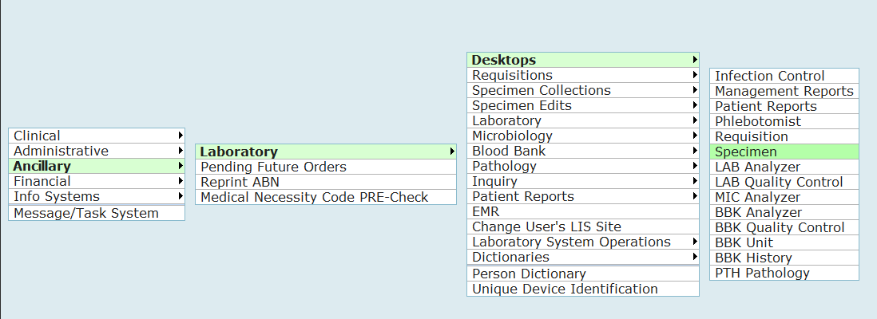
To get to the Specimen Tracking Desktop:

Slide 14
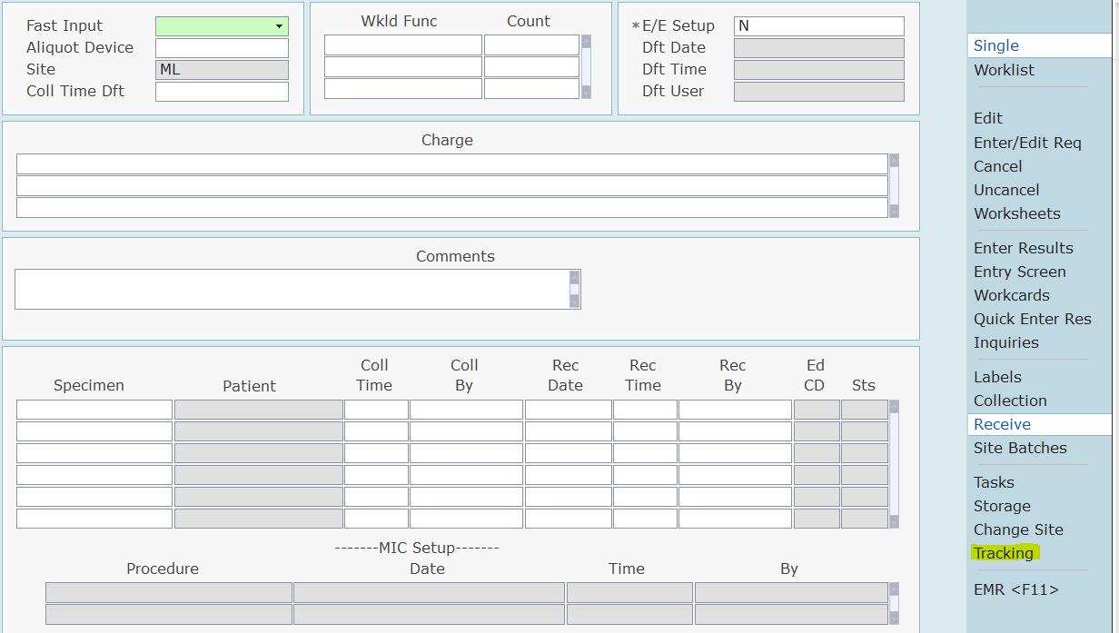
Next Choose Tracking:

Slide 15
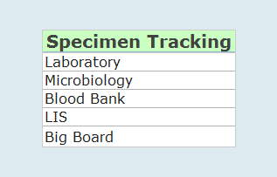
Choose the Department

Slide 16
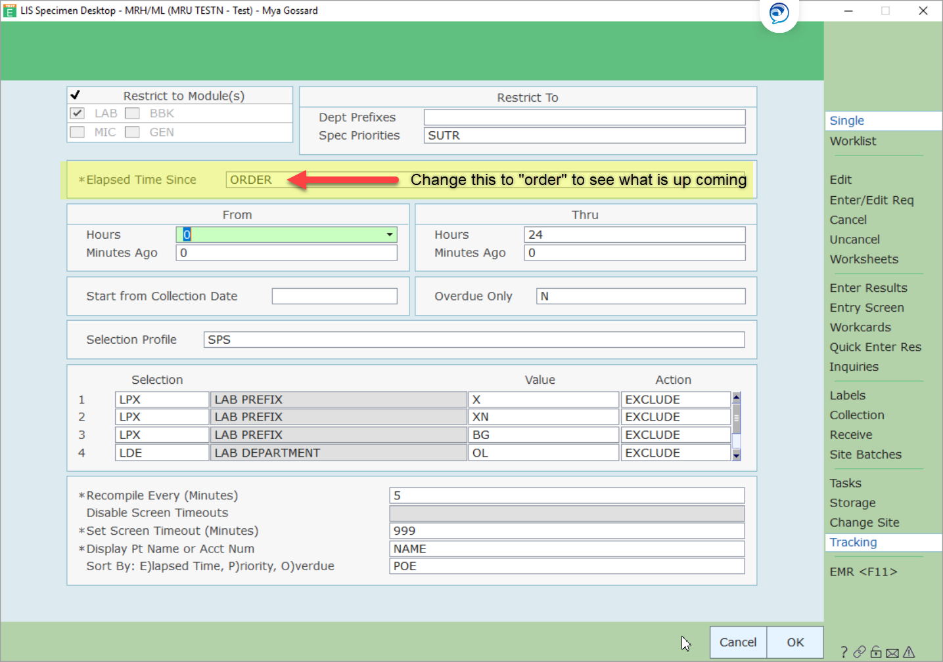
Change the Elapsed Time to Order:

Slide 17
Red = Stat Yellow = Urgent Green = Timed Black = Routine

Slide 18
Blood banding
For Type & Screen and administration of blood products

Slide 19
Blood Banding
Blood banding is to be done by the nursing shift director, department director, or manager
Nursing staff needs to notify the director or manager when a patient needs blood banding completed
Lab will assist, if needed from 7 am – 3 pm, Monday - Friday

Slide 20
Blood Banding Labels
The person banding the patient with the blood bank band will contact the Lab and request a wristband label.
The Lab will print this label to the Lab label printer on the nursing unit
The label will be affixed to the blood bank band by nursing prior to putting the band on the patient

Slide 21
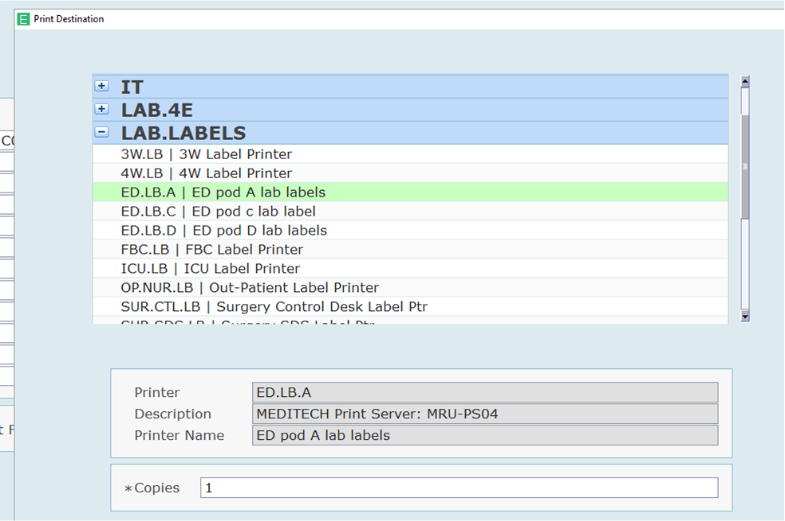
A Lab Label Printer Group has been defined to make it easier for Lab to choose the correct printer

Slide 22
When a Second Type is Needed
If a patient does not have a historical blood type on file, a second type is required before the patient can receive blood products
If a second type is needed, the laboratory will notify the nursing unit after the first specimen is received
Lab will print a “Second Type” label to the appropriate Nursing Lab Label Printer
Nursing will collect the specimen, label appropriately, and send the specimen to the Lab

Slide 23
IDENTIFYING CONTAMINATED SPECIMENS

Slide 24
Delta Check Failures
Pay attention to delta check failures. If a delta check failure occurs, attempt to identify the reason for the failure. Acceptable reasons for failure include:
Recent transfusions
Surgery
Drug therapy
Dialysis
Kidney failure
Post-Partum
Significant time lapse between samples

Slide 25
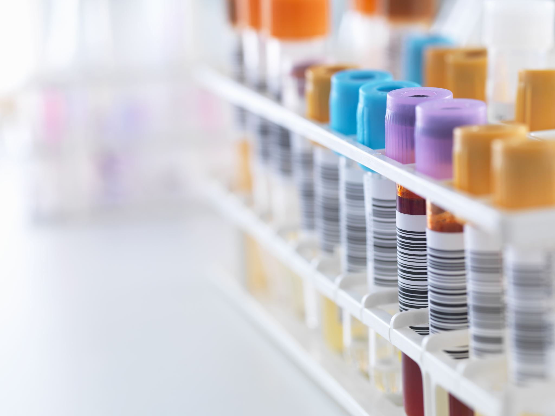
Possible Contamination
The following parameters may be helpful in identifying a contaminated specimen:
Na <130 and Cl <100 and K >5.5
Glucose >800 and Creatinine <0.6
Na >180 and K <2.5
Normal saline causes increased chloride and decreased calcium and potassium
Lactated ringers cause a decrease in calcium, glucose, and CO₂
Dextrose causes increase in glucose
EDTA contamination can cause an increased K, and decreased calcium, magnesium, zinc, and iron.

Slide 26
Clotted Specimens
CBC tubes should be inverted and visually inspected for a clot.
Sometimes a small clot that is not visible can be present.
Platelet clumping and extremely low platelet counts can indicate a possible clot.

Slide 27
Handling of Possibly Contaminated Specimens
If you identify a possible issue, let other departments know so all specimens from a draw can be evaluated.
All technologists have the responsibility to NOT release results if they have concerns about the accuracy of those results.
It is always acceptable to request a redraw if you are suspicious that results are inaccurate.

Slide 28
Helpful Policies for Review:
Delta Check
Detection and Correction of Errors
General Policies for Laboratory Testing
Notification of Critical Values
Specimen Acceptance or Rejection

Slide 29
REDRAWS

Slide 30
If a specimen issue is identified and a redraw is needed
Call and Notify
Lab will call and notify the nursing unit where the patient is located.
Communicate
Lab will communicate the specimens that need redrawn and why.
Print
Lab will print a label for the needed specimens to the appropriate Nursing Lab Label Printer.
Collect
Nursing will collect the specimen, label it, and deliver it to the Lab.
Edit
Lab will edit the collected and received information. A comment will be added that the specimen was redrawn. IT is working on canned comments for this.

