Slide 1
PROFICIENCY TESTING
Important tips for success

Slide 2
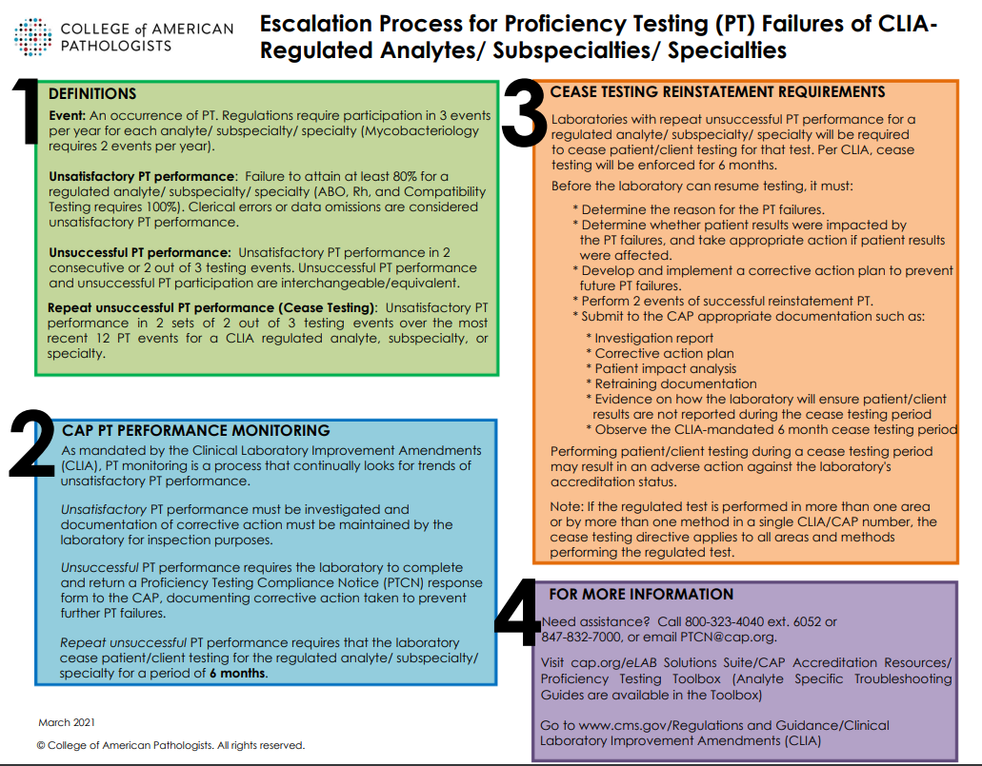
Laboratory proficiency testing (PT) is an external quality and accuracy assessment process that tests unknown specimens from an outside source to ensure accurate lab testing results.
There can be serious consequences for failing PT.

Slide 3
MRH PT failures by year
YEAR | NUMBER OF PT FAILURES
2023 | 6
2022 | 1
2021 | 3
2020 | 5
2019 | 4
2023 pt failures were the highest they have been in the last 5 years

Slide 4
Reasons for failure In 2023
Reported test results in wrong units
Specimen handling (reconstitution/mixing) issue
Specimen identification error
Calibration issues
Instrument issues
qc trends not addressed
multiple instrument errors without resolution

Slide 5
For successful proficiency testing all phases of testing must be addressed
Pre-analytical
analytical
Post-analytical

Slide 6
Pre-analytical
Upon Receipt of pt materials:
Date samples
Record on the “Cap proficiency testing tracking log”
Pay close attention to special instructions (such as test immediately upon receipt)
Review storage instructions and store appropriately
Notify the coordinator of the department that pt samples arrived
Broken or missing samples should be immediately reported to the coordinator, lab supervisor, or lab operations director

Slide 7
analytical
Prepare specimens according to instructions. This includes the following:
Proper reconstitution
Mixing per directions
Testing samples at the appropriate temperature (room temp, etc.)
Identify specimens appropriately
Only work with one pt sample at a time
When aliquoting, ensure the mrh specimen label matches the pt sample identification

Slide 8
Post-analytical
Ensure results are reported on the correct PT sample in Meditech
Coordinators will enter results on the CAP website:
Verify test method codes
Document required exception codes (i.e. > or < results when reportable ranges are exceeded)
Verify reporting units and decimal positions
Save entries and print for a secondary review
During secondary review:
Check results from lis/instrument printout to cap printout
Verify correct numbers, decimal positions, and reporting units

Slide 9
investigating failed proficiency testing
Check for transcription errors
Ensure that specimens were stored and reconstituted according to proficiency package instructions
Re-test failed samples
Review qc on and around the date of testing
Review calibration data on and around the date of testing
Check instrument maintenance logs for possible instrument errors

Slide 10
Identifying possible pt issues before they become a failure
Assess quality control often, examining the following:
Reoccurring QC failures
Loss of precision and accuracy
Developing trends and biases
Review s.d.i results in pt reports carefully (Even when pt was successful)
If s.d.i results are all positive or all negative, investigate possible issue
If average s.d.i is >1.5, investigate the possibility of an instrument issue

