Slide 1
Service & emotional Support Animals
KMC, pa

Slide 2
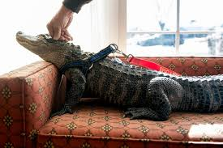
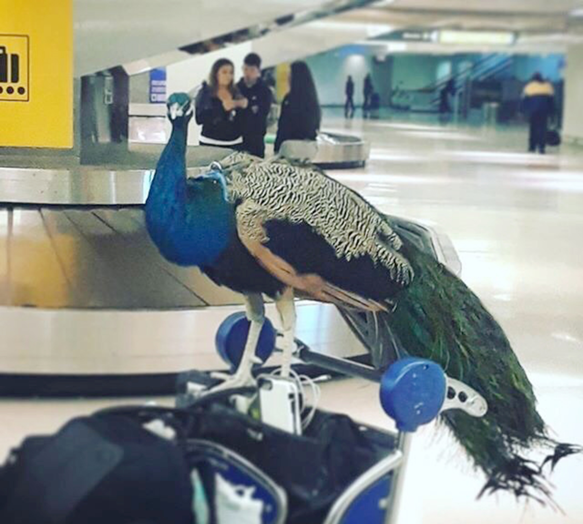
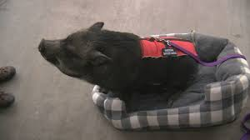
Service Animal Defined by Title II and Title III of the ADA:
Emotional, comfort, or therapy animals are not service animals.
Any dog that is individually trained to do work or perform tasks for the benefit of an individual with a disability, including a physical, sensory, psychiatric, intellectual, or other mental disability.
Other species of animals, are not considered service animals.
Wild or domestic
Trained or untrained,

Slide 3
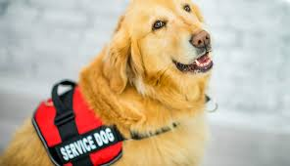
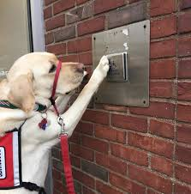
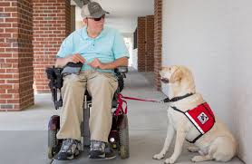
Accommodations:
must be allowed to accompany the handler to any place in the building or facility where members of the public are allowed
Service animals are not pets. So, although a “no pets” policy is perfectly legal, it does not allow a business to exclude service animals.
Titles II and III of the ADA makes it clear that service animals are allowed in public facilities and accommodations
Allergies or fear of dogs are not valid reasons for denying access.
Business owner is responsible to accommodate for allergy

Slide 4
What can and cannot be asked?
What CAN be asked?
What CANNOT be asked?
Is this animal required because of a disability?
What work or task has the animal been trained to perform?
Do NOT ask for documentation or proof that the animal has been:
Certified
Trained
Licensed

