Slide 1
Trauma Informed Care
KMC, PA

Slide 2
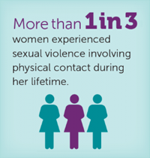
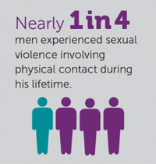
The Facts as Told by the CDC
Woman
Men
1 in 3 female rape victims experienced it for the 1st time between 11-17 years old
1 in 8 female rape victims reported that it occurred before the age of 10
1 in 4 male rape victims experienced it for the 1st time between 11-17 years old
1 in 4 male rape victims reported that it occurred before age 10

Slide 3
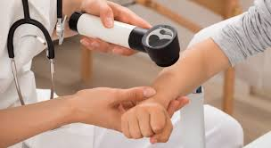
What Can We do?
Be Respectful
Have Empathy
Accept the Facts
Make it a standard practice to ask for consent before touching a patient
Explain the steps of the exam so patient knows what to expect
Communicate a disclosure to other members of the care team
Be mindful of the imbalance of power
Be disclosure ready
Ask patient who they want in the room

Slide 4
1 in 6 victims report being re-traumatized when undergoing exams. Let’s not be part of these statistics!

