Slide 1
General Dermatology

Slide 2
Terminology of Dermatology
Abscess-accumulation of pus in the dermis or subcutaneous tissue
Annular-ring-shaped
Atrophy-depressed surface due to a thinned epidermis and/or dermis and/or subcutis
Bulla (blister)-A large, circumscribed, fluid-containing elevation (>5 mm)
Burrow-Liner S-shaped channel in the epidermis
Carbuncle-inflammatory nodules or abscess of numerous contiguous hair follicles

Slide 3
Terminology continued…
Comedone-plugged pilosebaceous follicle containing serum and keratin
Closed=whitehead
Open=blackhead
Crust (scab)-dried serum, pus, or blood
Cyst-nodule containing fluid, cells, or keratin
Ecchymosis (bruise)-large, confluent area of purpura
Erosion-partial loss of epidermis. Heals without scarring.
Erythema-redness that blanches on pressure

Slide 4
Terminology continued…
Excoriation-shallow abrasion due to scratching. Linear or pinpoint erosions or crusts
Exudate-serum, blood, or pus accumulated on the skin surface
Fissure-linear split in epidermis and/or crack in (skin) dermis
Folliculitis-pustule involving a hair follicle
Furuncle-deep necrotizing type of folliculitis
Keratin/horn-rough, uneven surface due to accumulation of keratin. Hard to pick off, unlike crust
Lichenification-focal area of thickened skin with accentuation of skin lines due to rubbing/scratching

Slide 5
Terminology continued…
Linear-straight line
Macule-flat, circumscribed area of altered skin color <1 cm
Nodule-solid, round circumscribed elevation >5 mm
Papule-raised, solid lesion <5 mm
Patch-flat, pigmented lesion >5 mm
Plaque- a >5 mm, flat topped raised lesion (diameter>thickness)
Purpura-visible collection of free red blood cells (red, purple, brown); non-blanchable
Pustule-a small papule containing pus

Slide 6
Terminology continued…
Scale- thick stratum corneum due to increased proliferation or cohesion of keratinocytes
Scar- healed dermal (or deeper) lesion following trauma/inflammation
Sclerosis- skin induration/hardening
Serpiginous- snakelike appearance
Telangiectasia- small, dilated superficial blood vessels
Ulcer- loss of tissue affecting the entire epidermis and part of the dermis. Surface exudate and/or crusting often present. Heals with scarring

Slide 7
Terminology continued…
Umbilicated- round depression in center of papule
Vesicle- a small papule containing clear fluid
Wheal (hive)- transient swelling due to dermal edema; pruritic
Hypopigmentation- lighter in pigment then the person’s normal skin tone
Hyperpigmentation- darker in pigment then the person’s normal skin tone
Nummular/discoid- round or coin-shaped

Slide 8
3 layers of Skin
1. Epidermis (4 layers)
Basal cell layer (stratum basalis)
Spiny cell layer (stratum spinosum)
Granular cell layer (stratum granulosum)
Cornified layer (stratum corneum)
2. Dermis (2 layers)
Papillary dermis (thin zone beneath epidermis)
Reticular dermis (bulk of dermis)
3. Subcutis (subcutaneous fat)

Slide 9
Topical medications
Ointment- greasy vehicle that provides enhanced penetration; occlusive therefore don’t use on infected or oozing skin
Cream- less moisturizing than ointments, but more cosmetically appealing
Gel- non-greasy, non-occlusive, non-staining
Solution- useful under cosmetics, in hair-bearing regions, and when drying is desired
Lotion- less moisturizing than a cream, good for hair-bearing areas
Foams- easy application, with less grease/residue
Powders- used in intertriginous areas to reduce moisture, friction, maceration

Slide 10
Procedures
Shave biopsy: a superficial skin biopsy with a derma blade, #10, or #15 blade. No sutures; bleeding stopped by aluminum chloride, Monsel’s solution, or electrodessication
Punch biopsy: a round “cookie-cutter” knife that obtains tissue specimen. 2mm-10mm
Excisional biopsy: an elliptical complete removal of lesion down to fat. Useful in completely removing skin cancers.
Curettage: for hyperkeratotic lesions (SK, warts, superficial BCC) often accompanied by cautery

Slide 11
Procedures
KOH (Potassium Hydroxide)-scrape presumed dermatophyte infection with an alcohol pad or water and scrape with a #15 blade onto a slide. Then apply 2 drops of 10-20% KOH on slide to dissolve keratin for fungal elements. Heating accelerates the process. May have to wait several minutes to visualize.
Wet Mount-scrape presumed to be scabies infection. Mineral oil and #15 blade used to scrape onto a slide.
Cryosurgery-liquid nitrogen is used from a spray canister to treat actinic keratosis, molluscum contagiosum, skin tags, warts

Slide 12
Skin Cancers
Basal cell carcinoma (BCC)
Squamous cell carcinoma (SCC)
Squamous cell carcinoma in situ (SCCIS)
Malignant Melanoma (MM)
Malignant Melanoma in situ (MMIS)
“in-situ” refers to something that is superficial and hasn’t broken the deeper layers of the skin

Slide 13
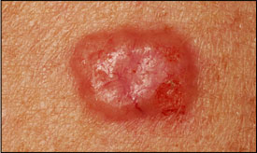
Basal Cell Carcinoma
Non-melanoma skin cancer (NMSC)
Most common type of skin cancer (~80% of cases)
It is considered to be the best type of skin cancer to have
Very slow growing
Very rarely metastasizes (<1%)
Eventually will destroy the surrounding tissue if left untreated

Slide 14
Squamous Cell Carcinoma
Non melanoma skin cancer (NMSC)
2nd most common type of skin cancer
SCC does have a higher potential to metastasize
Can arise within a few days on the skin

Slide 15
Melanoma
Melanoma accounts for approximately ~5% of the skin cancers but about ~80% of deaths
Can occur anywhere on the body, doesn’t always have to see sunlight to grow
ABCD’s of melanoma
Asymmetry
Borders-irregular
Color
Diameter
There is ALWAYS exceptions to the rules!
Majority of melanomas do not arise from pre-existing moles. They typically come from a new spot

Slide 16
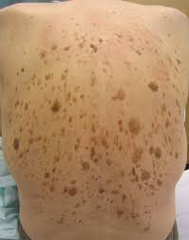
Seborrheic keratosis
A noncancerous skin condition that appears as a waxy, brown, black, or tan growth

Slide 17
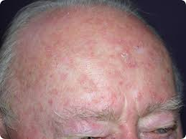
Actinic keratosis
A rough, scaly patch on the skin caused by years of sun exposure
Pre-cancerous lesion

Slide 18
Dysplastic Nevus/Atypical mole
Unusual benign moles that may resemble melanoma
Mild atypia
Moderate atypia
Severe atypia

Slide 19
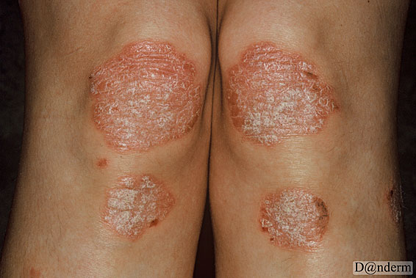
Psoriasis
A condition in which skin cells build up and form dry, scaly, itchy patches

Slide 20
Seborrheic dermatitis
A common chronic inflammatory skin disease of sebum-rich areas that causes scaly patches and redness
Most common areas: scalp, nose, ears, eyebrows

Slide 21
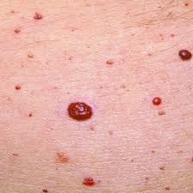
Angioma
A benign growth of small blood vessels

Slide 22
QUESTIONS

