Slide 1
Insurance training
Where to send claims
how to read insurance cards
Insurance subscriber
copayment amounts

Slide 2
Tips to Remember:
Verify insurance at every visit and scan in insurance card if updated insurance card.
All insurances must have an ID number and Group Number (if applicable).
Do not enter prescription insurance in the Information Screen.
If insurance is terminated, be sure to check the terminated box and enter terminated date.
If patient has Tricare, use the Benefits number not the DOD number. The sponsor name needs to be the subscriber.
If the patient has an authorization from the VA, enter only that insurance (specified on the authorization). Health insurance should not be billed

Slide 3
Always file with the address on the back or front of card that says mail claims t0
Please review both sides of the card and select the insurance based on the Mail Claims to address not the names or logos on the card.

Slide 4
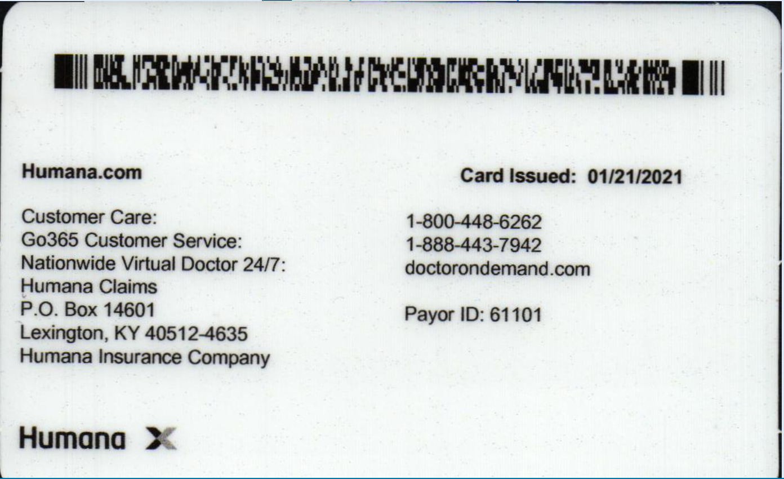
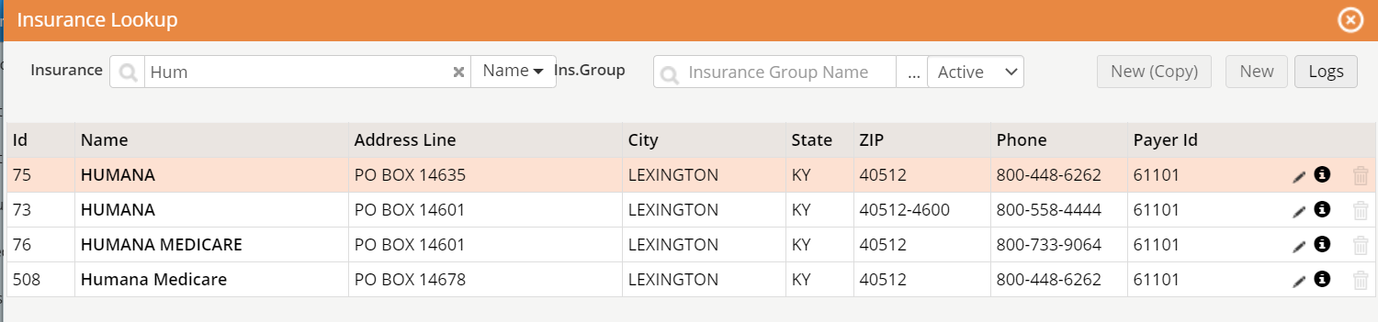
To find the correct insurance search by name, then find the correct address or by address.
Most insurances have more than one in eCW. This Humana gets filed with
PO Box 14601
Lexington, KY 40512
There are more than one Humana listed in eCW. Make sure to pick the correct one.

Slide 5
Medicare vs non-medicare
Some insurances have the same address for Medicare and non-medicare but the name is different

Slide 6
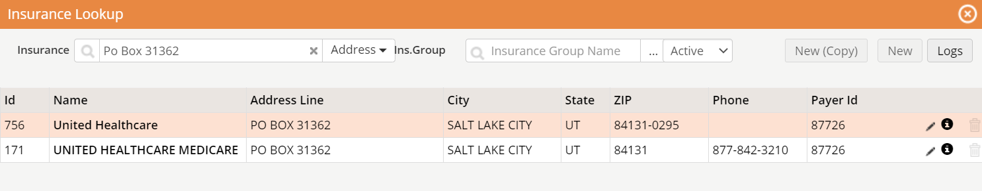
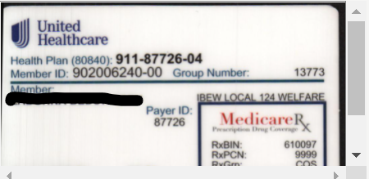
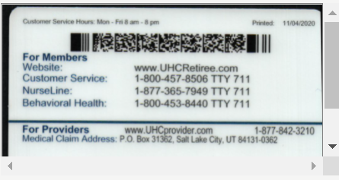

Slide 7
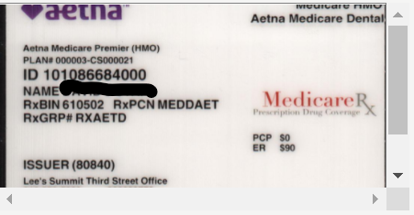
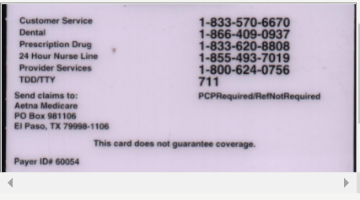
Some cards will say Medicare on the back. Some will say Medicare on the front.

Slide 8
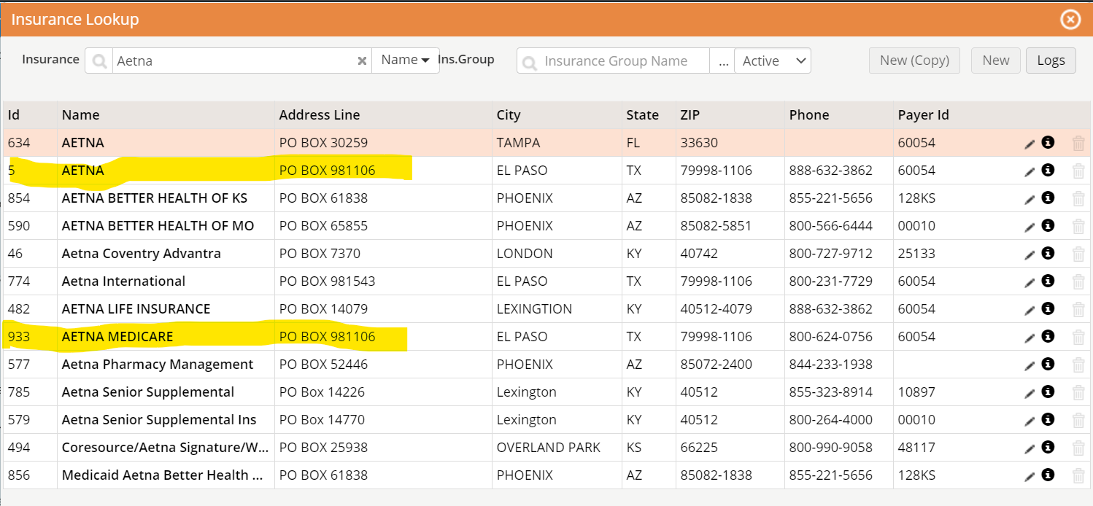
Aetna vs Aetna Medicare in eCW

Slide 9
Medicare tips
.

Slide 10
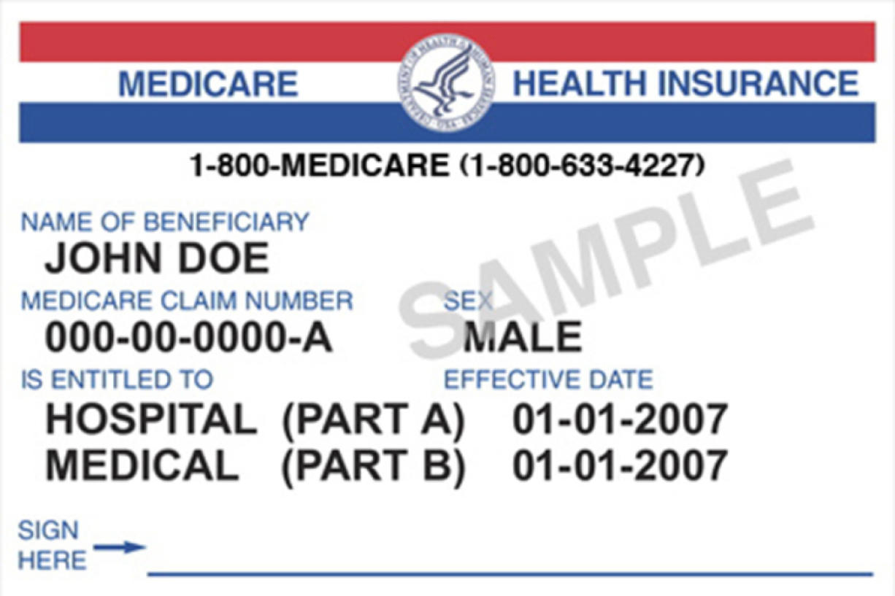
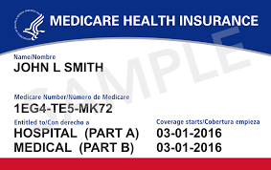
Medicare- Old vs New
Old has SSN and a letter
New has a mix of letters and numbers
Old Medicare Card
New Medicare Card

Slide 11
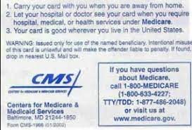
Medicare Health Insurance:
Claims to Medicare Part B
Subscriber is John L Smith
Sub Number 1EG4TEMK72
Front of Medicare Card
Back of Medicare Card

Slide 12
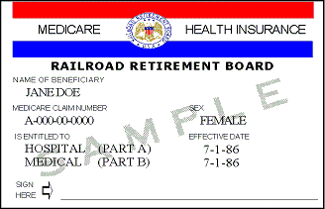
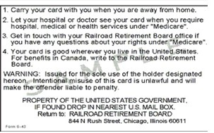
Medicare Railroad Card:
Claims to Medicare Railroad
Subscriber Name-Jane Doe
Subscriber Number-A000000000 (no dashes)
Front of card
Back of card

Slide 13
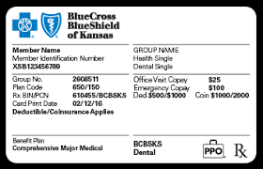
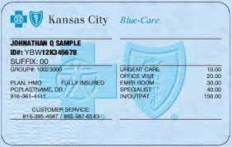
Blue Cross Blue Shields-File with Local BCBS:
BCBS of Kansas-Topeka, Manhattan, Emporia, Lawrence
BCBS of Kansas City- Legends, Olathe, Shawnee, Leawood, Independence
There are different BCBS cards
Remember to file with local BCBS

Slide 14
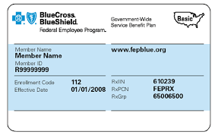
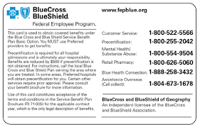
BCBS Federal- still file with local BCBS

Slide 15
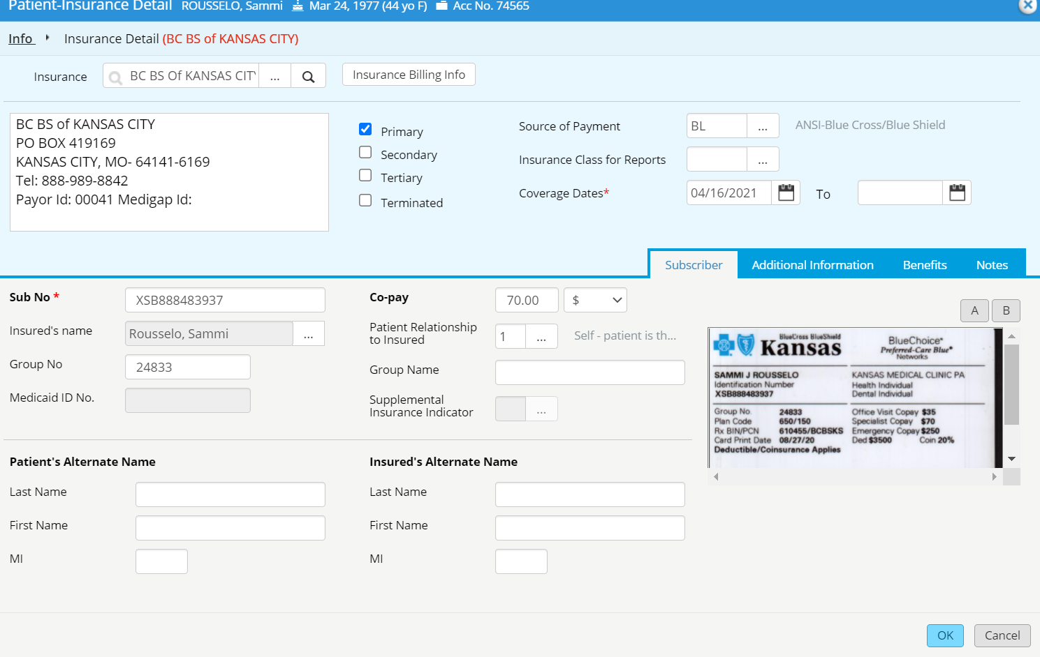
Insurance Subscriber Information
Insured’s name is the policy holder of the insurance.
This could be the patient, spouse, parent, guardian, etc.
When entering someone other than the patient as the subscriber to an insurance, be sure to enter complete information, DOB (01/01/1900, if unknown) and address.
Use the ellipses to change insured if not patient

Slide 16
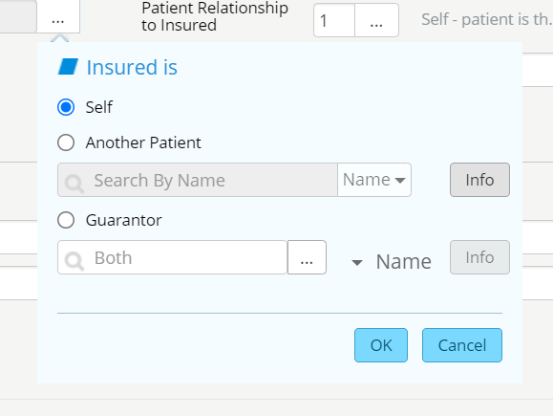
When you click on the ellipses it will pop up this screen. Click on the circle that applies.

Slide 17
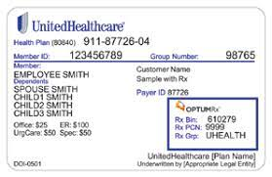
Reading Insurance Card
Insurance name
Subscriber number
Group number
Insured name
Copayment

Slide 18
Sub No- auto populates when insurance card is scanned
REMEMBER TO ALWAYS DOUBLE CHECK AND MAKE SURE IT PUT THE CORRECT LETTERS AND NUMBERS IN THE SYSTEM

Slide 19
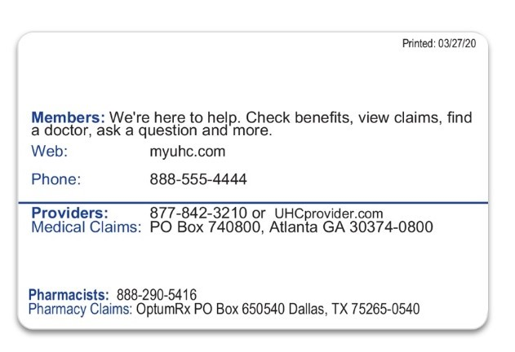
Back of card
Coverage date
Where to mail the claims
ALWAYS USE THE MEDICAL CLAIMS ADDRESS NOT JUST THE NAME OF THE INSURANCE
If you need to check benefits- number to call

Slide 20
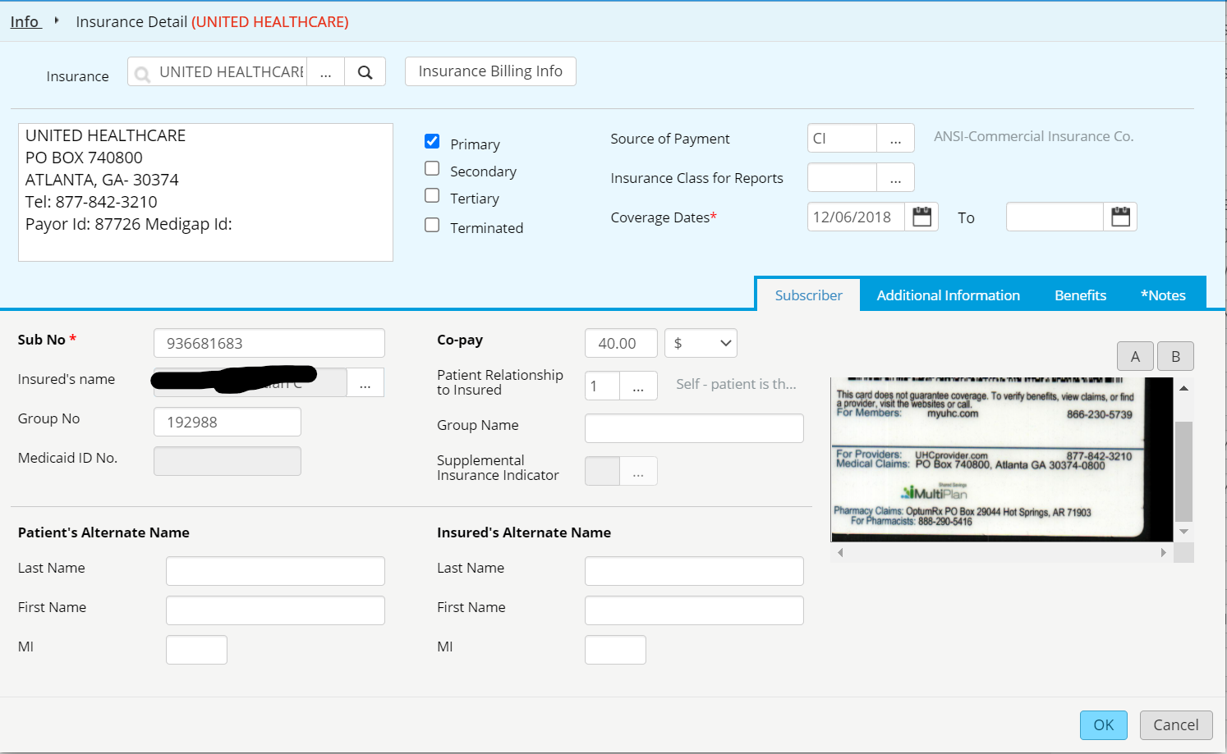
ADDRESS MUST MATCH

Slide 21
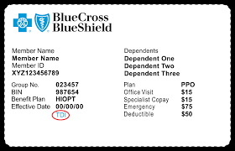
Each insurance card will have a different copay amount. Make sure when scanning insurance cards, it populates the correct copay amount. eCW normally populates the Office Visit not the Specialist copay.

Slide 22
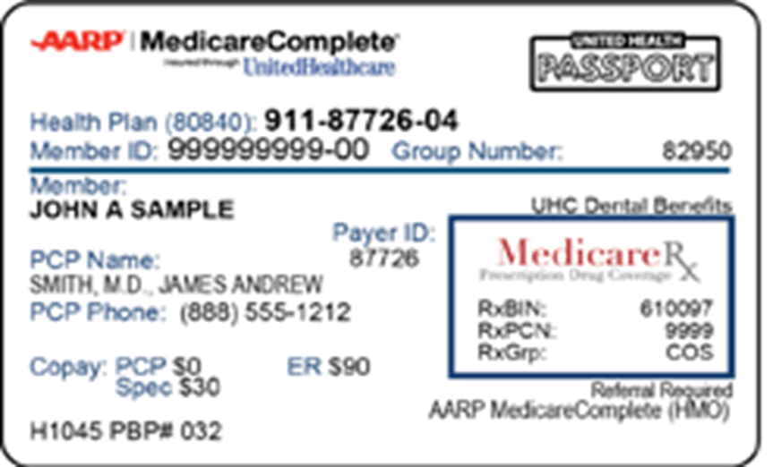
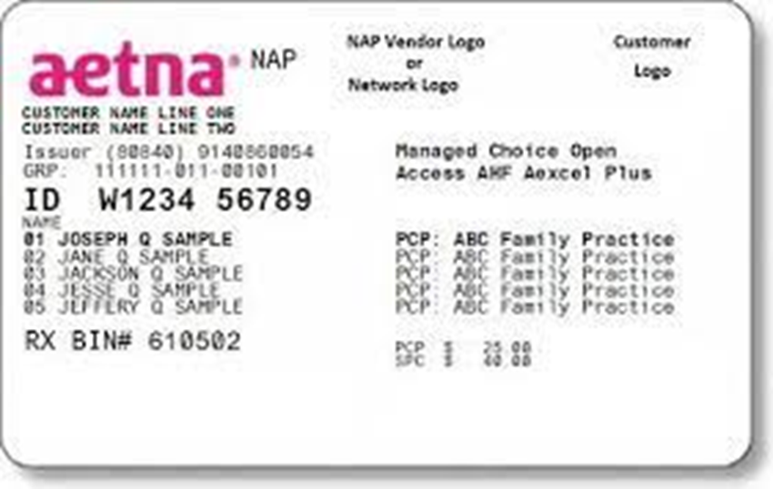
eCW will populate the PCP/Office visit copay. Make sure to change to Specialist copay

Slide 23
INSURANCE ELIGIBILITY- IE
To be able to verify the insurance the following must be correct in the system:
    Insurance name
    Where to mail the claims to
    ID number
    Group number- if applies
    Name of subscriber
    Subscriber’s DOB- if not the patient and unknown use- 01/01/1900

Slide 24
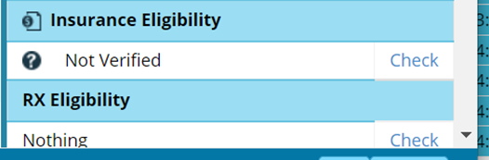
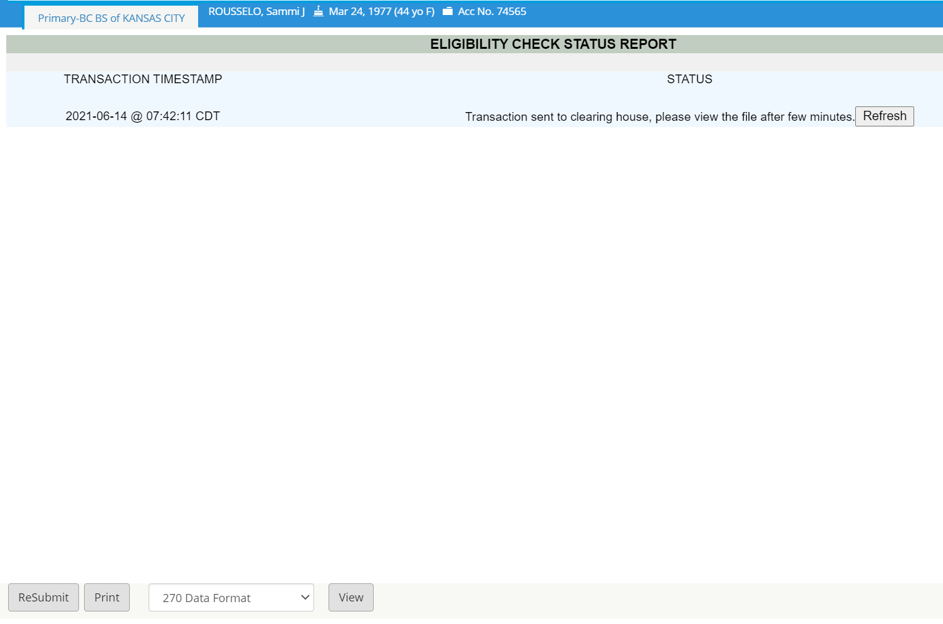
Insurance Eligibility
Click on Check
Click on Resubmit and Refresh

Slide 25
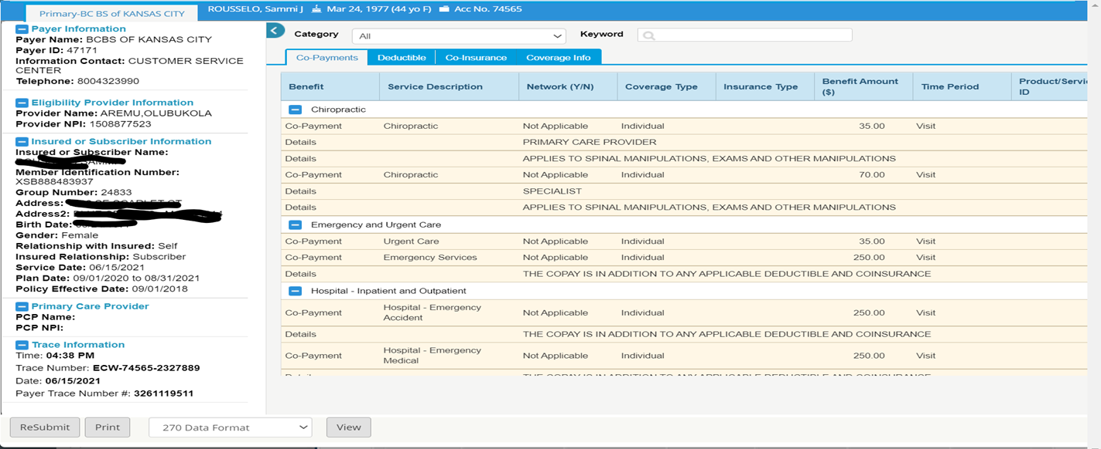
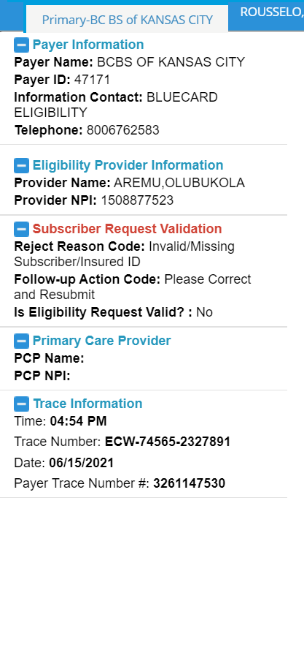

Insurance Eligibility
Insurance is Eligible
Something is incorrect: Insurance is not Eligible

Slide 26
Issues with insurance eligibility
After trying all the tips and tricks for Eligibility and it is still not going through:
    Some smaller insurance companies are not set up with TriZetto- so they will not IE
    Contact Whitney in Billing- if insurance is not going through- send a bean asking if that insurance should go through

Slide 27
SELF PAY
If patient does not have insurance or has an insurance we are not in network with- they will be
Self Pay.
Self Pay charges must be collected at time of service.

Slide 28
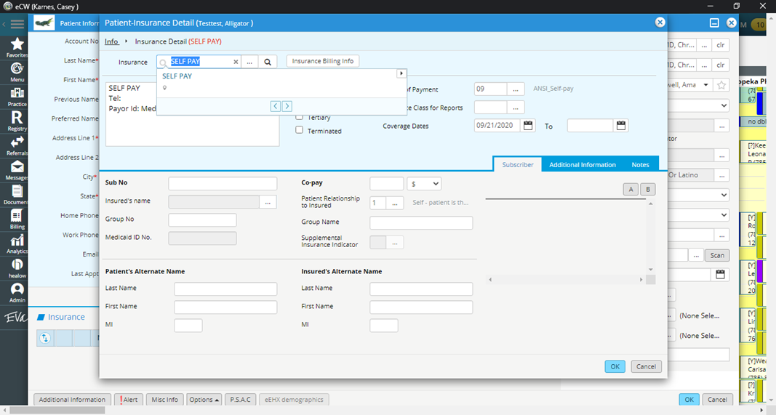
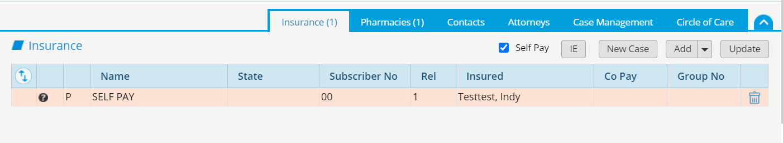
SELF-PAY
ADD SELF PAY AS INSURANCE
SUBSCRIBER NUMBER WILL 00
CHECK MARK SELF PAY

Slide 29
PATIENT PRESENTS WITH 2 INSURANCES
IT IS ALWAYS BEST TO ASK THE PATIENT
IF MEDICARE AND COMMERCIAL MAKE SURE TO ASK IF POLICY HOLDER IS WORKING. IF THEY ARE, MEDICARE IS SECONDARY.
ALWAYS BEST TO ASK PATIENT WHICH ONE IS PRIMARY!

Slide 30
Any Questions

Slide 31
THANK
YOU
FOR
ALL
YOU
DO!

