Slide 1
Time Outs
Kansas Medical Clinic, PA

Slide 2
National Time Out Day
June 14th
What is a Time-Out?
Right Patient
Right Procedure
Right Site
Allergies
Medications
Consents

Slide 3
Just Some Joint Commission Statistics
3,300 sentinel events from 2015 to 2018
440 were wrong site
30% of all adverse surgical events could be attributed to an incomplete/incorrectly performed time-out
A sentinel event is a patient safety event that results in death, permanent harm, or severe temporary harm
Notes:
Joint Commission data: https://www.jointcommission.org/-/media/tjc/documents/resources/patient-safety-topics/sentinel-event/summary_4q_2018pdf.pdf?db=web&hash=403DAA474698A06015E9113DBCBAAE6A

Slide 4
Other Statistics
Although most studies are related to operating room errors, if ambulatory settings were included, the statistics would be much higher
A Veterans Affairs study found that half of all WSPEs occurred outside of the operating room
59% wrong side; 23% wrong site, 14% wrong procedure, ,5% wrong patient
WSPE – wrong-site, wrong-procedure, wrong-patient errors – or ‘Never Events’
Notes:
Joint Commission data: https://www.jointcommission.org/-/media/tjc/documents/resources/patient-safety-topics/sentinel-event/summary_4q_2018pdf.pdf?db=web&hash=403DAA474698A06015E9113DBCBAAE6A

Slide 5
KMC Facts
Fact – KMC does have ‘Never Events’
Fact – KMC has reported a Wrong Patient incident
Fact – KMC has reported Wrong Site incidents
Fact – KMC has reported Wrong Side incidents
Fact – All reported incidents could have been avoided by conducting a Time-Out prior to procedure

Slide 6
Errors Related to Misuse of Time-Outs
Occurring before all staff members are ready
Performing without total participation
Lack of leadership engaged in Time-Out
Staff feeling unable to speak out
Inconsistent organizational focus on patient safety
Inconsistent staff education
Rushed Time-Outs

Slide 7
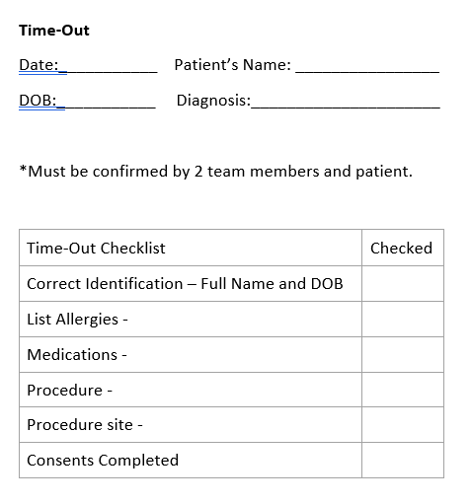
The Universal Protocol
Joint Commission acknowledged that the underlying factor in errors occurred due to communication issues
Developed the Universal Protocol which specified the use of a Time-Out prior to ALL procedures
Originally designed for operating rooms – now required for ANY procedure

Slide 8
Be a SUPERHERO
Support a safety culture
Use The Joint Commission Universal Protocol
Proactively reduce risk
Effect change in your organization
Reduce harm to patients
Have frank discussions about hazardous situations
Empower others to speak up when a patient is at risk
Respect other on the team
Openly seek opportunities for improving patient safety

