Slide 1
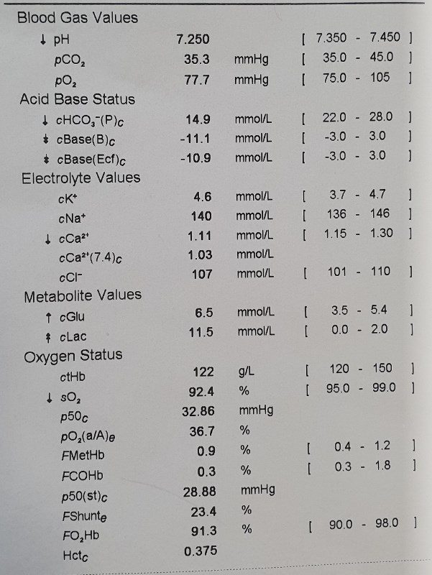
Understanding Blood Gas
Presented By: Khairani
Date: 01/04/21

Slide 2
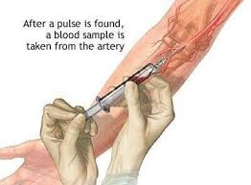
Understanding ABG
WHAT YOU SHOULD ALREADY KNOW:
ABG (Hep.syringe) is more accurate than VBG (Lithium Hep. Tube)
ABG is more accurate than VBG
Glass tube/syringe is preferable but poses safety risk
Preferable : Branchial Artery, , Radial Artery, Femoral Artery
VBG transportation: RT in less 20 min. NO ICE!!
Sample is temperature dependent (gas solubility increases when cold)
Familiar with ABL90 operations at NICU, ICU, CCU

Slide 3
Objective
Significances of Acid Base Balance
Understand Acid Base Equation
What is acidic and basic
Important ABG components
Respiratory and Renal mechanisms
Determine if pH is Respiratory or Metabolic- driven ( R.O.M.E )
Determine if non/partial/ full compensation has occurred
Relate the diseases/ symptoms with acid base imbalances

Slide 4
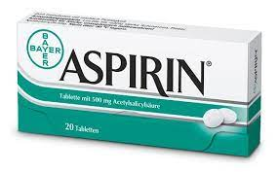
Determine the causes of Acid Base Imbalance
HEAD INJURY
SIDS
Cough syrup
DRUGS
PAINKILLER
ASTHMA
VOMITING
COVID NURSES
HIGH ALTITUDE
RENAL PATIENT
COVID PATIENT
SPORTS
Notes:
OTHERS: OBESITY ETC

Slide 5
Acid-Base Balance Maintaining pH requires a delicate balance btw CO2 (lungs) and bicarbonate (kidneys/ metabolic system)
Notes:
Why monitoring BG is important?
First to assess effectiveness of pulmonary exchange, to identify acid base imbalance and to monitor treatment.
The equation shows that CO2 dissolves to form carbonic acid which dissociates to form acidic H+ and basic bicarbonate (as buffer-which can combine to push equation back to left)
Blood pH depends on balance of CO2 and HCO3-
A change in CO2 amount will not change pH if it is accompanied by change in amount of HCO3- that preserve the balance (and vise versa)- this is compensation mechanism.
It is renal and respiratory systems that are responsible for maintaining pH.

Slide 6
Intro: Some Parameters of ABG
pH
PaCO2 and PaO2 — the partial pressures of CO2 and oxygen
HCO3‾ — bicarbonate
Base excess (BE) — a measure of the excess or deficiency of base in the blood; by definition, it is the amount of base (in mmol) that would correct one litre of blood to a normal pH (if an excess, its +ve, this is the amount of base needed to be removed for a normal pH, or if a deficit (-ve), the amount required to be added)
Lactate — the end product of anaerobic glycosis (a rise indicates poor oxygenation and perfusion of tissues)

Slide 7
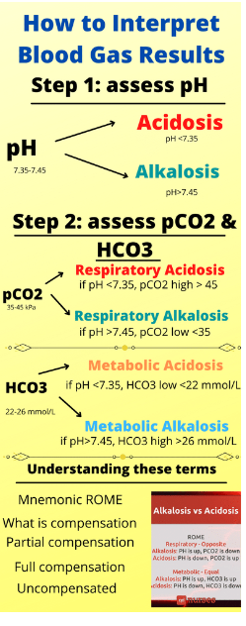
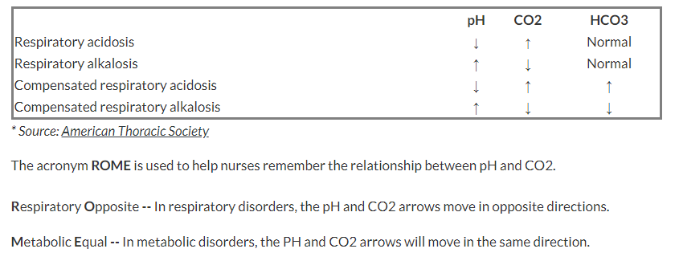
ABG Reference Interval
R.O.M.E Acronym

Slide 8
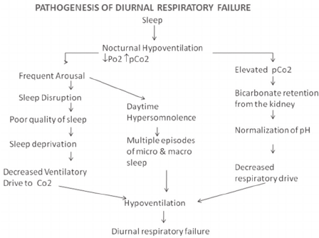
Effects of Hypo and hyperventilation As demonstrated by sleep hypoventilation and anxiety disorder:
The Effects of Hypoventilation in Panic Attack

Slide 9
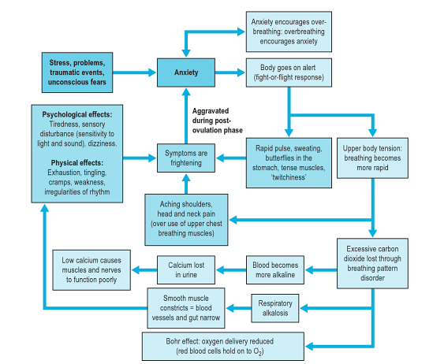
The Effects of Hyperventilation in Panic Attack

Slide 10
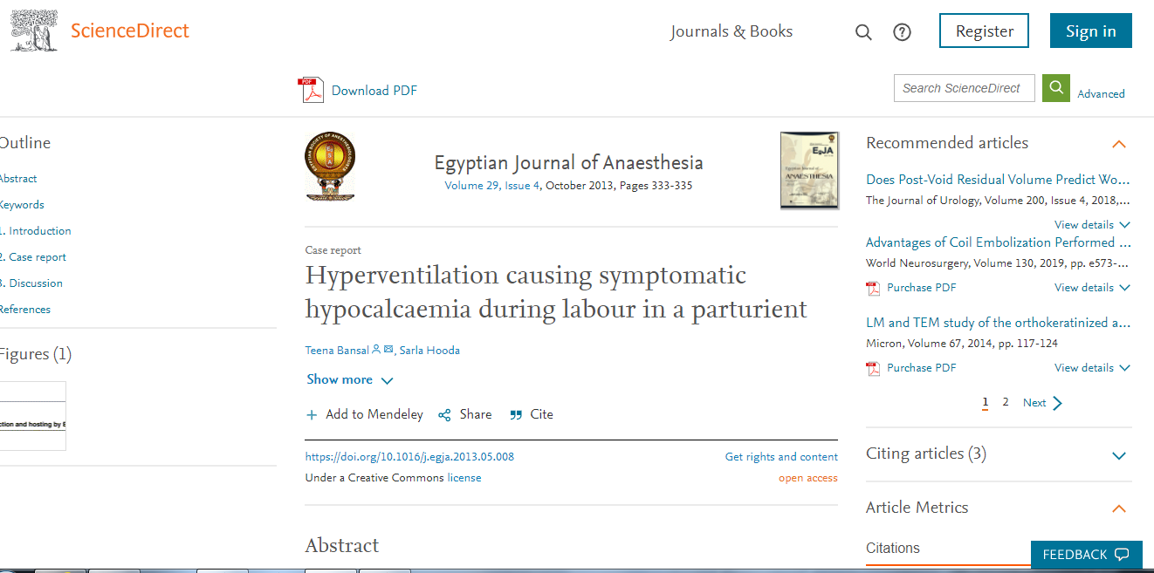
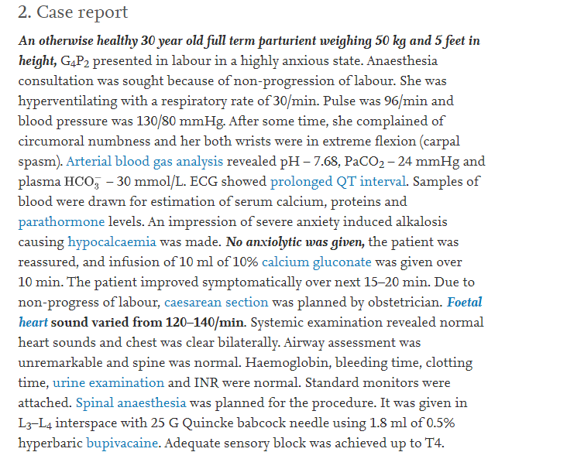
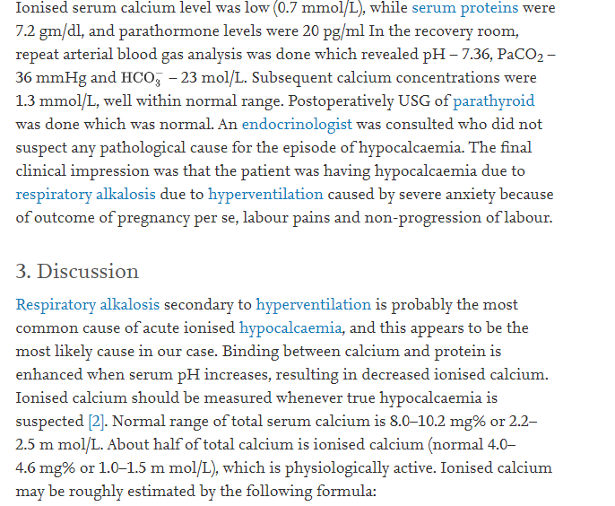
Hyperventilation (Resp Alkalosis) was implicated in causing low ionised Ca (hypocalcaemia) which results in cramps in laboured mothers

Slide 11
Respiratory acidosis
Respiratory acidosis is caused by inadequate alveolar ventilation (hypoventilation) leading to CO₂ retention.
A respiratory acidosis would have the following characteristics on an ABG:
↓ pH
↑ CO₂
Causes of respiratory acidosis include:
Respiratory depression (e.g. opiates)
Guillain-Barre: paralysis leads to an inability to adequately ventilate
Asthma
Chronic obstructive pulmonary disease (COPD)
Iatrogenic (incorrect mechanical ventilation settings)
CCHS

Slide 12
Respiratory alkalosis
Respiratory alkalosis is caused by excessive alveolar ventilation (hyperventilation) resulting in more CO₂ than normal being exhaled. As a result, PaCO₂ is reduced and pH increases causing alkalosis.
A respiratory alkalosis would have the following characteristics on an ABG:
↑ pH
↓ CO₂
Causes of respiratory alkalosis include: ³
Anxiety (i.e. panic attack)
Pain: causing an increased respiratory rate.
Hypoxia: resulting in increased alveolar ventilation in an attempt to compensate.
Pulmonary embolism
Pneumothorax
Iatrogenic (e.g. excessive mechanical ventilation)

Slide 13
Metabolic acidosis
Metabolic acidosis can occur as a result of either:
Increased acid production or acid ingestion.
Decreased acid excretion or rate of gastrointestinal and renal HCO₃– loss.
A metabolic acidosis would have the following characteristics on an ABG:
↓ pH
↓ HCO₃₋
↓ BE

Slide 14
Anion gap
The anion gap (AG) is a derived variable primarily used for the evaluation of metabolic acidosis to determine the presence of unmeasured anions. To work out if the metabolic acidosis is due to increased acid production or ingestion vs decreased acid excretion or loss of HCO₃– you can calculate the anion gap. The normal anion gap varies with different assays but is typically between 4 to 12 mmol/L.
Anion gap formula: Anion gap = Na+ – (Cl- + HCO₃₋)
An increased anion gap indicates increased acid production or ingestion:
Diabetic ketoacidosis (↑ production)
Lactic acidosis (↑ production)
Aspirin overdose (ingestion of acid)
A decreased anion gap indicates decreased acid excretion or loss of HCO₃–:
Gastrointestinal loss of HCO₃– (e.g. diarrhoea, ileostomy, proximal colostomy)
Renal tubular acidosis (retaining H⁺)
Addison’s disease (retaining H⁺)

Slide 15
Metabolic alkalosis
Metabolic alkalosis occurs as a result of decreased hydrogen ion concentration, leading to increased bicarbonate, or alternatively a direct result of increased bicarbonate concentrations.
A metabolic alkalosis would have the following characteristics on an ABG:
↑ pH
↑ HCO₃₋
↑ BE
Causes of metabolic alkalosis include:
Gastrointestinal loss of H⁺ ions (e.g. vomiting, diarrhoea)
Renal loss of H⁺ ions (e.g. loop and thiazide diuretics, heart failure, nephrotic syndrome, cirrhosis, Conn’s syndrome)
Iatrogenic (e.g. addition of excess alkali such as milk-alkali syndrome)

Slide 16
Mixed acidosis/alkalosis
It’s worth mentioning that it is possible to have a mixed acidosis or alkalosis (e.g. respiratory and metabolic acidosis/respiratory and metabolic alkalosis).
In these circumstances, the CO₂ and HCO₃– will be moving in opposite directions (e.g. ↑ CO₂ ↓ HCO₃– in mixed respiratory and metabolic acidosis).
Treatment is directed towards correcting each primary acid-base disturbance.

Slide 17
Mixed respiratory and metabolic acidosis
A mixed respiratory and metabolic acidosis would have the following characteristics on an ABG:
↓ pH
↑CO₂
↓HCO₃–
Causes of mixed respiratory and metabolic acidosis include:
Cardiac arrest
Multi-organ failure
Mixed respiratory and metabolic alkalosis
A mixed respiratory and metabolic alkalosis would have the following characteristics on an ABG:
↑ pH
↓ CO₂
↑ HCO₃–
Causes of mixed respiratory and metabolic alkalosis:
Liver cirrhosis in addition to diuretic use
Hyperemesis gravidarum
Excessive ventilation in COPD

Slide 18
Examples of Compensation
Respiratory Compensation
e.g. after consumption of aspirin (acidosis) or antacid (alkalosis)
Metabolic Compensation
e.g following hypoventilation (acidosis) or hyperventilation (alkalosis)

Slide 19
Compensation
Respiratory acidosis/alkalosis (changes in CO₂) can be metabolically compensated by increasing or decreasing the levels of HCO₃– in an attempt to move the pH closer to the normal range.
Metabolic acidosis/alkalosis (changes in HCO₃-) can be compensated by the respiratory system retaining or blowing off CO₂ in an attempt to move the pH closer to the normal range.
Rate of compensation
Respiratory compensation for a metabolic disorder can occur quickly by either increasing or decreasing alveolar ventilation to blow off more CO₂ (↑ pH) or retain more CO₂ (↓ pH).
Metabolic compensation for a respiratory disorder, however, takes at least a few days to occur as it requires the kidneys to either reduce HCO₃– production (to decrease pH) or increase HCO₃– production (to increase pH). As a result, if you see evidence of metabolic compensation for a respiratory disorder (e.g. increased HCO₃-/base excess in a patient with COPD and CO₂ retention) you can assume that the respiratory derangement has been ongoing for at least a few days, if not more.
It’s important to note that ‘over-compensation’ should never occur and, therefore, if you see something that resembles this you should consider other pathologies driving the change (e.g. a mixed acid/base disorder).

Slide 20
Respiratory and Renal Mechanisms, Compensation
RESPIRATORY MECHANISM
Body controls pH by increasing or decreasing rate and depth of breathing and thereby the amount CO2 expelled
If pH ↑→Hypoventilation → CO2↑ →correct pH
If pH is ↓ →Hyperventilation→ CO2 ↓ →correct pH
RENAL MECHANISM
Kidneys control ph by adjusting the excretion of H+ and renal tubular reabsorption of HCO3- in response to metabolic acid production.
COMPENSATION
When acidosis or alkalosis occurs (either through respiratory or renal mechanism), the opposite system will attempt to rectify this imbalance, this is termed “COMPENSATION”.
e.g. if kidneys fail to excrete metabolic acids, ventilation is adjusted in order to eliminate more CO2.

Slide 21
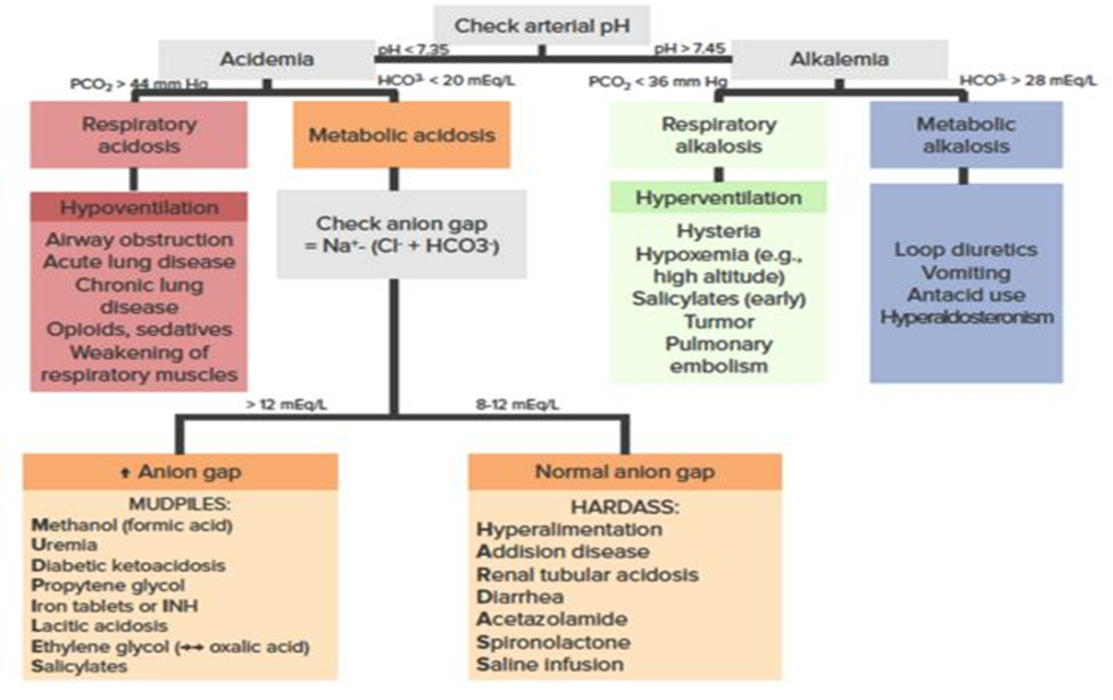
Summary

Slide 22
Causes of acid base imbalances

Slide 23
Worked example 1
A 17-year-old patient presents to ER complaining of a tight feeling in their chest, shortness of breath and some tingling in their fingers and around their mouth. She doesn’t have significant past medical history and are not on any regular medication. An ABG is performed on the patient (who is not currently receiving any oxygen therapy).
An ABG is performed and reveals the following:
pO2: 105 mmHg (82.5 – 97.5 mmHg)
pH: 7.49 (7.35 – 7.45)
pCO2: 27 mmHg (35 – 45 mmHg)
HCO3–: 24 (22 – 26 mEq/L)

Slide 24
Continue-
PaO₂ of 14 on room air is at the upper limit of normal, so the patient is not hypoxic.
pH
A pH of 7.49 is higher than normal and therefore the patient is alkalotic.
The next step is to figure out whether the respiratory system is contributing the alkalosis (e.g. ↓ CO₂).
PaCO₂
The CO₂ is low, which would be in keeping with an alkalosis, so we now know the respiratory system is definitely contributing to the alkalosis, if not the entire cause of it.
The next step is to look at the HCO₃– and see if it is also contributing to the alkalosis.
HCO₃–
HCO₃– is normal, ruling out a mixed respiratory and metabolic alkalosis, leaving us with an isolated respiratory alkalosis.
Compensation
There is no evidence of metabolic compensation of the respiratory alkalosis (which would involve a lowered HCO₃-) suggesting that this derangement is relatively acute (as metabolic compensation takes a few days to develop).
Interpretation
Respiratory alkalosis with no metabolic compensation.
The underlying cause of respiratory alkalosis, in this case, is a panic attack, with hyperventilation in addition to peripheral and peri-oral tingling being classical presenting features.

Slide 25
Respiratory alkalosis with no metabolic compensation.

Slide 26
Worked example 2
A 16-year-old female presents to hospital with drowsiness and dehydration. She has no previous past medical history and on no regular medication.
An ABG is performed on room air reveals the following:
PaO2: 105 mmHg (82.5 – 97.5 mmHg)
pH: 7.33 (7.35 – 7.45)
PaCO2: 22.5 mmHg (35 – 45 mmHg)
HCO3–: 17 (22 – 26 mEq/L)

Slide 27
A PaO2 of 14 on room air is at the upper limit of normal, so the patient is not hypoxic.
A pH of 7.33 is lower than normal and therefore the patient is acidotic.
The next step is to figure out whether the respiratory system is contributing the acidosis (i.e. ↑ CO2).
PaCO2:
The CO2 is low, which rules out the respiratory system as the cause of the acidosis (as we would expect it to be raised if this was the case).
So we now know the respiratory system is NOT contributing to the acidosis and this is, therefore, a metabolic acidosis.
The next step is to look at the HCO3– to confirm this.
HCO3–:
HCO3– is low, which is in keeping with a metabolic acidosis.
Check for Compensation
We now know that the patient has a metabolic acidosis and therefore we can look back at the CO2 to see if the respiratory system is attempting to compensate for the metabolic derangement.
In this case, there is evidence of respiratory compensation as the CO2 has been lowered in an attempt to normalise the pH.
An important point to recognise here is that although the derangement in pH seems relatively minor this should not lead to the assumption that the metabolic acidosis is also minor.
The severity of the metabolic acidosis is masked by the respiratory system’s attempt at compensating via reduced CO2 levels.
Interpretation
Metabolic acidosis with respiratory compensation.

Slide 28
Cont-
The underlying cause of the metabolic acidosis, in this case, is diabetic ketoacidosis.

Slide 29
Metabolic acidosis with partial respiratory compensation.

Slide 30
END OF PRESENTATION
THANK YOU AND GOOD LUCK IN POST-CME EXAMS

